Slide 1

Version Control
Based on teaching materials Mike Jackson, Greg Wilson, Chris Cannam, Katy Huff, Anthony Scopatz, Joshua R. Smith, and Sri Hari Krishna Narayanan
Copyright © Software Carpentry 2010-2013
This work is licensed under the Creative Commons Attribution License
See http://software-carpentry.org/license.html for more information.

Slide 2
Some questions:
“Can I have the code you used to create the data that you graphed in your conference paper?”
Someone tells you, “Your laptop's just been stolen!”
You want to work on a piece of code/paper on your home PC, your laptop and work PC – how would you ensure all the files are synchronized?
You're working with colleagues on a code and you find that a function you wrote has been rewritten and you want to know why.

Slide 3
Answer: version control!
AKA revision control or source control
Records and preserves history of changes to files and directories
Not just for source code…
  Configuration files
  Parameter sets
  Data files
  User documentation and manuals
  Conference papers, journal papers, book chapters

Slide 4
With version control we can…
Keep track of changes like a lab notebook for code and documents
Roll back changes to any point in the history of changes to our files
Back up our entire history of changes in various locations
Work on our files from multiple locations
Identify and resolve conflicts when the same file is edited within two repositories without losing any work
Collaboratively work on code or documents or any other files

Slide 5
We will cover:
Tracking our changes with a local repository.
Working from multiple locations with a remote repository
Collaborating with our colleagues using a repository.

Slide 6
Practical: Setting up

Slide 7
A Little About Branching

Slide 8
What is this master thing?
$ git status index.html
# On branch master
nothing to commit (working directory clean)
$ git checkout master

Slide 9

Why branch?
At some point you may want to fork your code, say after a release:
Master branch
V1
Merge Bug Fix
Release branch
Bug Fix

Slide 10
Popular Model
A release branch, representing a released version of the code.
A master branch, representing the most up-to-date stable version of the code.
Various feature and/or developer-specific branches representing work-in-progress, new features, etc.

Slide 11
Example
Can have more complex topologies:
Shall look at branching if time permits.
V1.0
V2.0
V3.0
Release
Master
Fred
Kate

Slide 12
Real Life Example
git log –oneline –graph
* 03ba6c5 Changed the underlying example to be of building a web site as opposed
* c82f25a Made the ppt consistent with the modified README.md file and added a c
* 355e8b7 Changed some of the examples and made various other small changes.
* 3f636a5 Imported content from the 2013-04-manchester branch as preferred this
* 0378c42 Merge branch '2013-05-oxford-dtc' of git://github.com/swcarpentry/bo
|\
| * 66154a3 Merge remote-tracking branch 'jiffyclub/ipythonblocks'
| |\
| | * 1c8307d Adding material for the "Building Blocks" section.
| | * c65c31b Adding material for "Playing with Blocks" section.
| | * ea1ccca Adding material related to introducing students to RGB colors.
| | * 24635bb Adding ipythonblocks module at version 1.5.
| | * c154d12 Adding README and instructor notes for new Python with ipythonbloc
| * | 7ec92dc Merge remote-tracking branch 'wking/get-my-ip'
| |\ \
| | * | 0aa6695 get-my-ip.py: Python 2.x sockets can't be used in 'with' stateme
| | * | 61cf119 get-my-ip.py: Add a script for getting your public IP address
| | /
| * | 6533091 Merge pull request #37 from jiffyclub/git-github
| |\ \
| | * | e444c09 Instructor notes for teaching git via collaboration on GitHub.
| * | | 5ff1808 Merge pull request #33 from wking/no-more-make

Slide 13
What do we know?
Know how initialise a local repository
How to add files
How to commit files
How to navigate between different versions
How look at the file log
How to tag files
Know what a branch is (but not how to use)
Will look at setting up remote repositories next.

Slide 14
Setting up Remote
Repositories

Slide 15
Service Providers
Bitbucket (http://bitbucket.org)
Launchpad (https://launchpad.net)
GitHub (https://github.com)
GoogleCode (http://code.google.com)
SourceForge (http://sourceforge.net)

Slide 16
Services
All provide broadly similar support tools.
These include:
Time histories changes to repositories
Commit-triggered e-mails
Browsing code from within a web browser, with syntax highlighting
Software release management
Issue (ticket) and bug tracking
Download, etc…

Slide 17
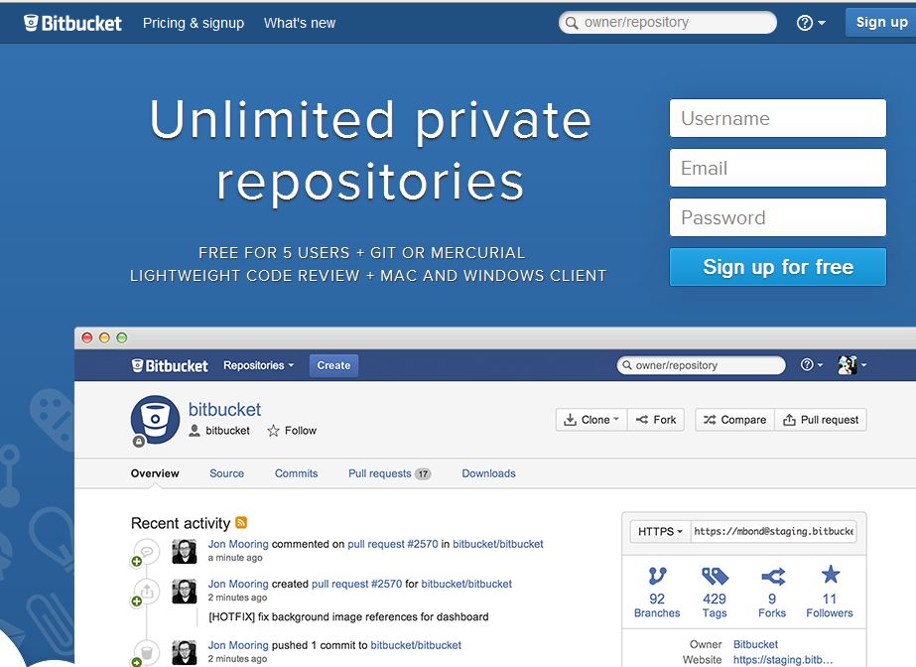
Create a Bitbucket account
https://bitbucket.org

Slide 18
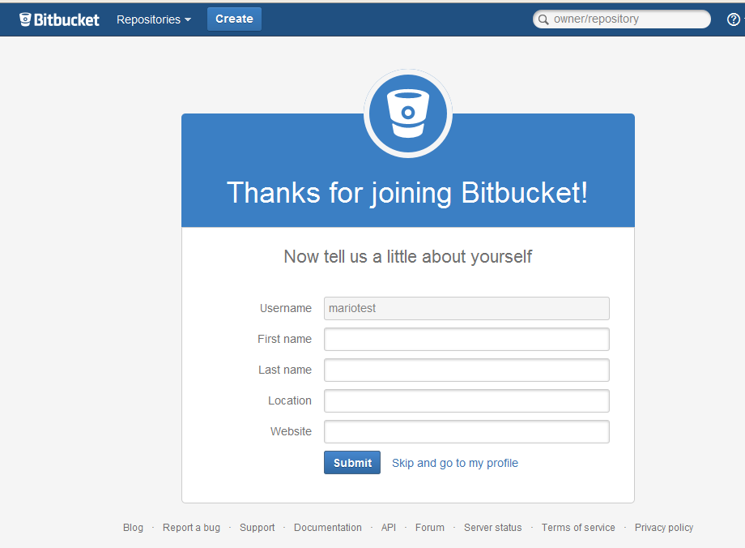
Add some info (if you want)

Slide 19
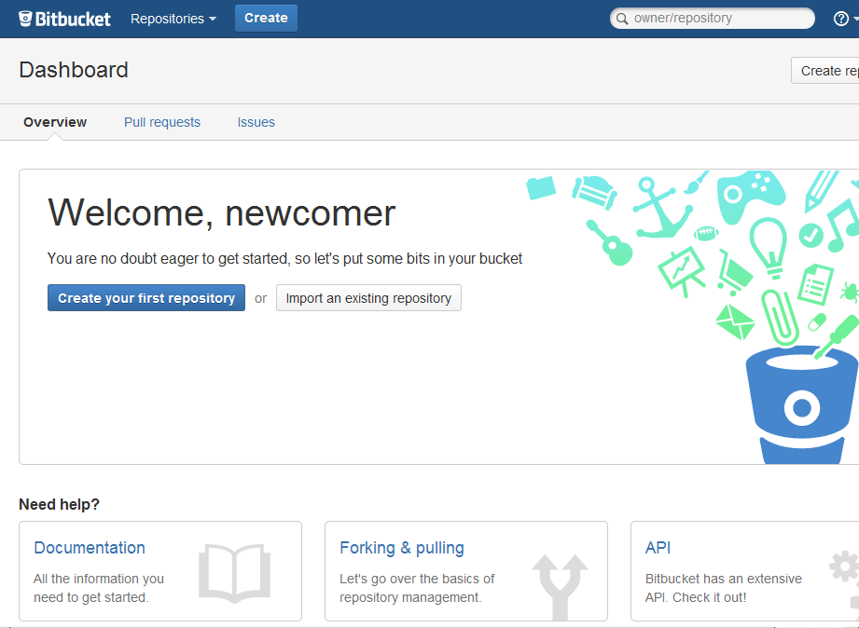
Ta Da! Creating your repository

Slide 20
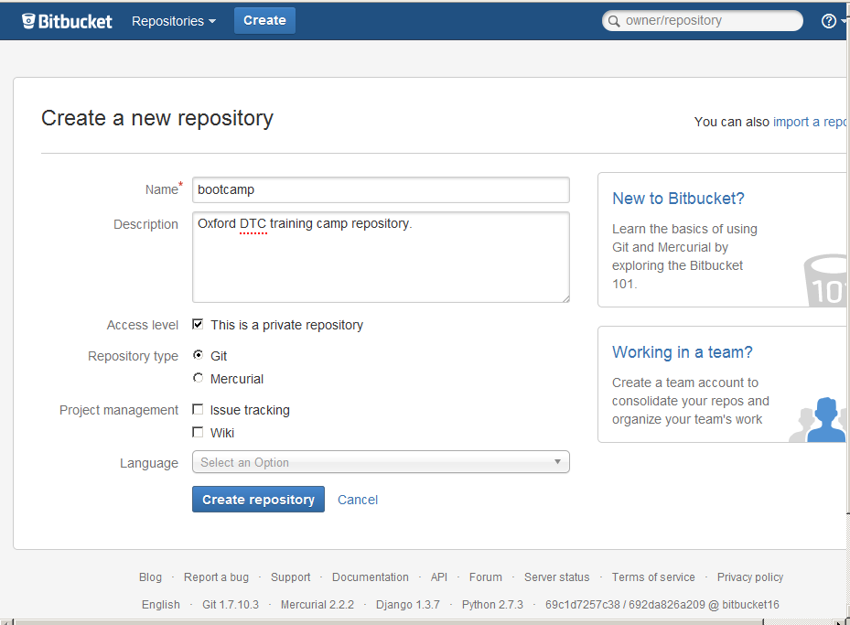
Specify your repository

Slide 21
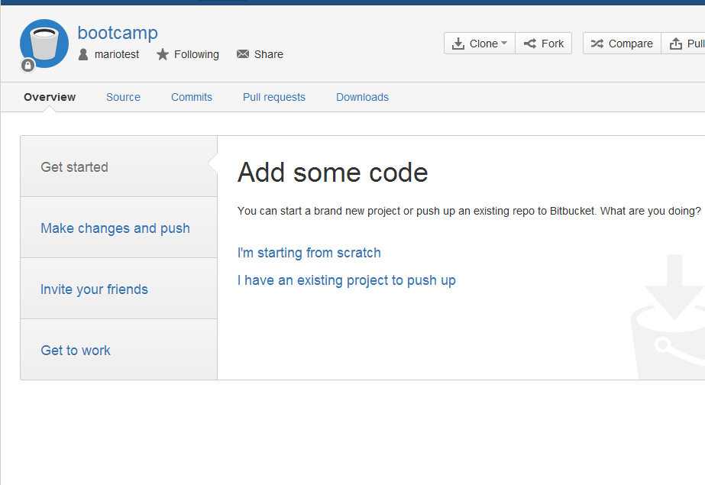
Want to add code

Slide 22
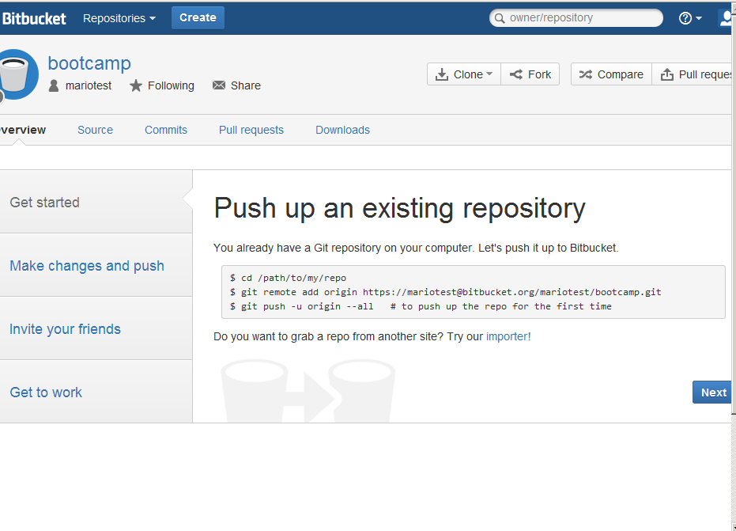
Push your code to the repository

Slide 23
Recap
What we have learnt:
Know how to create remote repositories
Know how to clone repositories
Know how to push content to the repository
Know how to fetch and merge or pull content
Know how to resolve conflicts
Next we look at establishing collaborations.

Slide 24
Collaborating

Slide 25
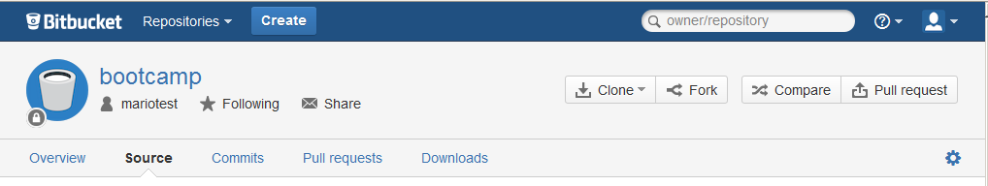
Pair up and Share your repository
Give them write access.
Add files,
modify files,
resolve conflicts …

Slide 26
Conclusions

Slide 27
Conclusions
Have found out how to use git to:
Keep track of changes like a lab notebook for code and documents.
Roll back changes to any point in the history of changes to our files - "undo" and "redo" for files.
Back up our entire history of changes in various locations.
Work on our files from multiple locations.
Identify and resolve conflicts when the same file is edited within two repositories without losing any work.
Collaboratively work on code or documents or any other files.
Can you now answer the questions posed at the start?

Slide 28
Further Information
Visual Git Reference - pictorial representations of what Git commands do.
http://marklodato.github.io/visual-git-guide/index-en.html
Pro Git - the "official" online Git book.
http://git-scm.com/book
Version control by example - an acclaimed online book on version control by Eric Sink.
http://www.ericsink.com/vcbe/

