Slide 1


Welcome to Software Carpentry!
June 3-4, 2015
Instructors:
Steve Goldstein
Alex Hanna
Christina Koch
Lauren Michael
Helpers:
Karl Broman
Myra Marx-Ferree
Jenna Nobles
Andy Pohl
Sarah Stevens

Slide 2
If You Can’t Reproduce It,
Is It Still Science?
And how long will it take?
Inspired by Greg Wilson,
Software Carpentry

Slide 3
Reality of Research Computing
Many scientists spend most of their time developing, maintaining, or running software
  Most don’t consider themselves software engineers
  Few have ever been taught how

Slide 4
So what?
Most results take longer to produce than they need to
Difficult to assess quality

Slide 5
Reinhart & Rogoff (2010)
Widely-cited study that justified economic austerity policies
(effect of debt on a country’s growth)
  Data omissions
  Questionable methods of weighting
  Coding errors
bit.ly/reinhart_rogoff

Slide 6
Software carpentry
Write software for people not computers
Automate repetitive tasks
Use the computer to record history
Make incremental changes
Use version control
Don’t repeat yourself
Plan for mistakes
First make it correct, then make it fast
Document design & purpose not mechanics
Conduct code reviews
Wilson et al. (2014) Best practices for scientific computing. PLoS Biology 12: e1001745
Notes:
Readable by humans (fixing bugs, trying to extend): meaningful names, clear style, modular
Modular code so that

Slide 7
Your closest collaborator is you six months ago,
but you don’t reply to emails.
Notes:
– _x0005_Mark Holder (see http://bit.ly/motivate_git)

Slide 8
Make Incremental Changes Redux
Choose one practice
  Implement it in your work
  Share it with your lab group
  Allow it to sink in
Repeat

Slide 9
Where to Start?
Depends on the nature of your work
Consider the purpose:
  Improve productivity
  Improve quality

Slide 10
Thoughts on Productivity and Automation
Cumulative Effort
Time

Slide 11
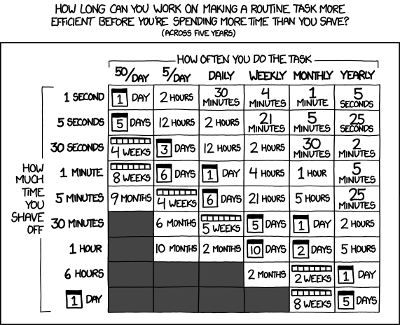
Thoughts on Productivity and Automation

