Slide 1
Questions…
How many of you test your code or scripts...
  With a set of input data and check that this gives an expected set of output data?
  With multiple sets of input data?
  With input data you know to be incorrect and check that your code or scripts behave appropriately
  After every change you've made to fix a bug or optimise your code or to add a new feature?
  Using some form of automation e.g. a set of testing scripts or a test framework?
Notes:
Behaviour in light of incorrect inputs e.g. giving a warning, or exiting, or anything that doesn't involve producing output data that seems OK but is not?

Slide 2
So why don’t we do it?
“I don’t write buggy code”
“It’s too hard”
“It’s not interesting”
“It takes too much time…”
“…I’ve research to do!”
Notes:
Well, we are naturally very protective of our work and may refuse to accept that our code has bugs. Unfortunately, almost all code has bugs.
If it's hard to write a test for some code, then this is a good sign that the code is not well designed.
Sometimes, testing is just viewed as not being interesting which means…it’s not research.

Slide 3

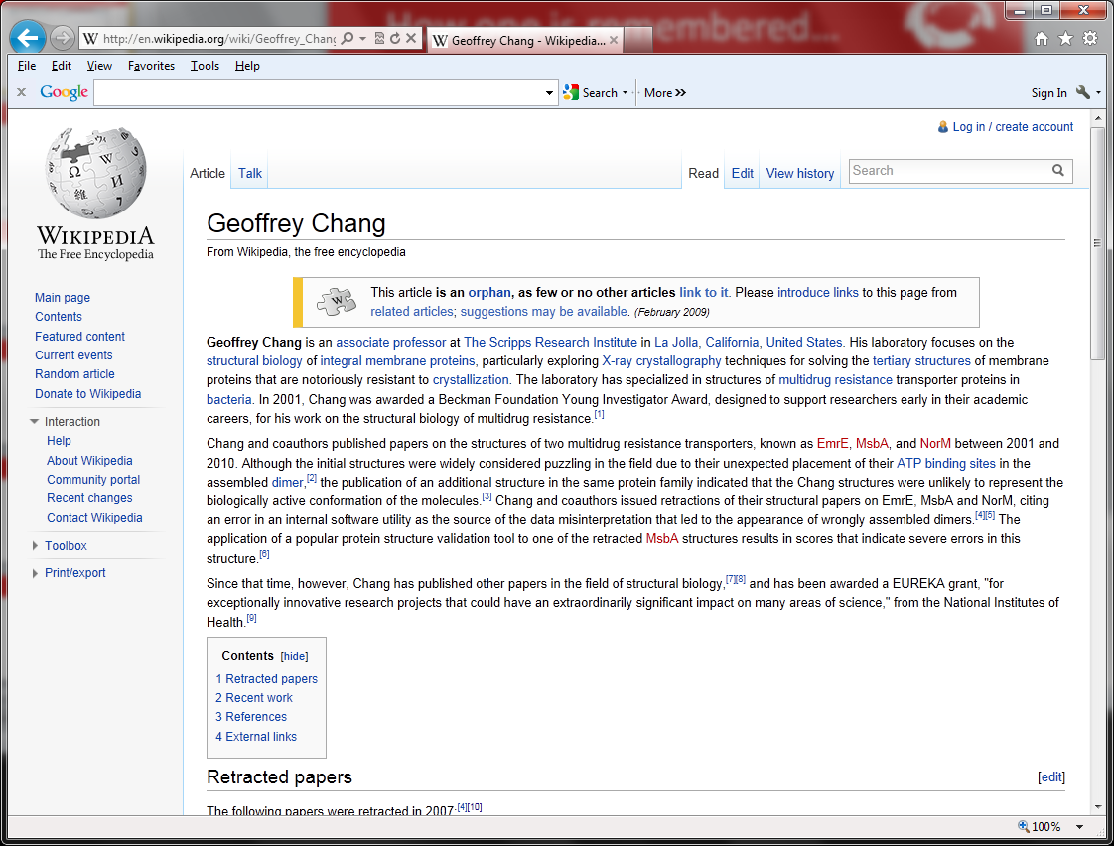
Why we should…
We wish to retract our research article … and both of our Reports...
An in-house data reduction program introduced a change in sign for anomalous differences…
Unfortunately, the use of the multicopy refinement procedure still allowed us to obtain reasonable refinement values for the wrong structures.
Notes:
Geoffrey Chang, Scripps, flipped sign bit, retractions and Wikipedia.
McKitrick and Michaels, climate research degrees, radians and retractions.
Do this too regularly and people may not trust our research, which could affect our chances for collaborations, publications or funding.

Slide 4
Testing allows us to check that our code…
Behaves as expected…
…and on any set of valid input data
Does this using any set of valid input data
Fails gracefully if given invalid input data
Handles extreme boundaries of input domains, output ranges, parametric combinations or any other edge cases
Behaves the same after we've changed it
And we can automate it!
Notes:
Behaves as expected and produces valid output data given valid input data.
It does not just crash or behave mysteriously or unpredictably but, for example, exits politely with a message as to why the input data is invalid.
Regression testing.
Confidence to add new features, optimise our code, parallelise our code, fix bugs…
...all without introducing bugs. Nothing is worse than fixing a bug only to introduce a new one.
Tests also help us remember what all the parts of our code does.
If we are working on a large project over three years and end up with 100s of functions, it may be hard to remember what each function does in detail.
If we have a test that checks all of the function's functionality, we can look at the test to remember what it's supposed to do.

Slide 5
Let’s go…
Your PostIt’s
  Red – I’m stuck, help!
  Green – I’m fine
Helpers are there for you
Browse to http://go.egi.eu/swcarpentry

Slide 6
Testing…
Saves us time
Gives us confidence that our code does what we want and expect it to
Promotes trust that our code, and so our research, is correct
Remember Geoffrey Chang!
“If it’s not tested, it’s broken”
  Bruce Eckel, Thinking in Java (3rd edition)
Notes:
Detect and fix bugs more quickly.

