Slide 1

The Unix Shell
Introduction
Copyright © Software Carpentry 2010
This work is licensed under the Creative Commons Attribution License
See http://software-carpentry.org/license.html for more information.

Slide 2
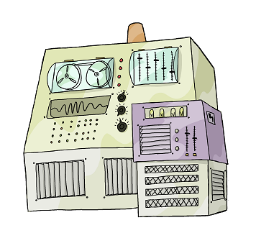

Slide 3
Run
Programs

Slide 4
Run
Programs
Store
Data

Slide 5
Run
Programs
Store
Data
Communicate
with each other

Slide 6
Run
Programs
Store
Data
Communicate
with each other
Interact
with us

Slide 7
Interact
with us

Slide 8
Interact
with us
Telepathy

Slide 9
Interact
with us
Telepathy
Speech

Slide 10
Interact
with us
Telepathy
Speech
WIMP
(windows, icons, mice, pointers)

Slide 11
Interact
with us
Rewiring
Telepathy
Speech
WIMP

Slide 12
Interact
with us
Rewiring
Telepathy
Typewriter
Speech
WIMP

Slide 13
Typewriter

Slide 14
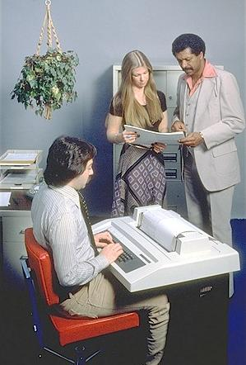
Typewriter
Line printer + keyboard

Slide 15
Typewriter
Line printer + keyboard
Text only

Slide 16
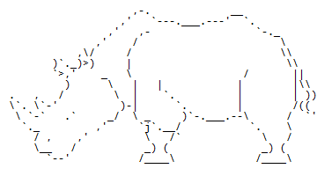
Typewriter
Line printer + keyboard
Text only

Slide 17
Typewriter
Line printer + keyboard
Text only
CLUI: command-line user interface

Slide 18

user logs in

Slide 19
user logs in
user types command

Slide 20
user logs in
user types command
computer executes command
and prints output

Slide 21
user logs in
user types command
computer executes command
and prints output
user types another command

Slide 22
user logs in
user types command
computer executes command
and prints output
user types another command
computer executes command
and prints output

Slide 23
user logs in
user types command
computer executes command
and prints output
user types another command
computer executes command
and prints output
⋮
user logs off

Slide 24
user logs in
user types command
computer executes command
and prints output
user types another command
computer executes command
and prints output
⋮
user logs off

Slide 25

user logs in
user types command
computer executes command
and prints output
user types another command
computer executes command
and prints output
⋮
user logs off
shell

Slide 26
user logs in
user types command
computer executes command
and prints output
user types another command
computer executes command
and prints output
⋮
user logs off
shell

Slide 27
A shell is just a program that runs other programs

Slide 28
A shell is just a program that runs other programs
Most popular is bash (the Bourne again shell)

Slide 29

A shell is just a program that runs other programs
Most popular is bash (the Bourne again shell)

Slide 30
A shell is just a program that runs other programs
Most popular is bash (the Bourne again shell)
Using it feels a lot more like programming
than using windows, a mouse, etc.

Slide 31
A shell is just a program that runs other programs
Most popular is bash (the Bourne again shell)
Using it feels a lot more like programming
than using windows, a mouse, etc.
Commands are terse and often cryptic

Slide 32
A shell is just a program that runs other programs
Most popular is bash (the Bourne again shell)
Using it feels a lot more like programming
than using windows, a mouse, etc.
Commands are terse and often cryptic
Use it because:

Slide 33
A shell is just a program that runs other programs
Most popular is bash (the Bourne again shell)
Using it feels a lot more like programming
than using windows, a mouse, etc.
Commands are terse and often cryptic
Use it because:
– many tools only have command-line interfaces

Slide 34
A shell is just a program that runs other programs
Most popular is bash (the Bourne again shell)
Using it feels a lot more like programming
than using windows, a mouse, etc.
Commands are terse and often cryptic
Use it because:
– many tools only have command-line interfaces
– allows you to combine tools in powerful new ways

Slide 35
created by
Greg Wilson
August 2010
Copyright © Software Carpentry 2010
This work is licensed under the Creative Commons Attribution License
See http://software-carpentry.org/license.html for more information.

