Slide 1

What We Think We Know
About Software Development
and Why We Believe it’s True
Greg Wilson
Software Carpentry
Steve Crouch, Mike Jackson
The Software Sustainability Institute
This work is licensed under the Creative Commons Attribution License
Copyright © Software Carpentry and The University of Edinburgh 2010-2012
See http://software-carpentry.org/license.html for more information.

Slide 2

Once upon a time…
7 Years War (1754-63)
Britain loses 1512 sailors to enemy action…
…and almost 100,000 to scurvy
Notes:
Symptoms: Horrible - Gums go black swell up, fingernails and teeth fall out, then the bad stuff starts!

Slide 3
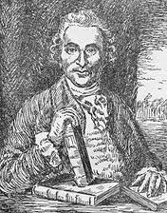
But before then…
Courtesy of the National Library of
Medicine
James Lind (1716-94)
1747: (possibly) first ever controlled medical experiment
Cider | Sea water
Sulphuric acid (!) | Oranges
Vinegar | Barley water
Notes:
~9 years before that, a Scottish surgeon James Lind found a solution.
If you pickle food, it doesn’t go bad…so can we pickle, well, preserve, sailors?
Took twelve sailors, divided them into six pairs, and gave each pair something different: cider, sea water, vitriol (which is a weak solution of sulphuric acid—bad day to be those guys), oranges, vinegar, and barley water.

Slide 4
Oranges (and lemons)…
Courtesy of the National Library of
Medicine
James Lind (1716-94)
1747: (possibly) first ever controlled medical experiment
Cider | Sea water
Sulphuric acid | Oranges
Vinegar | Barley water
And no-one listened…he’s not an English gentleman!
But in 1794 the Admiralty gave it a go…
…and England came out on top!
Notes:
Sailors who were given oranges were back on their feet in just a few days, while the others continued to sicken.
Many historians believe that one of the key reasons England came out of Napoleonic Wars on top.
British expeditions that went into the South Pacific and around Africa took lime trees with them.

Slide 5

Modern medicine
Medical profession eventually realised controlled studies were the right way to go
David Sackett
  Pioneer of “evidence-based medicine”
  Randomised double-blind test is a “gold standard”
Cochrane Collaboration
  http://www.cochrane.org/
  Largest collection of records of randomised controlled trials in the world
Image courtesy of Lab Science Career
Notes:
Randomised double-blind test – no drug/medicine released to market until this happens.

Slide 6

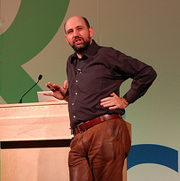
What about software development?
Martin Fowler IEEE Software, July/Aug 2009
“[Using domain specific language] leads to two primary benefits. The first, and simplest, is improved programmer productivity... The second... is... communication with domain experts.”
Image courtesy of adewale_oshineye
Notes:
He wrote the book on refactoring, literally!

Slide 7

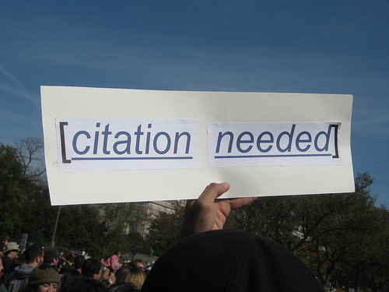
Just one more thing…
Two substantive claims…
…without a single citation!
Where’s the proof!
  The Scottish Verdict!
“Many software researchers advocate rather than investigate” – Robert L. Glass (2002)
Image courtesy of whatleydude
Image courtesy of futureatlas.com
Notes:
Perhaps seems like a good idea – you can express the problem you want to solve in a language that is closer to the area in which you want to express it.
In software engineering this kind of thing is par for the course, perhaps with a brief reference to an article from some guy over there who happened to agree. Not proof.
Advocate: RLG, Facts and Fallacies of Software Engineering – “probably true that this is the most contentious fact in this book”.

Slide 8

Times, they are a changin’
Growing emphasis on empirical studies in software research since the mid-1990s
Papers describing new tools or practices routinely include results from some kind of field study
International Conference on Software Engineering
  http://www.icse-conferences.org/
It will never work in theory
  http://www.neverworkintheory.org/
Almost always must include some field testing results in papers now
Image courtesy of Hacklock
Notes:
Often expensive to do, many flawed or incomplete, but standards are improving.
A cultural shift.

Slide 9
Estimating development
“Anchoring and Adjustment in Software Estimation”
  Aranda & Easterbrook (2005)
“How long do you think it will take to make a change to this program?”
Group A: “I admit I have no experience with software projects, but I guess this will take about 2 months to finish.”
Control Group: “I’d like to give an estimate for this project myself, but I admit I have no experience estimating. We’ll wait for your calculations for an estimate.”
Group B: “… I guess this will take about 20 months to finish.”
Notes:
Participants were recruited through email invitations sent to graduate computer science students and software developers.
23 participants, 57% had previous estimation experience.
Each group gets a 2 page specification, one variation.
Groups don’t know about the different guesses.

Slide 10
Anchoring effect
The anchor mattered more than…
  Experience in software engineering
  Tools used
  Formality of estimation
Are agile projects similarly afflicted, just on a shorter and more rapid cycle?
Group A (lowball) | 5.1 months
Control Group | 7.8 months
Group B (highball) | 15.4 months
Notes:
Anchoring effect – cognitive bias, rely too heavily on one piece of information, in this case the estimate from the novice!
Agile methods have shorter timescales but could still be prone to the same percentage mis-estimates.
Not (yet) studied but would be an argument in favour of agile methods IF people were more accurate at shorter period estimations.

Slide 11
A popular quote
“Exploratory experimental studies comparing online and offline programming performance”
  Sackman, Erikson and Grant (1968)
“The best programmers are up to 28 times more productive than the worst”
So all we need are a few good people…
  …like ourselves!
1968!
  Designed to compare batch versus interactive
  12 programmers for an afternoon
Notes:
Dozens of books quote this.
Was done in 1968 and not designed to measure productivity but batch versus interactive systems!
And just used 12 programmers – bad use of statistics.

Slide 12
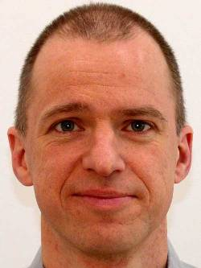
So what do we know?
Lutz Prechelt
  Productivity variations between programmers
  Effects of language and web programming frameworks
Productivity and reliability depend on length of program’s text
  Independent of language abstraction level
Go high-level
  Trading off performance
Notes:
Studies are hard to do and expensive but, compared to clinical trials, nothing.
Software controls planes, financial transactions, the results of your research! It’s important.
Consider a 5% productivity improvement in a typical programmer. Apply that to a £300 billion industry…

Slide 13
A classic result…
“Some Experience with Automated Aids to the Design of Large-Scale Reliable Software”
  Boehm et al (1975)
Most errors are introduced during requirements analysis and design
The later an error is detected the more costly it is to address
  1 hour to fix in the design
  10 hours to fix in the code
  100 hours to fix after it’s gone live…
Notes:
Validated by many others.
After it’s gone live when you’ve been hit with a lawsuit!

Slide 14
Which can be viewed by…
Pessimists
  Traditionalists
  “If we tackle the jump in the error injection curve, fewer bugs will get to the expensive part of the fixing curve”
Optimists
  Agile
  “If we do lots of short iterations, the total cost of fixing bugs will go down”
Notes:
Pessimists: fix the bugs earlier in a large cycle, cheaper than fixing later. Total cost will come down.
Optimists: let’s reduce the entire cycle to a couple of weeks, and stitch a lot of them together. Total area under the fixing effort curve is reduced. Essentially fixing ‘later’ becomes ‘very soon’ and overall, effort for fixing is reduced.

Slide 15
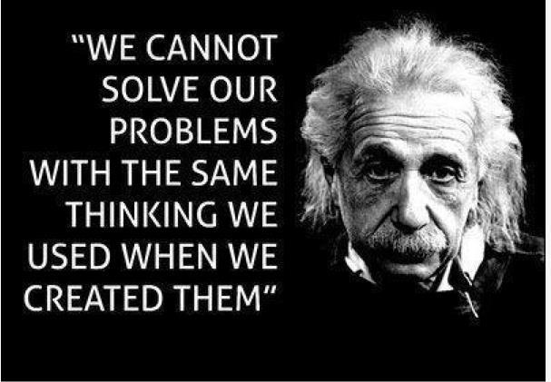
Greatest hits I
For every 20% increase in problem complexity, there is a 100% increase in solution complexity
  Woodfield (1979)
The two biggest causes of project failure are poor estimation and unstable requirements
  van Genuchten (1991) and many others
Development teams do not
benefit from existing experience, and they
repeat mistakes over and over again
  Brossler (1999)
Notes:
Woodfield was replicated a number of times.
Non-linear because of interaction effects.
Add a few more features, could equal five-fold increase in effort required
If you reduce the problem space i.e. by simplification or assumption, you can significantly reduce the solution required.
Perhaps this is why agile methods work so well.

Slide 16
Greatest hits II
Rigorous inspections can remove 60-90% of errors before first test is run
  Fagan (1975)
The first review and hour matter most
  Cohen (2006)
Physical distance doesn’t affect post-release fault rates, distance in organisational chart does
  Nagappan et al (2007) & Bird et al (2009)
Notes:
Fagan – don’t run the code, don’t even test it yet…Read it!
Cohen’s: footnote…
Having two or more people read the code, or for longer, doesn’t really yield a good enough return to make it worthwhile.
For best value, have one other read through the code for an hour at a time (after an hour, brain full – around 200 lines of code; take into account interactions.
Argues that we should be developing code in little steps. Look at Mozilla, Linux. Most progress in little additions.

Slide 17
Greatest hits III
Half the errors are found in 15% of the modules
  Davis (1995) quoting Endres (1975)
About 80% of the defects come from 20% of the modules, and about half the modules are error free
  Boehm and Basili (2001)
When you identify more errors than expected in some program module, keep looking!
Shouldn’t our development practices be built around these facts?
Notes:
Errors cluster and we’ve known this since 1975!

Slide 18

How did you learn to program?
You don’t just go out and write War and Peace
  You’d read other skilled writers first
You don’t just go out and write a foreign language
  You learn to read it first
Foreign programming languages!
Teach maintenance first
  Harlan Mills (1990)
Image courtesy of dwyman
“The best way to prepare [to be a programmer] is to write programs and to study great programs that other people have written” Susan Lammers, 1986, quoting a younger Bill Gates
Notes:
Quentin Tarantino made Reservoir Dogs…after watching De Palma, Leone, Scorsese, Hawks.
See how its done well (and badly) and learn, then write it yourself.
In more mature subjects they teach reading before writing.
SEI (Carnegie Mellon) tried to collect examples of code to read, gave up. Software engineers cannot decide on what is easy to read.

Slide 19
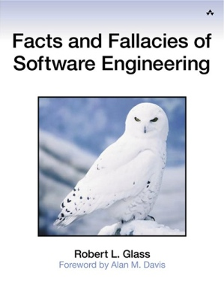
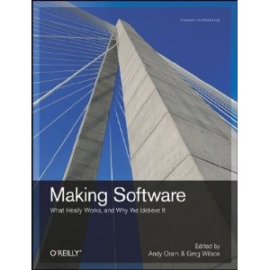
And there’s many more…!
http://software-carpentry.org/4_0/softeng/ebse
Notes:
Based on empirical results and qualitative studies.
Not just hearsay, “common sense” or “what we’ve always done”.

Slide 20
One other thing we know…
Software developers and researchers differ!
Saying “this is good because software developers say it is good” is not good enough!
  “Oi! we’re not software developers, we’re researchers!”
We say “this is good because it helps your research”
  Good software development practices contribute to good research
Notes:
Differ in nature of job, outputs (software versus papers, release and users versus peer review) and recognition.
Though we are advocating the recognition of software and data as first-class research outputs in their own right.

