Slide 1

Testing
Mike Jackson
The Software Sustainability Institute
This work is licensed under the Creative Commons Attribution License
Copyright © Software Carpentry and The University of Edinburgh 2010-2012
See http://software-carpentry.org/license.html for more information.

Slide 2
Confess!
“Why don’t you write tests?”
“I don’t write buggy code”
“It’s too hard”
“It’s not interesting”
“It takes too much time and I’ve research to do”
Notes:
Speak up if any of these look familiar!
Well, we are naturally very protective of our work and may refuse to accept that our code has bugs. Unfortunately, almost all code has bugs.
The practice of actually writing automated tests, code that tests our software, is perceived as being too difficult. However, if it’s hard to write a test for some code, then this is a good sign that the code is not well designed.
Sometimes, testing is just viewed as not being interesting. What this usually translates to is “I have no time and anyway it’s not the focus of our research”.
And, this is a fair point. So, why should we care about testing?
Ariane 5, the successor to Ariane 4 had new and improved engines. Ariane 5 used Ariane 4 code. Unfortunately, the developers didn’t test the code properly. Ariane 5’s faster engines gave rise to a bug which caused a buffer overflow. And, the buffer overflow caused Ariane 5 to explode. So, some forgotten tests led to millions of pounds down the drain and some very red faces.
There is a story, possibly an urban myth, that during F16 test flights over Israel the navigation computer would crash and reboot. Seemingly one calculation included a division by altitude and when the plane flew over the Dead Sea…division by zero!

Slide 3
Consider Geoffrey Chang…
Department of Molecular Biology, Scripps Institute
5th Annual Presidential Early Career Awards for Scientists and Engineers – 2000
Beckerman Foundation Young Investigator Award – 2001
Publications
Chang G, Roth CB. (2001) Structure of MsbA from E. coli: a homolog of the multidrug resistance ATP binding cassette (ABC) transporters. Science 293(5536):1793-800.
Pornillos O, Chen YJ, Chen AP, Chang G. (2005) X-ray structure of the EmrE multidrug transporter in complex with a substrate. Science 310(5756):1950-3.
Reyes CL, Chang G. (2005) Structure of the ABC transporter MsbA in complex with ADP.vanadate and lipopolysaccharide. Science 308(5724):1028-31.
Letters – Retraction, Science 22 December 2006: Vol. 314 no. 5807 p. 1875 DOI: 10.1126/science.314.5807.1875b
Retraction of Pornillos et al., Science 310 (5756) 1950-1953.
Retraction of Reyes and Chang, Science 308 (5724) 1028-1031.
Retraction of Chang and Roth, Science 293 (5536) 1793-1800.
Notes:
For us, consequences may not be so drastic but nevertheless they could be damaging. Consider Geoffrey Chang, a highly acclaimed researcher with the Scripps Institute, Beckman Award winner, designed to support researchers early in their academic careers, and with numerous publications to his name.
And then this publication, in Science…,
http://www.sciencemag.org/content/314/5807/1875.2.long

Slide 4
From small seeds…
We wish to retract our research article … and both of our Reports….our MsbA structures…were incorrect …our biological interpretations based on these inverted models for MsbA are invalid…
An in-house data reduction program introduced a change in sign … (I+ and I-) to (F- and F+)…Unfortunately, the use of the multicopy refinement procedure still allowed us to obtain reasonable refinement values for the wrong structures
…We very sincerely regret the confusion that these papers have caused and, in particular, subsequent research efforts that were unproductive as a result of our original findings.”
http://www.sciencemag.org/content/314/5807/1875.2.full
Notes:
All because of a flipped sign!

Slide 5
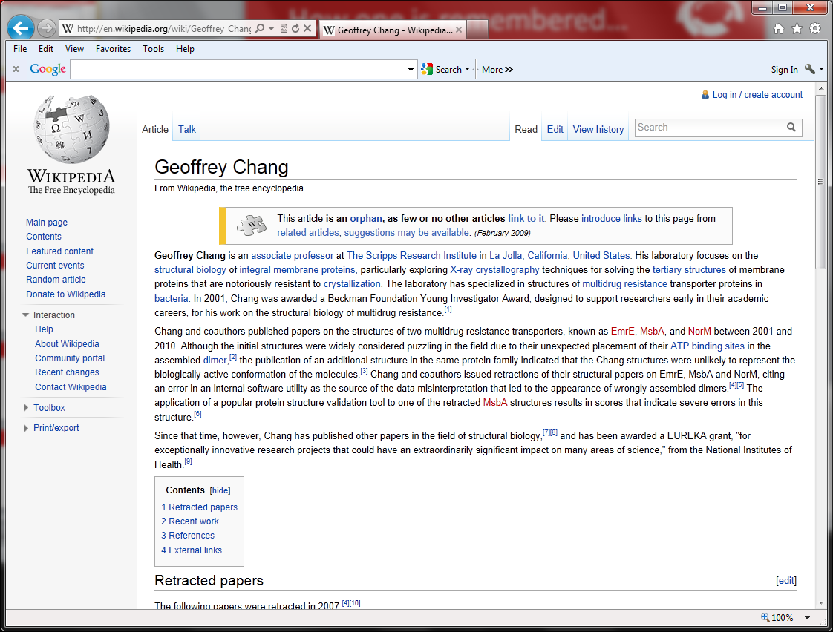
Fame has a fifteen minute half-life, infamy lasts a little longer
Notes:
And infamy lasts longer than 15 minutes,
http://en.wikipedia.org/wiki/Geoffrey_Chang

Slide 6
And he’s not alone
“A Test of Corrections for Extraneous Signals in Gridded Surface Temperature Data”
  R. McKitrick and P. Michaels, Climate Research 26(2) 2004,
“McKitrick screws up yet again”, Tim Lambert’s blog
“McKitrick mucks it up”, John Quiggin’s blog
“ERRATUM”
  R. McKitrick and P. Michaels, Climate Research 27(3) 2004
  “formula for computing cosine of absolute latitude … takes the angle in radians, but our data were entered in degrees”
1 radian
1 degree
Notes:
http://www.int-res.com/abstracts/cr/v26/n2/p159-173/
Global warming is an artefact produced by weather stations in or near big cities, the ‘urban heat islands’ hypothesis.
Published May 2004.
But very quickly…
http://scienceblogs.com/deltoid/2004/08/26/mckitrick6/
Note the graph. Their data had angles of latitude in degrees, a component they use expects angles in radians and they didn’t do a conversion!
http://crookedtimber.org/2004/08/25/mckitrick-mucks-it-up/
In December 2004… ERRATUM.
http://www.int-res.com/articles/cr2004/27/c027p265.pdf
Do this too regularly and people may not trust our research, which could affect our chances for collaborations, publications or funding.

Slide 7
What testing gives you
Confidence that your code does what it is supposed to
  That your research is built on a solid foundation
Ability to detect, and fix, bugs more quickly
Confidence to refactor or fix bugs without creating new bugs
Examples of how to use your code
“if it’s not tested, it’s broken”
  bittermanandy, 10/09/2010

