Slide 1
What we know

Slide 2
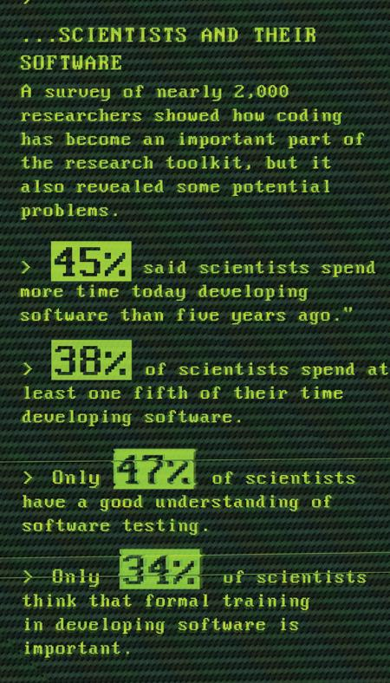
Why Software Carpentry?
Images by Greg Wilson and Neil Chue Hong. Data from Hannay et al, “How Do Scientists Develop and Use Scientific Software?
SECSE '09 Proceedings of the 2009 ICSE Workshop on Software Engineering for Computational Science and Engineering, IEEE Computer Society, 2009. DOI: 10.1109/SECSE.2009.5069155

Slide 3
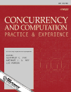
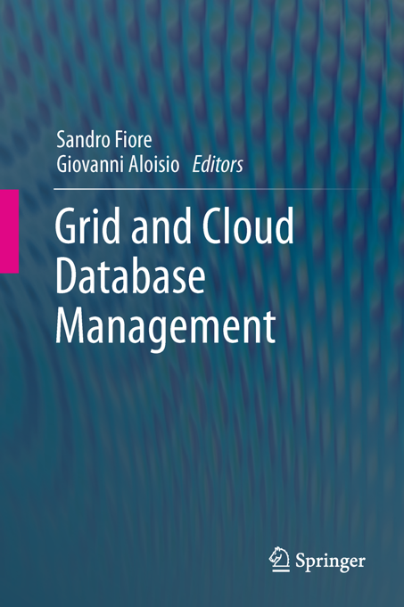


Software development ≠ research
or
Notes:
Software developers: “use these things because they’re good for software developers”.
Researchers: “we’re not software developers!”.
Software is a means to an end – the end is research.
Measure research by peer-reviewed publications.

Slide 4

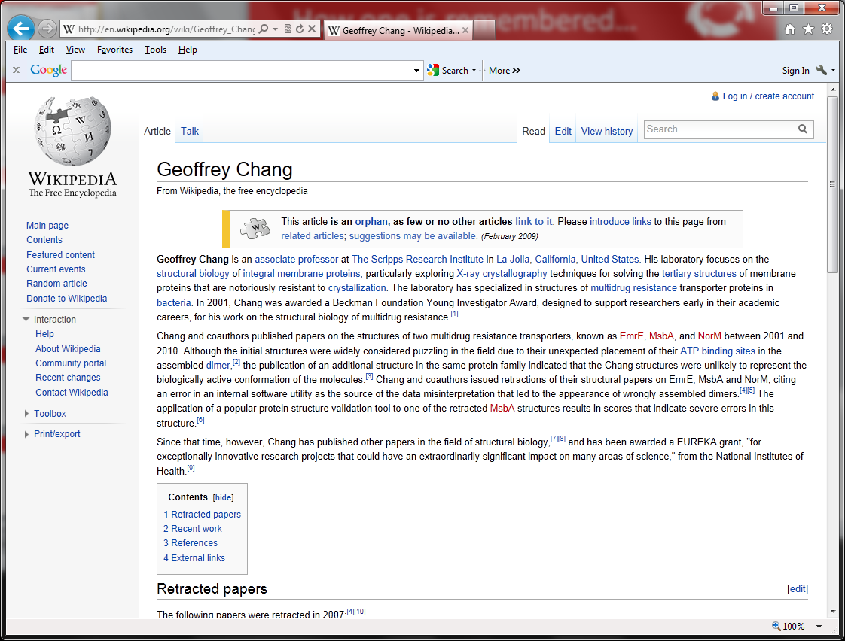
Remember Geoffrey Chang!
We wish to retract our research article … and both of our Reports...
An in-house data reduction program introduced a change in sign for anomalous differences…
Unfortunately, the use of the multicopy refinement procedure still allowed us to obtain reasonable refinement values for the wrong structures.
More stories (not all software related) at
http://retractionwatch.wordpress.com/
Notes:
Geoffrey Chang, Scripps, flipped sign bit, retractions and Wikipedia.
McKitrick and Michaels, 2004, climate research, data in degrees, but used component that expected data in radians, and they didn’t do any conversion, this was spotted and they had to retract.

Slide 5


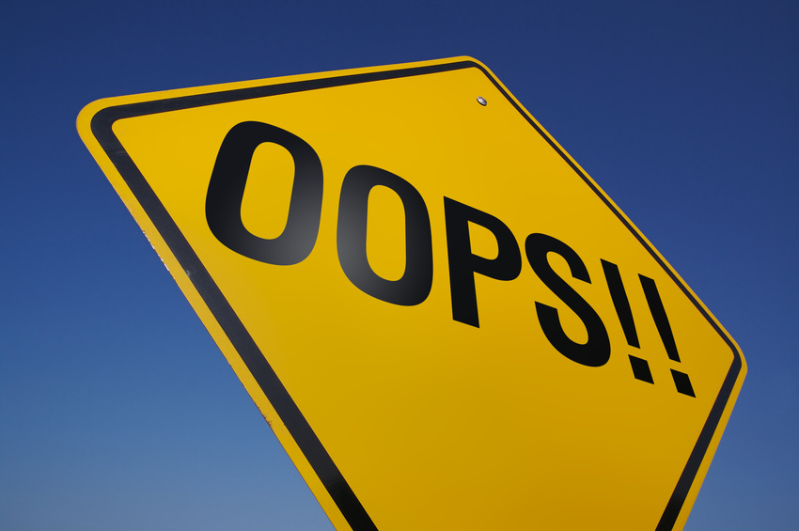



Correctness isn’t compelling, so…
Notes:
Software development skills help you to do things…
With less pain.
With less mistakes.
More time for interesting, exciting research!

Slide 6



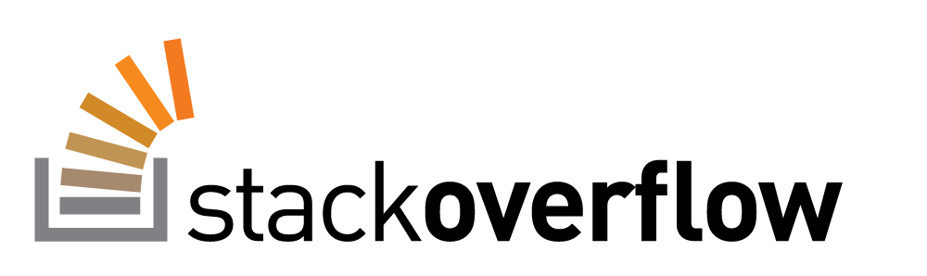
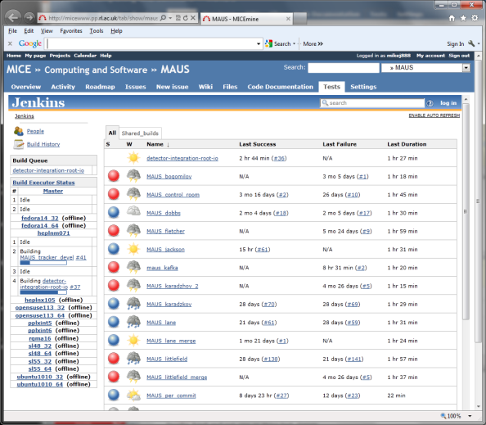


Correctness isn’t compelling…
  configure.sh
  build.sh
  install.sh
  history
  !123
  history | grep 'ssh'
  make clean
  make install
  make
filename = “data.txt”
source = open(filename, 'r')
actual_count = 0
expected_count = None
# Count number of data records.
for line in source:
if line.startswith('#-'): # Number of records
trash, expected_count = line.split()
expected_count = int(expected_count)
if line.startswith('#'): # Skip comments.
pass
elif line.startswith('D'): # Skip title line.
pass
else:
actual_count += 1
source.close()
def test_fibonacci_0():
assert fibonacci(0) == 0
Notes:
Correctness doesn’t motivate researchers. Chance of being “found out” is small. More importantly => no time!
http://software-carpentry.org/blog/2013/02/correctness-isnt-compelling.html
Selling point: “to do more in less time and save more time for research!”
Shell: “write once run many”, reduce errors, re-use tried-and-tested components, avoid re-inventing the wheel.
Make: automate repetitive tasks, reduce errors, document how software is built and how analyses are run.
Version control: record provenance of code, documents, configuration files, track which version of software produced data used in paper, presentation, poster or thesis, easier and quicker to retrieve, back up work, productively collaborate.
Good coding: make it easier to spot bugs in code and to make fixes, help others to validate by peer review, help others replicate or reproduce, encourage others to reuse, impact, reduce “truck factor”.
Testing: check outputs are correct automatically, ensure algorithms, implementation and data are correct and so that research is correct, make changes without introducing bugs and save time, fix bugs without introducing bugs and save time.

Slide 7
Iteration and release
Continuous integration
Version control
Red
Green
Refactor
Test-driven development
Pair programming
and/or
code
reviews
Notes:
Pair programming. Driver and navigator. Swop after an hour. Peer review. Share ideas and expertise. Share knowledge of code. Collective ownership. Induct new team members. Less Facebook-ing!.
Code reviews. Share ideas and expertise. Fagan and Cohen.
TDD. Red (fail). Green (pass). Refactor (clean). Focus on what code should do rather than what it does. Code always tested. Promotes working in small steps.
Version control. Provenance. Commit small, complete units of work, ideally a reviewable unit.
Continuous integration (CI). Checkout/build/test/publish. Fail-fast. Name and shame. Always runnable. Always releasable. On which note…
Release early, release often – so long as it’s built and tested cf. MPA. Users often don’t know what they want until they have something they can use. A tool can change how users do their work. Short iterations avoid spending too much time building what turns out to be the wrong thing. Well-suited to research software. Requires less coordination as people can track what they do for a few days themselves. Easier to find bugs – 2 weeks worth of code, not 2 months or 2 years worth. Always have something that is working, tested and ready for release. MAUS and bi-monthly releases.
Concentric circles focusing on continuous feedback, collaborative working and small development cycles. Agile development methods, frequent feedback for developer and customer. Not an excuse for cowboy coding, or no process. Even if you are a solo these still benefit you!

Slide 8
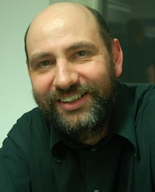
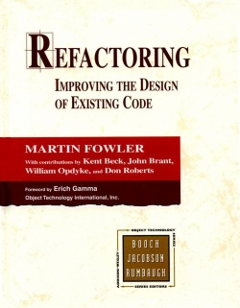
But, what do we know about software?
“[Using domain specific language] leads to two primary benefits. The first, and simplest, is improved programmer productivity... The second... is... communication with domain experts.” – Martin Fowler, IEEE Software, July/August 2009
And where’s your evidence?
Or a citation?
Er..hello?
Photo of Martin Fowler courtesy of Adewale oshineye, http://www.flickr.com/photos/adewale_oshineye/2933030620/
Notes:
Teaching researchers => need to explain “why” things are as they are.
Martin Fowler IEEE Software, July/Aug 2009.
Two substantial claims. Major journal. No citation. No evidence.

Slide 9
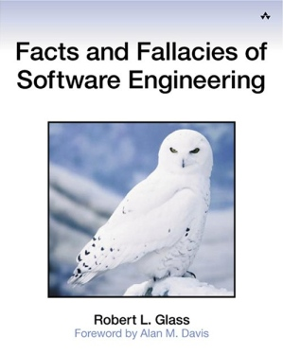


Them’s fightin’ words…
“Many software researchers advocate rather than investigate” – Robert L. Glass (2002)
+
Notes:
“As a result, (a) some advocated concepts are worth far less than their advocates believe, and (b) there is a shortage of evaluative research to help determine what the value of such concepts really is”
In software engineering this is par for the course, perhaps with a brief reference to an article from some guy over there who happened to agree.
It’s not proof. Not science.
“probably true that this is the most contentious fact in this book”.

Slide 10


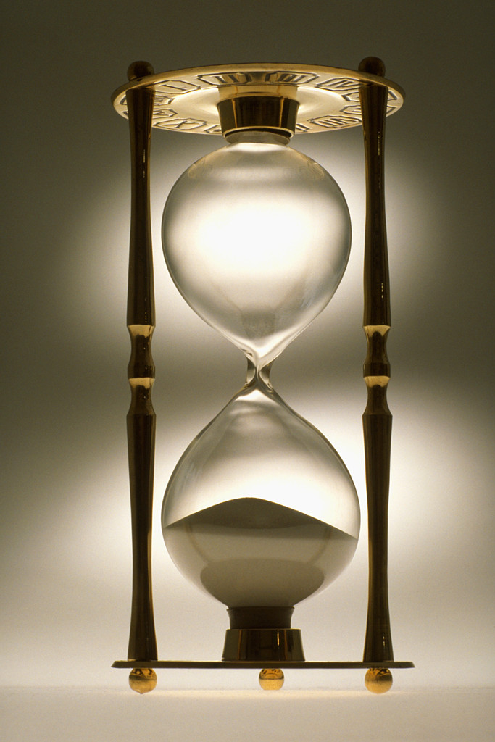
The most effective approach to error removal is…
Rigorous inspections can remove 60-90% of errors before first test is run, Fagan (1975)
The first review and hour matter most, Cohen (2006)
Notes:
Rigorous inspections can remove 60-90% of errors before first test is run
Fagan (1975) “Design and Code Inspections to Reduce Errors in Program Development"
The first review and hour matter most
Cohen (2006) “Best Kept Secrets of Peer Code Review”
Fagan – don’t run the code, don’t even test it yet…Read it!
This is one reason why we recommend pair programming.
Cohen’s: footnote…
Having two or more people read the code, or for longer, doesn’t really yield a good enough return to make it worthwhile.
For best value, have one other read through the code for an hour at a time.
After an hour your brain is full and you end up finding only trivial formatting errors.
This is why we recommend developing code in small, reviewable, chunks, regularly adding these to version control so others can see them.

Slide 11
Looking for errors…
# design errors >> # coding errors, Boehm et al. (1975)
50%-80% of errors
in
15%-20% of modules,
Davis (1995) quoting Endres (1975), Weinberg (1992)
number / cost
50% of modules are error free,
Boehm and Basili (2001)
time
Found an error?
Look nearby!
Notes:
“Some experience with automated aids to the design of large-scale reliable software”, Software Engineering, IEEE Transactions on, March 1975, Boehm, B.W. McClean, R.K. ; Urfrig, D.B. Volume: SE-1 , Issue: 1, Page(s): 125 – 133.
“large preponderance of design errors over coding errors on large-scale projects, not only with respect to numbers of errors, but also with respect to the relative time and effort required to detect them and correct them.”
"Half the errors are found in 15% of the modules" (Davis 1995, quoting Endres 1975).
“80% of all errors are found in just 2% (sic) of the modules" (Davis 1995, quoting Weinberg 1992).
"About 80% of the defects come from 20% of the modules, and about half the modules are error free" (Boehm and Basili 2001).

Slide 12
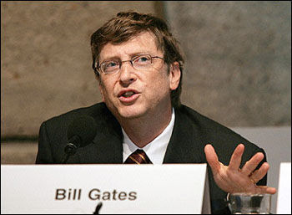
How do we learn programming?
“You teach people how to program by showing them how to write programs.”
“Fallacy 10”
filename = “data.txt”
source = open(filename, 'r')
actual_count = 0
expected_count = None
# Count number of data records.
for line in source:
if line.startswith('#-'): # Number of records
trash, expected_count = line.split()
expected_count = int(expected_count)
if line.startswith('#'): # Skip comments.
pass
elif line.startswith('D'): # Skip title line.
pass
else:
actual_count += 1
source.close()
“[T]he best way [to be a programmer] is to write programs and to study great programs that other people have written…I went to the garbage cans at the Computer Science Center and I fished out the listings of their operating systems.”
Image courtesy of IsaacMao, http://www.flickr.com/photos/isaacmao/1568730/
Notes:
Here’s the rules, write some code!
For any other language we read then write!
But what are examples of good code?
Where are the textbooks on reading code? How do we write one…for novices?
We only read code during maintenance!
Lammers, Susan. 1986. Programmers at Work. Redmond, WA: Microsoft Press quoting Bill Gates.
Code fragments should be the best we can do and conform to good programming practice.

Slide 13
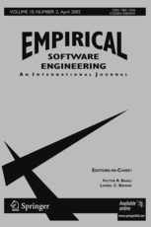
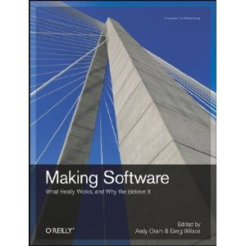

And there’s more…

