Slide 1
Putting it all together

Slide 2
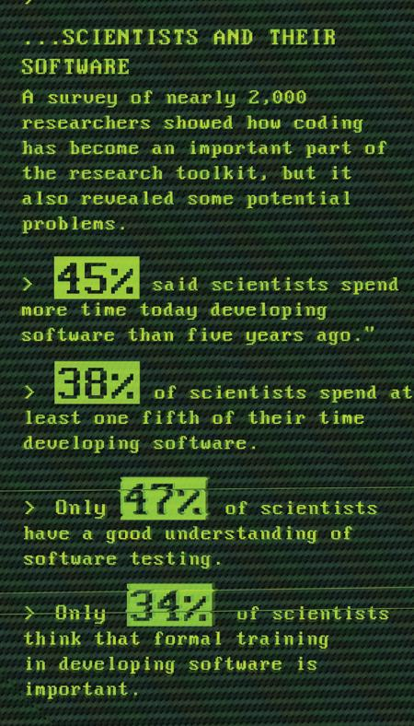
Why Software Carpentry?
Images by Greg Wilson and Neil Chue Hong. Data from Hannay et al, “How Do Scientists Develop and Use Scientific Software?
SECSE '09 Proceedings of the 2009 ICSE Workshop on Software Engineering for Computational Science and Engineering, IEEE Computer Society, 2009. DOI: 10.1109/SECSE.2009.5069155

Slide 3
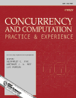



Software development ≠ research
or
Notes:
Software developers: “use these things because they’re good for software developers”.
Researchers: “we’re not software developers!”.
Software is a means to an end – the end is research.
Measure research by peer-reviewed publications.

Slide 4

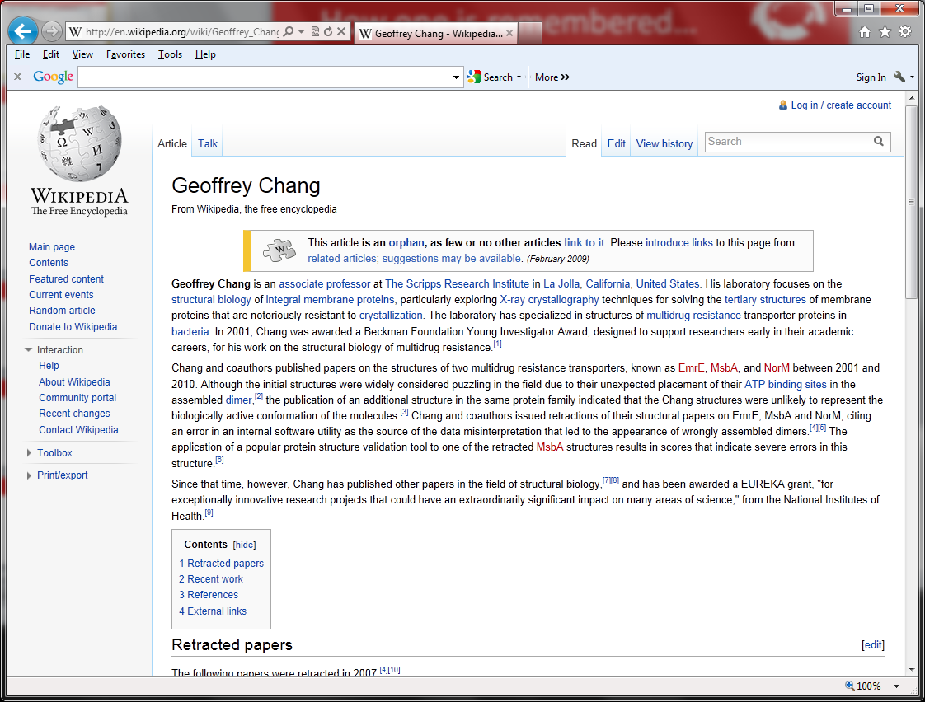
Remember Geoffrey Chang!
We wish to retract our research article … and both of our Reports...
An in-house data reduction program introduced a change in sign for anomalous differences…
Unfortunately, the use of the multicopy refinement procedure still allowed us to obtain reasonable refinement values for the wrong structures.
Notes:
Geoffrey Chang, Scripps, flipped sign bit, retractions and Wikipedia.
McKitrick and Michaels, 2004, climate research, data in degrees, but used component that expected data in radians, and they didn’t do any conversion, this was spotted and they had to retract.

Slide 5






Correctness isn’t compelling, so…
Notes:
Software development skills help you to do things…
With less pain.
With less mistakes.
More time for interesting, exciting research!

Slide 6


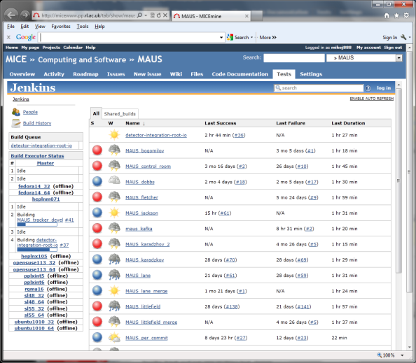

Correctness isn’t compelling…
  history
  !123
  history | grep 'ssh'
  configure.sh
  build.sh
  install.sh
def test_push_pop():
stack.push(123)
assert stack.pop() == 123
filename = ”data.txt”
source = open(filename, 'r')
actual_count = 0
expected_count = None
# Count number of data records.
for line in source:
if line.startswith('#-'): # Number of records
trash, expected_count = line.split()
expected_count = int(expected_count)
if line.startswith('#'): # Skip comments.
pass
elif line.startswith('D'): # Skip title line.
pass
else:
actual_count += 1
source.close()
class Stack:
”””
A simple FIFO stack.
”””
def __init__(self):
def push(self, item):
”””
Add item to stack.
@param self Stack object
@param item Item to add
”””
def pop(self, item):
def is_empty(self):
Notes:
Correctness doesn’t motivate researchers. Chance of being “found out” is small. More importantly => no time!
http://software-carpentry.org/blog/2013/02/correctness-isnt-compelling.html
Selling point: “to do more in less time and save more time for research!”
Shell: “write once run many”, reduce errors, re-use tried-and-tested components, avoid re-inventing the wheel.
Version control: record provenance of code, documents, configuration files, track which version of software produced data used in paper, presentation, poster or thesis, easier and quicker to retrieve, back up work, productively collaborate.
Good coding: make it easier to spot bugs in code and to make fixes, help others to validate by peer review, help others replicate or reproduce, encourage others to reuse, impact, reduce “truck factor”.
Testing: check outputs are correct automatically, ensure algorithms, implementation and data are correct and so that research is correct, make changes without introducing bugs and save time, fix bugs without introducing bugs and save time.

Slide 7
Iteration and release
Continuous integration
Version control
Test-driven development
Review
your
code
(teamwork)
Notes:
Pair programming. Driver and navigator. Swop after an hour. Peer review. Share ideas and expertise. Share knowledge of code. Collective ownership. Induct new team members. Less Facebook-ing!.
Code reviews. Share ideas and expertise. Fagan and Cohen.
TDD. Red (fail). Green (pass). Refactor (clean). Focus on what code should do rather than what it does. Code always tested. Promotes working in small steps.
Version control. Provenance. Commit small, complete units of work, ideally a reviewable unit.
Continuous integration (CI). Checkout/build/test/publish. Fail-fast. Name and shame. Always runnable. Always releasable. On which note…
Release early, release often – so long as it’s built and tested cf. MPA. Users often don’t know what they want until they have something they can use. A tool can change how users do their work. Short iterations avoid spending too much time building what turns out to be the wrong thing. Well-suited to research software. Requires less coordination as people can track what they do for a few days themselves. Easier to find bugs – 2 weeks worth of code, not 2 months or 2 years worth. Always have something that is working, tested and ready for release. MAUS and bi-monthly releases.
Concentric circles focusing on continuous feedback, collaborative working and small development cycles. Agile development methods, frequent feedback for developer and customer. Not an excuse for cowboy coding, or no process. Even if you are a solo these still benefit you!

Slide 8
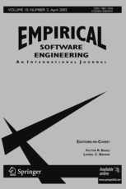
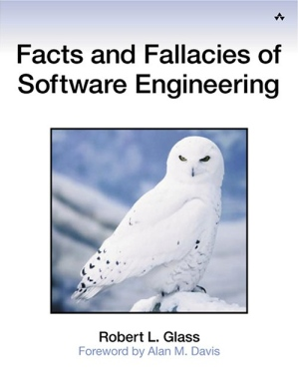
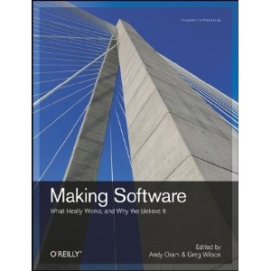

And there’s more…

Slide 9
Have your say…
Iterative development does not just
apply to software
so
what did you think of this boot camp?

Slide 10

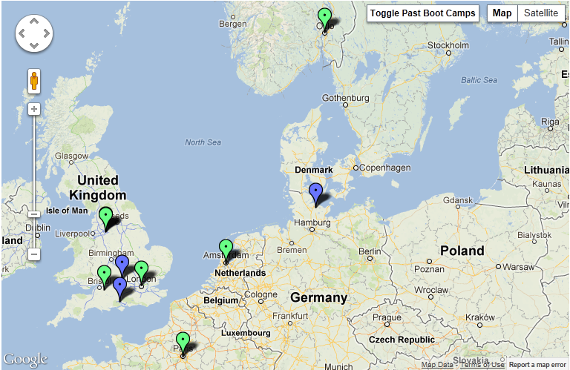


Want to get involved?
admin-uk@software-carpentry.org
http://software-carpentry.org/bootcamps

