Slide 1
Questions…
How many of you test your code or scripts...
  With a single set of input data, checking this gives an expected set of output data?
  With multiple sets of input data?
  With input data you know to be incorrect, checking that code or scripts behave as expected?
  After every change you've made, to fix a bug or optimise your code or to add a new feature?
  Using some form of automation e.g. a set of testing scripts or a test framework?

Slide 2
So why don’t we do it?
“I don’t write buggy code”
“It’s too hard”
“It’s not interesting”
“It takes too much time…”
“…I’ve research to do!”

Slide 3
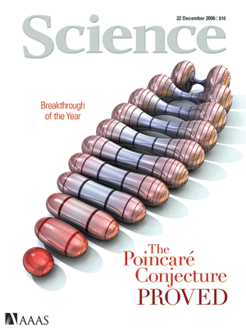
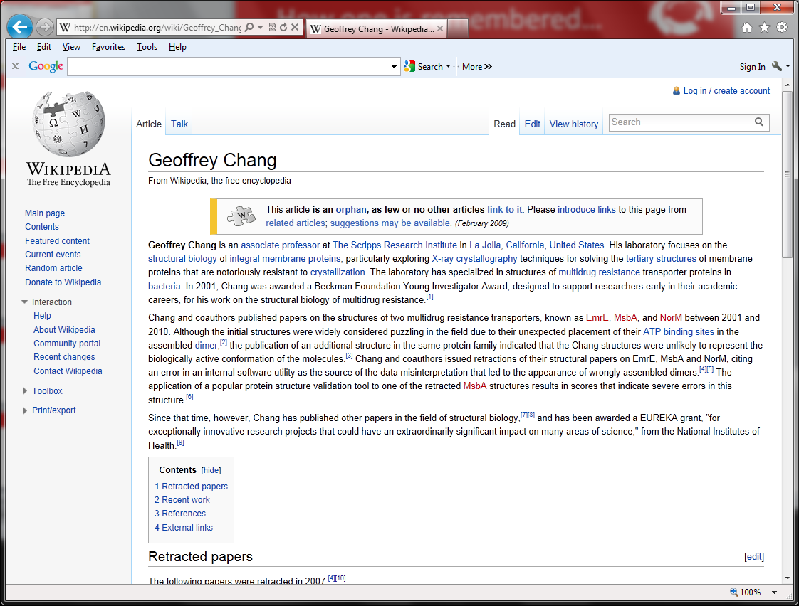
Why we should…Geoffrey Chang
We wish to retract our research article … and both of our Reports...
An in-house data reduction program introduced a change in sign for anomalous differences…
Unfortunately, the use of the multicopy refinement procedure still allowed us to obtain reasonable refinement values for the wrong structures.

Slide 4
Testing allows us to check that our code…
Verify that we have written our code correctly
  …bug free, precise, accurate and repeatable
  …after we’ve fixed bugs or made improvements
Validate that we have written the right code
  …produces the data we expect
  …on any set of valid input data
Fails gracefully…
  …if given invalid input data
  …if pushed beyond its limits
And we can automate it!

Slide 5
Testing…
Saves us time
Gives us confidence that our code does what we want and expect it to
Promotes trust that our code, and so our research, is correct
Remember Geoffrey Chang!
“If it’s not tested, it’s broken”
  Bruce Eckel, Thinking in Java (3rd edition)

