Slide 1






PRACE boot camp
Edinburgh
December 2012
Azalee Bostroem
Space Telescope Science Institute (STScI)
Mike Jackson
The Software Sustainability Institute

Slide 2
A message from our sponsors…

Slide 3
Today
Introduction
Using the shell to do more in less time
Using version control to manage and share information
Simple Python
Python lists and functions

Slide 4
Tomorrow
How (and how much) to test programs
Testing and automation
Automation and Make
Pulling everything together practical
What we know about software development
Feedback from you!

Slide 5

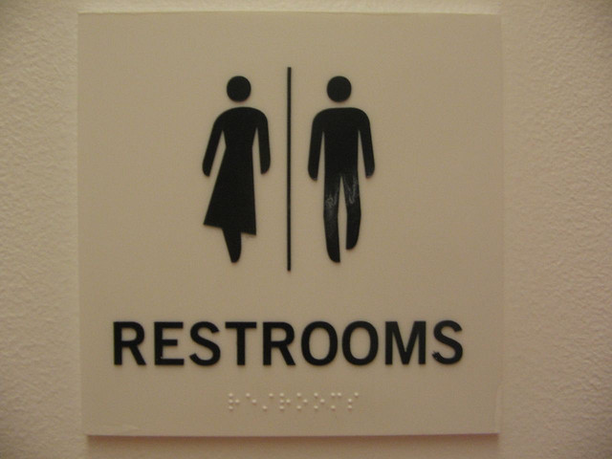


Important stuff
#swced
Images courtesy of (clockwise from top-left) oneVillage initiative, Bobbymond, Dajanda, Anton Novojilov

Slide 6
Meet’n’greet
Your helpers are…
Your fellow attendees are…

Slide 7
Want to get involved?
Write online lectures and practicals
  Scientific python libraries e.g. PANDAS or SciPy image processing
  Version control in Git
  Something of use to your discipline
Want to be a helper…
  …or instructor?
  Munich and Tuebingen, January 22-23rd, 2013
  Kiel, March 2013
  Manchester, April 2013
Notes:
Looks good on a CV.
A chance to get teaching experience, a networking opportunity, trips to nice places.
Boot camps always coming on-stream.

Slide 8
Want to get involved?
North American 3 week teaching tour
  MIT and Harvard => across the US => Stanford and Monterey
  Travel and accommodation covered
  Currently seeking funding
Get in touch!
  info@software.ac.uk
  info@software-carpentry.org
  Speak to Azalee or Mike
Notes:
The tour would be open to those who have contributed to Software Carpentry (see previous slide) and want to get more experience as instructors.
We can add you to the UK Software Carpentry list so you’re aware of helper/instructor opportunities – no obligation!

