Slide 1

What We Think We Know
About Software Development
and Why We Believe it’s True
Greg Wilson
Software Carpentry
Steve Crouch, Mike Jackson
The Software Sustainability Institute
This work is licensed under the Creative Commons Attribution License
Copyright © Software Carpentry and The University of Edinburgh 2011-2012
See http://software-carpentry.org/license.html for more information.
Notes:
In this talk we set the context for Software Carpentry
and give examples of research that back up claims we make.

Slide 2

Once upon a time…
7 Years War (1754-63)
Britain loses 1512 sailors to enemy action…
…and almost 100,000 to scurvy
Notes:
With scurvy, your gums go black, you swell up, fingernails and teeth fall out, then the bad stuff starts!

Slide 3
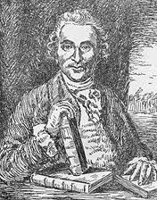
But before then…
Courtesy of the National Library of
Medicine
James Lind (1716-94)
1747: (possibly) first ever controlled medical experiment
Cider | Sea water
Sulphuric acid (!) | Oranges
Vinegar | Barley water
Notes:
~9 years before that, a Scottish surgeon James Lind found a solution.
If you pickle food, it doesn’t go bad…so can we pickle, or, preserve, sailors?
Took twelve sailors, divided them into six pairs, and gave each pair something different: cider, sea water, vitriol (which is a weak solution of sulphuric acid, must’ve been a bad day to be those guys), oranges, vinegar, and barley water.

Slide 4
Oranges (and lemons)…
Courtesy of the National Library of
Medicine
James Lind (1716-94)
1747: (possibly) first ever controlled medical experiment
Cider | Sea water
Sulphuric acid | Oranges
Vinegar | Barley water
And no-one listened…he’s not an English gentleman!
But in 1794 the Admiralty gave it a go…
…and England came out on top!
Notes:
Sailors who were given oranges were back on their feet in just a few days, while the others continued to sicken.
British expeditions that went into the South Pacific and around Africa took lime trees with them.
Many historians believe that one of the key reasons England came out of Napoleonic Wars on top.

Slide 5

Modern medicine
Medical profession eventually realised controlled studies were the right way to go
David Sackett
  Pioneer of “evidence-based medicine”
  Randomised double-blind test is a “gold standard”
Cochrane Collaboration
  http://www.cochrane.org/
  Largest collection of records of randomised controlled trials in the world
Image courtesy of Lab Science Career
Notes:
Randomised double-blind test – no drug/medicine released to market until this happens.

Slide 6

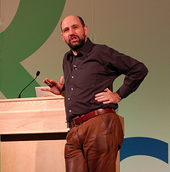
What about software development?
Martin Fowler IEEE Software, July/Aug 2009
“[Using domain specific language] leads to two primary benefits. The first, and simplest, is improved programmer productivity... The second... is... communication with domain experts.”
Image courtesy of adewale_oshineye
Notes:
He wrote the book on refactoring, literally!

Slide 7

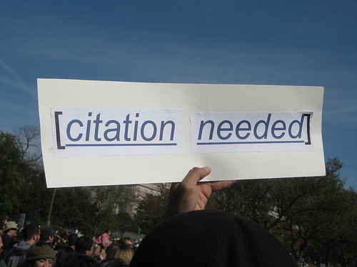
Just one more thing…
Two substantive claims…
…without a single citation!
Where’s the proof!
  The Scottish Verdict!
Image courtesy of whatleydude
Image courtesy of futureatlas.com
Notes:
Perhaps it seems like a good idea – you can express the problem you want to solve in a language that is closer to the area in which you want to express it.

Slide 8


Those are fightin’ words
“Many software researchers advocate rather than investigate” – Robert L. Glass (2002)
+
Notes:
Advocate: RLG, Facts and Fallacies of Software Engineering – “probably true that this is the most contentious fact in this book”.
In software engineering this is par for the course, perhaps with a brief reference to an article from some guy over there who happened to agree.
But it’s not proof.

Slide 9


Times, they are a changin’
Growing emphasis on empirical studies since the mid-1990s
Papers describing new tools or practices routinely include results from some kind of field study
International Conference on Software Engineering
Empirical Software Engineering
“It will never work in theory”
Notes:
A cultural shift.
Studies are hard to do and expensive but, compared to clinical trials, nothing.
Software controls planes, financial transactions, the results of your research! It’s important.

Slide 10
Simply the best?
“Exploratory experimental studies comparing online and offline programming performance”
  Sackman, Erikson and Grant (1968)
“The best programmers are up to 28 times more productive than the worst”
So all we need are a few good people…
1968!
  Designed to compare batch versus interactive
  12 programmers for an afternoon
Notes:
But we still have to beware!
Often expensive to do, many flawed or incomplete, but standards are improving.
Dozens of books quote this.
A few good people…like us!
Was done in 1968 and not designed to measure productivity but batch versus interactive systems!
And just used 12 programmers – bad use of statistics.
Bohen in 1975 claims up to a factor of 5 which is consistent with other disciplines.

Slide 11
So what do we know?
“Some Experience with Automated Aids to the Design of Large-Scale Reliable Software”
  Boehm et al (1975)
Most errors are introduced during requirements analysis and design
The later an error is detected the more costly it is to address
  1 hour to fix in the design
  10 hours to fix in the code
  100 hours to fix after it’s gone live…
number / cost
time
Notes:
Validated by many others.
After it’s gone live when you’ve been hit with a lawsuit!
It’s also more difficult to fix a bug in code you were working on a year ago, than code you were working on last week!

Slide 12
Think before you act…
For every 20% increase in problem complexity, there is a 100% increase in solution complexity
  Woodfield (1979)
The two biggest causes of project failure are poor estimation and unstable requirements
  van Genuchten (1991) and many others
Users often don’t know what they want till you give them something concrete
Notes:
Woodfield was replicated a number of times.
Non-linear because of interaction effects.
Add a few more features, could equal five-fold increase in effort required
If you reduce the problem space i.e. by simplification or assumption, you can significantly reduce the solution required.
Perhaps this is why agile methods work so well.
Likewise agile methods, focusing on prototyping and rapid iterations, help address unstable requirements.
Users often don’t know what they want till they get something they can use.

Slide 13


Why reading is good…
Rigorous inspections can remove 60-90% of errors before first test is run
  Fagan (1975) “Design and Code Inspections to Reduce Errors in Program Development"
The first review and hour matter most
  Cohen (2006) “Best Kept Secrets of Peer Code Review”
Notes:
Fagan – don’t run the code, don’t even test it yet…Read it!
This is one reason why we’ll recommend pair programming.
Cohen’s: footnote…
Having two or more people read the code, or for longer, doesn’t really yield a good enough return to make it worthwhile.
For best value, have one other read through the code for an hour at a time.
After an hour your brain is full and you end up finding only trivial formatting errors.
This is why we’ll recommend developing code in small, reviewable, chunks, regularly adding these to version control so others can see them.

Slide 14

How did you learn to program?
You don’t just go out and write War and Peace
  You’d read other skilled writers first
You don’t just go out and write a foreign language
  You learn to read it first
Teach maintenance first
  Harlan Mills (1990)
“The best way to prepare [to be a programmer] is to write programs and to study great programs that other people have written” Susan Lammers, 1986, quoting a younger Bill Gates
Image courtesy of dwyman
Notes:
Quentin Tarantino made Reservoir Dogs…after watching De Palma, Leone, Scorsese, Hawks.
See how its done well (and badly) and learn, then write it yourself.
Foreign programming languages!
In more mature subjects they teach reading before writing.
SEI (Carnegie Mellon) tried to collect examples of code to read, gave up. Software engineers cannot decide on what is easy to read.

Slide 15
Errors of a feather…
Half the errors are found in 15% of the modules
  Davis (1995) quoting Endres (1975)
About 80% of the defects come from 20% of the modules, and about half the modules are error free
  Boehm and Basili (2001)
When you identify more errors than expected in some program module, keep looking!
Notes:
Errors cluster and we’ve known this since 1975!

Slide 16

Aim high…
  Number of lines … a programmer can write in a fixed period of time is the same independent of the language used
    Corbato’s law
  Productivity and reliability depend on length of program’s text independent of language abstraction level
    Lutz Prechelt
  Use the highest-level language you can
    Trade off performance
Notes:
Consider a 5% productivity improvement in a typical programmer. Apply that to a £300 billion industry…
People have difficulty managing details – longer program, more details, more complex!
Higher-level languages are typically slower so profile and optimise when it works.

Slide 17

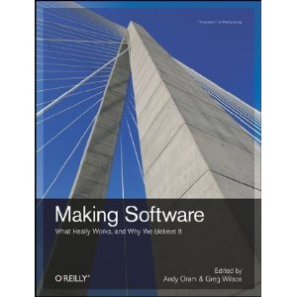
And there’s many more…!
http://software-carpentry.org/4_0/softeng/ebse
Notes:
Based on empirical results and qualitative studies.
Not just hearsay, “common sense” or “what we’ve always done”.

Slide 18
So…
Shouldn’t our development practices be built around these, and other, facts?
+
Notes:
…rather than what Fred the Linux guru said in the pub because it worked for him one time.

Slide 19
One other thing we know…
Software developers and researchers differ!
Saying “this is good because software developers say it is good” is not good enough!
We say “this is good because it helps your research”
  Good software development practices contribute to good research
…which we hope we’ve demonstrated…
Notes:
Differ in nature of job, outputs (software versus papers, release and users versus peer review) and recognition.
Though we are advocating the recognition of software and data as first-class research outputs in their own right.

Slide 20
Shell
Reduce errors by re-using tried-and-tested components
String together components into powerful computational and data processing pipelines
Avoid re-inventing the wheel and free up time to do research

Slide 21
Make
Automate repetitive tasks
Reduce errors
Document how your software is built…
…or how your analyses are run
Free up time to do research

Slide 22
Version control
Record the provenance of your code, documents or configuration files
Track which version of your software produced the data you used in a paper, presentation, poster or thesis
Back up your work
Productively collaborate
Notes:
Version control gives you who changed what and when.
Remember that you need to provide the why!

Slide 23
Python
Make it easier for colleagues to spot bugs in your code
Help others to validate what you did by peer review
Help others replicate or reproduce what you did
Encourage others to reuse what you did
Reduce your “truck factor”
Notes:
Modular code.
Meaningful names.
Indentation.

Slide 24
Unit testing
Ensure that your algorithms, implementation and data are correct and so that your research is correct
Make changes without introducing bugs
Fix bugs without introducing bugs
Remember Geoffrey Chang!

Slide 25
Iteration and release
Continuous integration
Version control
Red
Green
Refactor
Test-driven development
Pair programming
and/or
code
reviews
Notes:
Pair programming. Driver and navigator. Swop after an hour. Peer review. Share ideas and expertise. Share knowledge of code. Collective ownership. Induct new team members. Less Facebook-ing!.
Code reviews. Share ideas and expertise. Fagan and Cohen.
TDD. Red (fail). Green (pass). Refactor (clean). Focus on what code should do rather than what it does. Code always tested. Promotes working in small steps.
Version control. Provenance. Commit small, complete units of work, ideally a reviewable unit.
Continuous integration (CI). Checkout/build/test/publish. Fail-fast. Name and shame. Always runnable. Always releasable. On which note…
Release early, release often – so long as it’s built and tested cf. MPA. Users often don’t know what they want until they have something they can use. A tool can change how users do their work. Short iterations avoid spending too much time building what turns out to be the wrong thing. Well-suited to research software. Requires less coordination as people can track what they do for a few days themselves. Easier to find bugs – 2 weeks worth of code, not 2 months or 2 years worth. Always have something that is working, tested and ready for release. MAUS and bi-monthly releases.
Concentric circles focusing on continuous feedback, collaborative working and small development cycles. Agile development methods, frequent feedback for developer and customer. Not an excuse for cowboy coding, or no process. Even if you are a solo these still benefit you!

Slide 26
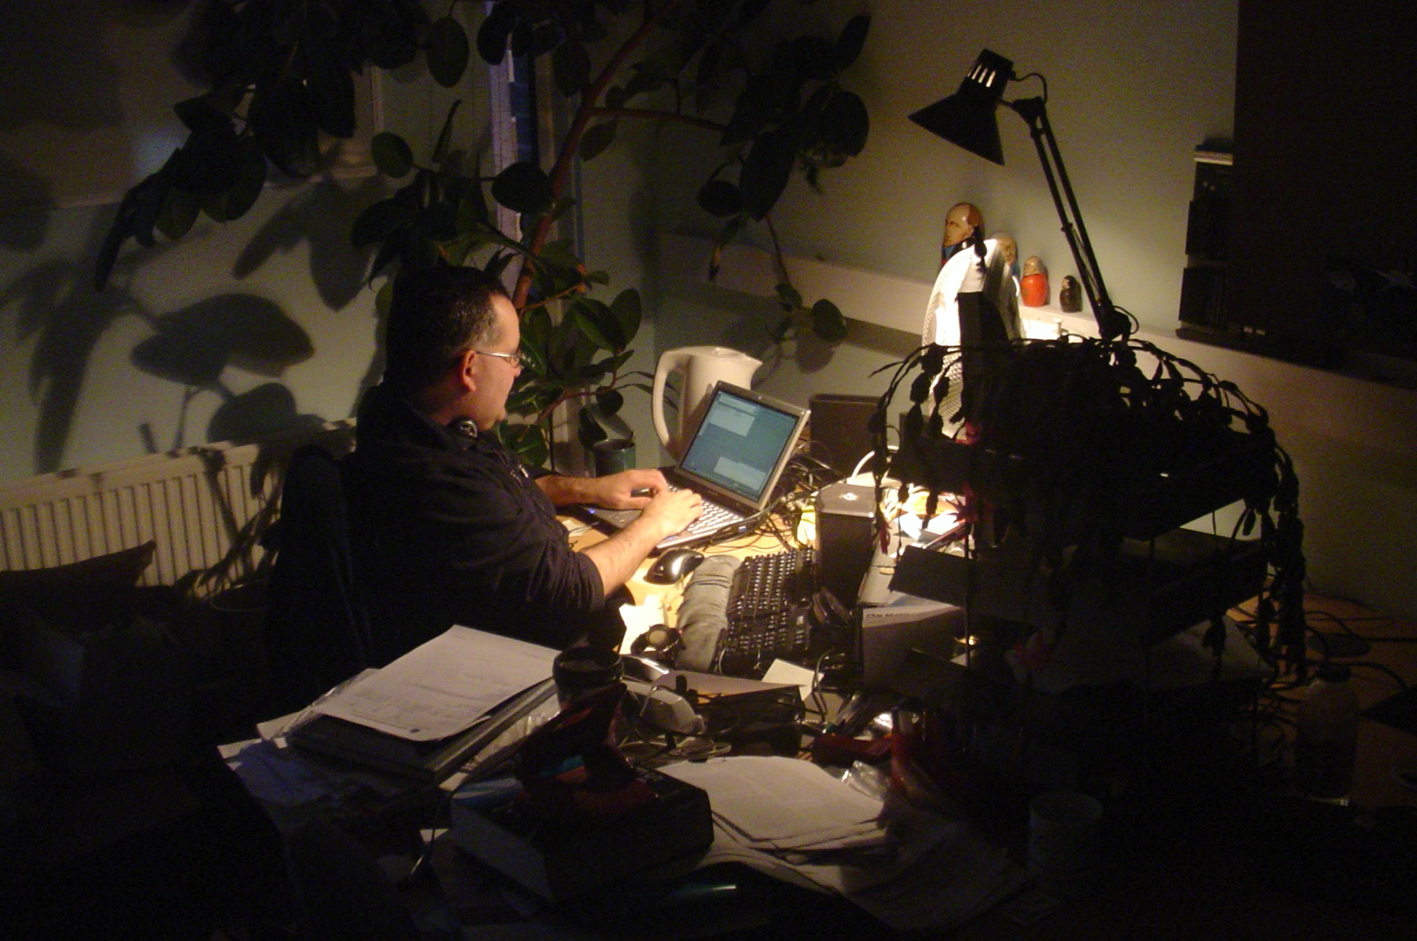
All work and no play…
“Why Crunch Modes Doesn't Work: Six Lessons”, Evan Robinson
  Continuous work reduces cognitive function 25% for every 24 hours!
  Our greatest productivity occurs in the first four to six hours
Notes:
Take regular breaks away from the screen. Go for a walk. Avoid RSI!
And, on that note…

Slide 27
Iterative development does not just apply to software!
What were the good and bad points about this boot camp?
http://www.surveymonkey.com/s/DD9HJNX
Notes:
Just ask Ridley Scott after he releases Blade Runner version 4 or Prometheus version 2!
Get a helper to scribe.
Go round each attendee in turn – one suggests a good point, the next a bad point etc.

