Slide 1

MATLAB Programming
Introduction
Copyright © Software Carpentry 2011
This work is licensed under the Creative Commons Attribution License
See http://software-carpentry.org/license.html for more information.
Notes:
Hello, and welcome to the Software Carpentry series on MATLAB programming. This is the first episode in the series, and we will briefly tour the world of MATLAB.

Slide 2
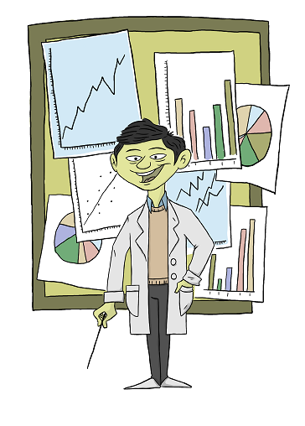
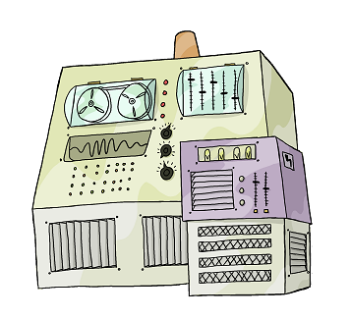
Good scientific software:
For whom is software written?
Notes:
We start by making a few observations on what scientific software *should* look like.
Probably the most important aspect of good software is that it is written for humans rather than machines.

Slide 3
Good scientific software:
For whom is software written?
Notes:
Humans are the ones who have to understand, critique, and debug software, and your task as a programmer is to make it easier on your fellow programmers.

Slide 4
Good scientific software:
For whom is software written?
1) Human readable
Notes:
Software written for humans is, first of all, written in a readable format. The structure and purpose of code should be obvious.

Slide 5
Good scientific software:
For whom is software written?
1) Human readable
2) Emphasizes domain and problem specific computation.
Notes:
Software written for humans emphasizes what is important. Usually, we write code to solve particular problems in particular domains. Good code should emphasize those domains rather than the low level algorithms that are utilized.

Slide 6
Good scientific software:
For whom is software written?
1) Human readable
2) Emphasizes domain and problem specific computation.
3) Testable
Notes:
Good code should always be testable, which means that its purpose must be clear enough that tests can be written.

Slide 7
Good scientific software:
For whom is software written?
1) Human readable
2) Emphasizes domain and problem specific computation.
3) Testable
… and then …
4) Efficient
Notes:
Finally, good code should be efficient. We will see how MATLAB provides efficiency without sacrificing readability and testability.

Slide 8
Bad scientific software:
1) Emphasizes efficiency over readability
2) Emphasizes efficiency over testability
3) Reinvents the wheel
4) Couples domain specific knowledge with underlying mathematical routines.
Fast, wrong code gets you the wrong answer… faster.
Notes:
Contrast good code with bad code. Bad code is hard for humans to read. It emphasizes small efficiency gains over human readability and testability.
Often, it re-implements functions that have already been written and tested by someone else. Also, it can be hard to find the domain specific algorithm among all of the low level, secondary routines.

Slide 9
MATLAB is a …
… programming language…
… and a programming environment.
Encourages
Reuse of tested, efficient mathematical routines
High level representation of programs
Mathematical expression over details of algorithms.
Notes:
MATLAB is a tool to help scientists write good, efficient programs, and write them quickly. It provides a wide array of efficient mathematical routines that have been tested by someone else. Also, it provides a high level programming language that helps programmers express their work as mathematical ideas rather than programming details.

Slide 10
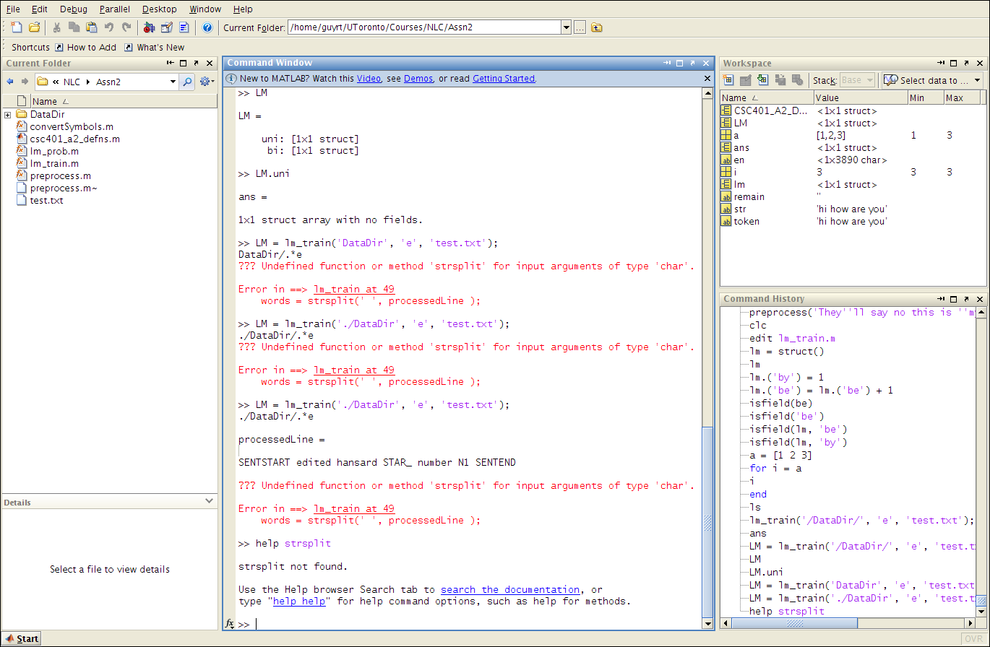
MATLAB the environment
Notes:
On most systems, MATLAB opens a graphical environment like this one.

Slide 11
MATLAB the environment
Notes:
It includes a list of all variables that have been created.

Slide 12
MATLAB the environment
Notes:
The center of the window is a command line where we can create and manipulate variables.

Slide 13
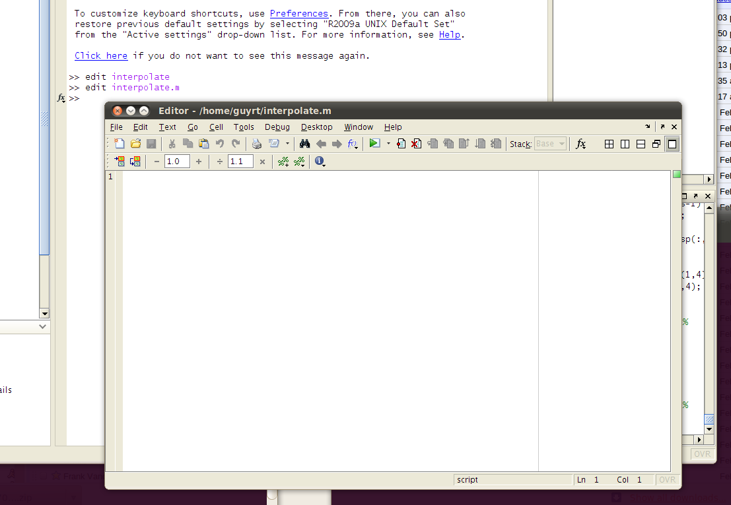
MATLAB the environment
Notes:
Most programs are written in the editor, which provides a way to create functions that can be called from other functions or from the MATLAB command line. We will cover programs in two lectures on flow control.

Slide 14
MATLAB as a programming language:
Arrays
>> nums = [1,2,3]
>> nums = nums + 4;
For loops
>> for i = nums:
>> isprime(i);
Notes:
The MATLAB programming language is built around the multi-dimensional floating point array. We will cover floating point arrays in the lectures on programming basics, array indexing, and linear algebra. Typical flow control structures like for loops, while loops, and if statements are available and are introduced in the lectures on flow control.

Slide 15
Key idea: Data parallel programming
The programmer works at level of mathematical ideas…
… not loops and indices.
Most operators work on arrays directly.
Common theme: you probably* don’t want to use a loop
* (exceptions apply)
Notes:
Throughout this lecture series, we will return to the idea of data parallel programming. In data parallel programs, the programmer is encouraged to think at a high level of abstraction. Implementing algorithms, which typically takes a lot of loops and indices, is handled by the programming language. This means that code is easier to write and debug, and typically, data parallel programs are much faster.

Slide 16
Example:
>> for i = 1:length(arr)
>> arr(i) = arr(i) * 100;
>> end
Or…
>> arr = arr * 100;
Notes:
This simple example demonstrates the difference between a typical program that emphasizes loops and a data parallel implementation of the same thing. The data parallel approach places more emphasis on the objective of the operation than on the implementation of the objective. We will see numerous examples of how data parallel thinking can simplify and speed up your code.

Slide 17
Why learn MATLAB?
Rapid prototyping
Scales well to large, production problems.
Thousands of mathematical routines
Tested
Efficient
Common language in many fields
Notes:
So why learn MATLAB?
Over the last 20 years, MATLAB has become one of the most common languages in the scientific programming community. Its wide range of built in functions allows rapid prototyping and it scales well to large, production platforms. Perhaps its biggest strength is the support community, which has provided algorithms based on recent publications across many fields.

Slide 18
created by
Richard T. Guy
February 2011
Copyright © Software Carpentry 2011
This work is licensed under the Creative Commons Attribution License
See http://software-carpentry.org/license.html for more information.
Notes:
In our next episode, we will start to examine the basic data type in MATLAB, which is a multi-dimensional array of double precision numbers.

