Slide 1

MATLAB Programming
Invasion Percolation 2
Copyright © Software Carpentry 2011
This work is licensed under the Creative Commons Attribution License
See http://software-carpentry.org/license.html for more information.
Notes:
Hello, and welcome to another episode of the Software Carpentry lecture on MATLAB programming.

Slide 2

Example: Invasion-percolation through fractured rock.
Let’s make a first pass.
Notes:
This is part two of a set of episodes on program design in Matlab. In the last episode, we introduced an example problem of invasion percolation through a fractured or porous rock.

Slide 3
Pseudo-code:
while (the percolation has not reached an edge)
candidates = all cells adjacent to filled cells
min_value = minimum value in candidate cells
min_candidates = candidate cells with min_value
cell = randomly chosen element of min-candidates
cell.value = FILLED
end while
Notes:
A simple invasion percolation simulation identifies the cells that are adjacent to previously filled cells, selects the cell with the minimum value, breaking ties randomly, then fills the cell.

Slide 4
Before we start writing code:
How can we test that our algorithm is correct?
How can we test that changes the algorithm don’t change the answer?
Write tests, then write program.
Notes:
Instead of starting to write code immediately, let’s back up a step and ask ourselves how we would know that our simulation is correct. What tests should we write?

Slide 5
Three tests:
1) Simple example with human-calculable results.
2) Slightly more complex example with known statistical patterns.
3) Repeatable, “real world” data.
Notes:
In this example, we will suggest three types of tests. The first is a simple set of examples with a single correct answer. These can be checked against the known answer to ensure that our program is not making any obvious mistakes. Second, we will create tests that require the simulator to break ties randomly. The question here will be whether the ties are broken correctly, and we will have to look at the statistics of the output.
Finally, we will introduce tests on “real world” data that is as close as possible to the kinds of grid values that one would actually experience. The key feature here is that the data can be recreated with exactly the same values.

Slide 6
Test 1: Simple example.
Remove randomness by providing a clear path to the correct answer.
What is another good test?
2 | 2 | 1 | 2 | 2 | 2 | 2
2 | 2 | 1 | 1 | 2 | 2 | 2
2 | 2 | 2 | 1 | 2 | 2 | 2
2 | 2 | 2 | 1 | 2 | 2 | 2
2 | 2 | 2 | 2 | 2 | 2 | 2
2 | 2 | 2 | 2 | 2 | 2 | 2
2 | 2 | 2 | 2 | 2 | 2 | 2
Notes:
The first test creates a channel of minimum values that forces the solution in to one known value. Try to think of other tests like this one that might be good additions.

Slide 7
Test 2: Statistically understandable example
Include requirement of choosing path at random, but in a way humans can understand.
Should choose either path at random.
2 | 2 | 1 | 2 | 2 | 2 | 2
2 | 2 | 1 | 1 | 2 | 2 | 2
2 | 2 | 2 | 1 | 2 | 2 | 2
2 | 2 | 2 | 1 | 2 | 2 | 2
2 | 2 | 2 | 1 | 2 | 2 | 2
2 | 2 | 2 | 1 | 1 | 2 | 2
2 | 2 | 2 | 2 | 1 | 2 | 2
Notes:
Our second test creates two channels to the edge that are the same length. If the simulation is running correctly, then approximately one half of all simulations will end by filling a square on the top of the grid, and approximately one half will fill cells on the bottom.

Slide 8
What does failure look like?
If we run 100 tests and get 52 simulations that end up on top and 48 on bottom, is this a failure?
If we run 1e6 simulations and get 52% end up on top and 48% end up on bottom, is this a failure?
Test for a statistically significant deviation from Binomial distribution (p = 0.50)
Notes:
A key question when we use a stastistical test is was does failure look like. For instance, if we run this test 100 times, we expect almost 50% of the trials to end on the top of the grid, but we won’t get exactly 50% for every 100 tests. The correct test will compare the observed number of trials that end on the top of the grid for agreement with a binomial distribution using a chi-squared test.

Slide 9
Test 3) “Real world” Test data:
function grid = make_grid(size, maxNumber, seed)
if nargin < 2
maxNumber = 10;
elseif nargin == 3
rand('seed',seed)
elseif nargin > 3
error('Usage: make_grid(size, maxNumber)');
end
Notes:
Finally, we will design a function to give us repeatable test data. The full function can be found at software-carpentry.org.

Slide 10
Test 3) “Real world” Test data:
function grid = make_grid(size, maxNumber, seed)
if nargin < 2
maxNumber = 10;
elseif nargin == 3
rand('seed',seed)
elseif nargin > 3
error('Usage: make_grid(size, maxNumber)');
end
Notes:
Since we are using the random generator to create test data, we need to be sure to include a way to create the exact same grid again in the future. This function lets the caller provide a seed for the random number generator. Given a seed, the random number generator will produce a unique, repeatable set of output.

Slide 11
Test 3) “Real world” Test data:
function grid = make_grid(size, maxNumber, seed)
(… run tests …)
if length(size) < 2
error('Size should be a vector of form [X Y]')
end
grid = floor(rand(size) * (maxNumber - 1)) + 1;
Notes:
The actual work in this function can be performed in one line, where we create a grid of random integers between 1 and and ceiling.

Slide 12
Pseudo-code:
while (the percolation has not reached an edge)
candidates = all cells adjacent to filled cells
min_value = minimum value in candidate cells
min_candidates = candidate cells with min_value
cell = a randomly chosen element of min_candidates
cell.value = FILLED
end while
Notes:
Now that we have written three test examples, it is time to write the actual program.

Slide 13
function [grid, num_filled] = invperc_simple(grid)
FILLED = -1; % Used to denote a filled element.
[sI, sJ] = size(grid);
grid( floor(sI/2) + 1 , floor(sJ/2) + 1 ) = FILLED;
num_filled = 1;
Notes:
As always, this function will be available on the website.

Slide 14
function [grid, num_filled] = invperc_simple(grid)
… setup …
while 1
… choose a candidate …
… fill candidate …
… Check stop conditions …
end
Notes:
If we examine the skeleton of the program, the most difficult step is to choose a candidate cell to fill.

Slide 15
function [grid, num_filled] = invperc_simple(grid)
… setup …
while 1
candidates = find_candidates_slow(grid,FILLED);
if isempty(candidates)
error('No fillable candidates found!');
end
… fill candidate …
… Check stop conditions …
end
Notes:
We have abstracted that part of the problem into another function.

Slide 16
function [grid, num_filled] = invperc_simple(grid)
… setup …
while 1
… choose a candidate …
row_index = floor(1+(rand()*size(candidates,1) ));
grid_index = candidates(row_index,:);
grid(grid_index(1), grid_index(2)) = FILLED;
num_filled = num_filled + 1;
… check stop conditions …
end
Notes:
Once the candidate cells are identified, we choose one at random, set the value to a special constant called FILLED…

Slide 17
function [grid, num_filled] = invperc_simple(grid)
… setup …
while 1
… choose a candidate …
… fill candidate slot …
if grid_index(1) == 1 || grid_index(1) == sI ...
|| grid_index(2) == 1 || grid_index(2) == sJ
break;
end
end
Notes:
And finally compute stopping conditions.

Slide 18
If a function is a “helper” for a function and does not stand alone, add it in the same file.
function [grid, num_filled] = invperc_simple(grid)
… do stuff …
end % function
function min_indices = find_candidates_slow(grid, filled)
… do stuff …
end % function
Notes:
Find_candidates_slow is the function we use to find candidate cells to be filled, and we can put it in the same file as invperc_simple because it is not designed to be called from anywhere but inside the invperc_simple function. In general, if a function should be globally available, it belongs in its own file.

Slide 19
function min_indices = find_candidates_slow(grid, filled)
[sI, sJ] = size(grid);
local_min = inf;
min_indices = [];
for i=1:sI
for j = 1:sJ
… Examine cell …
end
end
end % function
Notes:
The function takes the most naïve approach possible. Every time it is called, it goes through every cell in the entire array and examines whether any of its neighbors are filled cells.

Slide 20
function min_indices = find_candidates_slow(grid, filled)
… start up …
for i=1:sI
for j = 1:sJ
if grid(i,j) == filled
continue
end
… Check if cell borders filled cell …
end
end
end % function
Notes:
If the cell has already been filled, it is not a candidate.

Slide 21
function min_indices = find_candidates_slow(grid, filled)
… start up …
for i=1:sI
for j = 1:sJ
… Check if cell filled …
# If cell borders a filled cell…
if ((i > 1 && grid(i-1,j) == filled) || (i < sI && grid(i+1,j) == filled ) ...
|| (j > 1 && grid(i,j-1) == filled) ||
(j < sJ && grid(i,j+1) == filled ) )
... See if value is minimum …
end
end
end
end % function
Notes:
We also have to check whether the cell borders a filled cell.
This if statement looks confusing, but it is actually very repetitive. It checks whether i and j are in the correct range and whether the cell to left and right or top and bottom is filled, respectively. It might help if you take a real example and a real i and j and see why this statement is true only if cell i,j borders a filled cell.

Slide 22
function min_indices = find_candidates_slow(grid, filled)
… start up …
for i=1:sI
for j = 1:sJ
… Check if cell filled …
if “cell i,j borders a filled cell”
if grid(i,j) < local_min
local_min = grid(i,j);
min_indices = [i j];
elseif grid(i,j) == local_min
min_indices = [min_indices ; [i j]];
end
end
end
end
end % function
Notes:
If cell i,j does border a filled cell and its value is a new local min, then we update the minimum to hold just this grid location. If it equals the current minimum grid value then we add it to the list of available grid locations so that later we can choose one at random.

Slide 23
Testing is left as an exercise
AFTER it works correctly, the next question is can it be faster?
Notes:
That is all there is to the simple invasion percolation simulator. As an exercise, download the file from the website and verify that it passes the tests that we described.

Slide 24
Do we even need to optimize?
Optimization is not always a good idea…
… it might not make a huge difference …
… it often reduces the programs generality…
… and it might introduce bugs …
Notes:
Now that we are pretty confident the program we wrote is correct, it is time to ask whether it needs to be optimized. Note that the first question isn’t how to optimize the function, it is whether we should at all. Optimization can greatly improve performance sometimes, but it might not always make a meaningful difference. Also, it optimization might rely on problem specific knowledge that reduces the program’s generalizability, and it can always break correct code by introducing bugs.

Slide 25
Where did the time go?
>> profile on
>> invperc_simple(grid);
>> profile off
>> profile viewer
Notes:
The profiler is a tool to examine how long each function takes to run. When you turn the profiler on, it measures how long each function takes to complete. It also measures how much of the time was spent in sub-functions.

Slide 26
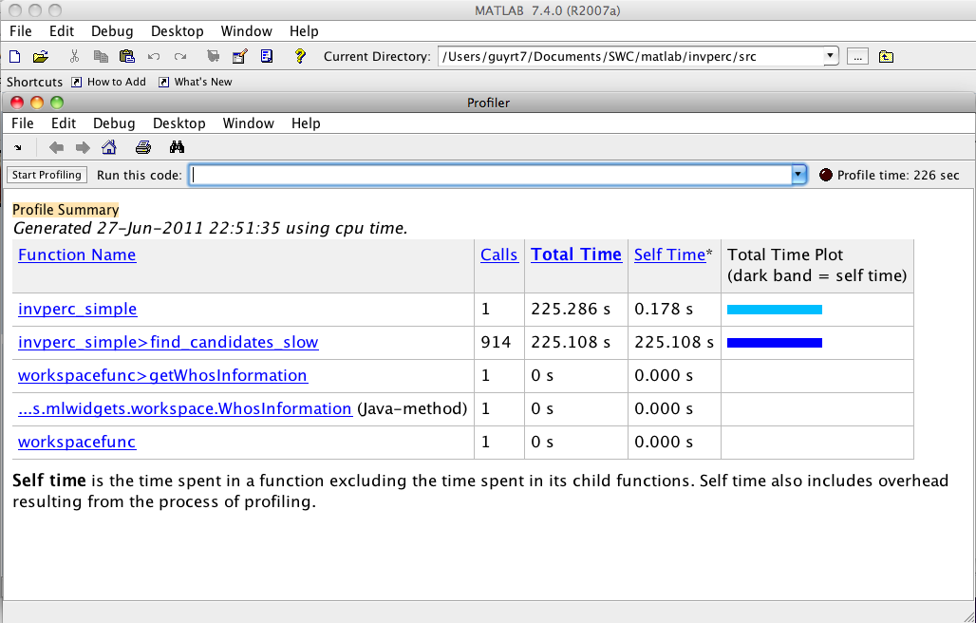
Where did the time go?
Notes:
In this case, the profiler told us that it takes 225.286 seconds to run the top level function, invperc_simple.

Slide 27
Where did the time go?
Notes:
Of that time, almost all of it was spend in the sub-function find_candidates slow.

Slide 28
Fix the subfunction, because that is where the time is spent…
See the source code on the website for a replacement inner function that uses the find operation.
Notes:
This gives us a key piece of information: we know that if we focus our efforts on the find_candidates_slow function then we have the greatest chance of lowering overall runtime.
We wrote an updated function that uses vector operations and the built in find function to improve the efficiency of the find_candidates function without changing the actual algorithm.

Slide 29
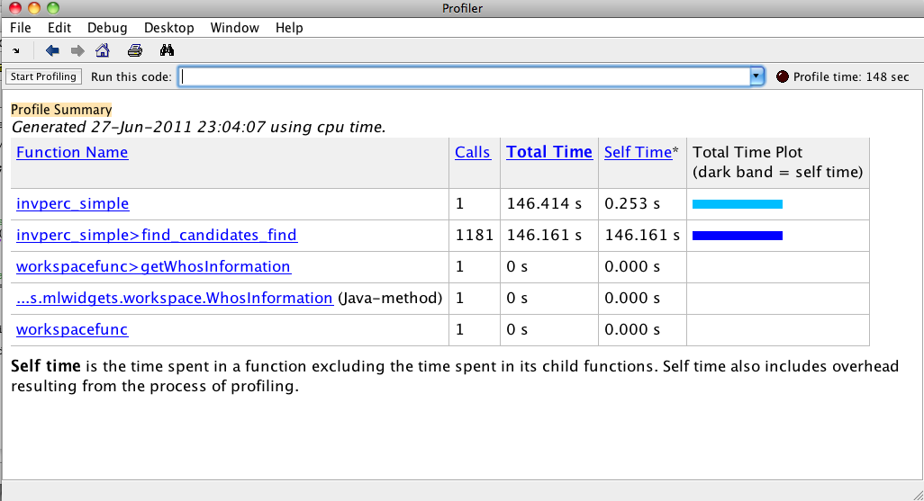
Notes:
Simple fixing the inner function helped our algorithm a lot. The inner loop required over a thousand function calls, but it still ran in half the time of the earlier version. As we’ve mentioned in other episodes, the first rule to efficient Matlab programming is to always use built-in functions where possible.

Slide 30
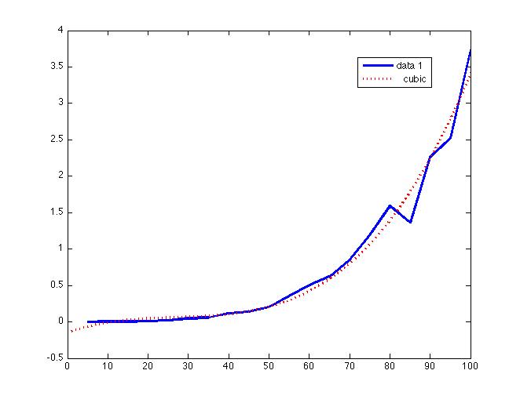
A dangerous pattern still exists…
Runtime (sec)
Problem Size
Notes:
If we run several problem sizes, we notice a much more troubling pattern. It looks like the time it takes to complete a problem fits a cubic curve. This means that if we double the size of the problem, it will take 8 times longer to solve.

Slide 31
Pseudo-code:
while (the percolation has not reached an edge)
candidates = all cells adjacent to filled cells
min_value = minimum value in candidate cells
min_candidates = candidate cells with min_value
chosen = a randomly chosen element of candidates.
chosen.value = FILLED
end while
Takes at least n/2 iterations and as many as n^2 iterations for an nxn grid.
Notes:
Let’s re-examine our pseudo-code to try to understand why the runtime increases so quickly. The outer while loop will run until the simulation reaches an edge, which takes anywhere from n/2 to n^2 operations.

Slide 32
Pseudo-code:
while (the percolation has not reached an edge)
candidates = all cells adjacent to filled cells
min_value = minimum value in candidate cells
min_candidates = candidate cells with min_value
chosen = a randomly chosen element of candidates.
chosen.value = FILLED
end while
Takes n^2 iterations as we wrote it.
Takes at least n/2 iterations and as many as n^2 iterations for an nxn grid.
Notes:
The way we wrote out find_candidates functions, they loop through every element in the grid to identify cells that are adjacent to filled cells. For an n by n grid, this step takes another n^2 operations.

Slide 33
Pseudo-code:
while (the percolation has not reached an edge)
candidates = all cells adjacent to filled cells
min_value = minimum value in candidate cells
min_candidates = candidate cells with min_value
chosen = a randomly chosen element of candidates.
chosen.value = FILLED
end while
This algorithm takes at least n^3 steps for
an n X n grid!
Try to estimate how long it will take if n = 1000!
Takes n^2 iterations as we wrote it.
Takes at least n/2 iterations for an nxn grid.
Notes:
That means the program takes between n^3 and n^4 operations on an n by n grid. Clearly, if we want to run the simulator on a large problem, we have to lower the runtime.

Slide 34
Next episode:
Do we really need to look at every element in every loop iteration?
It turns out you can do much better by thinking harder about our data structures.
Try to find a solution before you watch the next episode!
Notes:
In the next episode, we will re-examine the find_candidates function and ask whether we need to examine every cell in every iteration of the algorithm. If you can, try to think of a better way to perform the find_candidates operation to lower our total runtime.

Slide 35
To review:
Sometimes it is best to write test cases then write your code…
Once your code is correct, use the profiler to identify the speed bottlenecks…
Rerun your tests after you make any changes.
Notes:
As a review, we wrote test cases before writing code, so we can be sure that aspects of the program run correctly as we write them. Once we’ve got correct code, it’s important to use the profiler to identify speed bottlenecks. As we try to correct slowdowns, we can rerun our tests to ensure that our updates do not break the simulation.

Slide 36
created by
Richard T. Guy
February 2011
Copyright © Software Carpentry 2011
This work is licensed under the Creative Commons Attribution License
See http://software-carpentry.org/license.html for more information.
Notes:
Thanks for watching!

