Slide 1

MATLAB Programming
Basic File Input and Output
Copyright © Software Carpentry 2011
This work is licensed under the Creative Commons Attribution License
See http://software-carpentry.org/license.html for more information.
Notes:
Hello, and welcome to another episode of the Software Carpentry lecture on MATLAB programming. In this episode, we'll have a look at file input and output.

Slide 2
Scientists use (a lot of) data
Images ( matrix )
Sound files ( array or matrix)
Video ( 3 dimension matrix )
Instrument output ( time series )
Spreadsheets ( set of matrices )
…
MATLAB can read all of these… and more.
Notes:
Scientists use a lot of data, and it takes many forms. Almost all of the data that we use can be interpreted as an array, and MATLAB has the tools to convert many common data formats into array structures.

Slide 3
Data import and output:
Input and convert to data structure
Print output to the screen
Write arrays in a suitable file format.
Notes:
In this lecture, we investigate MATLAB’s data input and output mechanisms. We cover three topics…
First, we look at a few functions that open files and translate their file format to a MATLAB data structure.
We also investigate functions to print formatted output to the screen.
Last, we investigate functions to write arrays and other data structures in common file formats.

Slide 4
Two ways to import data:
Using the graphical interface
Notes:
Importing data can be done in two ways. The easiest is to use the graphical interface directly.

Slide 5
Two ways to import data:
Using the graphical interface
Easiest to learn
MATLAB figures out what kind of file you have
Notes:
The graphical interface is easiest for quickly loading a single file, but it isn’t really feasible if you have to load a lot of files.

Slide 6
Two ways to import data:
Using the graphical interface
Easiest to learn
MATLAB figures out what kind of file you have
Using the command line
Notes:
The alternative is to call import functions directly…

Slide 7
Two ways to import data:
Using the graphical interface
Easiest to learn
MATLAB figures out what kind of file you have
Using the command line
Can be automated
Supports many more formats
Notes:
Command line functions can be automated in scripts and functions.
Usually, MATLAB can figure out what to do with a file based on its format, but if it is unclear how to interpret your file, you can provide hints to the import functions when you use the command line.

Slide 8
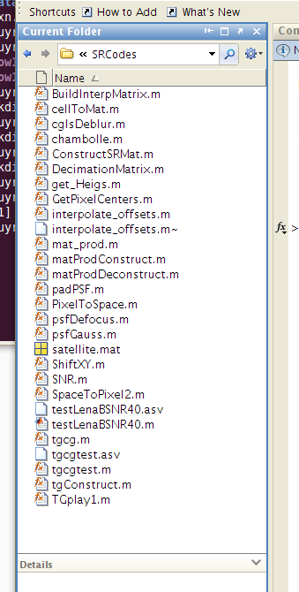
Notes:
The graphical interface has a box that displays the contents of the working directory.

Slide 9
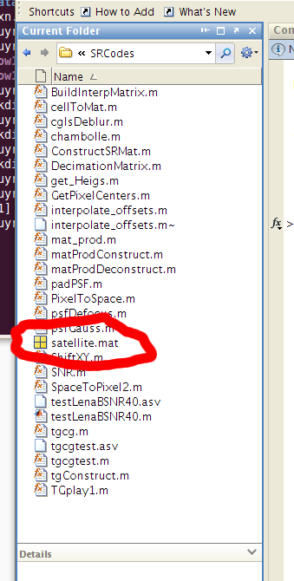
Notes:
One of the files in this folder is named satellite.mat.

Slide 10
.mat file:
MATLAB’s prefered format.
Binary, which saves space.
Designed to store multiple variables.
Notes:
Files with the “dot mat” extension are MATLAB storage files that store data in a binary format. Since they are designed for use in MATLAB, MAT files can store multiple variables, which makes it easy to save an entire work session in one file.

Slide 11
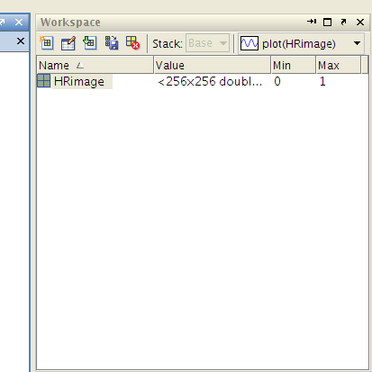
Double click
Notes:
Double clicking on the satellite.mat imports all of the variables into the workspace. In this case, there was only one variable called HRImage. When variables are stored in a .mat file, they keep their original names. Be careful about opening multiple files that contain variables with the same names, as this can overwrite old data.

Slide 12
Text data: comma or space separated
My file: tweets.txt
Latitude longitude tweet_density
43.650332 -79.389013 0.000739
43.669778 -79.38267 0.00273
43.648943 -79.391319 0.003818
Notes:
Here is an example of a common file format. Each row of this file contains three numbers separated by a space. Text files are not the most efficient way to store data, but they are nice because humans can quickly check what is in the file.

Slide 13
Load data into MATLAB:
>> data = importdata(‘tweets.txt’);
Notes:
There are several commands that can handle data from text files, but the most flexible is the command importdata…

Slide 14
Load data into MATLAB:
>> data = importdata(‘tweets.txt’);
importdata is a ‘wrapper function.’
Identifies the format of the file
Is it text, image, MAT file format, spreadsheet, sound, XML, … ?
Find the correct function to load the file.
Optional arguments can help figure this out.
Notes:
Importdata is a wrapper function, which means its job is to figure out what format the file is using and identify the correct function to read the data.
Sometimes, importdata may have trouble identifying the correct format of a file. This is especially true if the file uses an unexpected column delimiter or has multiple header lines. Type “help importdata” to see more information about the optional arguments.

Slide 15





importdata(file, options)
load(…)
xmlread(…)
…
imread(…)
Notes:
Wrapper functions help hide internal details from the end user. In this case, importdata will call a function like load, xmlread, or imread depending on the file. Users do not have to remember which function to use in every situation.

Slide 16
>> in = importdata(‘tweets.txt’);
>> in
in =
data: [40000x3 double]
textdata: {'Lat' ' Lng' ' Weight'}
colheaders: {'Lat' ' Lng' ' Weight'}
Notes:
Importdata returns the input as a structure. If you haven’t done so already, it would be a good idea to look at the software carpentry episode on MATLAB data structures, including the episode on cell arrays.

Slide 17
>> in = importdata(‘tweets.txt’);
>> in
in =
data: [40000x3 double]
textdata: {'Lat' ' Lng' ' Weight'}
colheaders: {'Lat' ' Lng' ' Weight'}
Notes:
When we inspect the elements of the structure, we see that the file’s information was broken into a large, 3 column matrix called data…

Slide 18
>> in = importdata(‘tweets.txt’);
>> in
in =
data: [40000x3 double]
textdata: {'Lat' ' Lng' ' Weight'}
colheaders: {'Lat' ' Lng' ' Weight'}
Notes:
… a cell array of strings called colheaders that are the column headers for each column in our matrix…

Slide 19
>> in = importdata(‘tweets.txt’);
>> in
in =
data: [40000x3 double]
textdata: {'Lat' ' Lng' ' Weight'}
colheaders: {'Lat' ' Lng' ' Weight'}
Notes:
… and a third item called textdata that contains a copy of the column headers. If we had more lines of text at the start of our file, these would have been stored in a nested cell array in textdata.

Slide 20
MATLAB can also read things like spreadsheets:
>> in = importdata(‘mydata.xls’);
>> in
in =
Sheet1 = [6 x 2 double]
Sheet2 = [13 x 1 double]
Notes:
The structure’s format depends on the type of file that is imported. For instance, we can read this spreadsheet using the same importdata function.

Slide 21
MATLAB can also read things like spreadsheets:
>> in = importdata(‘mydata.xls’);
>> in
in =
Sheet1 = [6 x 2 double]
Sheet2 = [13 x 1 double]
Each sheet is a member of the structure
Notes:
The result is a structure, and each element of the structure is a sheet in the spreadsheet.

Slide 22
Exporting results:
Visualization
Printing to screen
Exporting to a file
Notes:
The other half of file IO is retrieving results from MATLAB. There are multiple ways to save data. We can save a plot or image of our data, we can save printed output such as a series of commands and their results, or we can export variables to a file.

Slide 23
Exporting results:
Visualization
Printing to screen
Exporting to a file
Special episode on graphing and images
Notes:
Visualization is a large topic that deserves its own episode…

Slide 24
created by
Richard T. Guy
February 2011
Copyright © Software Carpentry 2011
This work is licensed under the Creative Commons Attribution License
See http://software-carpentry.org/license.html for more information.

