Slide 1

MATLAB Programming
Visualization
Copyright © Software Carpentry 2011
This work is licensed under the Creative Commons Attribution License
See http://software-carpentry.org/license.html for more information.
Notes:
Hello, and welcome to another episode of the Software Carpentry lecture on MATLAB programming. In this episode, we will examine visualization techniques using the functions plot and imshow.

Slide 2
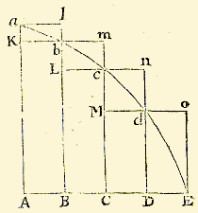
Good science requires good visualizations.
Notes:
Visualization has always played a big role in understanding our data and ideas. This image, from Isaac Newton, demonstrates the ideas that led to the integral.
In order to clearly express our findings, scientists need to be able to create interesting and relevant images.

Slide 3
Why use MATLAB for plots?
Produces publication quality plots and images
Coupled with computation program.
Proper visualization might take exploration.
Notes:
An advantage that plotting with MATLAB provides is that the plots are created directly from the program used to perform calculations. As we will see in this lecture, producing informative plots might require that we transform our data, which is easily done from within MATLAB.

Slide 4
Simplest plot is a line plot:
>> plot(M)
Plot each column of M as a separate line.
Notes:
MATLAB contains several plotting functions that are highly customizable.
The simplest plot function is the function plot, which will create a line graph with one data set for each column of M.

Slide 5
Sample data sets:
dow.txt : Daily closing value of Dow Jones Industrial Average, an index of the price of 30 stocks on the New York Sock Exchange
sp.txt : Daily closing value of the Standard and Poors 500, a broader index containing 500 stocks.
Notes:
In this example, we will use two data sets that contain historical financial data for the Dow Jones Industrial Average and the Standard and Poors 500.

Slide 6
Data looks like:
Year Month Day Value
1950 01 03 198.89
1950 01 04 200.20
1950 01 05 200.57
1950 01 06 200.96
1950 01 07 201.90
…
Notes:
Both files contain four columns. The first three form a date and the fourth value is the closing value of one of the two indices on that day.

Slide 7
Load data:
>> dow = importdata(‘dow.txt’);
>> sp = importdata(‘sp.txt’);
Simple plot:
>> plot(dow(:,4))
Notes:
First, we load our data into two variables dow and sp using the importdata function that we introduced in the lecture on file IO. Then, it is easy to plot the column of closing values for the Dow Jones.

Slide 8
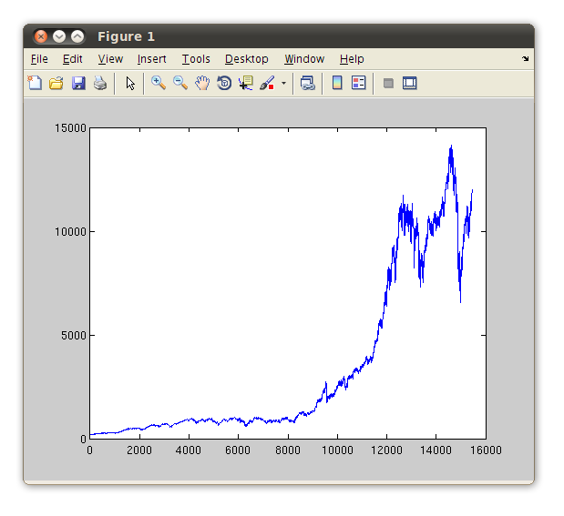
>> plot(dow(:,4))
Notes:
The plot looks familiar to anyone familiar with finance, but the axes may not make sense.

Slide 9
>> plot(dow(:,4))
Was this 1987?
Notes:
If you are an economist, you know that there was a crash in 1987. The crash might be that small bump before the graph starts growing, but it is hard to say.

Slide 10
>> plot(dow(:,4))
What does the X axis mean?
Notes:
Since we only told MATLAB to plot a vector, the X axis is the index of the vector. If we pass two vectors to the plot function, it will reassign the X axis.

Slide 11
>> dow(1,1:3)
ans =
1950 1 3
Year
Month
Day
Notes:
The first three columns in the matrix dow are the year, month, and day of the associated closing value. We need to transform these into a decimal year.

Slide 12
>> time = dow(1,:) + (dow(2,:)-1) / 12 + (dow(3,:)-1) / 30 / 12
Plot the Dow’s value versus time:
>> plot(time, dow(:,4))
Notes:
As a rough approximation, we divide the month value by twelve and the day value by thirty times twelve. This translates all of the dates into the years unit.
This time when we call plot, we pass the value for the X axis first, and the value for Y second.

Slide 13
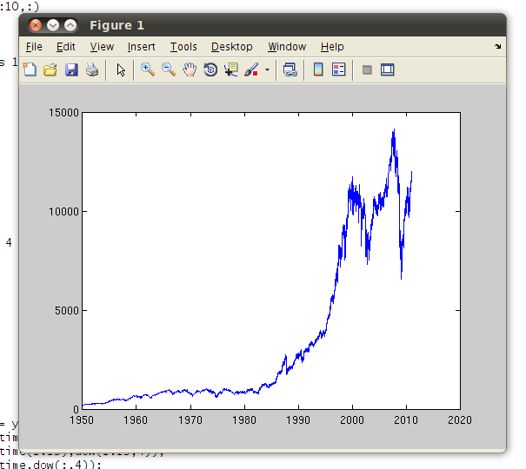
>> plot(time, dow(:,4))
Notes:
MATLAB chose the correct values for the x-axis. Generally, MATLAB is very smart about choosing good tic marks for axes in plots. If you want to change them, you can do so in the tool dropdown menu.

Slide 14
What if we want to edit the plot?
Notes:
If you want to make further edits to the format of the plot, you can access either Insert and Tools dropdown menus.

Slide 15
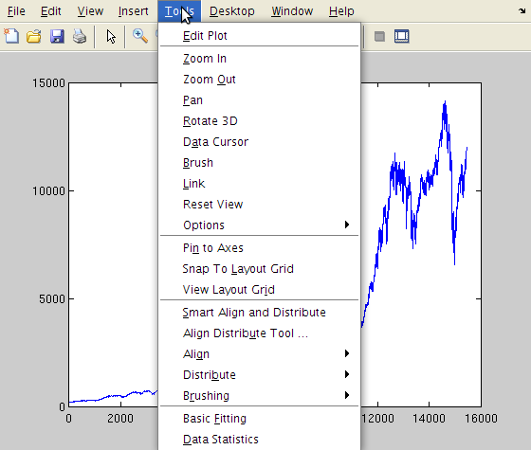
What if we want to edit the plot?
Notes:
Most options are available under the tools menu.

Slide 16
What if we want to edit the plot?
Provides access to plot details
Notes:
The first option, edit plot, provides access to all aspects to the plot’s format.

Slide 17
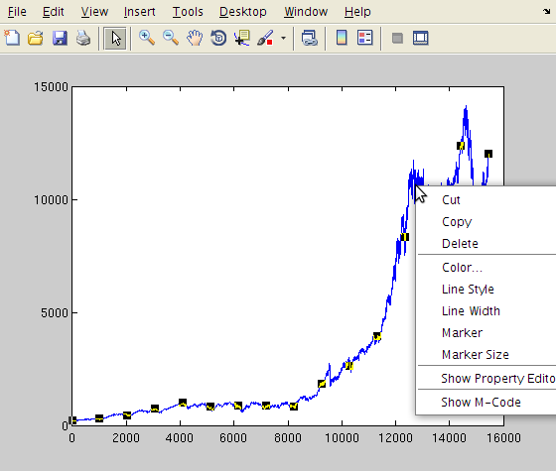
What if we want to edit the plot?
Change line
Add markers
Many other options.
Notes:
An easier way to make quick changes is to right click on the aspect of the plot you want to edit. In this case, we right clicked on the line plot, which brings up a context menu that has controls for the line style, width, and markers. If you want to make more customized edits, you can do so with the property editor.

Slide 18
Compare the Dow to the S&P:
>> stocks = [dow(:,4) sp(:,4)];
>> plot(time, stocks);
Plotting a matrix (stocks) against a vector(time) plots each column of the matrix with the shared X-axis.
Notes:
If you pass two inputs to the plot function, we already saw that the first one is treated as an X value and the second is treated as Y. In this example, we compare the two stock indices by placing them both in a matrix and plotting the matrix against time.

Slide 19
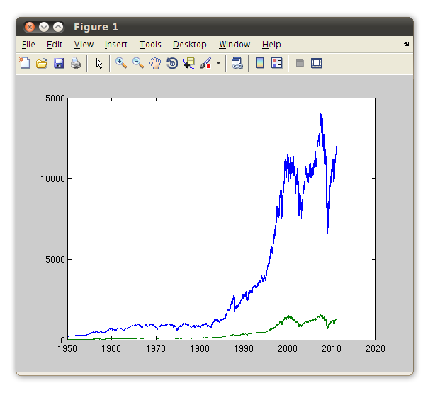
>> plot(time, stocks);
Notes:
Each column of the matrix stocks is plotted as its own curve. The blue line is familiar, and the green line is the S and P 500. Unfortunately, this plot is not too informative because the two variables are on different scales. For instance, it is hard to tell which index gained more as a percentage of its starting value.

Slide 20
Rescale the indices to start at the same place:
>> d2 = dow(:,4) / dow(1:4);
>> s2 = sp(:,4) / sp(1,4);
>> plot(time, [d2 s2]);
Notes:
It is best to rescale the sets of indices in relation to their starting value. This will produce a plot of the rate of return of each index.

Slide 21
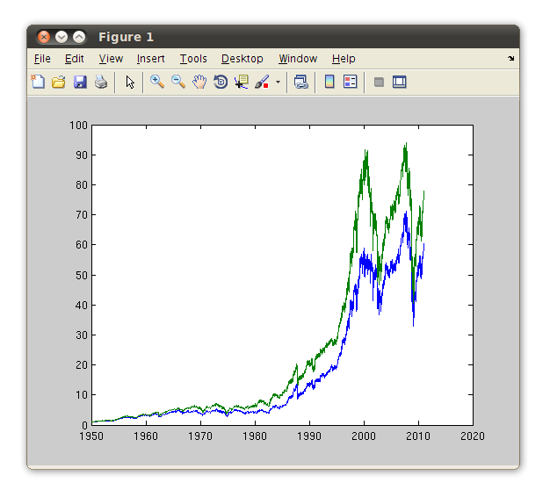
>> plot(time, [d2 s2]);
Notes:
When the variables are rescaled, we see that the S and P 500 actually outperforms the Dow Jones, but that it is significantly more volatile. The important point to note is that proper data visualization might take several iterations before the full sense of the message can be found.

Slide 22
MATLAB has utilities to plot many kinds of data:
hist: histograms
pie: pie charts
bar, barh: bar charts
Even many kinds of 3D charts:
pie3
bar3
pareto
Notes:
MATLAB offers several other plotting utilities including functions to make the standard pie and bar graphs. The hist function can be used to make a histogram. If your data requires it, MATLAB can make many kinds of 3 dimensional charts as well.
Again, all of these plots are fully customizable.

Slide 23
A lot of data is one dimensional…
… what about 2-D data?
Example: geographically oriented data.
Ever wondered where people tweet the most?
Notes:
Another way to visualize data is to treat a matrix as an image. In this example, we will examine a data set of public, geolocated Twitter messages near Toronto.

Slide 24
Question: what places in Toronto are the most popular locations for people to send a geo-located tweet?
Data collection:
Record all geolocated tweets for 2 months.
Divide the city into a grid and count the number of tweets in each cell of the grid.
Notes:
We start with the question of from where in Toronto people are most likely to send a geolocated tweet.
To answer this question, I recorded all geo-located tweets for 2 months in downtown Toronto. Then I divided the city into a grid and counted the relative number of tweets in each cell of the grid.

Slide 25
Question: what places in Toronto are the most popular locations for people to send a geo-located tweet?
Data collection:
Record all geolocated tweets for 2 months.
Divide the city into a grid and count the number of tweets in each cell of the grid.
Data: a matrix of grid centers and the relative number of tweets in that spot.
Notes:
The result is a data matrix, where each point in the matrix is the relative number of tweets near a grid center on the map.

Slide 26
Question: what places in Toronto are the most popular locations for people to send a geo-located tweet?
Data collection:
Record all geolocated tweets for 2 months.
Divide the city into a grid and count the number of tweets in each cell of the grid.
Data: a matrix of grid centers and the relative number of tweets in that spot.
Notes:
Of course, like many other data sets, this one is best thought of as a matrix.

Slide 27
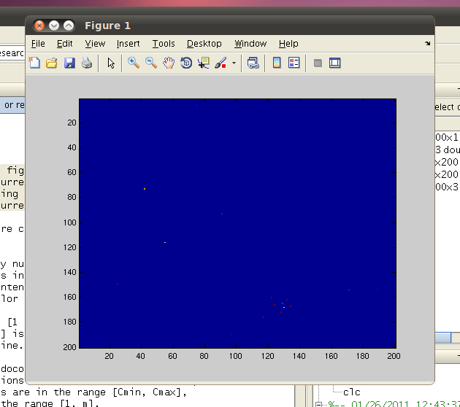
>> image(data);
Notes:
The simplest way to create an image in MATLAB is to call image and pass it a matrix. Unfortunately, this matrix isn’t very amenable to imaging.

Slide 28
>> image(data);
Notes:
We see a few pixels that are not dark blue, and the rest is just the same color.

Slide 29
image():
Take either an N X M or N X M X 3 array.
Third dimension is for three channels of a color image.
Map each location a color using a colormap.
Notes:
To understand what happened, we need to take a closer look at the image function. Image takes either an N by M matrix or an N by M by 3 array. If the input is 2 dimensional, then each element is treated as an intensity value. If it has 3 dimensions, then each pixel is described by three intensity values corresponding to three color channels.
Image uses a colormap, which is an N by 3 matrix, to map intensities to colors.

Slide 30
Data
45 | 1 | 1 | 1
46 | 1 | 1 | 1
46 | 1 | 1 | 1
46 | 45 | 45 | 45
Colormap
Only use first column because Data is 4x4
Image
Notes:
For this simple colormap, values are taken from the range 0 to 64, split into four equal sets, and mapped to the corresponding location in the image. Since the data is not 3 dimensional, we only need to use the first column of colormap.

Slide 31
A colormap is a color guide that maps the values 0.0 to 64.0 to colors.
Many colormaps…
Just check…
>> help colormaps
…for all the options.
Notes:
The intensity values between 0 and 64 are mapped evenly to the rows of the colormap, which produces the colored output. There are many colormaps in MATLAB which can be accessed by typing help colormap. In a moment, we will explore a few more of the standard colormaps.

Slide 32
A colormap is a color guide that maps the values 0.0 to 64.0 to colors.
Many colormaps…
Just check…
>> help colormaps
…for all the options.
What if our matrix has a different range?
Notes:
An important point about image is that it expects all of the values to be between 0 and 64. If the data has a different range, then it is truncated to the range 0 to 64.

Slide 33
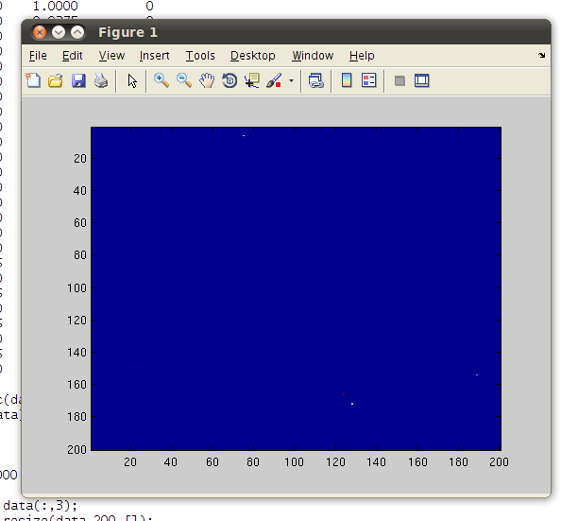
>> imagesc(data);
Scales the matrix to use the entire colormap.
Notes:
It is usually better to use imagesc, which rescales the values of the matrix to fit in the range 0 to 64, which ensures that the entire colormap is used. Unfortunately, we still do not see an image in this data.

Slide 34
Key: imagesc scales the data linearly.
Our data:
>> max(max(data))
1.93 e+04
>> min(min(data))
2.05 e-24
>> mean(mean(data))
1.1190
Our data is scaled exponentially…
Notes:
The reason is that imagesc scales data linearly between the highest and lowest points. Our data follows an exponential distribution, which means that the largest values are a great deal larger than the average value.

Slide 35
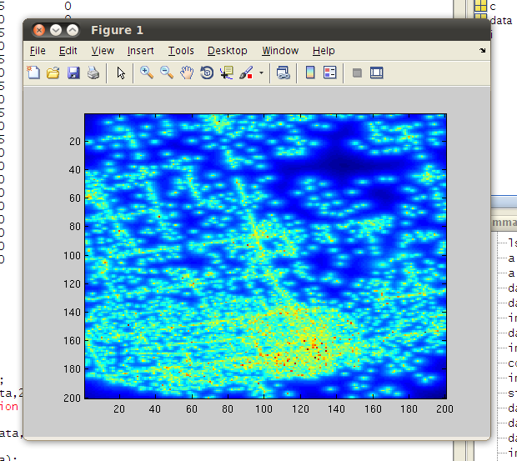
>> imagesc(log(data));
Notes:
Imaging the logarithm of our data, we see a much more interesting pattern. We can pick out major streets and public areas in this plot.

Slide 36
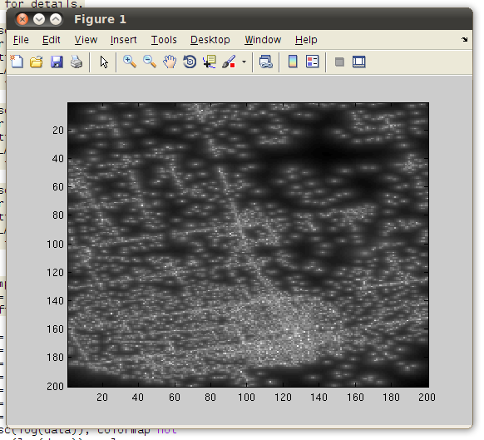
>> imagesc(log(data)), colormap gray;
Notes:
Depending on the data, it might be worth trying other colormaps. This colormap is grayscale, and lighter values correspond to higher intensities.

Slide 37
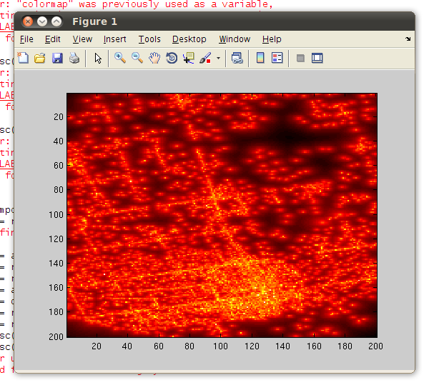
>> imagesc(log(data)), colormap hot;
Notes:
Colormap hot uses a black to yellow heatmap.

Slide 38
Conclusion:
Imaging is a powerful way to explore data…
… but be sure to take full advantage of the pattern in that data.
Notes:
In conclusion, plots and images are powerful tools to expore data, but be sure to take full advantage of the pattern that is in the data. Sometimes, you may need to rescale or otherwise edit data to fully capture its meaning.

Slide 39
created by
Richard T. Guy
February 2011
Copyright © Software Carpentry 2011
This work is licensed under the Creative Commons Attribution License
See http://software-carpentry.org/license.html for more information.

