Slide 1

Regular Expressions
Introduction
Copyright © Software Carpentry 2010
This work is licensed under the Creative Commons Attribution License
See http://software-carpentry.org/license.html for more information.

Slide 2


Slide 3


Slide 4
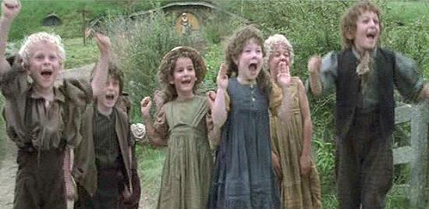

Slide 5


Slide 6
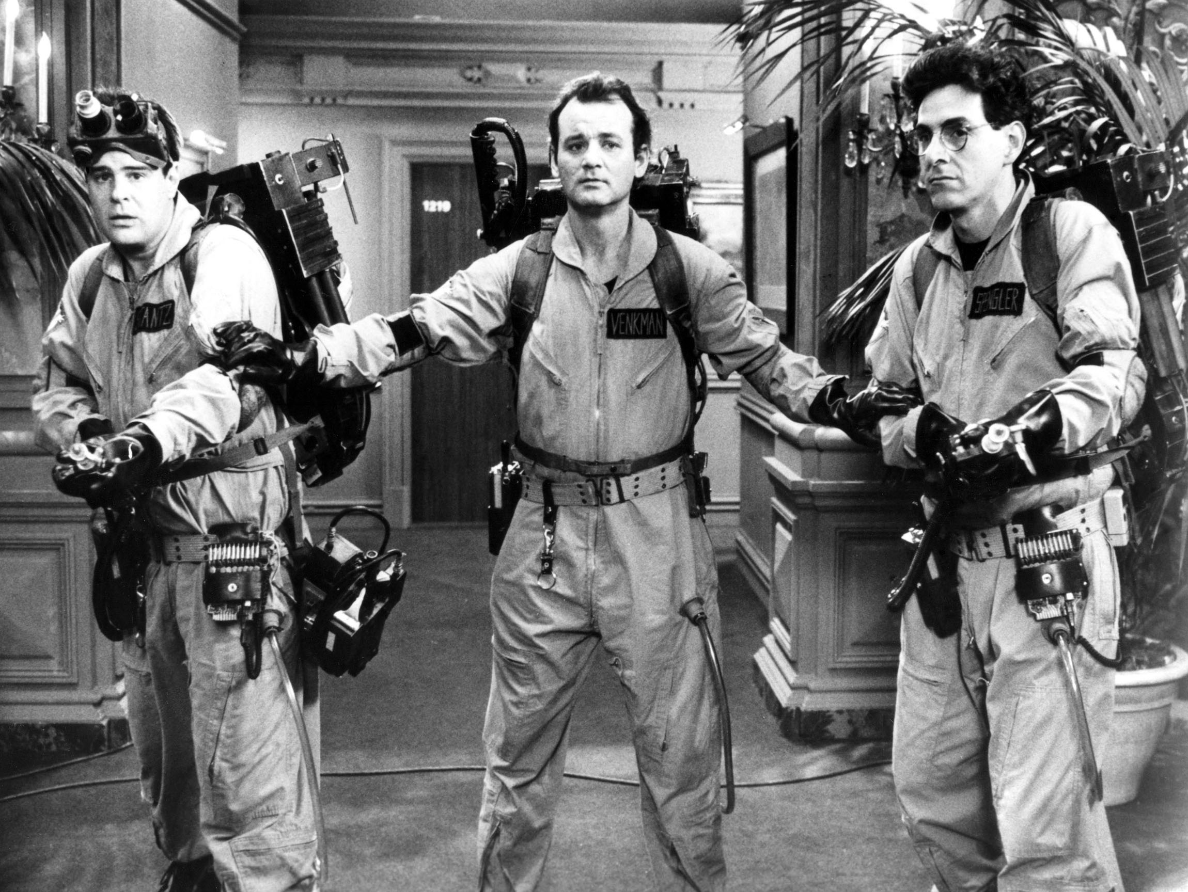

Slide 7
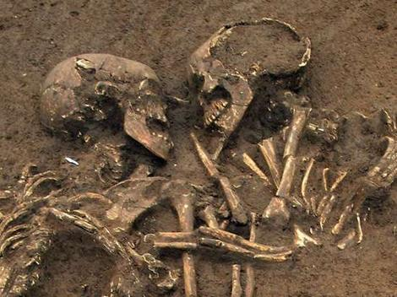

Slide 8


Slide 9
Your mission: read 20-30 files containing several
hundred measurements each of background
evil levels (in millivaders) and convert them to
a uniform format for further processing

Slide 10
Your mission: read 20-30 files containing several
hundred measurements each of residual
evil levels and convert them to a uniform format
for further processing
Each reading has a site name, the date, and the
level of background evil (in millivaders)

Slide 11
Your mission: read 20-30 files containing several
hundred measurements each of residual
evil levels and convert them to a uniform format
for further processing
Each reading has a site name, the date, and the
level of background evil (in millivaders)
Some use tabs to separate fields, others use commas

Slide 12
Your mission: read 20-30 files containing several
hundred measurements each of residual
evil levels and convert them to a uniform format
for further processing
Each reading has a site name, the date, and the
level of background evil (in millivaders)
Some use tabs to separate fields, others use commas
Dates are written in several different styles

Slide 13
Notebook #1
Site Date Evil (millivaders)
---- ---- ------------------
Baker 1 2009-11-17 1223.0
Baker 1 2010-06-24 1122.7
Baker 2 2009-07-24 2819.0
Baker 2 2010-08-25 2971.6
Baker 1 2011-01-05 1410.0
Baker 2 2010-09-04 4671.6
⋮ ⋮ ⋮

Slide 14
Notebook #1
Site Date Evil (millivaders)
---- ---- ------------------
Baker 1 2009-11-17 1223.0
Baker 1 2010-06-24 1122.7
Baker 2 2009-07-24 2819.0
Baker 2 2010-08-25 2971.6
Baker 1 2011-01-05 1410.0
Baker 2 2010-09-04 4671.6
⋮ ⋮ ⋮
single tab as separator

Slide 15
Notebook #1
Site Date Evil (millivaders)
---- ---- ------------------
Baker 1 2009-11-17 1223.0
Baker 1 2010-06-24 1122.7
Baker 2 2009-07-24 2819.0
Baker 2 2010-08-25 2971.6
Baker 1 2011-01-05 1410.0
Baker 2 2010-09-04 4671.6
⋮ ⋮ ⋮
spaces in site names

Slide 16
Notebook #1
Site Date Evil (millivaders)
---- ---- ------------------
Baker 1 2009-11-17 1223.0
Baker 1 2010-06-24 1122.7
Baker 2 2009-07-24 2819.0
Baker 2 2010-08-25 2971.6
Baker 1 2011-01-05 1410.0
Baker 2 2010-09-04 4671.6
⋮ ⋮ ⋮
dates in international standard format (YYYY-MM-DD)

Slide 17
Notebook #2
Site/Date/Evil
Davison/May 22, 2010/1721.3
Davison/May 23, 2010/1724.7
Pertwee/May 24, 2010/2103.8
Davison/June 19, 2010/1731.9
Davison/July 6, 2010/2010.7
Pertwee/Aug 4, 2010/1731.3
Pertwee/Sept 3, 2010/4981.0
⋮ ⋮ ⋮

Slide 18
Notebook #2
Site/Date/Evil
Davison/May 22, 2010/1721.3
Davison/May 23, 2010/1724.7
Pertwee/May 24, 2010/2103.8
Davison/June 19, 2010/1731.9
Davison/July 6, 2010/2010.7
Pertwee/Aug 4, 2010/1731.3
Pertwee/Sept 3, 2010/4981.0
⋮ ⋮ ⋮
slashes as separators

Slide 19
Notebook #2
Site/Date/Evil
Davison/May 22, 2010/1721.3
Davison/May 23, 2010/1724.7
Pertwee/May 24, 2010/2103.8
Davison/June 19, 2010/1731.9
Davison/July 6, 2010/2010.7
Pertwee/Aug 4, 2010/1731.3
Pertwee/Sept 3, 2010/4981.0
⋮ ⋮ ⋮
site names don't appear to have spaces

Slide 20
Notebook #2
Site/Date/Evil
Davison/May 22, 2010/1721.3
Davison/May 23, 2010/1724.7
Pertwee/May 24, 2010/2103.8
Davison/June 19, 2010/1731.9
Davison/July 6, 2010/2010.7
Pertwee/Aug 4, 2010/1731.3
Pertwee/Sept 3, 2010/4981.0
⋮ ⋮ ⋮
month names and day numbers of varying length

Slide 21
Solution: regular expressions

Slide 22
Solution: regular expressions
A pattern that strings can match

Slide 23
Solution: regular expressions
A pattern that strings can match
Like '*.txt' matches filenames ending in '.txt'

Slide 24
Solution: regular expressions
A pattern that strings can match
Like '*.txt' matches filenames ending in '.txt'
Warning: notation is ugly

Slide 25
Solution: regular expressions
A pattern that strings can match
Like '*.txt' matches filenames ending in '.txt'
Warning: notation is ugly
Writing patterns for strings as strings...

Slide 26
Solution: regular expressions
A pattern that strings can match
Like '*.txt' matches filenames ending in '.txt'
Warning: notation is ugly
Writing patterns for strings as strings...
...using only the symbols on the keyboard (instead
of inventing new symbols like mathematicians do)

Slide 27
# read the first half-dozen data records from two files
readings = []
for filename in ('data-1.txt', 'data-2.txt'):
lines = open(filename, 'r').read().strip().split('\n')
readings += lines[2:8]
for r in readings:
print r

Slide 28
Baker 1 2009-11-17 1223.0
Baker 1 2010-06-24 1122.7
Baker 2 2009-07-24 2819.0
Baker 2 2010-08-25 2971.6
Baker 1 2011-01-05 1410.0
Baker 2 2010-09-04 4671.6
Davison/May 23, 2010/1724.7
Pertwee/May 24, 2010/2103.8
Davison/June 19, 2010/1731.9
Davison/July 6, 2010/2010.7
Pertwee/Aug 4, 2010/1731.3
Pertwee/Sept 3, 2010/4981.0

Slide 29
# select readings in month '06'
for r in readings:
if '06' in r:
print r
Baker 1 2010-06-24 1122.7

Slide 30
# select readings in month '06' or month '07'
for r in readings:
if ('06' in r) or ('07' in r):
print r
Baker 1 2010-06-24 1122.7
Baker 2 2009-07-24 2819.0

Slide 31
# what about readings in month '05'? (shouldn't be any)
for r in readings:
if ('05' in r):
print r
Baker 1 2011-01-05 1410.0

Slide 32
# what about readings in month '05'? (shouldn't be any)
for r in readings:
if ('05' in r):
print r
Baker 1 2011-01-05 1410.0
"in string" is a dangerously blunt tool

Slide 33
# try using regular expressions instead
import re
for r in readings:
if re.search('06', r):
print r
Baker 1 2010-06-24 1122.7

Slide 34
# try using regular expressions instead
import re
for r in readings:
if re.search('06', r):
print r
Baker 1 2010-06-24 1122.7
not much of an improvement so far...

Slide 35
# find records with '06' or '07' in one search
import re
for r in readings:
if re.search('06|07', r):
print r
Baker 1 2010-06-24 1122.7
Baker 2 2009-07-24 2819.0

Slide 36
# find records with '06' or '07' in one search
import re
for r in readings:
if re.search('06|07', r):
print r
Baker 1 2010-06-24 1122.7
Baker 2 2009-07-24 2819.0
first argument is
the pattern to search for

Slide 37
# find records with '06' or '07' in one search
import re
for r in readings:
if re.search('06|07', r):
print r
Baker 1 2010-06-24 1122.7
Baker 2 2009-07-24 2819.0
first argument is
the pattern to search for
written as a string

Slide 38
# find records with '06' or '07' in one search
import re
for r in readings:
if re.search('06|07', r):
print r
Baker 1 2010-06-24 1122.7
Baker 2 2009-07-24 2819.0
second argument is the
data to search in

Slide 39
# find records with '06' or '07' in one search
import re
for r in readings:
if re.search('06|07', r):
print r
Baker 1 2010-06-24 1122.7
Baker 2 2009-07-24 2819.0
second argument is the
data to search in
reversing these is a
common mistake
(and hard to track down)

Slide 40
# find records with '06' or '07' in one search
import re
for r in readings:
if re.search('06|07', r):
print r
Baker 1 2010-06-24 1122.7
Baker 2 2009-07-24 2819.0
vertical bar '|' means OR

Slide 41
# find records with '06' or '07' in one search
import re
for r in readings:
if re.search('06|07', r):
print r
Baker 1 2010-06-24 1122.7
Baker 2 2009-07-24 2819.0
vertical bar '|' means OR
match either what's on
the left, or what's on the
right, in a single search

Slide 42
# we're going to be trying out a lot of patterns,
# so let's write a function
def show_matches(pattern, strings):
for s in strings:
if re.search(pattern, s):
print '**', s
else:
print ' ', s

Slide 43
# test our function right away
show_matches('06|07', readings)
Baker 1 2009-11-17 1223.0
** Baker 1 2010-06-24 1122.7
** Baker 2 2009-07-24 2819.0
Baker 2 2010-08-25 2971.6
Baker 1 2011-01-05 1410.0
Baker 2 2010-09-04 4671.6
Davison/May 23, 2010/1724.7
Pertwee/May 24, 2010/2103.8
Davison/June 19, 2010/1731.9
Davison/July 6, 2010/2010.7
Pertwee/Aug 4, 2010/1731.3
Pertwee/Sept 3, 2010/4981.0

Slide 44
# why doesn't this work?
show_matches('06|7', readings)
** Baker 1 2009-11-17 1223.0
** Baker 1 2010-06-24 1122.7
** Baker 2 2009-07-24 2819.0
** Baker 2 2010-08-25 2971.6
Baker 1 2011-01-05 1410.0
** Baker 2 2010-09-04 4671.6
** Davison/May 23, 2010/1724.7
Pertwee/May 24, 2010/2103.8
** Davison/June 19, 2010/1731.9
** Davison/July 6, 2010/2010.7
** Pertwee/Aug 4, 2010/1731.3
Pertwee/Sept 3, 2010/4981.0

Slide 45
In mathematics, "ab+c" means (a×b) + c

Slide 46
In mathematics, "ab+c" means (a×b) + c
Multiplication is implied, and has higher precedence

Slide 47
In mathematics, "ab+c" means (a×b) + c
Multiplication is implied, and has higher precedence
To force the other meaning, write "a(b+c)"

Slide 48
In mathematics, "ab+c" means (a×b) + c
Multiplication is implied, and has higher precedence
To force the other meaning, write "a(b+c)"
In regular expressions, "06|7" means '06' or '7'

Slide 49
In mathematics, "ab+c" means (a×b) + c
Multiplication is implied, and has higher precedence
To force the other meaning, write "a(b+c)"
In regular expressions, "06|7" means '06' or '7'
...and there are a lot of 7's in our file

Slide 50
In mathematics, "ab+c" means (a×b) + c
Multiplication is implied, and has higher precedence
To force the other meaning, write "a(b+c)"
In regular expressions, "06|7" means '06' or '7'
...and there are a lot of 7's in our file
To force the other meaning, parenthesize "0(6|7)"

Slide 51
In mathematics, "ab+c" means (a×b) + c
Multiplication is implied, and has higher precedence
To force the other meaning, write "a(b+c)"
In regular expressions, "06|7" means '06' or '7'
...and there are a lot of 7's in our file
To force the other meaning, parenthesize "0(6|7)"
But "06|07" is more readable anyway

Slide 52
# still matching days when we want to match months
show_matches('05', readings)
Baker 1 2009-11-17 1223.0
Baker 1 2010-06-24 1122.7
Baker 2 2009-07-24 2819.0
Baker 2 2010-08-25 2971.6
** Baker 1 2011-01-05 1410.0
Baker 2 2010-09-04 4671.6
Davison/May 23, 2010/1724.7
Pertwee/May 24, 2010/2103.8
Davison/June 19, 2010/1731.9
Davison/July 6, 2010/2010.7
Pertwee/Aug 4, 2010/1731.3
Pertwee/Sept 3, 2010/4981.0

Slide 53
# could rely on context
show_matches('-05-', readings)
Baker 1 2009-11-17 1223.0
Baker 1 2010-06-24 1122.7
Baker 2 2009-07-24 2819.0
Baker 2 2010-08-25 2971.6
Baker 1 2011-01-05 1410.0
Baker 2 2010-09-04 4671.6
Davison/May 23, 2010/1724.7
Pertwee/May 24, 2010/2103.8
Davison/June 19, 2010/1731.9
Davison/July 6, 2010/2010.7
Pertwee/Aug 4, 2010/1731.3
Pertwee/Sept 3, 2010/4981.0

Slide 54
# could rely on context
show_matches('-05-', readings)
Baker 1 2009-11-17 1223.0
Baker 1 2010-06-24 1122.7
Baker 2 2009-07-24 2819.0
Baker 2 2010-08-25 2971.6
Baker 1 2011-01-05 1410.0
Baker 2 2010-09-04 4671.6
Davison/May 23, 2010/1724.7
Pertwee/May 24, 2010/2103.8
Davison/June 19, 2010/1731.9
Davison/July 6, 2010/2010.7
Pertwee/Aug 4, 2010/1731.3
Pertwee/Sept 3, 2010/4981.0
month has '-' before and
after

Slide 55
# could rely on context
show_matches('-05-', readings)
Baker 1 2009-11-17 1223.0
Baker 1 2010-06-24 1122.7
Baker 2 2009-07-24 2819.0
Baker 2 2010-08-25 2971.6
Baker 1 2011-01-05 1410.0
Baker 2 2010-09-04 4671.6
Davison/May 23, 2010/1724.7
Pertwee/May 24, 2010/2103.8
Davison/June 19, 2010/1731.9
Davison/July 6, 2010/2010.7
Pertwee/Aug 4, 2010/1731.3
Pertwee/Sept 3, 2010/4981.0
so no matches

Slide 56
Matching is enough: we need to extract data

Slide 57
Matching is enough: we need to extract data
When a regular expression matches, the library
remembers what matched against every
parenthesized sub-expression

Slide 58
# extract the year from the match
match = re.search('(2009|2010|2011)',
'Baker 1\t2009-11-17\t1223.0')
print match.group(1)
2009

Slide 59
# extract the year from the match
match = re.search('(2009|2010|2011)',
'Baker 1\t2009-11-17\t1223.0')
print match.group(1)
2009
pattern to match
years is in
parentheses

Slide 60
# extract the year from the match
match = re.search('(2009|2010|2011)',
'Baker 1\t2009-11-17\t1223.0')
print match.group(1)
2009
first record from data

Slide 61
# extract the year from the match
match = re.search('(2009|2010|2011)',
'Baker 1\t2009-11-17\t1223.0')
print match.group(1)
2009
first record from data
(remember '\t' is a tab)

Slide 62
# extract the year from the match
match = re.search('(2009|2010|2011)',
'Baker 1\t2009-11-17\t1223.0')
print match.group(1)
2009
re.search returns a match object if a match is found

Slide 63
# extract the year from the match
match = re.search('(2009|2010|2011)',
'Baker 1\t2009-11-17\t1223.0')
print match.group(1)
2009
re.search returns a match object if a match is found
returns None if there is no match

Slide 64
# extract the year from the match
match = re.search('(2009|2010|2011)',
'Baker 1\t2009-11-17\t1223.0')
print match.group(1)
2009
match.group(k) returns the text that matched the
k^{th} sub-expression in the regular expression

Slide 65
# extract the year from the match
match = re.search('(2009|2010|2011)',
'Baker 1\t2009-11-17\t1223.0')
print match.group(1)
2009
match.group(k) returns the text that matched the
k^{th} sub-expression in the regular expression
k goes from 1 to N (number of matches), not 0 to N-1

Slide 66
# extract the year from the match
match = re.search('(2009|2010|2011)',
'Baker 1\t2009-11-17\t1223.0')
print match.group(1)
2009
match.group(k) returns the text that matched the
k^{th} sub-expression in the regular expression
k goes from 1 to N (number of matches), not 0 to N-1
because match.group(0) is all the text that was matched

Slide 67
Regular expression to match month would be
"(01|02|03|04|05|06|07|08|09|10|11|12)"

Slide 68
Regular expression to match month would be
"(01|02|03|04|05|06|07|08|09|10|11|12)"
Expression to match day would be three times longer

Slide 69
Regular expression to match month would be
"(01|02|03|04|05|06|07|08|09|10|11|12)"
Expression to match day would be three times longer
Use '.' (period) to match any single character

Slide 70
Regular expression to match month would be
"(01|02|03|04|05|06|07|08|09|10|11|12)"
Expression to match day would be three times longer
Use '.' (period) to match any single character
So '....-..-..' matches four characters, a dash, two
more characters, another dash, and two more
characters

Slide 71
Regular expression to match month would be
"(01|02|03|04|05|06|07|08|09|10|11|12)"
Expression to match day would be three times longer
Use '.' (period) to match any single character
So '....-..-..' matches four characters, a dash, two
more characters, another dash, and two more
characters
And '(....)-(..)-(..)' remembers those matches
individually

Slide 72
# match and extract YYYY-MM-DD date formats
match = re.search('(....)-(..)-(..)',
'Baker 1\t2009-11-17\t1223.0')
print match.group(1), match.group(2), match.group(3)
2009 11 17

Slide 73
# match and extract YYYY-MM-DD date formats
match = re.search('(....)-(..)-(..)',
'Baker 1\t2009-11-17\t1223.0')
print match.group(1), match.group(2), match.group(3)
2009 11 17
Try doing that with substring searches...

Slide 74
# let's write another function to show match groups
def show_groups(pattern, text):
m = re.search(pattern, text)
if m is None:
print 'NO MATCH'
return
print 'all:', m.group(0)
for i in range(1, 1 + len(m.groups())):
print '%2d: %s' % (i, m.groups(i))
show_groups('(....)-(..)-(..)',
'Baker 1\t2009-11-17\t1223.0')
01: 2009
02: 11
03: 17

Slide 75
Letters and digits match themselves.

Slide 76
Letters and digits match themselves.
'|' means OR.

Slide 77
Letters and digits match themselves.
'|' means OR.
'.' matches any single character.

Slide 78
Letters and digits match themselves.
'|' means OR.
'.' matches any single character.
Use '()' to enforce grouping.

Slide 79
Letters and digits match themselves.
'|' means OR.
'.' matches any single character.
Use '()' to enforce grouping.
re.search returns a match object or None.

Slide 80
Letters and digits match themselves.
'|' means OR.
'.' matches any single character.
Use '()' to enforce grouping.
re.search returns a match object or None.
match.group(k) is the text that matched group k.

Slide 81
created by
Greg Wilson
June 2010
Copyright © Software Carpentry 2010
This work is licensed under the Creative Commons Attribution License
See http://software-carpentry.org/license.html for more information.

