Slide 1

Software Engineering
Empirical Results
Copyright © Software Carpentry 2011
This work is licensed under the Creative Commons Attribution License
See http://software-carpentry.org/license.html for more information.
Notes:
Hello, and welcome to the second episode of the Software Carpentry lecture on software engineering. In this episode, we'll have a look at the science behind some of the claims we make in this course.

Slide 2

Seven Years War
Notes:
Our story starts with the Seven Years War

Slide 3
Seven Years War
Actually nine years long
(1754-63)
Notes:
Which was actually nine years long (proving that it's not just programmers who have trouble counting).

Slide 4
Seven Years War
Actually nine years long
(1754-63)
Britain lost 1,512 sailors to enemy action
Notes:
During that war, the British lost about 1500 sailors to enemy action

Slide 5
Seven Years War
Actually nine years long
(1754-63)
Britain lost 1,512 sailors to enemy action
And almost 100,000 to scurvy
Notes:
And almost 100,000---the population of a small city---to scurvy.

Slide 6
Seven Years War
Actually nine years long
(1754-63)
Britain lost 1,512 sailors to enemy action
And almost 100,000 to scurvy
Unnecessarily
Notes:
The irony is, they didn't need to lose any.

Slide 7
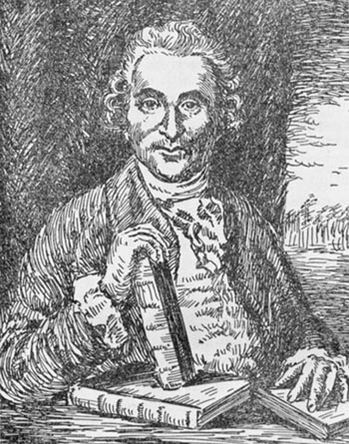
James Lind (1716-94)
1747: first controlled medical
experiment in history
Notes:
Before the war even started, a Scottish surgeon named James Lind had done the first controlled medical experiment in history. He was intrigued by the fact that vegetables don't go bad if they're pickled, and he wondered: could the same thing somehow be done for people?

Slide 8
James Lind (1716-94)
1747: first controlled medical
experiment in history
• cider • sea water
• vitriol • oranges
• vinegar • barley water
Notes:
So he took twelve sailors, divided them into six pairs, and gave each pair something different: cider, sea water, vitriol (which is a weak solution of sulfuric acid---bad day to be those guys), oranges, vinegar, and barley water.

Slide 9
James Lind (1716-94)
1747: first controlled medical
experiment in history
• cider • sea water
• vitriol • oranges
• vinegar • barley water
Notes:
Lo and behold, the sailors who were given oranges were back on their feet in just a few days, while the others continued to sicken.

Slide 10
James Lind (1716-94)
1747: first controlled medical
experiment in history
• cider • sea water
• vitriol • oranges
• vinegar • barley water
Allowed British ships to be effective on long patrols
during the Napoleonic Wars
Notes:
It was a long time before the British Admiralty paid attention to his results, but when they finally did, it allowed British ships to stay at sea for months, which may have turned the tide of history during the Napoleonic Wars.

Slide 11

1950: Hill & Doll study comparing
smokers and non-smokers
Notes:
It took even longer for the medical profession to start paying attention, but they finally did too. One of the turning points was Hill and Doll's landmark study in 1950 that compared cancer rates in smokers and non-smokers. Their study proved two things:

Slide 12
1950: Hill & Doll study comparing
smokers and non-smokers
1. Smoking causes lung cancer
Notes:
First, smoking causes lung cancer.

Slide 13
1950: Hill & Doll study comparing
smokers and non-smokers
1. Smoking causes lung cancer
Many people would rather fail
than change
Notes:
Second, many people would rather fail than change. Even when confronted with overwhelming evidence, many people will cling to creationism, refuse to acknowledge that human beings are at least partly responsible for global climate change, or insist that vaccines cause autism.

Slide 14


1950: Hill & Doll study comparing
smokers and non-smokers
1. Smoking causes lung cancer
Many people would rather fail
than change
+
Notes:
Unfortunately, this is still largely true in software engineering, where many people act as if a few pints and a quotation from some self-appointed guru constitute "proof" of claims that X is better than Y.

Slide 15
1950: Hill & Doll study comparing
smokers and non-smokers
1. Smoking causes lung cancer
Many people would rather fail
than change
+
Notes:
The good news is, things are finally changing.

Slide 16
A rarity in software engineering until the mid 1990s
Notes:
Empirical studies of real programmers and real software were a rarity in software engineering before the mid 1990s.

Slide 17

A rarity in software engineering until the mid 1990s
But today, papers describing new tools
or working practices routinely include
results from empirical studies
Notes:
Today, though, papers describing new tools or working practices routinely include results from some kind of empirical study to back up their claims.

Slide 18
A rarity in software engineering until the mid 1990s
But today, papers describing new tools
or working practices routinely include
results from empirical studies
Particularly ones by young researchers
Notes:
Particularly papers written by younger researchers, which bodes well for the future.

Slide 19

A rarity in software engineering until the mid 1990s
But today, papers describing new tools
or working practices routinely include
results from empirical studies
Particularly ones by young researchers
Many are flawed or incomplete,
but standards are constantly improving
Notes:
Many of these studies are still flawed or incomplete, but the standards of major journals and conferences are constantly improving.

Slide 20

Notes:
Here's an example of the kind of study we're talking about.

Slide 21


Notes:
Does it matter if your developers are sitting together…

Slide 22

Notes:
…or spread out on opposite sides of the world?

Slide 23

Notes:
Two scientists at Microsoft Research tried to find out by looking at data collected during the construction of Windows Vista.

Slide 24
Notes:
They found out that geographical separation didn't have a strong impact on the quality of the software a team built.

Slide 25

Notes:
What did was how far apart team members were in the org chart: basically, the higher up you had to go to find a common boss, the more bugs there would be in the software they built.

Slide 26
Unsurprising in retrospect
Notes:
In retrospect, this isn't a surprising result: the further apart people are organizationally, the more trouble they're likely to have getting or setting clear, consistent goals.

Slide 27
Unsurprising in retrospect
Actionable
Notes:
The beauty of this result is that it's actionable: all other things being equal, you can improve the quality of a piece of software by restructuring the team. (I would have said "by simply restructuring the team", but of course, that kind of thing is never simple…)

Slide 28


What goes wrong in developers' first job?
Notes:
Here's another neat result, also from Microsoft: what goes wrong for developers in their first job?

Slide 29
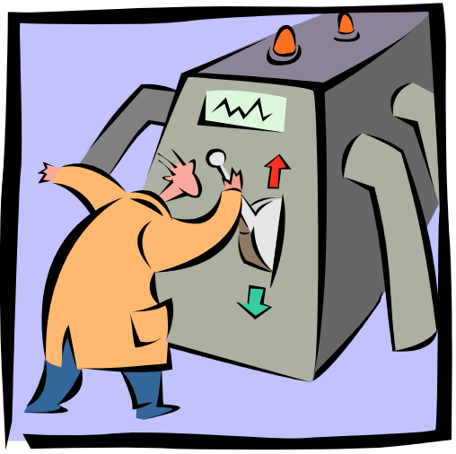
What goes wrong in developers' first job?
Notes:
A detailed qualitative study of eight new hires, none of whom had previous industry experience, found that technology was never the biggest problem.

Slide 30

What goes wrong in developers' first job?
Notes:
Where everyone actually stumbled was group dynamics: when to ask for help, how to ask, how to contribute to meetings, and so on. These skills are usually not part of a technical education, but in every case, this was what hurt new hires' productivity the most.

Slide 31
What goes wrong in developers' first job?
Also unsurprising in retrospect, and actionable
Notes:
Again, in retrospect this finding isn't surprising, but it's also actionable: by investing a little in team skills early on, companies (and presumably research labs as well) can reduce both their hidden costs and their new hires' frustrations.

Slide 32
Statistics is just one path
Notes:
This second study highlights something important about empirical studies in software engineering: a lot of the best ones are not statistical in nature.

Slide 33

Statistics is just one path
Notes:
Instead, a lot of first-rate work draws on techniques from anthropology…

Slide 34

Statistics is just one path
Notes:
…and business studies.

Slide 35
Statistics is just one path
Controlled experiments are expensive…
Notes:
This is partly because controlled experiments large enough to be statistically significant are very expensive to run.

Slide 36
Statistics is just one path
Controlled experiments are expensive…
…and often eliminate exactly what we want to study
Notes:
The real reason, though, is that qualitative techniques are often the right ones to use, because controlled laboratory studies would all too often eliminate the real-world effects that we actually want to study.

Slide 37
Statistics is just one path
Controlled experiments are expensive…
…and often eliminate exactly what we want to study
Biggest hurdle is re-education
Notes:
In fact, one of the biggest obstacles to wider adoption of evidence-based software engineering is the resistance of scientists and programmers, many of whom dismiss qualitative methods as "soft" without actually knowing anything about them.

Slide 38
Test-Driven Development
Notes:
Another reason for resistance is that people don't like finding out that their cherished beliefs might be wrong. One example is test-driven development: the practice of writing tests before writing code.

Slide 39
Test-Driven Development
An article of faith among many programmers
Notes:
Many programmers believe quite strongly that this is the "right" way to program, and that it leads to better code in less time.

Slide 40

Test-Driven Development
An article of faith among many programmers
Meta-analysis of over 30 studies
No consistent effect
Notes:
However, a meta-analysis of over thirty studies found no consistent effect.

Slide 41
Test-Driven Development
An article of faith among many programmers
Meta-analysis of over 30 studies
No consistent effect
• Some positive
Notes:
Some of the studies reported benefits…

Slide 42
Test-Driven Development
An article of faith among many programmers
Meta-analysis of over 30 studies
No consistent effect
• Some positive
• Some negative
Notes:
…some found that it made things worse…

Slide 43
Test-Driven Development
An article of faith among many programmers
Meta-analysis of over 30 studies
No consistent effect
• Some positive
• Some negative
• Some inconclusive
Notes:
…and some were inconclusive.

Slide 44
Test-Driven Development
An article of faith among many programmers
Meta-analysis of over 30 studies
No consistent effect
• Some positive
• Some negative
• Some inconclusive
The better the study, the weaker the signal
Notes:
One clear finding, though, was that the better the study, the weaker the signal. This result may be disappointing to some people (it certainly was to me), but progress sometimes is. And even if these studies are wrong, figuring out why, and doing better studies, will advance our understanding.

Slide 45
Boehm et al (1975): "Some Experience with
Automated Aids to the Design of Large-Scale
Reliable Software"
Notes:
Here's another useful result, one that dates all the way back to the 1970s…

Slide 46
Boehm et al (1975): "Some Experience with
Automated Aids to the Design of Large-Scale
Reliable Software"
…and many more since
Notes:
…and has been replicated many times since.

Slide 47
Boehm et al (1975): "Some Experience with
Automated Aids to the Design of Large-Scale
Reliable Software"
…and many more since
Most errors introduced during
requirements analysis and design
number / cost
time
Notes:
First, most errors in software are introducing during requirements analysis and design, not during coding.

Slide 48
Boehm et al (1975): "Some Experience with
Automated Aids to the Design of Large-Scale
Reliable Software"
…and many more since
Most errors introduced during
requirements analysis and design
The later they are removed,
the more expensive they are
number / cost
time
Notes:
Second, the later a bug is removed, the more expensive the fix is. What's more, that curve actually is exponential: as we move from analysis to design to coding to testing to deployment, fixing a bug is five to ten times more expensive at each successive stage, and these costs are multiplicative.

Slide 49


Pessimists
Optimists
Notes:
The beauty of this result is that it explains why programmers disagree about how to run projects.

Slide 50
If we tackle the hump in the error injection curve, fewer bugs will get to the expensive part of the fixing curve.
Pessimists
Optimists
Notes:
Pessimists look at these curves and say, let's tackle the hump in the bug creation curve by doing more analysis and design up front.

Slide 51
If we tackle the hump in the error injection curve, fewer bugs will get to the expensive part of the fixing curve.
Pessimists
If we do shorter iterations, the total cost of fixing bugs
will go down.
Optimists
Notes:
Meanwhile, optimists say, if we do many short iterations instead of a few long ones, the total cost of fixing bugs will go down…

Slide 52
If we tackle the hump in the error injection curve, fewer bugs will get to the expensive part of the fixing curve.
Pessimists
If we do shorter iterations, the total cost of fixing bugs
will go down.
Optimists
Notes:
…because the total area under the sawtooth curve is less than the area under the original curve. Both sides are right: they're just looking at different aspects of the problem.

Slide 53
Fagan 1975: "Design and Code Inspections to Reduce
Errors in Program Development"
Notes:
Here's another classic result, also from the mid-1970s.

Slide 54

Fagan 1975: "Design and Code Inspections to Reduce
Errors in Program Development"
Reading code carefully is the most
cost effective way to find bugs
Notes:
It turns out that reading code carefully is the most effective way to find bugs---and the most cost-effective as well. In fact, reading code carefully can find 60-90% of all the bugs in it before it's run for the first time.

Slide 55

Fagan 1975: "Design and Code Inspections to Reduce
Errors in Program Development"
Reading code carefully is the most
cost effective way to find bugs
Cohen 2006: most of the value comes
from the first hour and
the first pair of eyes
Notes:
Thirty years on, Cohen and others refined this result by looking at data collected at Cisco. They found that in almost all of the value of code reviews came from the first reviewer, and the first hour they were reviewing code. Basically, having more than one person review the code doesn't find enough bugs to make it worthwhile, and if someone spends more than an hour reading code, they become fatigued and stop finding anything except trivial formatting errors.

Slide 56
Fagan 1975: "Design and Code Inspections to Reduce
Errors in Program Development"
Reading code carefully is the most
cost effective way to find bugs
Cohen 2006: most of the value comes
from the first hour and
the first pair of eyes
Code review now normal in open source
Notes:
In light of this, it's not surprising that code review has become a common practice in most open source projects: given the freedom to work any way they want, most top-notch developers have discovered for themselves that having someone else look over a piece of code before it's committed to version control makes development faster, not slower.

Slide 57
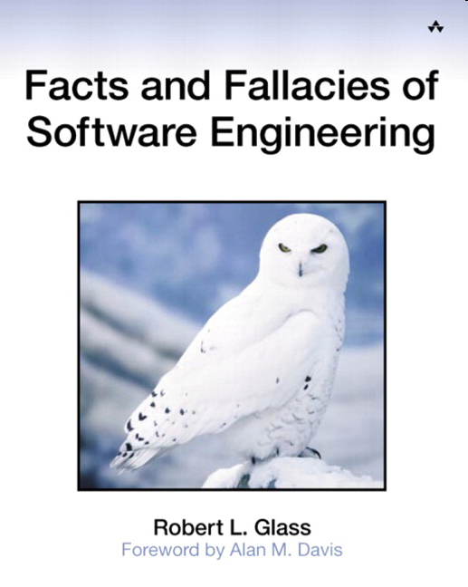
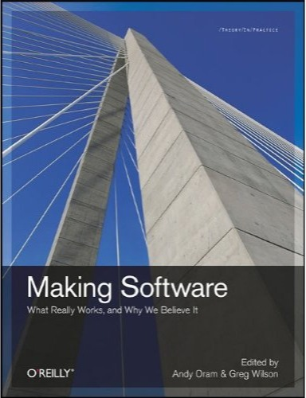
Notes:
Books like Robert Glass's Facts and Fallacies of Software Engineering, and a recent collection from O'Reilly called Making Software, present these results and many more in a digestible way.

Slide 58
Do programming languages affect productivity?
Notes:
Does your choice of programming language affect your productivity?

Slide 59
Do programming languages affect productivity?
Does using design patterns make for better code?
Notes:
Does using design patterns make your code better?

Slide 60
Do programming languages affect productivity?
Does using design patterns make for better code?
Can we predict software faults statistically?
Notes:
Can data mining techniques help us predict how many bugs are in a piece of software, and where they're likely to occur?

Slide 61
Do programming languages affect productivity?
Does using design patterns make for better code?
Can we predict software faults statistically?
Is up-front design cost-effective?
Notes:
Is up-front design cost-effective, or should software evolve week by week in response to immediate needs?

Slide 62
Do programming languages affect productivity?
Does using design patterns make for better code?
Can we predict software faults statistically?
Is up-front design cost-effective?
Why is it hard to learn how to program?
Notes:
Why do so many people find it so hard to learn how to program?

Slide 63
Do programming languages affect productivity?
Does using design patterns make for better code?
Can we predict software faults statistically?
Is up-front architecture cost-effective?
Why is it hard to learn how to program?
Is open source software actually better?
Notes:
Is open source software actually higher quality than closed source alternatives?

Slide 64
Do programming languages affect productivity?
Does using design patterns make for better code?
Can we predict software faults statistically?
Is up-front architecture cost-effective?
Why is it hard to learn how to program?
Is open source software actually better?
Are some programmers 10X better?
Notes:
And are some programmers ten times more productive than others (or 28 times, or a hundred times---you'll see all these numbers quoted on the web, and more).

Slide 65
narrated by
Greg Wilson
February 2011
Copyright © Software Carpentry 2011
This work is licensed under the Creative Commons Attribution License
See http://software-carpentry.org/license.html for more information.
Notes:
We actually have answers to some of these questions now, and if you're going to spend any significant time programming, or arguing about programming, it's easier than ever to find out what we know and why we believe it's true.

