Slide 1
data

Slide 2

Title
Hello, world!
body
h1
p
Title
Hello
em
world!
<body>
<h1>Title</h1>
<p>Hello, <em>world!</em></p>
</body>

Slide 3
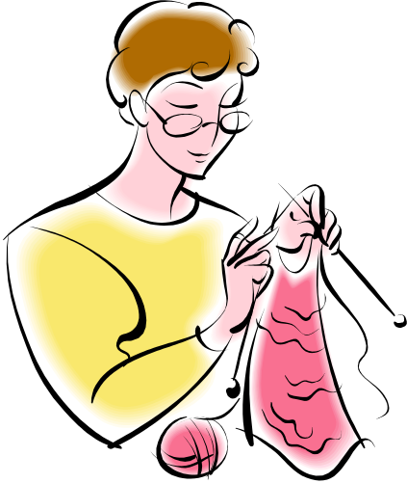
The knitting circle meets on
the second Tuesday of every month
BEGIN:VCALENDAR
VERSION:2.0
PRODID:-//hacksw/handcal//NONSGML v1.0//EN
BEGIN:VEVENT
UID:uid1@example.com
DTSTAMP:19970714T170000Z
ORGANIZER;CN=John Doe
DTSTART:19970714T170000Z
DTEND:19970715T035959Z
SUMMARY:Bastille Day Party
END:VEVENT
END:VCALENDAR

