Slide 1

Version Control
Basic Operation
Copyright © Software Carpentry 2010
This work is licensed under the Creative Commons Attribution License
See http://software-carpentry.org/license.html for more information.

Slide 2
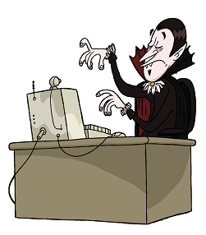

Slide 3


Slide 4
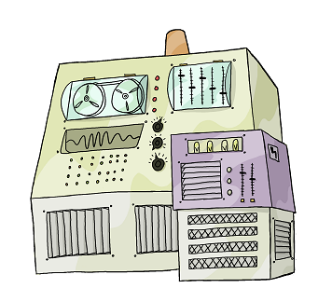
universal.software-carpentry.org

Slide 5
httpS://universal.software-carpentry.org/monsters

Slide 6
Name Orbital Radius ...
Amalthea 181.4 ...
Io 421.6 ...
Europa 670.9 ...
Ganymede 1070.4 ...
Callisto 1882.7 ...

Slide 7
Name Orbital Radius ...
Amalthea 181.4 ...
Io 421.6 ...
Europa 670.9 ...
Ganymede 1070.4 ...
Callisto 1882.7 ...

Slide 8
Name Orbital Radius ...
Io 421.6 ...
Europa 670.9 ...
Ganymede 1070.4 ...
Callisto 1882.7 ...

Slide 9
Name Orbital Radius ...
Amalthea 181.4 ...
Io 421.6 ...
Europa 670.9 ...
Ganymede 1070.4 ...
Callisto 1882.7 ...

Slide 10
created by
Greg Wilson
July 2010
Copyright © Software Carpentry 2010
This work is licensed under the Creative Commons Attribution License
See http://software-carpentry.org/license.html for more information.

