Slide 1

Version Control
Command Line
Copyright © Software Carpentry 2010
This work is licensed under the Creative Commons Attribution License
See http://software-carpentry.org/license.html for more information.

Slide 2
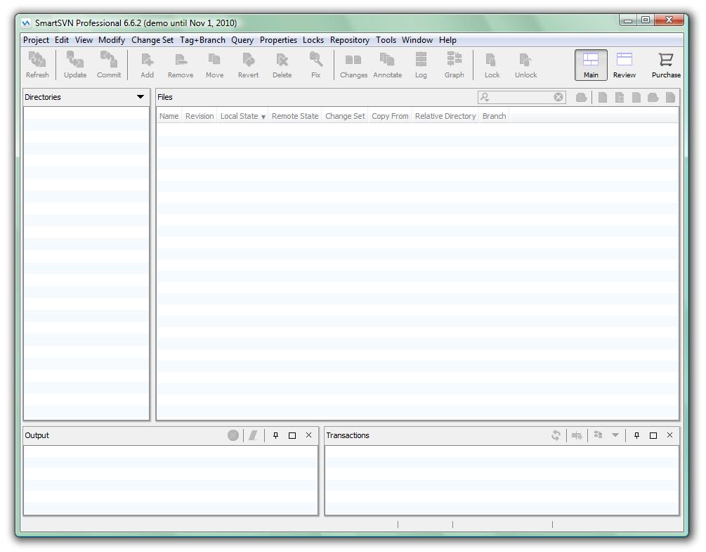
SmartSVN

Slide 3
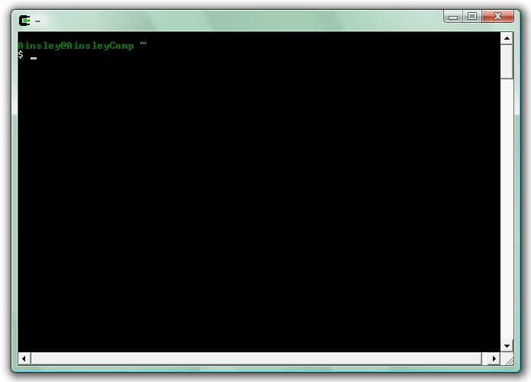
SmartSVN
Command Line

Slide 4
It’s fast.

Slide 5
It’s fast.
It’s simple.

Slide 6
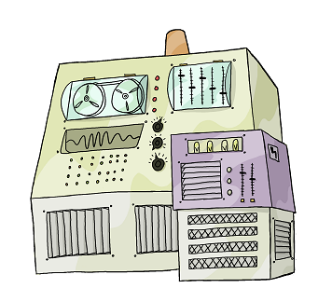

revision 6

Slide 7

$ svn checkout

Slide 8
$ svn co

Slide 9
$ svn co https://universal.software-carpentry.org
/cygwin/home/dracula/monsters

Slide 10
$ svn co https://universal.software-carpentry.org
/cygwin/home/dracula/monsters
repository

Slide 11
$ svn co https://universal.software-carpentry.org
/cygwin/home/dracula/monsters
working copy

Slide 12
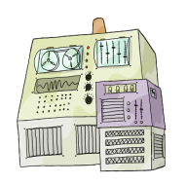
$ svn co https://universal.software-carpentry.org
/cygwin/home/dracula/monsters
A earth/carlsbad.txt
A earth/antarctica.txt
...
Checked out revision 6.
$
6
6

Slide 13
$ svn co https://universal.software-carpentry.org
/cygwin/home/dracula/monsters
A earth/carlsbad.txt
A earth/antarctica.txt
...
Checked out revision 6.
$ cd /cygwin/home/dracula/monsters
$
6

Slide 14
$ svn co https://universal.software-carpentry.org
/cygwin/home/dracula/monsters
A earth/carlsbad.txt
A earth/antarctica.txt
...
Checked out revision 6.
$ cd /cygwin/home/dracula/monsters
$ ls
earth mars jupiter …
$
6

Slide 15
$ svn log

Slide 16
$ svn log
Damn the budget – the Jovian moons would be …
--------------------------------------------
r6 | mummy | 2010-07-26 09:21:39 | 1 lines
The budget might not even stretch to a deep…
--------------------------------------------
r5 | mummy | 2010-07-26 09:19:18 | 1 lines
…
$
6

Slide 17
$ svn log
Damn the budget – the Jovian moons would be …
--------------------------------------------
r6 | mummy | 2010-07-26 09:21:39 | 1 lines
The budget might not even stretch to a deep…
--------------------------------------------
r5 | mummy | 2010-07-26 09:19:18 | 1 lines
…
$
6

Slide 18
$ svn log
Damn the budget – the Jovian moons would be …
--------------------------------------------
r6 | mummy | 2010-07-26 09:21:39 | 1 lines
The budget might not even stretch to a deep…
--------------------------------------------
r5 | mummy | 2010-07-26 09:19:18 | 1 lines
…
$
6

Slide 19
$ svn log
Damn the budget – the Jovian moons would be …
--------------------------------------------
r6 | mummy | 2010-07-26 09:21:39 | 1 lines
The budget might not even stretch to a deep…
--------------------------------------------
r5 | mummy | 2010-07-26 09:19:18 | 1 lines
…
$
6

Slide 20
$ cd jupiter
$
6

Slide 21
$ cd jupiter
$ nano moons.txt
GNU Nano
Name Orbital Radius Orbital Period Mass
Io 421.6 1.769138 893.2
Europa 670.9 3.551181 480.0
Ganymede 1070.4 7.154553 1481.9
Calisto 1882.7 16.689018 1075.9
…
$
6+

Slide 22
$ cd jupiter
$ nano moons.txt
GNU Nano
Name Orbital Radius Orbital Period Mass
Io 421.6 1.769138 893.2
Europa 670.9 3.551181 480.0
Ganymede 1070.4 7.154553 1481.9
Calisto 1882.7 16.689018 1075.9
…
$
see SWC lecture on “The Shell” for
details about file creation
6+

Slide 23
$ cd jupiter
$ nano moons.txt
GNU Nano
Name Orbital Radius Orbital Period Mass
Io 421.6 1.769138 893.2
Europa 670.9 3.551181 480.0
Ganymede 1070.4 7.154553 1481.9
Calisto 1882.7 16.689018 1075.9
…
$
6+

Slide 24
$ cd jupiter
$ nano moons.txt
GNU Nano
Name Orbital Radius Orbital Period Mass
Io 421.6 1.769138 893.2
Europa 670.9 3.551181 480.0
Ganymede 1070.4 7.154553 1481.9
Calisto 1882.7 16.689018 1075.9
…
$ svn add
6+

Slide 25
$ cd jupiter
$ nano moons.txt
GNU Nano
Name Orbital Radius Orbital Period Mass
Io 421.6 1.769138 893.2
Europa 670.9 3.551181 480.0
Ganymede 1070.4 7.154553 1481.9
Calisto 1882.7 16.689018 1075.9
…
$ svn add moons.txt
6+

Slide 26
$ cd jupiter
$ nano moons.txt
GNU Nano
Name Orbital Radius Orbital Period Mass
Io 421.6 1.769138 893.2
Europa 670.9 3.551181 480.0
Ganymede 1070.4 7.154553 1481.9
Calisto 1882.7 16.689018 1075.9
…
$ svn add moons.txt
A moons.txt
$
6+

Slide 27
revision 6
revision 6+

Slide 28
$ svn commit –m “Some basic facts about the
Galilean moons of Jupiter.”
6+

Slide 29
$ svn commit –m “Some basic facts about the
Galilean moons of Jupiter.”
6+

Slide 30
$ svn commit –m “Some basic facts about the
Galilean moons of Jupiter.”
6+

Slide 31
$ svn commit –m “Some basic facts about the
Galilean moons of Jupiter.”
Adding moons.txt
Transmitting file data . .
Committed revision 7.
$
7
7

Slide 32

revision 7
revision 6

Slide 33

$ cd /cygwin/home/wolfman/monsters
6

Slide 34
$ cd /cygwin/home/wolfman/monsters
$ svn update
6

Slide 35
$ cd /cygwin/home/wolfman/monsters
$ svn update
A jupiter/moons.txt
Updated to revision 7.
$
7
7

Slide 36
$ cd /cygwin/home/wolfman/monsters
$ svn update
A jupiter/moons.txt
Updated to revision 7.
$ cd jupiter
$ less moons.txt
Name Orbital Radius Orbital Period Mass
Amalthea 181.4 0.498179 0.075
Io 421.6 1.769138 893.2
Europa 670.9 3.551181 480.0
Ganymede 1070.4 7.154553 1481.9
Calisto 1882.7 16.689018 1075.9
7

Slide 37
$ cd /cygwin/home/wolfman/monsters
$ svn update
A jupiter/moons.txt
Updated to revision 7.
$ cd jupiter
$ less moons.txt
Name Orbital Radius Orbital Period Mass
Amalthea 181.4 0.498179 0.075
Io 421.6 1.769138 893.2
Europa 670.9 3.551181 480.0
Ganymede 1070.4 7.154553 1481.9
Calisto 1882.7 16.689018 1075.9
7

Slide 38
$ nano moons.txt
GNU Nano
Name Orbital Radius Orbital Period Mass
Io 421.6 1.769138 893.2
Europa 670.9 3.551181 480.0
Ganymede 1070.4 7.154553 1481.9
Callisto 1882.7 16.689018 1075.9
7+

Slide 39
$ nano moons.txt
GNU Nano
Name Orbital Radius Orbital Period Mass
Amalthea 181.4 0.498179 0.075
Io 421.6 1.769138 893.2
Europa 670.9 3.551181 480.0
Ganymede 1070.4 7.154553 1481.9
Callisto 1882.7 16.689018 1075.9
7+

Slide 40
$ nano moons.txt
GNU Nano
Name Orbital Radius Orbital Period Mass
Amalthea 181.4 0.498179 0.075
Io 421.6 1.769138 893.2
Europa 670.9 3.551181 480.0
Ganymede 1070.4 7.154553 1481.9
Callisto 1882.7 16.689018 1075.9
…
$ svn commit –m “1. Fixed typo Calisto->Callisto.
2. Added info about Amalthea.”
Sending jupiter/moons.txt
Transmitting file data .
Committed revision 8.
8
8

Slide 41
$ cd /cygwin/home/dracula/monsters
7

Slide 42
$ cd /cygwin/home/dracula/monsters
$ svn diff
7

Slide 43
$ cd /cygwin/home/dracula/monsters
$ svn diff –r HEAD
7

Slide 44
$ cd /cygwin/home/dracula/monsters
$ svn diff –r HEAD
7

Slide 45
$ cd /cygwin/home/dracula/monsters
$ svn diff –r HEAD
Index: jupiter/moons.txt
=================================================================
--- jupiter/moons.txt (revision 8)
+++ jupiter/moons.txt (working copy)
@@ -1,6 +1,5 @@
Name Orbital Radius Orbital Period Mass
-Amalthea 181.4 0.498179 0.075
Io 421.6 1.769138 893.2
Europa 670.9 3.551181 480.0
Ganymede 1070.4 7.154553 1481.9
-Callisto 1882.7 16.689018 1075.9
+Calisto 1882.7 16.689018 1075.9
$
7

Slide 46
$ cd /cygwin/home/dracula/monsters
$ svn diff –r HEAD
Index: jupiter/moons.txt
=================================================================
--- jupiter/moons.txt (revision 8)
+++ jupiter/moons.txt (working copy)
@@ -1,6 +1,5 @@
Name Orbital Radius Orbital Period Mass
-Amalthea 181.4 0.498179 0.075
Io 421.6 1.769138 893.2
Europa 670.9 3.551181 480.0
Ganymede 1070.4 7.154553 1481.9
-Callisto 1882.7 16.689018 1075.9
+Calisto 1882.7 16.689018 1075.9
$
7

Slide 47
$ cd /cygwin/home/dracula/monsters
$ svn diff –r HEAD
Index: jupiter/moons.txt
=================================================================
--- jupiter/moons.txt (revision 8)
+++ jupiter/moons.txt (working copy)
@@ -1,6 +1,5 @@
Name Orbital Radius Orbital Period Mass
-Amalthea 181.4 0.498179 0.075
Io 421.6 1.769138 893.2
Europa 670.9 3.551181 480.0
Ganymede 1070.4 7.154553 1481.9
-Callisto 1882.7 16.689018 1075.9
+Calisto 1882.7 16.689018 1075.9
$
7

Slide 48

$ cd /cygwin/home/dracula/monsters
$ svn diff –r HEAD
Index: jupiter/moons.txt
=================================================================
--- jupiter/moons.txt (revision 8)
+++ jupiter/moons.txt (working copy)
@@ -1,6 +1,5 @@
Name Orbital Radius Orbital Period Mass
-Amalthea 181.4 0.498179 0.075
Io 421.6 1.769138 893.2
Europa 670.9 3.551181 480.0
Ganymede 1070.4 7.154553 1481.9
-Callisto 1882.7 16.689018 1075.9
+Calisto 1882.7 16.689018 1075.9
$ svn update
G jupiter/moons.txt
Updated to revision 8.
8
8

Slide 49

revision 8
revision 8
revision 8

Slide 50
Dealing with Conflicts

Slide 51
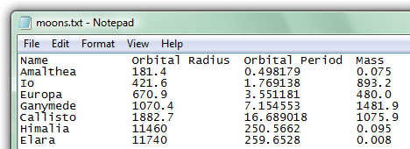
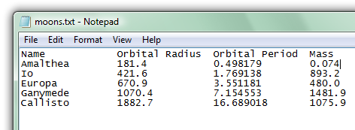
revision 8
revision 8+
revision 8+

Slide 52
revision 9
revision 8+
revision 9

Slide 53
$ svn commit -m “Added data for Himalia, Elara"
Sending jupiter/moons.txt
svn: Commit failed (details follow):
svn: File or directory 'moons.txt' is out of date;
try updating
svn: resource out of date; try updating
$
9
8+

Slide 54
$ svn commit -m “Added data for Himalia, Elara"
Sending jupiter/moons.txt
svn: Commit failed (details follow):
svn: File or directory 'moons.txt' is out of date;
try updating
svn: resource out of date; try updating
$
9
8+

Slide 55
$ svn commit -m “Added data for Himalia, Elara"
Sending jupiter/moons.txt
svn: Commit failed (details follow):
svn: File or directory 'moons.txt' is out of date;
try updating
svn: resource out of date; try updating
$ svn update
G jupiter/moons.txt
Updated to revision 9.
$
9
9+

Slide 56
$ svn commit -m “Added data for Himalia, Elara"
Sending jupiter/moons.txt
svn: Commit failed (details follow):
svn: File or directory 'moons.txt' is out of date;
try updating
svn: resource out of date; try updating
$ svn update
G jupiter/moons.txt
Updated to revision 9.
$ svn commit -m “Added data for Himalia, Elara"
Sending jupiter/moons.txt
Transmitting file data .
Committed revision 10.
$
10
10

Slide 57
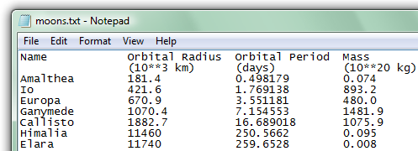
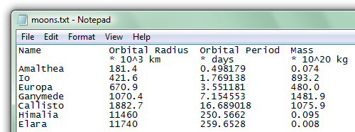
revision 10
revision 10+
revision 9+

Slide 58
revision 11
revision 11
revision 9+

Slide 59
$ svn commit -m “Added measurement units"
Sending jupiter/moons.txt
svn: Commit failed (details follow):
svn: File or directory 'moons.txt' is out of date;
try updating
svn: resource out of date; try updating
$
11
9+

Slide 60
$ svn commit -m “Added measurement units"
Sending jupiter/moons.txt
svn: Commit failed (details follow):
svn: File or directory 'moons.txt' is out of date;
try updating
svn: resource out of date; try updating
$ svn update
11
9+

Slide 61
$ svn commit -m “Added measurement units"
Sending jupiter/moons.txt
svn: Commit failed (details follow):
svn: File or directory 'moons.txt' is out of date;
try updating
svn: resource out of date; try updating
$ svn update
Conflict discovered in ‘jupiter/moons.txt'.
Select: (p) postpone, (df) diff-full, (e) edit,
(mc) mine-conflict, (tc) theirs-conflict,
(s) show all options:
11
9+

Slide 62
$ svn commit -m “Added measurement units"
Sending jupiter/moons.txt
svn: Commit failed (details follow):
svn: File or directory 'moons.txt' is out of date;
try updating
svn: resource out of date; try updating
$ svn update
Conflict discovered in ‘jupiter/moons.txt'.
Select: (p) postpone, (df) diff-full, (e) edit,
(mc) mine-conflict, (tc) theirs-conflict,
(s) show all options: df
11
9+

Slide 63
--- jupiter/.svn/text-base/moons.txt.svn-base Fri Oct 1 21:08
+++ jupiter/.svn/tmp/moons.txt.tmp Fri Oct 1 22:59
@@ -1,6 +1,11 @@
Name Orbital Radius Orbital Period Mass
+<<<<<<< .mine
+ * 10^3 km * days * 10^20 kg
+=======
+ (10**3 km) (days) (10**20 kg)
+>>>>>>> .r11
Amalthea 181.4 0.498179 0.074
Io 421.6 1.769138 893.2
Europa 670.9 3.551181 480.0
Ganymede 1070.4 7.154553 1481.9
Callisto 1882.7 16.689018 1075.9
Select: (p) postpone, (df) diff-full, (e) edit, (r) resolved,
(mc) mine-conflict, (tc) theirs-conflict,
(s) show all options:

Slide 64
--- jupiter/.svn/text-base/moons.txt.svn-base Fri Oct 1 21:08
+++ jupiter/.svn/tmp/moons.txt.tmp Fri Oct 1 22:59
@@ -1,6 +1,11 @@
Name Orbital Radius Orbital Period Mass
+<<<<<<< .mine
+ * 10^3 km * days * 10^20 kg
+=======
+ (10**3 km) (days) (10**20 kg)
+>>>>>>> .r11
Amalthea 181.4 0.498179 0.074
Io 421.6 1.769138 893.2
Europa 670.9 3.551181 480.0
Ganymede 1070.4 7.154553 1481.9
Callisto 1882.7 16.689018 1075.9
Select: (p) postpone, (df) diff-full, (e) edit, (r) resolved,
(mc) mine-conflict, (tc) theirs-conflict,
(s) show all options:

Slide 65
--- jupiter/.svn/text-base/moons.txt.svn-base Fri Oct 1 21:08
+++ jupiter/.svn/tmp/moons.txt.tmp Fri Oct 1 22:59
@@ -1,6 +1,11 @@
Name Orbital Radius Orbital Period Mass
+<<<<<<< .mine
+ * 10^3 km * days * 10^20 kg
+=======
+ (10**3 km) (days) (10**20 kg)
+>>>>>>> .r11
Amalthea 181.4 0.498179 0.074
Io 421.6 1.769138 893.2
Europa 670.9 3.551181 480.0
Ganymede 1070.4 7.154553 1481.9
Callisto 1882.7 16.689018 1075.9
Select: (p) postpone, (df) diff-full, (e) edit, (r) resolved,
(mc) mine-conflict, (tc) theirs-conflict,
(s) show all options:

Slide 66
--- jupiter/.svn/text-base/moons.txt.svn-base Fri Oct 1 21:08
+++ jupiter/.svn/tmp/moons.txt.tmp Fri Oct 1 22:59
@@ -1,6 +1,11 @@
Name Orbital Radius Orbital Period Mass
+<<<<<<< .mine
+ * 10^3 km * days * 10^20 kg
+=======
+ (10**3 km) (days) (10**20 kg)
+>>>>>>> .r11
Amalthea 181.4 0.498179 0.074
Io 421.6 1.769138 893.2
Europa 670.9 3.551181 480.0
Ganymede 1070.4 7.154553 1481.9
Callisto 1882.7 16.689018 1075.9
Select: (p) postpone, (df) diff-full, (e) edit, (r) resolved,
(mc) mine-conflict, (tc) theirs-conflict,
(s) show all options: e

Slide 67
GNU Nano
Name Orbital Radius Orbital Period Mass
<<<<<<< .mine
+ * 10^3 km * days * 10^20 kg
+=======
+ (10**3 km) (days) (10**20 kg)
+>>>>>>> .r11
Amalthea 181.4 0.498179 0.074
Io 421.6 1.769138 893.2
Europa 670.9 3.551181 480.0
Ganymede 1070.4 7.154553 1481.9
Callisto 1882.7 16.689018 1075.9
…

Slide 68
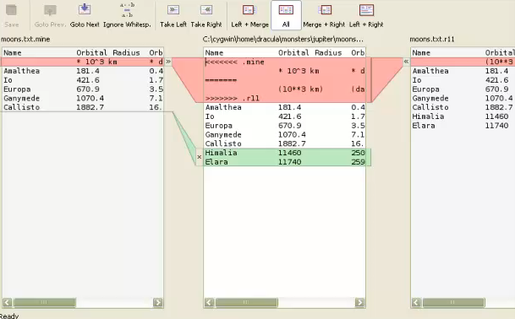
GNU Nano
Name Orbital Radius Orbital Period Mass
<<<<<<< .mine
+ * 10^3 km * days * 10^20 kg
+=======
+ (10**3 km) (days) (10**20 kg)
+>>>>>>> .r11
Amalthea 181.4 0.498179 0.074
Io 421.6 1.769138 893.2
Europa 670.9 3.551181 480.0
Ganymede 1070.4 7.154553 1481.9
Callisto 1882.7 16.689018 1075.9
…

Slide 69
GNU Nano
Name Orbital Radius Orbital Period Mass
<<<<<<< .mine
+ * 10^3 km * days * 10^20 kg
+=======
+ (10**3 km) (days) (10**20 kg)
+>>>>>>> .r11
Amalthea 181.4 0.498179 0.074
Io 421.6 1.769138 893.2
Europa 670.9 3.551181 480.0
Ganymede 1070.4 7.154553 1481.9
Callisto 1882.7 16.689018 1075.9
…

Slide 70
GNU Nano
Name Orbital Radius Orbital Period Mass
* 10^3 km * days * 10^20 kg
Amalthea 181.4 0.498179 0.074
Io 421.6 1.769138 893.2
Europa 670.9 3.551181 480.0
Ganymede 1070.4 7.154553 1481.9
Callisto 1882.7 16.689018 1075.9
…

Slide 71
Select: (p) postpone, (df) diff-full, (e) edit, (r) resolved,
(mc) mine-conflict, (tc) theirs-conflict,
(s) show all options:
11
9+

Slide 72
Select: (p) postpone, (df) diff-full, (e) edit, (r) resolved,
(mc) mine-conflict, (tc) theirs-conflict,
(s) show all options: r
11
9+

Slide 73
Select: (p) postpone, (df) diff-full, (e) edit, (r) resolved,
(mc) mine-conflict, (tc) theirs-conflict,
(s) show all options: r
Updated to revision 11.
$
11
11+

Slide 74
Select: (p) postpone, (df) diff-full, (e) edit, (r) resolved,
(mc) mine-conflict, (tc) theirs-conflict,
(s) show all options: r
Updated to revision 11.
$ svn commit -m “Added measurement units“
Sending jupiter/moons.txt
Transmitting file data .
Committed revision 12.
12
12

Slide 75
Rollback

Slide 76
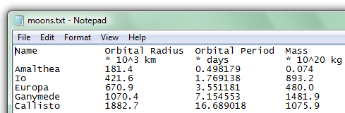
revision 12
revision 12

Slide 77
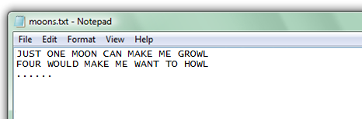
revision 12
revision 12+

Slide 78
revision 12
UNDO!
revision 12+

Slide 79
$ cd /cygwin/home/wolfman/monsters/jupiter
$
12+

Slide 80
$ cd /cygwin/home/wolfman/monsters/jupiter
$ svn revert
12+

Slide 81
$ cd /cygwin/home/wolfman/monsters/jupiter
$ svn revert moons.txt
12+

Slide 82
$ cd /cygwin/home/wolfman/monsters/jupiter
$ svn revert moons.txt
Reverted moons.txt
$
12

Slide 83
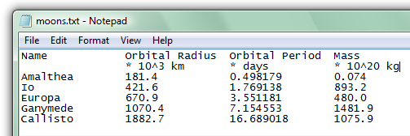
revision 12
revision 12

Slide 84
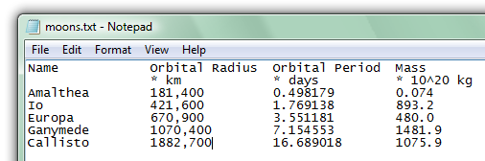
revision 12
revision 12+

Slide 85
revision 13
revision 13

Slide 86
revision 13
I want to reverse!
revision 13

Slide 87
NO ERASING!
10
11
12
13

Slide 88
merge
10
11
12
13
14

Slide 89
$ cd /cygwin/home/dracula/monsters/jupiter
$ svn merge
13

Slide 90
$ cd /cygwin/home/dracula/monsters/jupiter
$ svn merge -r
13

Slide 91
$ cd /cygwin/home/dracula/monsters/jupiter
$ svn merge –r HEAD:12
13

Slide 92
$ cd /cygwin/home/dracula/monsters/jupiter
$ svn merge –r HEAD:12 moons.txt
13

Slide 93
$ cd /cygwin/home/dracula/monsters/jupiter
$ svn merge –r HEAD:12 moons.txt
-- Reverse-merging r13 into ‘moons.txt’
U moons.txt
$
13+

Slide 94
$ cd /cygwin/home/dracula/monsters/jupiter
$ svn merge –r HEAD:12 moons.txt
-- Reverse-merging r13 into ‘moons.txt’
U moons.txt
$ svn diff
...
$
13+

Slide 95
$ cd /cygwin/home/dracula/monsters/jupiter
$ svn merge –r HEAD:12 moons.txt
-- Reverse-merging r13 into ‘moons.txt’
U moons.txt
$ svn diff
...
$ svn commit –m “Alright, no commas.”
Sending jupiter/moons.txt
Transmitting file data .
Committed revision 14.
14
14

Slide 96
svn co | check out repository
svn log | view change history
svn add | add file
svn commit | commit file
svn update | update to most recent revision
svn diff | view differences between revisions
svn merge | merge revisions

Slide 97
created by
Ainsley Lawson
October 2010
Copyright © Software Carpentry 2010
This work is licensed under the Creative Commons Attribution License
See http://software-carpentry.org/license.html for more information.

