Slide 1

Version Control
Rollback
Copyright © Software Carpentry 2010
This work is licensed under the Creative Commons Attribution License
See http://software-carpentry.org/license.html for more information.

Slide 2
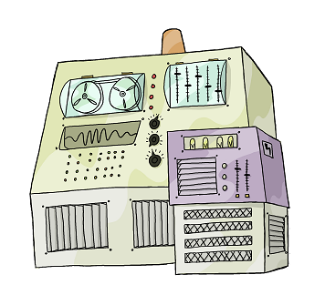

revision 12
revision 12

Slide 3
revision 12
Name Orbital Radius ...
* 10^3 KM ...
Amalthea 181.4 ...
Io 421.6 ...
Europa 670.9 ...
Ganymede 1070.4 ...
Callisto 1882.7 ...
revision 12

Slide 4

revision 12
Name Orbital Radius ...
* 10^3 KM ...
Amalthea 181.4 ...
Io 421.6 ...
Europa 670.9 ...
Ganymede 1070.4 ...
Callisto 1882.7 ...
revision 12

Slide 5
revision 12
Just one moon can make me growl
four would make me want to howl
...
revision 12 +

Slide 6
revision 12
Just one moon can make me growl
four would make me want to howl
...
revision 12 +

Slide 7
revision 12
Name Orbital Radius ...
* 10^3 KM ...
Amalthea 181.4 ...
Io 421.6 ...
Europa 670.9 ...
Ganymede 1070.4 ...
Callisto 1882.7 ...
revision 12

Slide 8

revision 12
Name Orbital Radius ...
* 10^3 KM ...
Amalthea 181.4 ...
Io 421.6 ...
Europa 670.9 ...
Ganymede 1070.4 ...
Callisto 1882.7 ...
revision 12

Slide 9
revision 12
Name Orbital Radius ...
Amalthea 181,400 ...
Io 421,600 ...
Europa 670,900 ...
Ganymede 1,070,400 ...
Callisto 1,882,700 ...
revision 12 +

Slide 10
revision 13
Name Orbital Radius ...
Amalthea 181,400 ...
Io 421,600 ...
Europa 670,900 ...
Ganymede 1,070,400 ...
Callisto 1,882,700 ...
revision 13

Slide 11
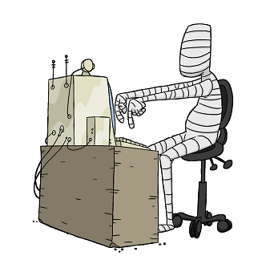
revision 13
Name Orbital Radius ...
Amalthea 181,400 ...
Io 421,600 ...
Europa 670,900 ...
Ganymede 1,070,400 ...
Callisto 1,882,700 ...
revision 13

Slide 12
revision 13
!
Name Orbital Radius ...
Amalthea 181,400 ...
Io 421,600 ...
Europa 670,900 ...
Ganymede 1,070,400 ...
Callisto 1,882,700 ...
revision 13

Slide 13
10
11
12
13

Slide 14
10
11
12
13

Slide 15
10
11
12
13
14

Slide 16
merge
10
11
12
13
14

Slide 17
branching

Slide 19


Slide 20
10
11
12
13
14
15

Slide 21
branch
10
11
12
13
14
15

Slide 22
12
13
14
15
10
11
12
13
14
15

Slide 23
12
13
14
15
10
11
12
13
14
15

Slide 24
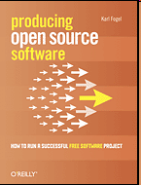
Karl Fogel: Producing Open Source Software:
How to Run a Successful Free Software Project.
O’Reilly Media, 2005, 0596007590.

Slide 25
Karl Fogel: Producing Open Source Software:
How to Run a Successful Free Software Project.
O’Reilly Media, 2005, 0596007590.
Laura Wingerd and Christopher Seiwald:
"High-level Best Practices in Software Configuration
Management". Perforce Software, last updated 2010,
http://www.perforce.com/perforce/papers/bestpractices.html

Slide 26
created by
Greg Wilson
July 2010
Copyright © Software Carpentry 2010
This work is licensed under the Creative Commons Attribution License
See http://software-carpentry.org/license.html for more information.

