Slide 1
Topics to be covered in Unit 6
Enumerated, Structure, and Union types – The type definition (typedef), enumerated types, Structure, Unions
Files – File name, file information table, streams, text and binary streams, stream file processing, system created steams,
Standard library I/O functions, file open and close, Formatting I/O functions,
Character I/O functions,
Binary I/O,
Standard library functions

Slide 2
Enumerated, Structure and Union Types
Objectives
❏ To introduce the structure, union, and enumerated types
❏ To use the type definition statement in programs
❏ To use enumerated types
❏ To create and use structures in programs
❏ To be able to use unions in programs

Slide 3
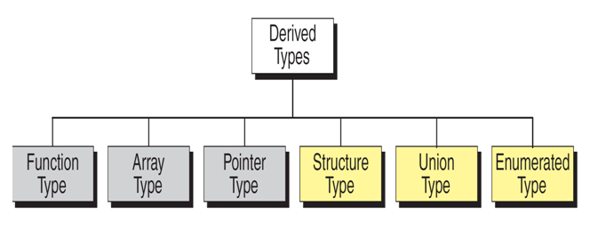
Derived Types

Slide 4
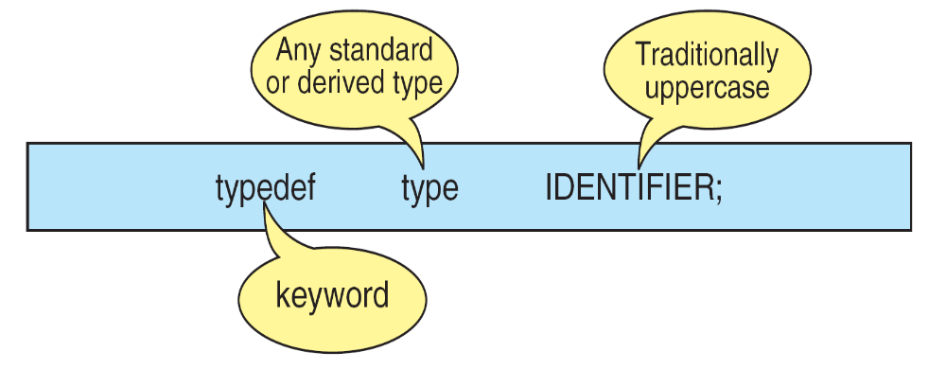
The Type Definition (typedef)
A type definition, typedef, gives a name to a data type by creating a new type that can then be used anywhere a type is permitted.
Its purpose is to redefine the name of an existing variable type.
Type-definition Format

Slide 5
The general syntax of the typedef is as follows,
typedef data_type IDENTIFIER;
where typedef is the keyword that tells the compiler about the type definition, data_type refers to an existing data type and IDENTIFIER refers the “new” name given to the data type.
Note that using typedef, we are not creating new data types.
Instead we are creating only new name for the existing data type.
These new data type names are called user-defined data types.

Slide 6
Suppose we want to store marks scored in various subjects in variables sub1, sub2 and sub3. These variables can be declared as follows,
int sub1, sub2, sub3;
Using the user-defined data types, the variables can be declared as shown below,
typedef int MARKS;
MARKS sub1, sub2, sub3;

Slide 7
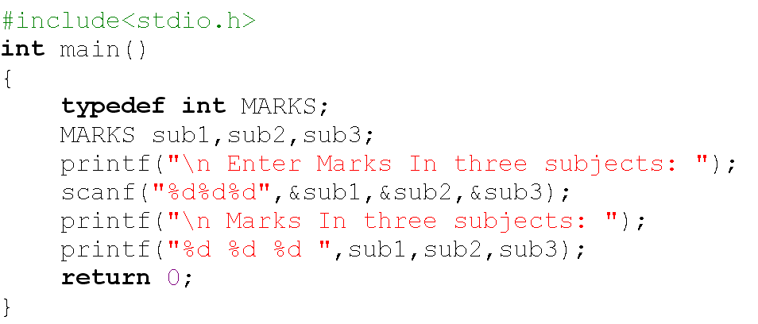
//Example program to demonstrate typedef

Slide 8
Enumerated Types
The enumerated type is a user-defined type based on the standard integer type.
In an enumerated type, each integer value is given an identifier called an enumeration constant.

Slide 9
Declaring an Enumerated Type:
To declare an enumerated type, we must declare its identifier and its values. Because it is derived from integer type, its operations are the same as for integers.
Syntax for defining an enumerated type is as follows,
enum type_Name
{
member1;
member2;
….
….
};

Slide 10
Where enum is the keyword that tells the compiler about enumerated type definition, enum type_Name together represent the user defined data type and member1, member2… are integer constants but represented using descriptive names. These are called enumerator constants or enumerators.
The definition is terminated with a semicolon.
The syntax for declaring the variables are shown below:
enum type_Name var;

Slide 11
Following are some of the examples of enumerator type:
enum color
{
RED,
BLUE,
GREEN
};
enum color c1, c2;
enum days
{
SUNDAY,
MONDAY,
…
SATURDAY
} d1;

Slide 12
Assigning Values to Enumerated Types
After an enumerated variable has been declared, we can store values in it.
While, the compiler automatically assigns values to enumerated types starting with 0, the next values are initialized with a value by adding 1 to previous value.
For example,
enum color {RED, BLUE, GREEN, WHITE};
Here red representing the value 0, blue is 1, green is 2, white is 3.
You can also create variables from the enumerated type.
For example, enum color skyColor;

Slide 13
We can override it and assign our own values.
For example, to make JAN start with 1 we could use the following declaration.
enum month
{
JAN=1, FEB, MAR, APR, MAY,JUN, JUL, AUG, SEP, OCT, NOV, DEC
}m1;
Note that we need not to assign every enumerator constant value. If we omit the initializes, the complier assigns the next value by adding 1.
Consider the following enumerated declaration,
enum days
{
sun=3, mon, tue, wed=0, thu, fri, sat
} d1, d2;

Slide 14
//Example program to demonstrate enum
#include<stdio.h>
main()
{
enum color
{
RED,
GREEN,
BLUE
}c1;
printf("%d %d %d",RED,GREEN,BLUE);
c1 = BLUE;
printf("\n%d ",c1);
}
Output:
0 1 2
2

Slide 15
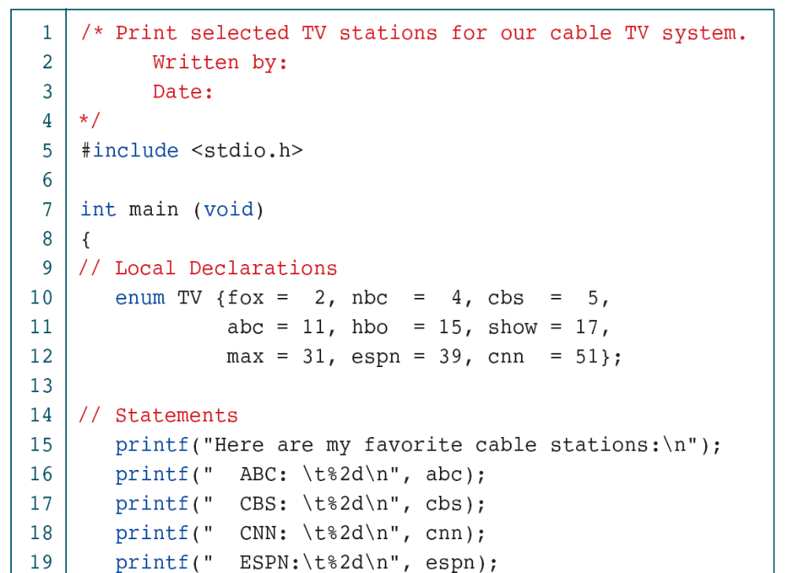

Slide 16
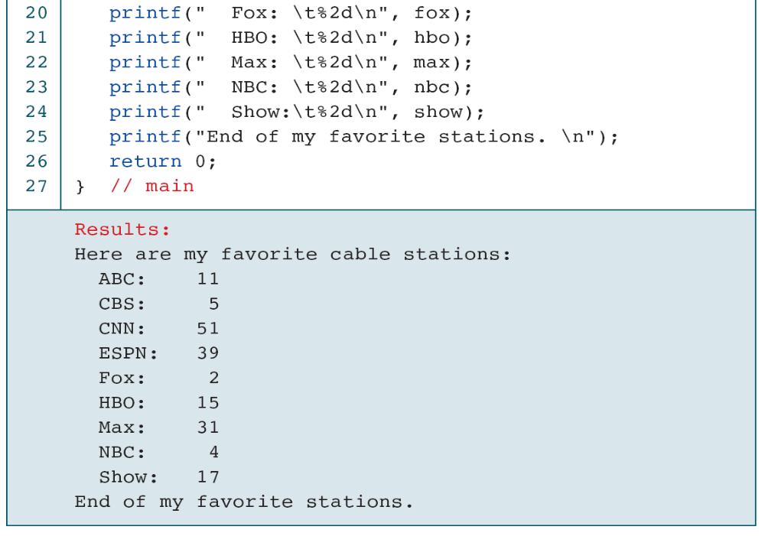

Slide 17
#include<stdio.h>
#include<conio.h>
enum ABC {x,y,z};
void main() {
int a;
clrscr();
a=x+y+z; //0+1+2
printf("Sum: %d",a);
getch();
}
Output-sum:3
#include<stdio.h>
#include<conio.h>
enum week {sun, mon, tue, wed, thu, fri, sat};
void main()
{
enum week today;
today=tue;
printf("%d day",today+1);
getch();
}
Output-3 day

Slide 18
Structure
A structure is a collection of related elements, possibly of different types, having a single name.
DEFINITION OF STRUCTURES:
Like all data types, structures must be declared and defined.
A structure definition forms a template that may be used to crate structure objects.
C has two ways to define a structure:
tagged structure and type-defined structures.

Slide 19
TAGGED STRUCTURE:
The structure definition associated with the structure name is referred as tagged structure.
It does not create an instance of a structure and does not allocate any memory.
The general form or syntax of tagged structure definition is as follows,
struct tag_name
{
type1 member1;
type2 member2;
……………
};
where struct is the keyword which tells the compiler that a structure is being defined, tag_name is the name of the structure and member1, member2 … are called members of the structure.
The members are declared within curly braces.
The closing brace must end with the semicolon.

Slide 20
Example: Student details using tagged structure
struct student
{
char name [10];
int roll_number;
float avg_marks;
}; // no memory is allocated for the structure
Memory is not reserved for the structure definition since no variables are associated with the structure definition.
The members of the structure do not occupy any memory until they are associated with the structure variables.
The declaration of the structure variable takes of the form:
struct tag_name var1, var2…;
Where, struct is the keyword, tag_name is the name of the structure.
Structure variables are separated by comma, followed by semicolon.

Slide 21
Structure variable names can be created any where in the program.
For example the variable declaration as follows:
struct student s1; // memory is allocated for the variable
Now a variable of type struct student (derived type) is created and the memory is allocated for the variable s1.
The following figure shows the memory organization for the above example s1.
10 Bytes 2 Bytes 4 Bytes

Slide 22
The number of bytes allocated for the structure variable is the sum of sizes of the individual members.
In the above example the size of s1=16 bytes (10+2+4).
You can also create structure variables in the following way:
struct tag_name
{
type1 member1;
type2 member2;
……………
}var1, var2…; //Here each variable occupies memory.
Example: Student details using structure variables.
struct student
{
char name [10];
int roll_number;
float avg_marks;
}s1; //Here memory is allocated for a variable s1.

Slide 23
We can omit the tag_name from the structure definition, the following is valid.
struct
{
char name [10];
int roll_number; float avg_marks;
} s1, s2;
Declares s1 and s2 as structure variables representing two students.
This structure definition and declaration is normally not used because we can not declare variables in later stage in the program.

Slide 24
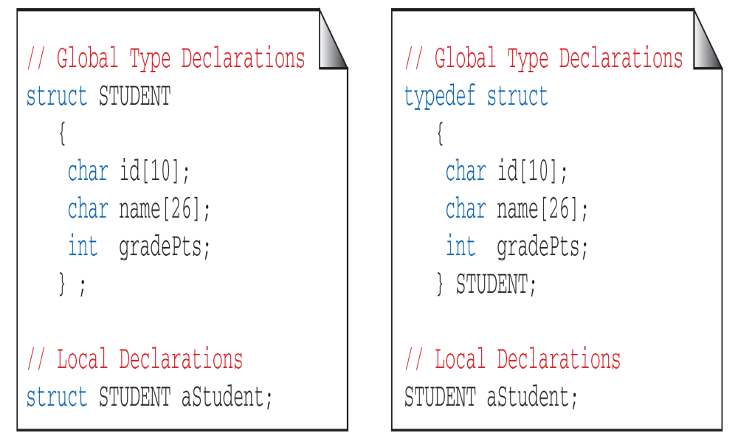
Structure Declaration Format

Slide 25
TYPEDEFINED STRUCTURE:
The structure definition associated with keyword typedef is called type-defined structure. This is the most powerful way of defining the structure.
The syntax of typedefined structure is:
typedef struct
{
type1 member1;
type2 member2;
……
} TYPE_ID;
Where, typedef is keyword added to the beginning of the definition, struct is the keyword which tells the compiler that a structure is being defined and member1, member2…are called fields of the structure.
The closing brace must end with type definition name which in turn ends with semicolon.

Slide 26
Example: Student details
typedef struct /*Structure Definition*/
{
char name [10];
int roll_number;
float avg_marks;
} STUDENT; //no memory is allocated for structure
/*Structure Declaration*/
STUDENT s1, s2; //memory is allocated for the variables
Note: Using typedef it is not possible to declare a variable. But, we can have user defined data type. TYPE_ID can be treated as the new data type.

Slide 27
INITIALIZATION OF STRUCTURES:
The rules for structure initialization are similar to the rules for array initialization.
The initializers are enclosed in braces and separate by commas.
They must match their corresponding types in the structure definition.
The syntax is shown below:
struct tag_name variable = {value1, value2,… valuen};
Structure initialization can be done in any of the following initializations.
Initialization along with Structure definition
Consider the structure definition for student with three fields name, roll number and average marks. The initialization of variable can be done as shown below:
struct student
{
char name [5];
int roll_number;
float avg;
} s1= {“Ravi”, 10, 67.8};

Slide 28
Initialization during Structure declaration:
Consider the structure definition for student with three fields name, roll number and average marks. The initialization of variable can be done as shown below,
struct student
{
char name[5];
int roll_number;
float avg;
};
struct student s1= {“Ravi”, 10, 67.8};

Slide 29
Initializing Structures

Slide 30
Points to Remember:
The members of the structure cannot be initialized in the structure definition.
For example,
struct s
{
char name [10] ="ravi”;
int rno;
} s1; //It is invalid.
The initial values are assigned to members of the structure on one-to-one basis i.e., the values are assigned to various members in the order specified from the first member.
For example,
s1= {“ravi”, 60, 56.7};
is valid. Here, the string “ravi” will be assigned to the first member, 60 is assigned to the second member and 56.7 is assigned to the third member.

Slide 31
During partial initialization, the values are assigned to members in the order specified and the remaining members are initialized with garbage values.
For example,
s1= {“ravi”};
will assign the string “ravi” to name and the remaining members are initialized to garbage values.
However the statement, s1= {40, 67.8};
is invalid, because, without initializing the first member name, we are trying to initialize last two members.
During initialization, the number of initializers should not exceed the number of members. It leads to syntax error.
For example, s1= {“ravi”, 45, 78.9, 89};
The compiler issues a syntax error “too many initializers”

Slide 32
ACCESSING STRUCTURES:
The members of a structure can be accessed by using dot(.) operator.
Before dot, there must always be a structure variable.
After the dot, there must always be a structure member.
The syntax to access the structure members as follows:
structure_variable_name. structure_member_name
For example, consider the example as shown below,
struct student
{
char name [5];
int roll_number;
float avg;
};
struct student s1= {“Ravi”, 10, 67.8};
The members can be accessed using the variables as shown below:
s1.name //refers the string “ravi”
s1.roll_number //refers the roll_number 10
s1.avg //refers avg 67.8

Slide 33
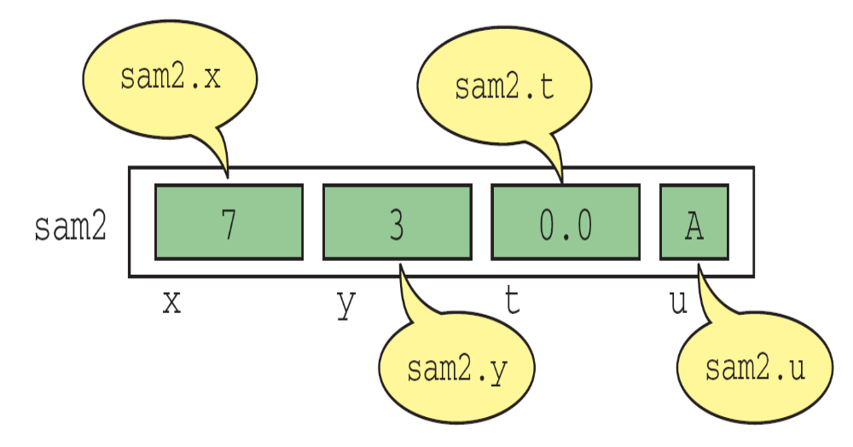
Structure Direct Selection Operator

Slide 34
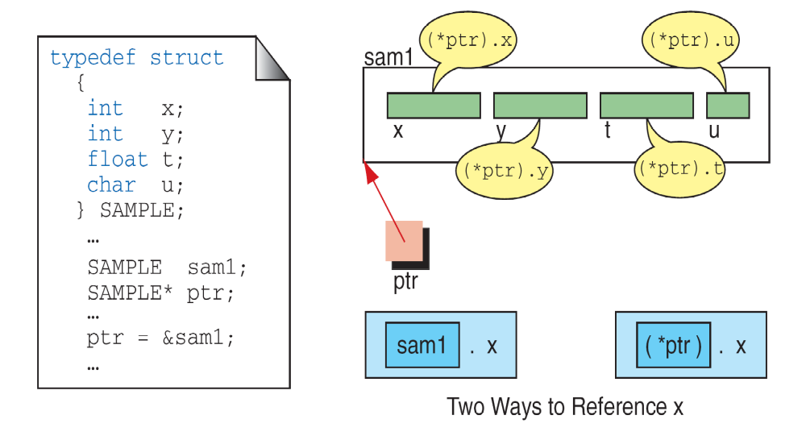
(*pointerName).fieldName ↔ pointerName⁻>fieldName
Pointers to Structures

Slide 35
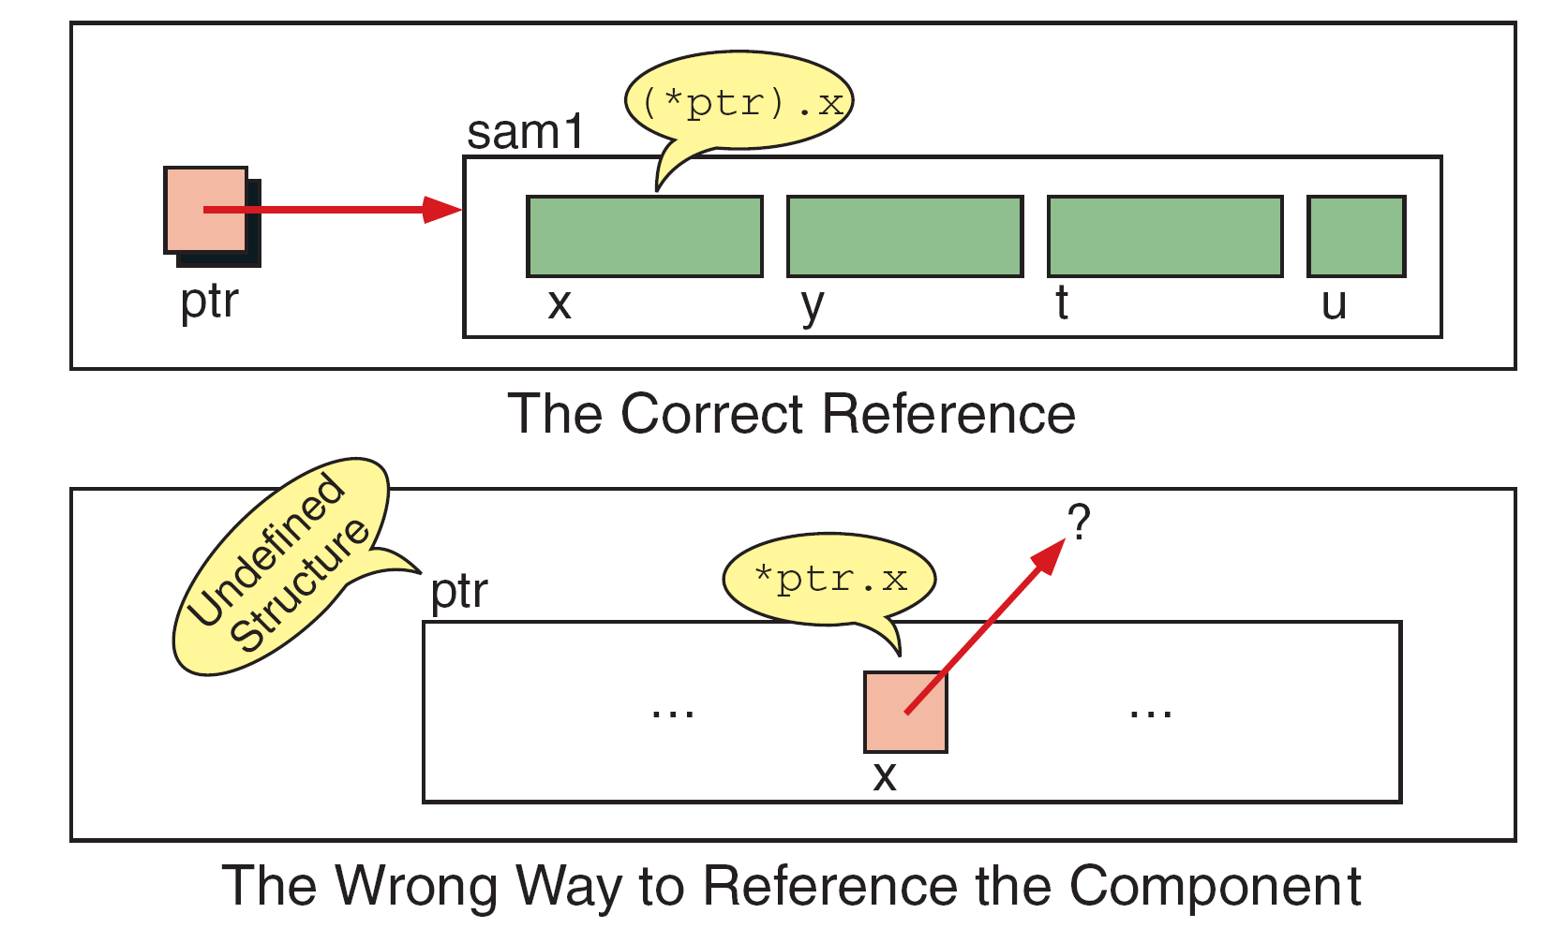
Interpretation of Invalid Pointer Use

Slide 36
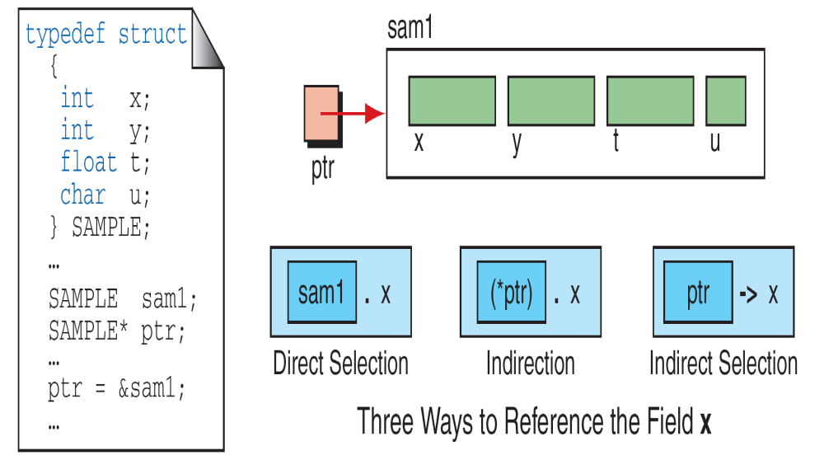
Indirect Selection Operator

Slide 37
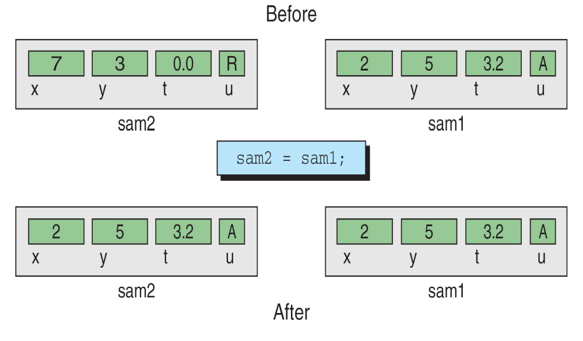
Copying a Structure

Slide 38
Using normal variable | Using pointer variable
Syntax: struct tag_name { data type var_name1; data type var_name2; data type var_name3; }; | Syntax: struct tag_name { data type var_name1; data type var_name2; data type var_name3; };
Example: struct student { int mark; char name[10]; float average; }; | Example: struct student { int mark; char name[10]; float average; };
Declaring structure using normal variable: struct student report; | Declaring structure using pointer variable: struct student *report, rep;
Initializing structure using normal variable: struct student report = {100, “Mani”, 99.5}; | Initializing structure using pointer variable: struct student rep = {100, “Mani”, 99.5}; report = &rep;
Accessing structure members using normal variable: report.mark; report.name; report.average; | Accessing structure members using pointer variable: report -> mark; report -> name; report -> average;

Slide 39
#include <stdio.h>
#include <string.h>
struct student
{
int id;
char name[20];
float percentage;
};
int main()
{
struct student record = {0}; //Initializing to null
record.id=1;
strcpy(record.name, "Raju");
record.percentage = 86.5;
printf(" Id is: %d \n", record.id);
printf(" Name is: %s \n", record.name);
printf(" Percentage is: %f \n", record.percentage);
return 0;
}
OUTPUT:
Id is: 1
Name is: Raju
Percentage is: 86.500000

Slide 40
#include <stdio.h>
#include <string.h>
struct Books {
char title[50];
char author[50];
char subject[100];
int book_id;
};
int main( ) {
struct Books Book1;
struct Books Book2;
strcpy( Book1.title, "C Programming");
strcpy( Book1.author, "Nuha Ali");
strcpy( Book1.subject, "C Programming Tutorial");
Book1.book_id = 6495407;
strcpy( Book2.title, "Telecom Billing");
strcpy( Book2.author, "Zara Ali"); strcpy( Book2.subject, "Telecom Billing Tutorial"); Book2.book_id = 6495700;
printf( "Book 1 title : %s\n", Book1.title);
printf( "Book 1 author : %s\n", Book1.author);
printf( "Book 1 subject : %s\n", Book1.subject);
printf( "Book 1 book_id : %d\n", Book1.book_id);

Slide 41
printf( "Book 2 title : %s\n", Book2.title);
printf( "Book 2 author : %s\n", Book2.author);
printf( "Book 2 subject : %s\n", Book2.subject);
printf( "Book 2 book_id : %d\n", Book2.book_id);
return 0;
}
Output:
Book 1 title : C Programming
Book 1 author : Nuha Ali
Book 1 subject : C Programming Tutorial
Book 1 book_id : 6495407
Book 2 title : Telecom Billing
Book 2 author : Zara Ali
Book 2 subject : Telecom Billing Tutorial
Book 2 book_id : 6495700

Slide 42
Arrays with in structures:
It is also possible to declare an array as a member of structure, like declaring ordinary variables.
For example to store marks of a student in three subjects then we can have the following definition of a structure.
struct student
{
char name [5];
int roll_number;
int marks [3];
float avg;
};
Then the initialization of the array marks done as follows,
struct student s1= {“ravi”, 34, {60,70,80}};
The values of the member marks array are referred as follows,
s1.marks [0] will refer the 0th element in the marks
s1.marks [1] will refer the 1st element in the marks
s1.marks [2] will refer the 2ndt element in the marks

Slide 43
ARRAY OF STRUCTURES:
We can also create array of structures. Array of structures can be declared as follows:
struct tag_name array_name[size];
Let’s take an example, to store the information of 3 students, we can have the following structure definition and declaration,
struct student
{
char name[10];
int rno;
float avg;
};
struct student s[3];

Slide 44
The above code defines an array called s, which contains three elements. Each element is defined to be of type struct student.
For the student details, array of structures can be initialized as follows,
struct student s[3] = {
{“ABC”, 1, 56.7},
{“xyz”, 2, 65.8},
{“pqr”, 3, 82.4}
};

Slide 45
#include<stdio.h>
struct student {
int rollno;
char name[20];
};
main() {
struct student s1 = {1222,"sreenu"};
printf("\n%d %s",s1.rollno,s1.name);
}
#include<stdio.h>
typedef struct {
int rollno;
char name[20];
}student;
main() {
student s1 = {1222,"sreenu"};
printf("\n%d %s",s1.rollno,s1.name);
}
#include<stdio.h>
struct student {
int rollno;
char name[20];
}s1;
main() {
s1.rollno = 1222;
gets(s1.name);
printf("\n%d %s",s1.rollno,s1.name);
}

Slide 46
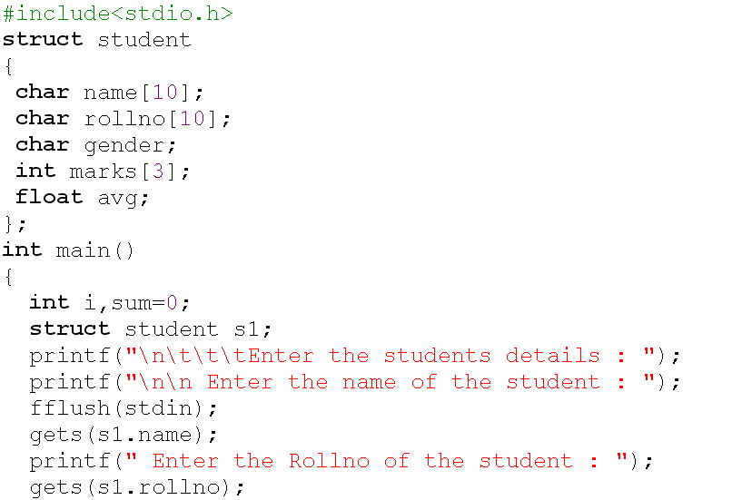

Slide 47
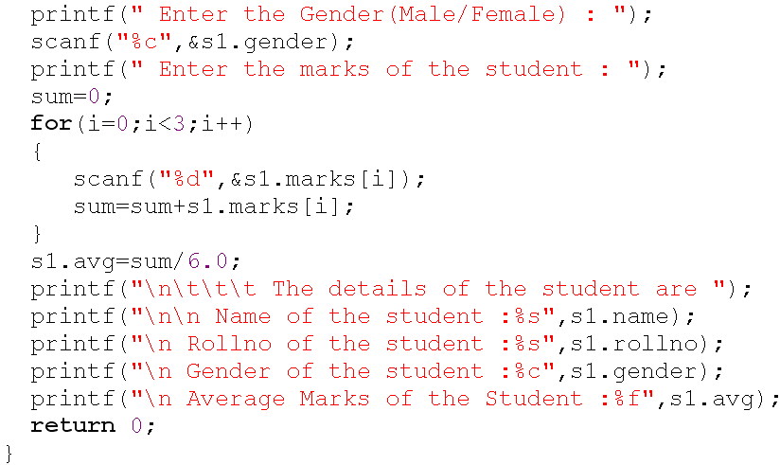

Slide 48
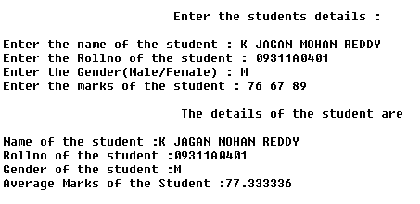

Slide 49
#include<stdio.h>
#include<conio.h>
#include<string.h>
struct student{
int rollno;
char name[10];
};
void main(){
int i;
struct student st[5];
clrscr();
printf("Enter Records of 5 students");
for(i=0;i<5;i++){
printf("\nEnter Rollno:");
scanf("%d",&st[i].rollno);
printf("\nEnter Name:");
scanf("%s",&st[i].name);
} printf("\nStudent Information List:");
for(i=0;i<5;i++){
printf("\nRollno:%d, Name:%s",st[i].rollno,st[i].name);
}
getch();
}

Slide 50
Enter Records of 5 students
Enter Rollno:1
Enter Name:Sonoo
Enter Rollno:2
Enter Name:Ratan
Enter Rollno:3
Enter Name:Vimal
Enter Rollno:4
Enter Name:James
Enter Rollno:5
Enter Name:Sarfraz
Student Information List:
Rollno:1,
Name:Sonoo
Rollno:2, Name:Ratan
Rollno:3, Name:Vimal
Rollno:4, Name:James
Rollno:5,Name:Sarfraz

Slide 51
NESTED STRUCTURES:
A structure which includes another structure is called nested structure.
The syntax for the nesting of the structure as follows:
struct tag_name1
{
type1 member1;
…….
…….
};
struct tag_name2
{
type1 member1;
……
……
struct tag_name1 var;
……
};
The syntax for accessing members of a nested structure as follows,
outer_structure_variable.inner_structure_variable.membername

Slide 52
Example:
struct data
{
int day;
int month;
int year;
};
struct student
{
char name [10];
int roll_number;
struct data dob;
int marks [3];
float avg;
} s1;
The members contained in the inner structure namely day, month and year can be referred to as
s1.dob.day
s1.dob.month
s1.dob.year

Slide 53
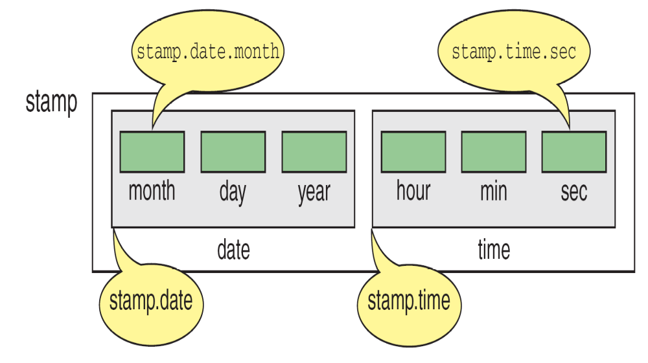
Nested Structure

Slide 54
SELF-REFERENTIAL STRUCTURE
A structure definition which includes at least one member as a pointer to the same structure is known as self-referential structure.
It can be linked together to form useful data structures such as lists, queues, stacks and trees.
Terminated with a NULL pointer (0).
The syntax for using the self referential structure as follows,
struct tag_name
{
type1 member1;
type2 member2;
….
struct tag_name *next;
};

Slide 55
//Program to demonstrate structure with functions.
#include<stdio.h>
struct student
{
int rollno;
char name[20];
}s1;
void display(struct student);
main()
{
s1.rollno = 1222;
gets(s1.name);
display(s1);
}
void display(struct student s2)
{
printf("%d%s",s2.rollno,s2.name);
}

Slide 56
UNIONS
A union is one of the derived data type.
Union is a collection of variables referred under a single name.
The syntax, declaration and use of union is similar to the structure but its functionality is different.
The major distinction between structure and union is, in terms of storage.
In structure each member has its own storage location, whereas all the members of a union use the same location.
Although a union may contain many members of different types, it can handle only one member at a time.

Slide 57
The general format or syntax of a union definition is as follows,
union tag_name
{
type1 member1;
type2 member2;
……..
};
The compiler allocates a piece of storage that is large enough to hold the largest variable type in the union.
A union variable can be declared same way as structure variable.
union tag_name var1, var2...;

Slide 58
A union definition and variable declaration can be done by using
any one on the following:
union u
{
char c;
int i;
float f;
};
union u a;
typedef union
{
char c;
int i;
float f;
} U;
U a;
union u
{
char c;
int i;
float f;
} a;
tagged union variable union typedef union

Slide 59
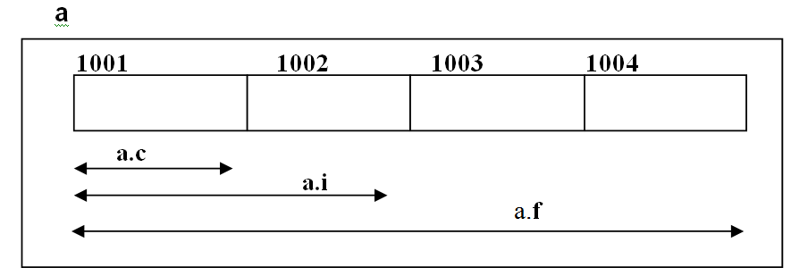
To access the members of union, the same syntax used to access various members of a structure can be used, by using the dot operator (“. “).
For above example, we can access various members of the union as shown below,
a.c a.i a.f
For the above example, union contains three members, each with a different data type. However, we can use only one of them at a time.

Slide 60
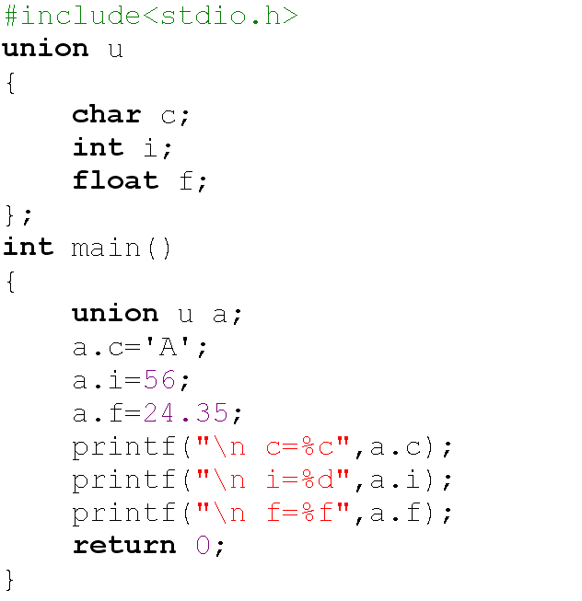


Slide 61
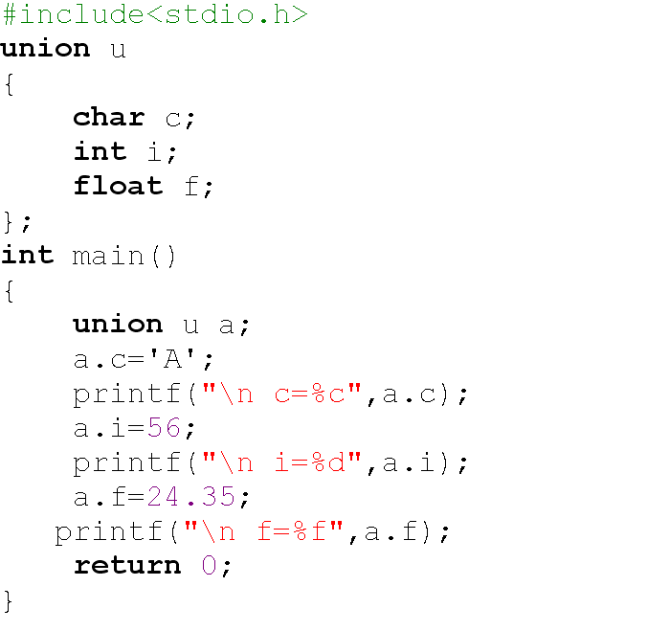


Slide 62
 | Arrays | Structures | Unions
Keyword | … | struct | union
Definition | An array is a homogeneous collection of data. | A structure is a collection of logically related elements, possibly of different types, having a single name. | A union is a collection of logically related elements, possibly of different types, having a single name, shares single memory location.
Declaration | data_type array_Name[size]; | struct tag_name { type1 member1; type1 member2; …………… …………… }; struct tag_name var; | union tag_name { type1 member1; type1 member2; …………… …………… }; union tag_name var;
Initialization | Done by separating list of values with comma (,), specified in Curly braces { }. | Same. | Same.
Accessing | Accessed by specifying array name with subscript | Accessed by specifying structure variablename. membername | Accessed by specifying union variablename. membername

Slide 63
Memory Allocation | Each array element occupies memory, stored in contigenous locations. | Each member of the structure occupies unique location, stored in contigenous locations. | Memory is allocated by considering the size of largest member. All the members share the common location
Size | Size of the array is depending on the array type and size. sizeof (arr); | Size of the structure depends on the type of members, adding size of all members. sizeof (st_var); | Size is given by the size of largest member storage. sizeof(un_variable);
Using pointers | An array elements values can be accessed by using de-referencing operator(*) | Structure members can be accessed by using de-referencing dot operator and selection operator(->) | Same as structure.
 | We can have array of structures or unions. here the array type is structure or union. | We can have arrays as a member of structures. | We can have array as a member of union.
 | All elements can be accessed at a time | All members can be accessed at a time | Only one member can be accessed at a time.

