Slide 1

Programming Telling a computer what to do (roughly)

Slide 2
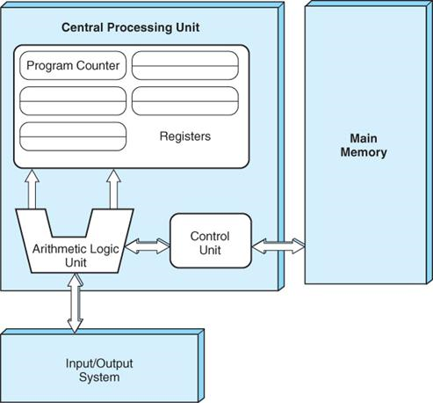
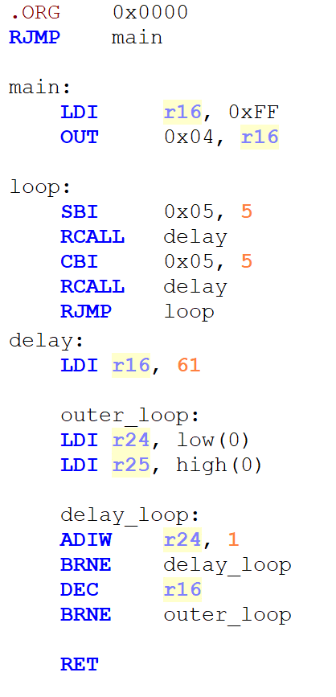
Assembly Language
:100000000C945C000C946E000C946E000C946E00CA
:100010000C946E000C946E000C946E000C946E00A8
:100020000C946E000C946E000C946E000C946E0098
:100030000C946E000C946E000C946E000C946E0088
:100040000C9488000C946E000C946E000C946E005E
:100050000C946E000C946E000C946E000C946E0068
:100060000C946E000C946E00000000080002010069
:100070000003040700000000000000000102040863
:100080001020408001020408102001020408102002
:10009000040404040404040402020202020203032E
:1000A0000303030300000000250028002B000000CC
:1000B0000000240027002A0011241FBECFEFD8E043
:1000C000DEBFCDBF21E0A0E0B1E001C01D92A930AC
:1000D000B207E1F70E9403020C9413020C94000093
:1000E00061E08DE00C94930161E08DE00E94CC0111
:1000F00068EE73E080E090E00E94F50060E08DE043
:100100000E94CC0168EE73E080E090E00C94F50072
:100110001F920F920FB60F9211242F933F938F933C
:100120009F93AF93BF938091010190910201A091A1
:100130000301B09104013091000123E0230F2D371A
:1001400020F40196A11DB11D05C026E8230F0296DB
:10015000A11DB11D20930001809301019093020124
:10016000A0930301B09304018091050190910601D1
:10017000A0910701B09108010196A11DB11D8093C6
:10018000050190930601A0930701B0930801BF9168
:10019000AF919F918F913F912F910F900FBE0F9034
:1001A0001F9018953FB7F894809105019091060132
:1001B000A0910701B091080126B5A89B05C02F3F6B
:1001C00019F00196A11DB11D3FBF6627782F892F19
:1001D0009A2F620F711D811D911D42E0660F771FDE
:1001E000881F991F4A95D1F708958F929F92AF92D9
:1001F000BF92CF92DF92EF92FF926B017C010E943F
:10020000D2004B015C01C114D104E104F104F1F00E
:100210000E9412020E94D200681979098A099B097A
:10022000683E73408105910570F321E0C21AD10840
:10023000E108F10888EE880E83E0981EA11CB11C2D
:10024000C114D104E104F10429F7DDCFFF90EF9050
:10025000DF90CF90BF90AF909F908F90089578944B
:1002600084B5826084BD84B5816084BD85B58260BB
:1002700085BD85B5816085BDEEE6F0E08081816059
:100280008083E1E8F0E01082808182608083808159
:1002900081608083E0E8F0E0808181608083E1EB31
:1002A000F0E0808184608083E0EBF0E08081816019
:1002B0008083EAE7F0E080818460808380818260CF
:1002C00080838081816080838081806880831092B8
:1002D000C1000895833081F028F4813099F0823094
:1002E000A1F008958730A9F08830B9F08430D1F4B6
:1002F000809180008F7D03C0809180008F778093F4
:100300008000089584B58F7702C084B58F7D84BD49
:1003100008958091B0008F7703C08091B0008F7DE9
:100320008093B0000895CF93DF9390E0FC01E458F0
:10033000FF4F2491FC01E057FF4F8491882349F13E
:1003400090E0880F991FFC01E255FF4FA591B491F1
:100350008C559F4FFC01C591D4919FB7611108C086
:10036000F8948C91209582238C93888182230AC0F3
:10037000623051F4F8948C91322F309583238C9312
:100380008881822B888304C0F8948C91822B8C9373
:100390009FBFDF91CF9108950F931F93CF93DF936A
:1003A0001F92CDB7DEB7282F30E0F901E859FF4F93
:1003B0008491F901E458FF4F1491F901E057FF4F80
:1003C00004910023C9F0882321F069830E946A0107
:1003D0006981E02FF0E0EE0FFF1FEC55FF4FA59174
:1003E000B4919FB7F8948C91611103C0109581234B
:1003F00001C0812B8C939FBF0F90DF91CF911F91F4
:100400000F91089508950E942F010E9402020E94F8
:100410007000C0E0D0E00E9474002097E1F30E94D9
:0A0420000000F9CF0895F894FFCF13
:00000001FF
The lowest (sensible) level that you can specify a sequence of instructions for your computer.
:020000020000FC
:1000000000C00F
:EF04B92D9A03D
:02D9801D0FBCF
:7B100010000DE
:380E090E00196
:F1F70A95D1F70
:8959D00000001F

Slide 3
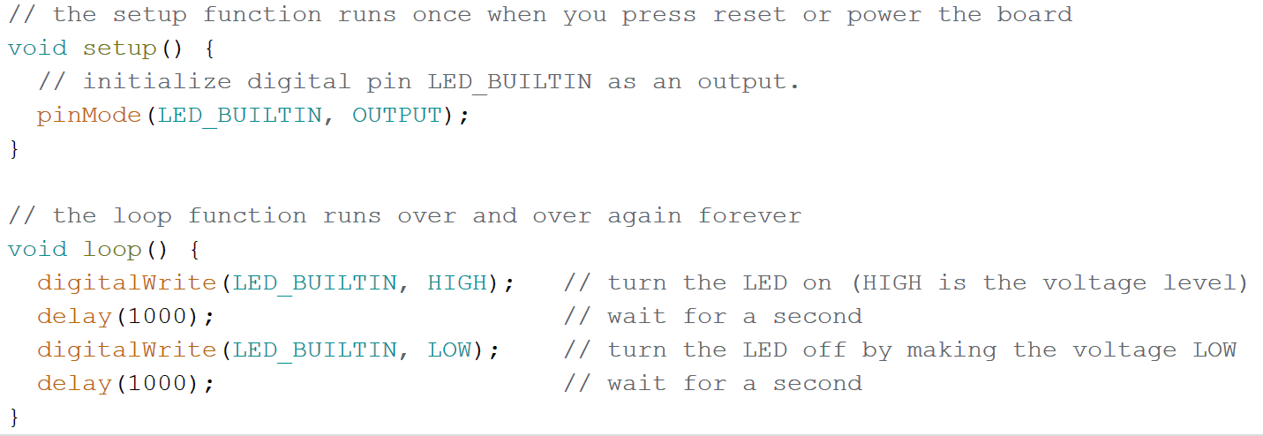
High-Level Programming Languages
A higher (more sensible) level that you can specify a sequence of instructions for your computer.
Assemble
Compile
:020000020000FC
:1000000000C00F
:EF04B92D9A03D
:02D9801D0FBCF
:7B100010000DE
:380E090E00196
:F1F70A95D1F70
:8959D00000001F

Slide 4
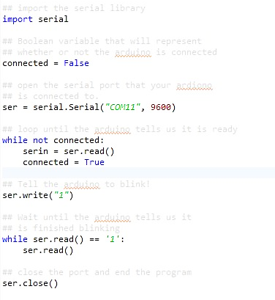
Compiled vs. Interpreted Languages
When is machine code generated?

Slide 5
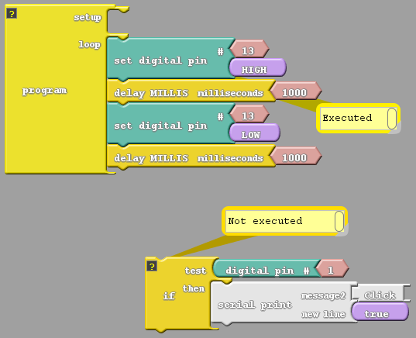
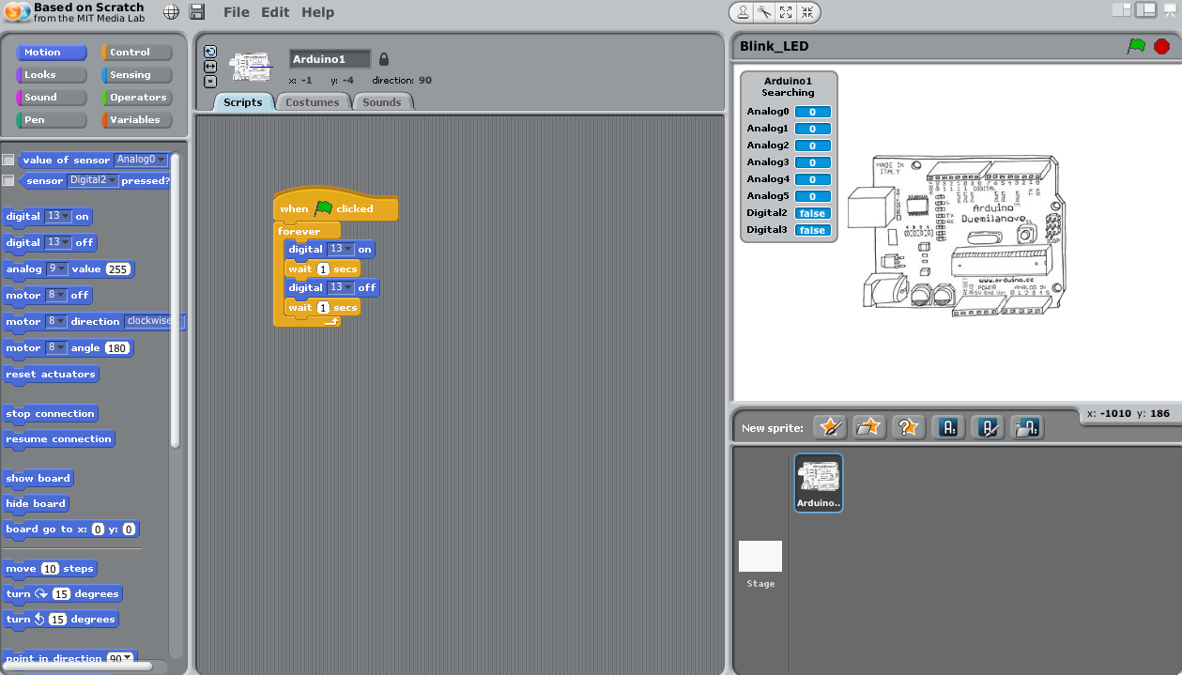
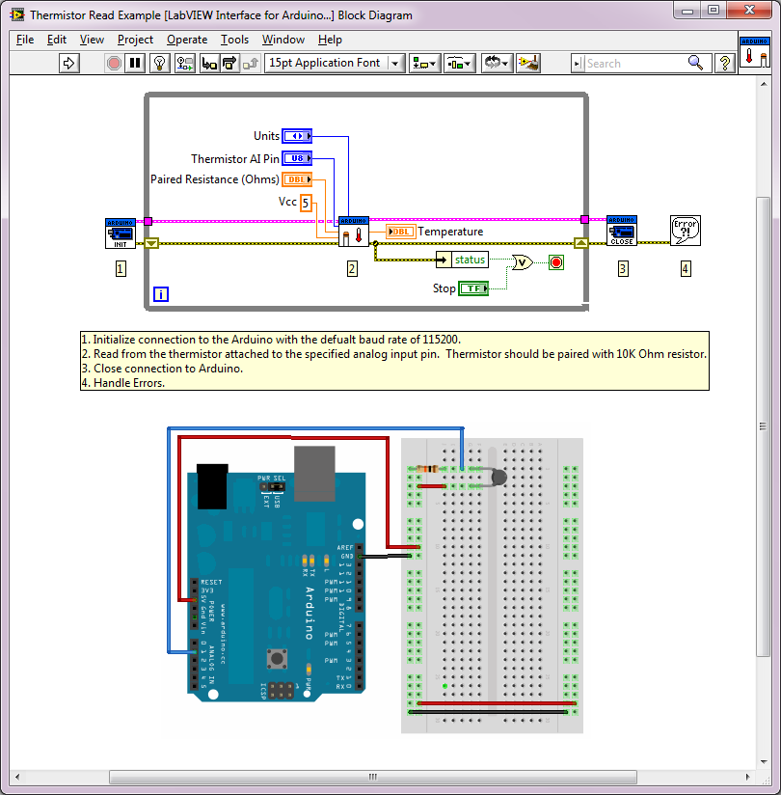
Language Composition
Text? Drawing? Physical wires?

