Slide 1
greyboxes
2/9/19

Slide 2
who are we?

Slide 3
who are you?
and
- what is your electronics experience on a scale of 1-5?
- your programming experience?
- what’s your favorite ice cream flavor?

Slide 4
why are we here?

Slide 5
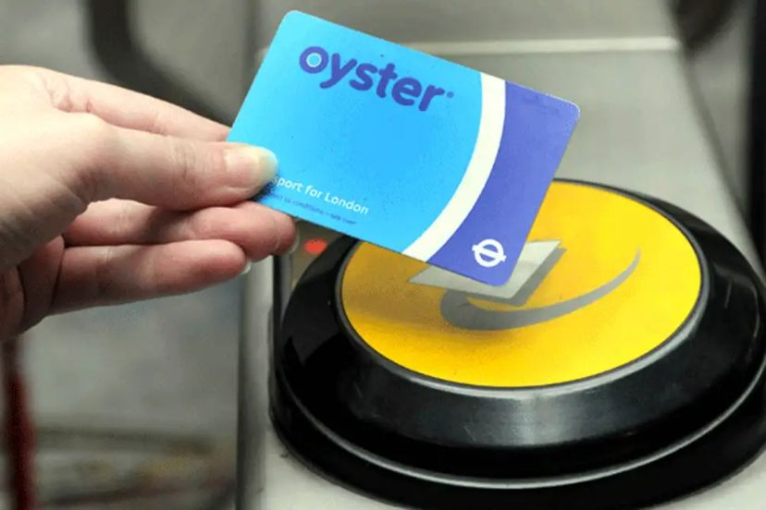

Slide 6
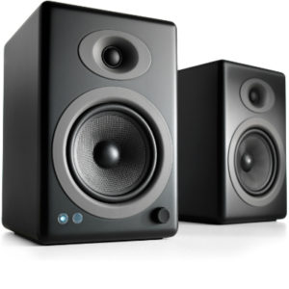

Slide 7
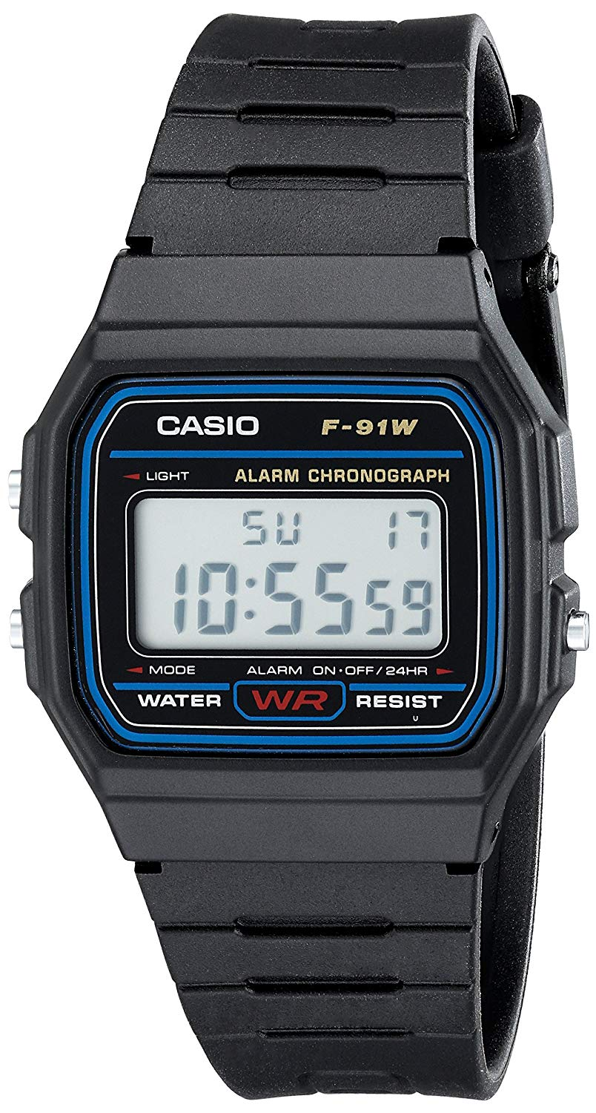

Slide 8
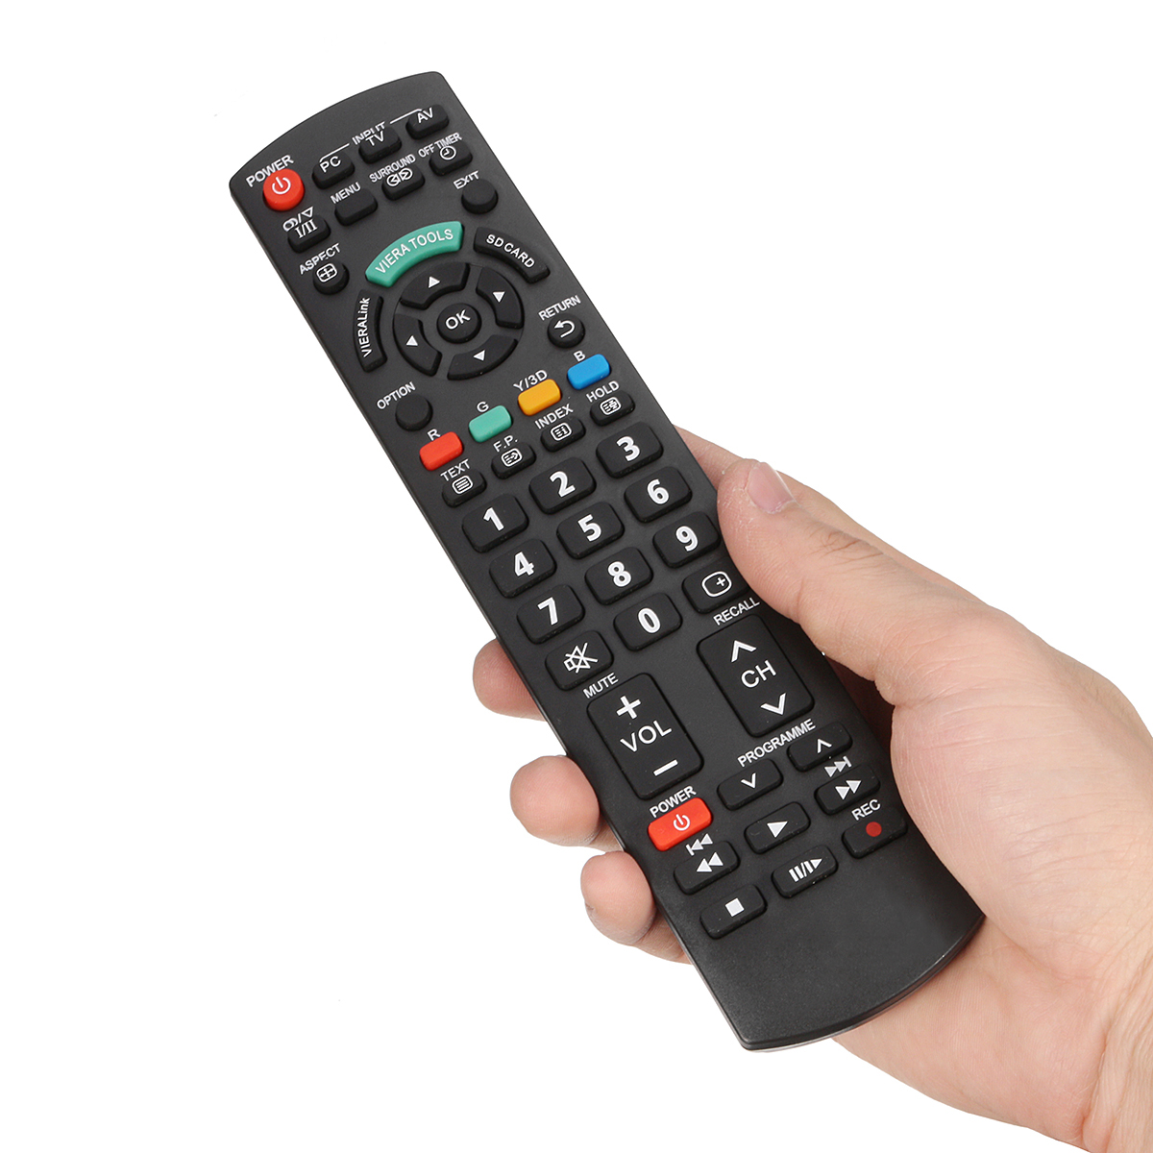

Slide 9
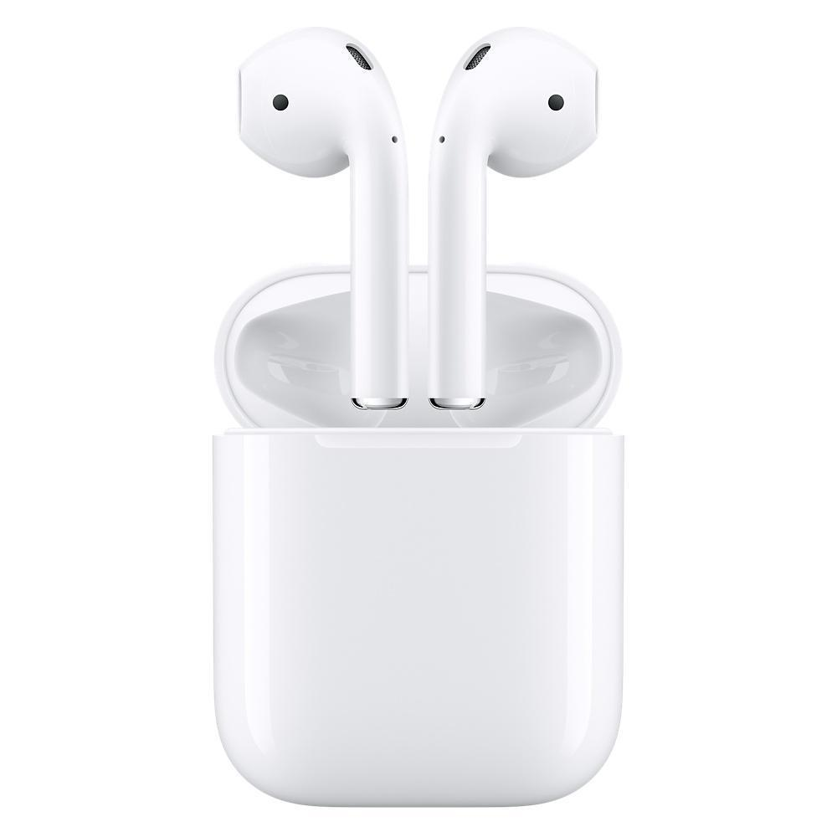

Slide 10
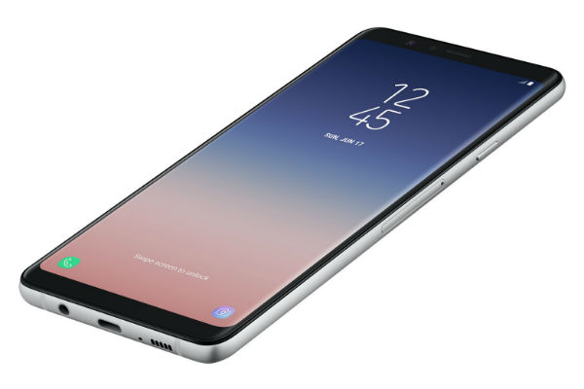

Slide 11


Slide 12
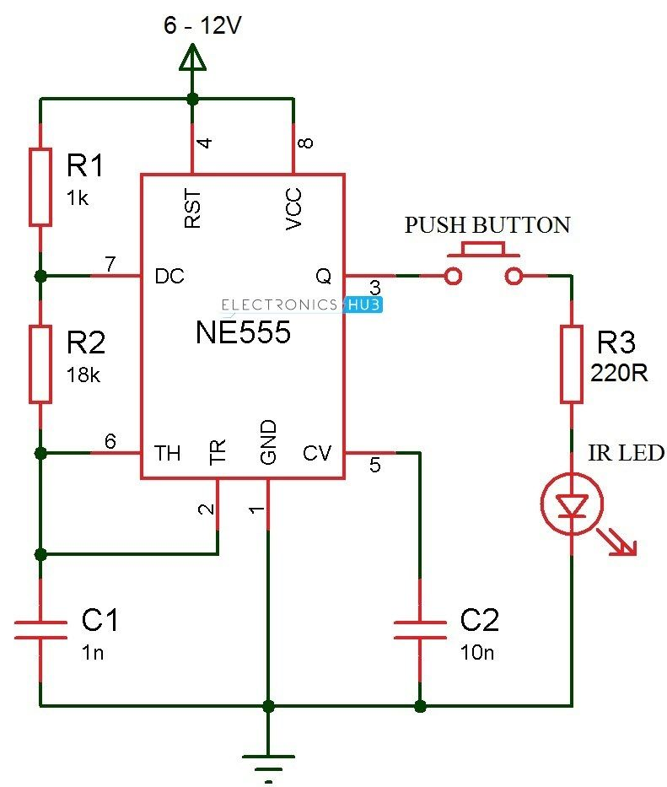
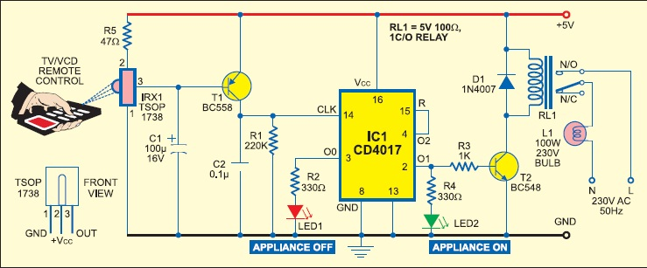

Slide 13
