Slide 1
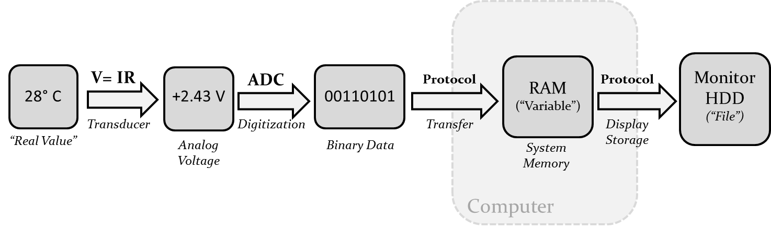

How do you get data into (and out of) a computer?
Part 1: Introduction to Data Acquisition (DAQ) - Input

Slide 2
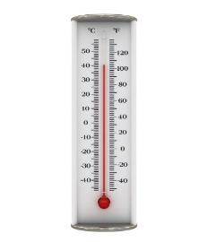
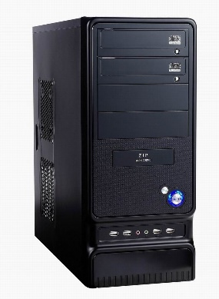
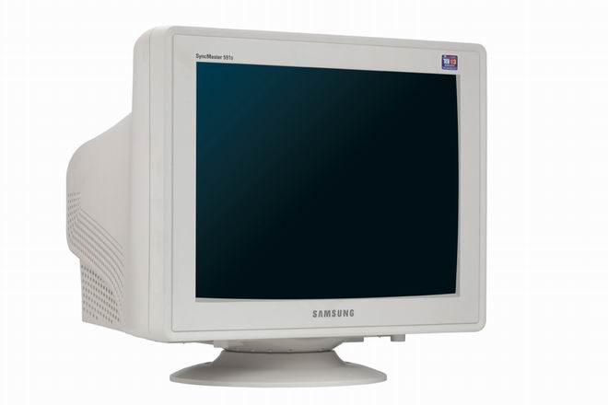
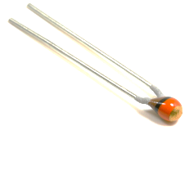
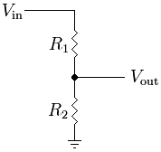
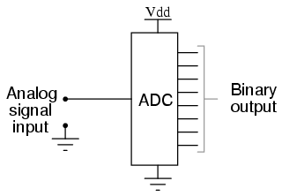
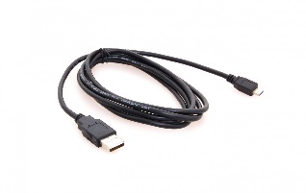
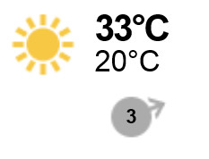
Data Acquisition (DAQ)
The process of measuring a real-word value via voltage conversion, digitization, and transfer to system memory. (for subsequent processing and storage).
What is the
temperature
outside?
How do you get
that value into
a computer?
Lisbon
> 33
Without DAQ, then we would all be theoretical neuroscientists.

Slide 3
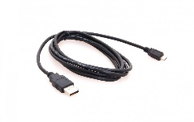

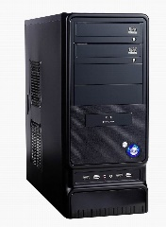
Data Acquisition (DAQ)
The process of measuring a real-word value via voltage conversion, digitization, and transfer to system memory. (for subsequent processing and storage).
V= IR
ADC
Protocol
RAM
(“Variable”)
Protocol
MonitorHDD
(“File”)
33° C
+2.43 V
00100001
Sensor
Digitization
Transfer
Display
Storage
“Real Value”
Voltage
Binary Data
System
Memory
Lisbon
Computer
> 33
Anything is measurable…and everyone should no how to do this.

Slide 4

Sensor (voltage transducer)
Computers can only measure voltage. Therefore, any real-world quantity must be converted into a voltage before it can be measured and digitized.
V= IR
LDR, Thermistor, Photodiode, etc.
Camera, E-phys System
Microphone, Keyboard, Touchscreen
33° C
+2.43 V
Sensor
“Real Value”
Voltage

Slide 5
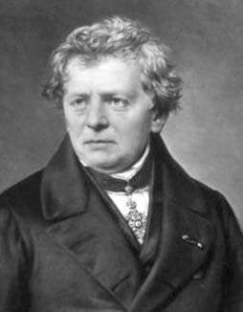
Ohm’s Law
A linear relationship between Voltage, Current and Resistance exists for “Ohmic” circuit elements. This
V = IR
V= IR
Ohm’s Law
33° C
+2.43 V
V - Voltage: Force pushing electrons
(Volts)
I - Current: Number of electrons/second
(Amps)
R - Resistance: Ease to electron flow
(Ohms)
Sensor
“Real Value”
Voltage
Ohm
This linear relationship between passive circuit elements will solve the majority of electronics dilemmas.

Slide 6
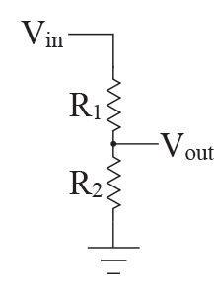
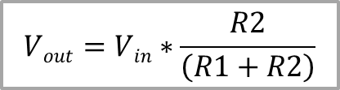
Voltage Divider
Two resistors will proportionally attenuate a voltage as current flows from a source to ground. This relationship can be used to create an intermediate voltage dependent on a variable resistor.
V= IR
33° C
+2.43 V
Sensor
$$Vout=Vin∗\frac{R2}{\left(R1+R2\right)}$$
“Real Value”
Voltage
Voltage Divider
This circuit is everywhere in modern circuits. A sensor can be constructed by simply making one of the resistors dependent on a “real world” quantity. (pressure, temperature, light, rotation…sweat…anything!)

Slide 7
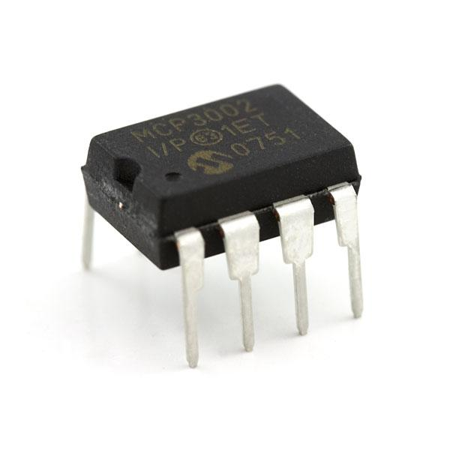
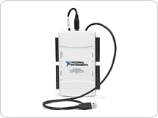
Analog to Digital Converter (ADC)
An integrated circuit that converts analog values to binary (digital) representation. They come in many flavours, speeds and bit depths.
ADC
+2.43 V
00100001
Digitization
Voltage
Binary Data
An ADC converts analog voltage to a binary representation.
(Relevant Characteristics)
- How fast? (Sample Rate, Hz)
- Resolution? (#bits per sample)
- Range (of input voltage)
ADCs are everywhere. In your digital cameras, smartphone, and GPS. Everything a computer knows about the “real-world” goes through an ADC. There are many types, with many different features (speeds, resolution, noise, channels…).

Slide 8
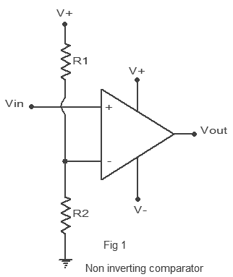
Digital Input
The process of measuring a real-word value via voltage conversion, digitization, and transfer to system memory. (for subsequent processing and storage).
Voltage Comparator
ADC
0 to 5 V
0 or 1
Digitization
Voltage
Binary Data
The simplest ADC: 1-bit
The “simplest” computer input. 0 or 1.

Slide 9
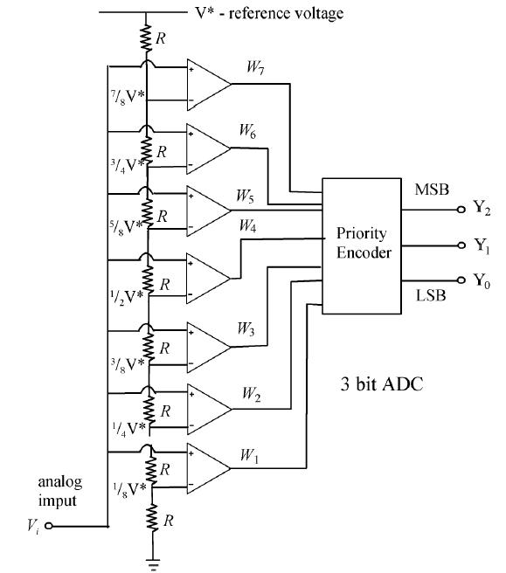
Analog Input: Flash ADC
The process of measuring a real-word value via voltage conversion, digitization, and transfer to system memory. (for subsequent processing and storage).
Fast
Low Bit Depth
Large!
Serial Voltage Divider
ADC
0/+5 V
00100001
Digitization
Voltage
Binary Data
Flash ADC
Comparator
An easy to understand, but not often used version of an ADC. Very, very fast…but low bit depth.

Slide 10
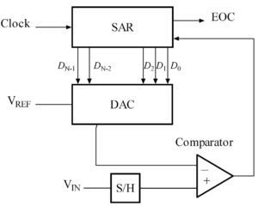
Analog Input: Successive Approximation ADC
The process of measuring a real-word value via voltage conversion, digitization, and transfer to system memory. (for subsequent processing and storage).
Slow(er)
High Bit Depth
Small
ADC
0/+5 V
00100001
Digitization
Voltage
Binary Data
Successive Approximation ADC
Much more common form of ADC.

Slide 11
Communication Protocol
A standard procedure for transferring binary information between digital devices,
Protocol
RAM
(“Variable”)
00100001
Transfer
Binary Data
System
Memory
Computer

Slide 12
Serial Port (USART/USART – RS-232)
A standard procedure for transferring binary information between digital devices,
Protocol
RAM
(“Variable”)
00100001
Transfer
Binary Data
System
Memory
Computer

Slide 13
System Memory (RAM)
The process of measuring a real-word value via voltage conversion, digitization, and transfer to system memory. (for subsequent processing and storage).
Protocol
RAM
(“Variable”)
00100001
Transfer
Binary Data
System
Memory
Computer
You can only “work” with data in System memory. This is where you can start doing analysis…roting data to other devices for control of storage. This is when your data is IN the computer.

Slide 14
Data Display/Storage
This is technically data “output”…but just for completeness.
RAM
(“Variable”)
Protocol
MonitorHDD
(“File”)
Display
Storage
System
Memory
Computer

Slide 15
Data Acquisition (DAQ)
The process of measuring a real-word value via voltage conversion, digitization, and transfer to system memory. (for subsequent processing and storage).
V= IR
ADC
Protocol
RAM
(“Variable”)
Protocol
MonitorHDD
(“File”)
33° C
+2.43 V
00100001
Sensor
Digitization
Transfer
Display
Storage
“Real Value”
Voltage
Binary Data
System
Memory
Computer
This is how computers know about the world.

Slide 16
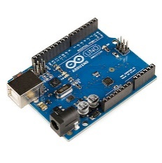
Microcontroller Worksheet
DAQ and Control with a simple microcontroller.
We

Slide 17
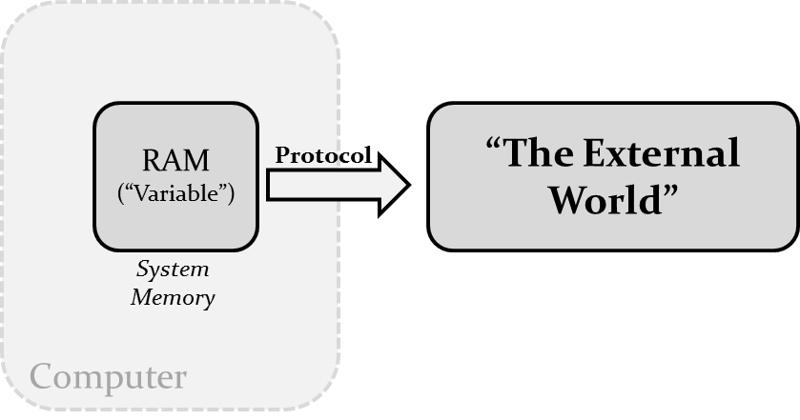
How do you get data into (and out of) a computer?
Part 2: Introduction to Actuation– Output

Slide 18
Control (with a binary computer)
Conversely to acquisition, computers can only output voltages.
If you want to…
“Play a tone”
“Make something move”
“Turn on a light”
“Open a valve”
“Show a movie”
… etc.
“The External World”
RAM
(“Variable”)
Protocol
System
Memory
Computer

Slide 19
Control (with a binary computer)
Conversely to acquisition, computers can only output voltages.
Computer Peripherals
Specialized
Sound
Card
Monitor
HDD
VGA, HDMI
SATA
MIDI
RAM
(“Variable”)
Protocol
TTL
LED
Solenoid
DC Motor
Relay
Digital Output
System
Memory
DAC
Laser Diode
Galvo Mirror
Computer
Analog Output
PWM / FM
“Hobby”
Servo
Piezo
Buzzer
Pseudo-Analog Output

Slide 20
Digital Output
Conversely to acquisition, computers can only output voltages.
ON vs OFF
RAM
(“Variable”)
Protocol
TTL
LED
Solenoid
DC Motor
Relay
Digital Output
System
Memory
Computer

Slide 21
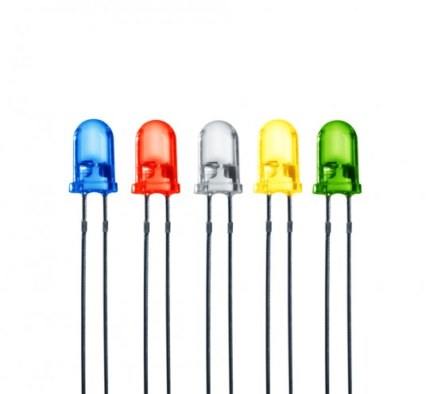
TTL: Transistor-Transistor Logic
Conversely to acquisition, computers can only output voltages.
0 to +5 Volts
RAM
(“Variable”)
Protocol
TTL
LED
Digital Output
System
Memory
Computer

Slide 22
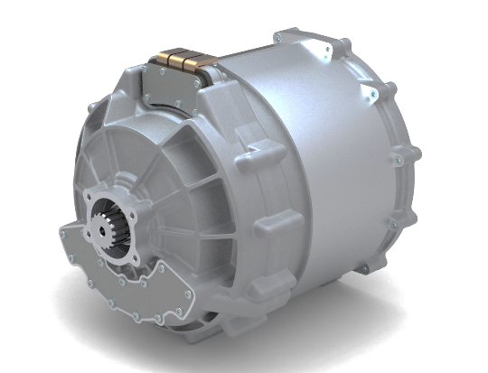

Digital Output
Conversely to acquisition, computers can only output voltages.
RAM
(“Variable”)
Protocol
TTL
LED
Solenoid
DC Motor
Relay
Digital Output
System
Memory
~10 mA
Computer
Can you start (“jump”) your car with a USB port?

Slide 23
Electrical Load
An element in a circuit that consumes power. The more power consumed, the “heavier” the load.
RAM
(“Variable”)
Protocol
TTL
Electric Car
Engine?
Power = V*I = V*R²
Digital Output
System
Memory
Computer

Slide 24

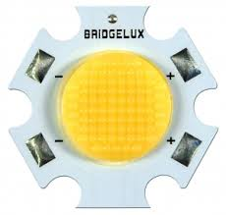
Digital Output (Heavy Loads: > 100 mA)
Conversely to acquisition, computers can only output voltages.
- “Make something move”
- “Turn on the room lights”
“Drive a high power laser”
…
RAM
(“Variable”)
Protocol
Motor
Display
Storage
System
Memory
Computer

Slide 25
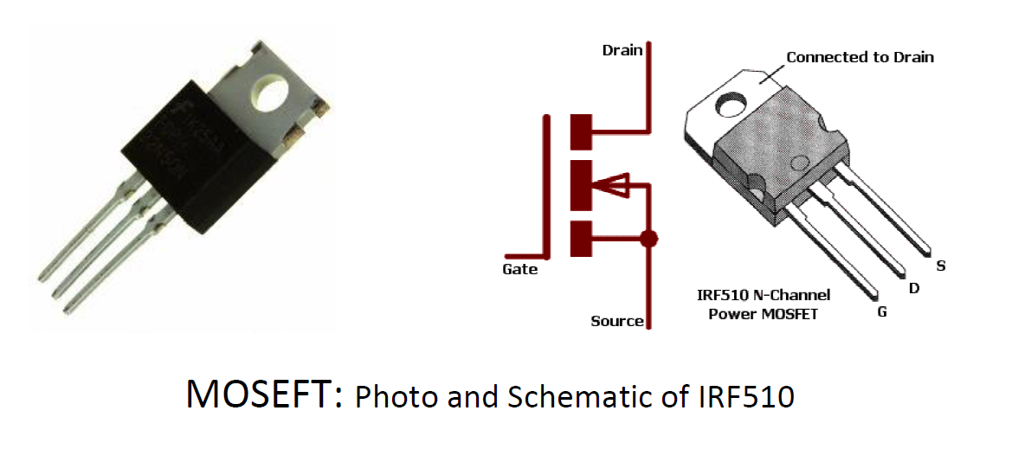
Transistor (MOSFET) Switch
PN-Junction, Gate, Holes, Doping, and more!

Slide 26
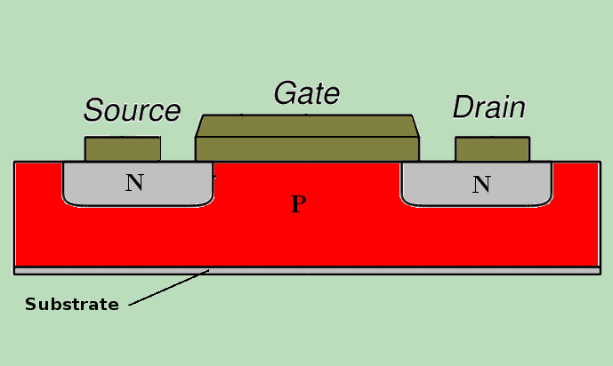
The Silicon Transistor
PN-Junction, Gate, Holes, Doping, and more!

Slide 27
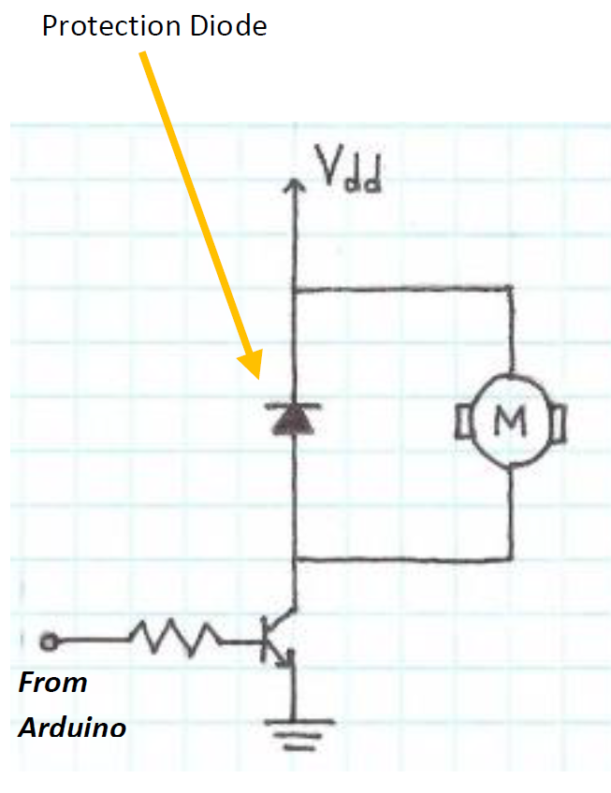
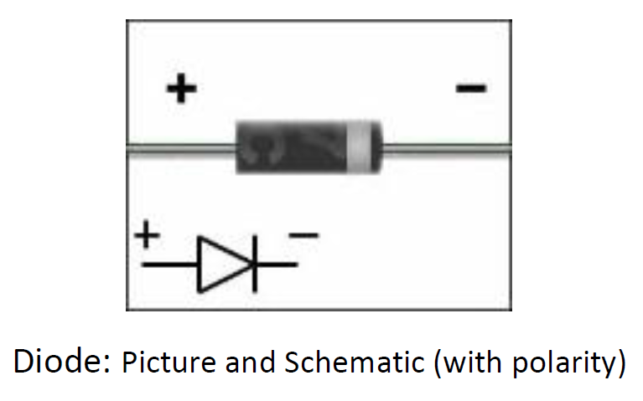
Transistor: Switching Inductive Loads
Current caused by induction can cause negative current flow (backwards), which can damage
Protection Diode

Slide 28
Analog Output
Conversely to acquisition, computers can only output voltages.
RAM
(“Variable”)
Protocol
DAC
0101001
+3.72 V
Display
Storage
Display
Storage
System
Memory
Computer

Slide 29
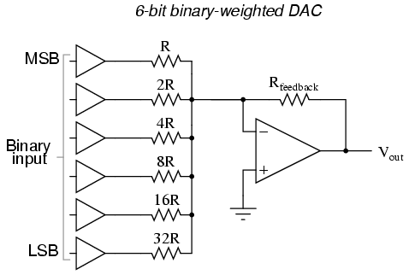
Digital-to-Analog Converter (DAC)
Conversely to acquisition, computers can only output voltages.
RAM
(“Variable”)
Protocol
DAC
0101001
+2.31 V
Display
Storage
Display
Storage
System
Memory
Computer
Note: The Arduino Uno has no DACs.

Slide 30
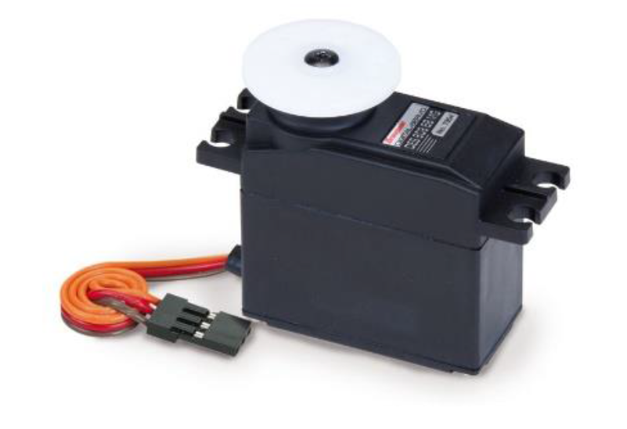
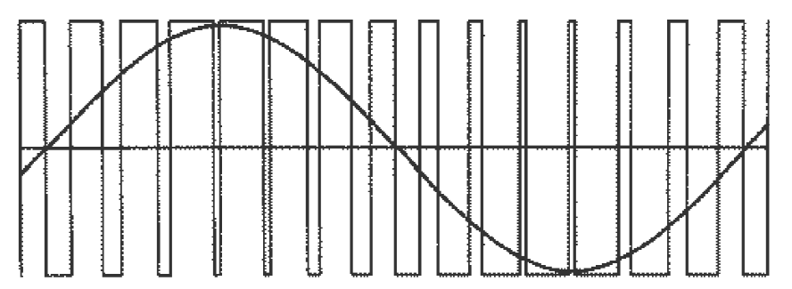
Pulse-Width Modulation (PWM)
Pesudo-Analog Output. Duty-cycle approximates an analog value.
RAM
(“Variable”)
Protocol
“Hobby Servo”
Display
Storage
System
Memory
Computer
PWM
(approx. sinewave)

Slide 31
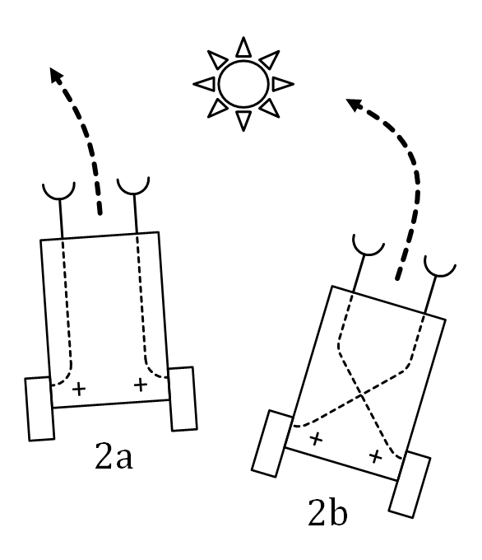
Vehicle Project
Autonomous Braitenberg vehicles that follow (or avoid) light.

