Slide 1
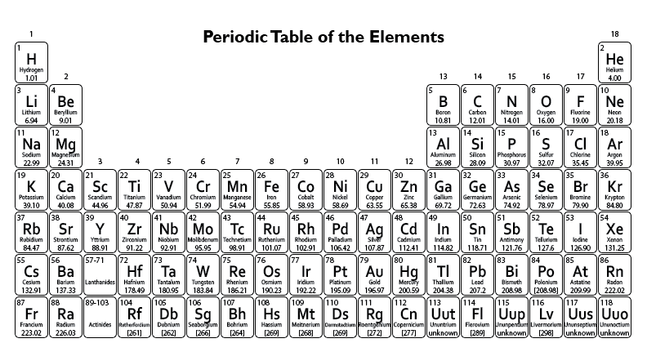


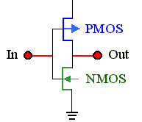
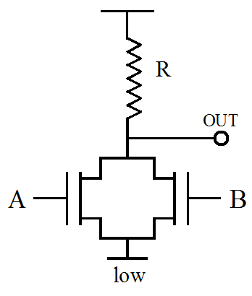
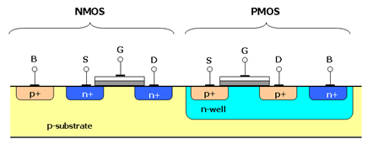
Transistor Worksheet
M _________
O _________
S _________
F _________
E _________
T _________
Transistor – NPN FET
Logic – NMOS/PMOS Inverter vs CMOS Inverter
+V
+V
+V
+V
NMOS Not
PMOS Not
CMOS Not
What is this? ____________
Fabrication – The CMOS process
Draw the P doping mask(s)

Slide 2
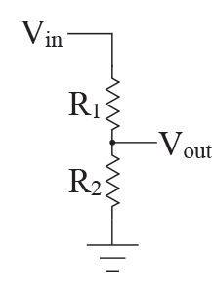
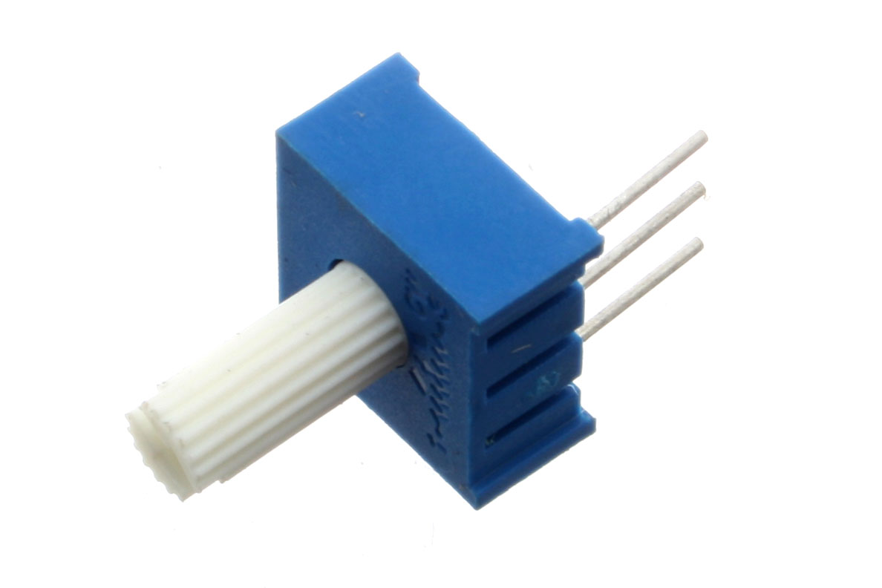
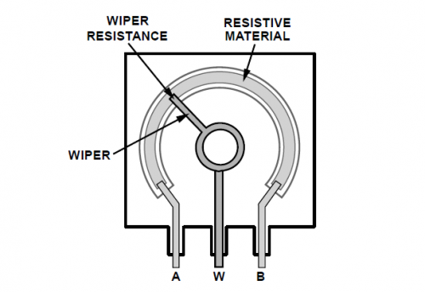
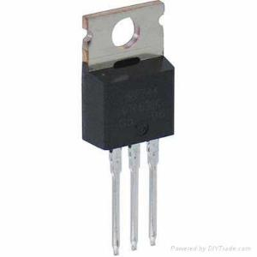
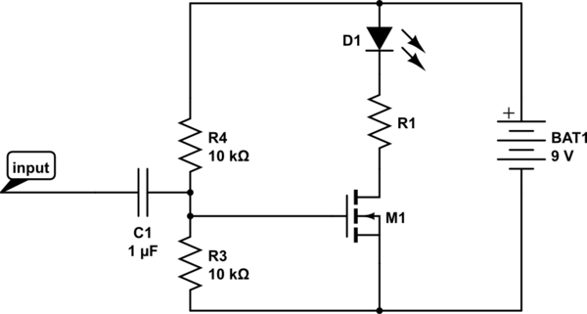
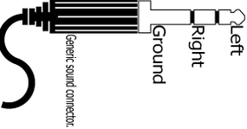

Transistor Lab
Passive Electronic Circuit
Build a voltage divider using a potentiometer.
Test the circuit.
$$Vout=Vin∗\frac{R2}{\left(R1+R2\right)}$$
Transistor Circuit – NPN FET
Use the voltage divider you designed above to measure the Gate Threshold voltage for an NPN MOSEFT (IRF510).
Draw test circuit here
Plot I_{DS} vs. V_{GS} here
G D S
Challenge
Build the circuit below. Use an audio signal as input.
What value for R1?
(LED current limit = 25 mA)
Why use the input capacitor?
Replace R4/R3 with your voltage divider.

