Slide 1
HAPPIEST HEALTH DIGITAL TWIN CHALLENGE 2026
Rum
OSA Digital Twin
Predicting obstructive sleep apnea events by fusing a synthetic EHR risk profile with wearable-style physiological signals.
Team Leader: Sweta Halder | College: IGDTUW (Indira Gandhi Delhi Technical University for Women) | Team Size: 1 (Solo)

Slide 2
01
The Problem: OSA Is Common and Badly Underdiagnosed
Obstructive Sleep Apnea — a chronic, lifestyle-linked condition
Why OSA
• Closely tied to obesity, hypertension and type 2 diabetes — all rising in India.
• Diagnosis normally needs an overnight sleep-lab study, which most patients never get.
• A Digital Twin can estimate risk continuously, without waiting for a formal diagnosis.
• This project builds a proof-of-concept: fuse a patient's health history with real physiological signal to flag risk, window by window, through the night.
What "Digital Twin" Means Here
• Static data: a synthetic EHR — comorbidities such as obesity, hypertension, diabetes.
• Dynamic data: overnight ECG and respiration — wearable-style, from real anonymized recordings.
• Fused output: a single risk flag (LOW / MODERATE / HIGH) a clinician could act on.
2
3
0
data streams fused into one twin
risk tiers — LOW / MODERATE / HIGH
real patient records required
Rum — OSA Digital Twin | 2

Slide 3
Rum — OSA Digital Twin: System Architecture
A synthetic EHR risk profile and real wearable-style physiological signals are fused into one clinical flag.
STATIC (patient history)
DYNAMIC (real-time signal)
Synthea
Open-source synthetic patient generator — fully synthetic EHR, zero real patient data.
MIT-BIH Polysomnographic Database
PhysioNet, open-access. Real ECG + nasal airflow + SpO2, expert-scored apnea/hypopnea annotations.
↓
↓
Weighted comorbidity score
Rule-weighted: obesity, hypertension, prediabetes, type 2 diabetes, existing sleep apnea diagnosis.
30-second windows → HRV + breathing features
Heart rate, RR-interval SDNN, LF/HF ratio, breath rate, breath-interval variability, breath amplitude.
↓
↓
Static risk (cohort percentile, 0–1)
Patient's rank within the synthetic population's weighted risk score.
XGBoost + causal smoothing
Leave-one-patient-out validated. Trailing 3-min average → dynamic risk score (0–1).
↘
↙
Fusion
risk = 0.3 × static risk + 0.7 × dynamic risk (hand-set weights, illustrative)
↓
Threshold flag
LOW (<0.50) MODERATE (0.50-0.65) HIGH (≥0.65)
↓
Clinician Dashboard (concept)
Patients ranked by fused risk — overnight risk timeline — EHR risk tags. Not a diagnostic device.

Slide 4
03
Data Sources
Open-access only — no request, approval, or credentialing required
MIT-BIH Polysomnographic Database
• PhysioNet, Open Data Commons Attribution License.
• Real ECG, nasal airflow and SpO2 signals.
• Expert-scored sleep-stage AND apnea/hypopnea annotations.
• 15 of 18 subjects used — selected for a consistent nasal-airflow channel and a spread of severities, plus 2 zero-event healthy controls.
Synthea
• Open-source synthetic patient generator.
• Fully synthetic EHR — zero real patient data.
• Filtered for OSA-relevant comorbidities: obesity, hypertension, prediabetes, type 2 diabetes.
• Explicitly named as an acceptable EHR source in the challenge brief.
18
15
300
subjects available, fully open-access
used in this prototype
synthetic patients generated
Rum — OSA Digital Twin | 3

Slide 5
04
Methodology Highlights
Decisions made along the way, and why
1
30-second windows, real labels
Each overnight recording is cut into 30s windows aligned to expert annotations — not self-invented proxy labels.
2
Caught a data-leakage mistake
A random train/test split scored 0.94 AUC. Splitting by patient (Leave-One-Patient-Out) revealed the true score: 0.65.
3
Reframed as early warning
Beyond “is this window an event,” the model predicts whether an event occurs in the next ~90 seconds.
4
Checked against a shortcut
A persistence baseline (just repeat the current label) scored 0.776 — higher than the naive predictive model. The honest metric only counts currently-normal windows.
5
Smoothing + threshold calibration
A causal 3-minute trailing average, with thresholds chosen from out-of-fold predictions and checked against 2 zero-event healthy controls for false alarms.
Rum — OSA Digital Twin | 4

Slide 6
05
Results
Leave-one-patient-out ROC-AUC — 13 scoreable subjects
Task | Mean ROC-AUC
Detect event in the current window | 0.687
Predict event within ~90s, all windows | 0.722
Persistence baseline (current label only) | 0.776
Predict event within ~90s, currently-normal windows only (headline result) | 0.658
Onset-only, 4 SpO2 subjects — without SpO2 | 0.660
Onset-only, 4 SpO2 subjects — with SpO2 | 0.730
Why 0.658 is the headline number: apnea events cluster, so “current label predicts future label” alone scores 0.776 — higher than the naive predictive model (0.722). The 0.658 figure removes that shortcut by testing only windows that are currently normal.
Rum — OSA Digital Twin | 5

Slide 7
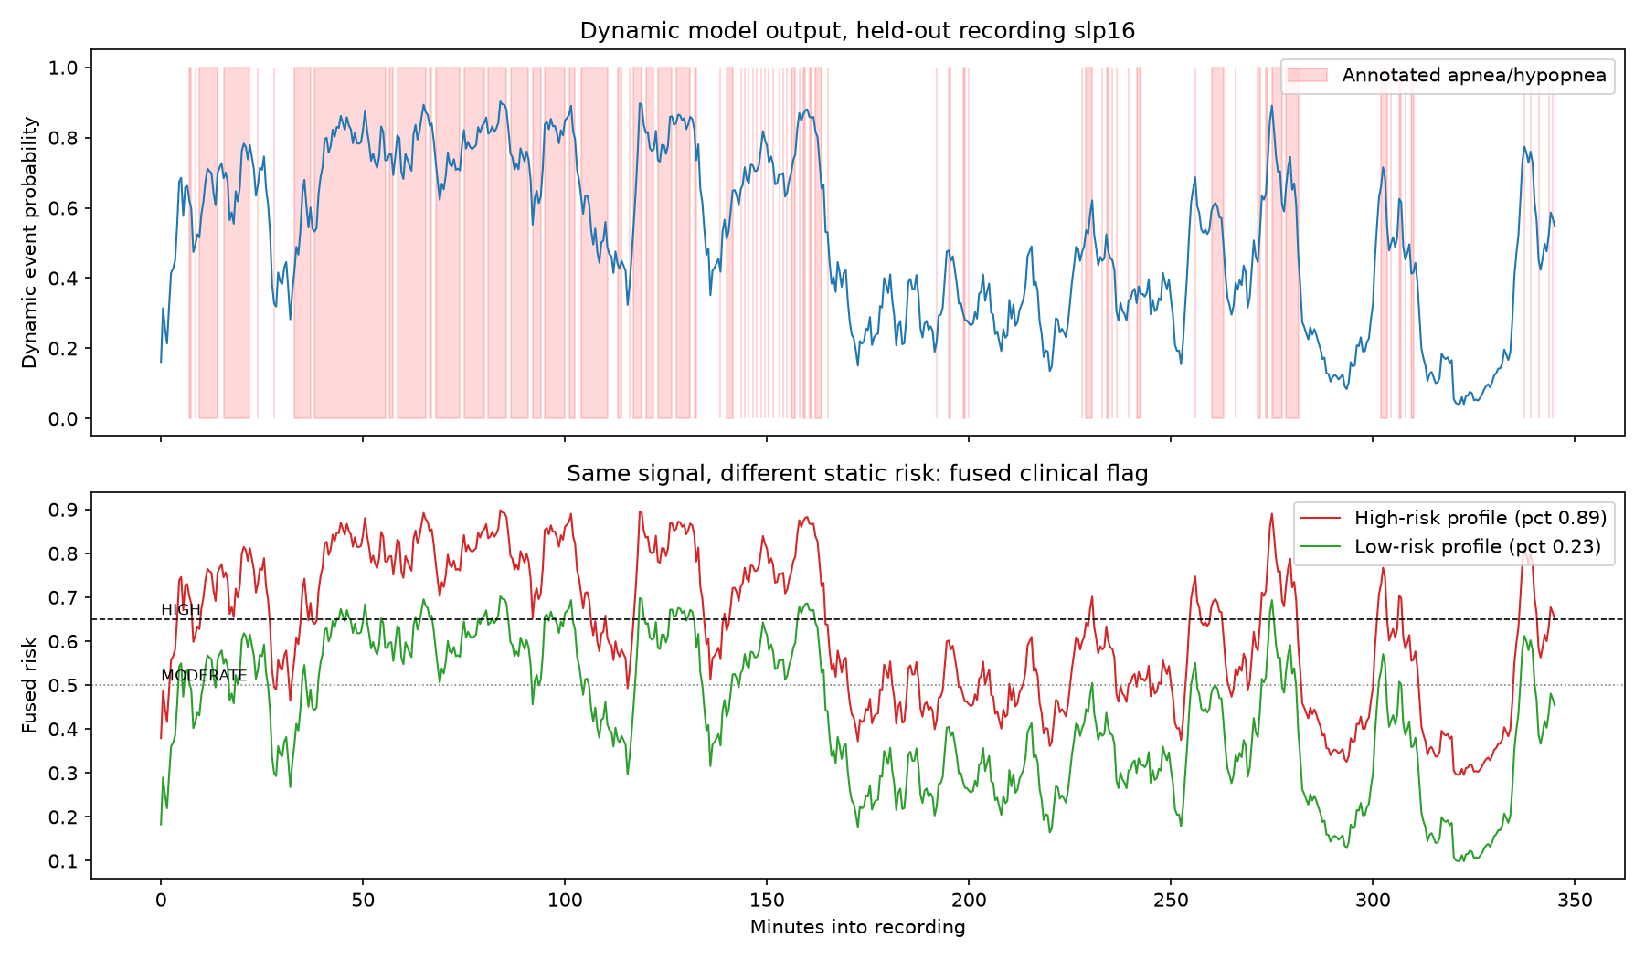
06
Alert Thresholds & Fusion in Action
Same physiological signal, different patients, different urgency
Threshold | Alert rate | Precision | Recall | False-alarm (healthy)
HIGH ≥ 0.65 | 22% | 0.86 | 0.41 | 10%
MODERATE ≥ 0.50 | 39% | 0.70 | 0.59 | 37%
Thresholds chosen from out-of-fold predictions, validated against 2 zero-event healthy controls as a false-alarm check.
46%
8%
HIGH flag rate — patient at the 89th EHR-risk percentile
HIGH flag rate — patient at the 23rd EHR-risk percentile
Held-out recording slp16: dynamic model output (top) and the fused flag for a high-risk vs low-risk EHR profile (bottom).
Same recording (slp16, 51 events/hr). Only the static EHR profile changed.
Rum — OSA Digital Twin | 6

Slide 8
07
Limitations & Future Work
Known gaps, stated plainly
• Modest absolute performance (onset-only AUC ~0.66). 30-second windows are short for frequency-domain HRV, which conventionally uses 2–5 minutes.
• Hyperparameters were tuned on all subjects before leave-one-patient-out evaluation, so scores carry mild optimism. Nested cross-validation is the fix.
• The SpO2 experiment covers only 4 severe-apnea subjects with no controls; “normal” windows may include recovery from a preceding event.
• Real signals and synthetic EHR cannot be linked per patient (privacy constraint) — fusion happens at the score level, with hand-set, illustrative weights (0.3 / 0.7) and thresholds, not clinically calibrated.
• Future work: longer windows, sequence models on raw signals, probability calibration, a larger and more diverse cohort, and prospective validation on consumer wearables.
• This is a research prototype, not a diagnostic device.
Rum — OSA Digital Twin | 7

Slide 9
Thank You
Team Rum — OSA Digital Twin
GitHub: https://github.com/swe74-29/Rum_IGDTUW
Research prototype — not a diagnostic device.

