Slide 1
Pattern Recognition
Homework 5 announcement
TA: 楊証琨, Jimmy
Ph.D. student at National Taiwan Universitiy
d08922002@csie.ntu.edu.tw
Notes:
‹#›

Slide 2


Homework 5
Deadline: June 12 Sun. at 23:59
Code assignment (100%): Implement the deep neural network by any deep learning frameworks, e.g., Pytorch, TensorFlow and Keras, and then train DNN model on the Cifar-10 dataset
Submit your 1) code (.py/.ipynb) and 2) reports (.pdf) on E3
Sample Code
HW5 questions
Please follow the file naming rules <STUDENT ID>_HW5.pdf, otherwise, you will get penalty of your scores
E3
Compress
submit
Notes:
The deadline of HW1 is October seventeen. There will be two parts of this hw1, Make sure you will done two thing before deadline. First, finish…, I will introduce Kaggle later, wh do i mean finish is that you will inference the testing data by your trained model and submit your predictions. Only if you see your student ID and score on leaderboard mean you finish this competition. Mail

Slide 3
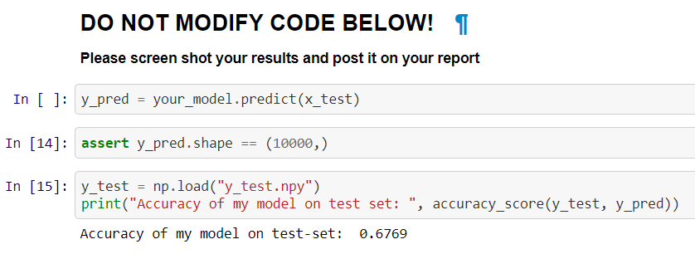
Reports
Include the implementation details, model architecture, hyperparameters, and used deep learning framework
https://github.com/paperswithcode/releasing-research-code
Include the accuracy of your model in the reports!

Slide 4
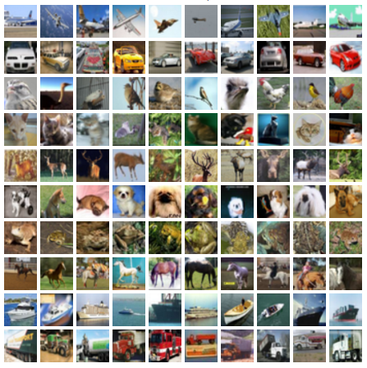
Cifar-10 dataset
60,000 (50,000 training + 10,000 testing) samples, 32x32 RGB images in 10 classes
airplane, automobile, ship, truck, bird, cat, deer, dog, frog, horse

Slide 5
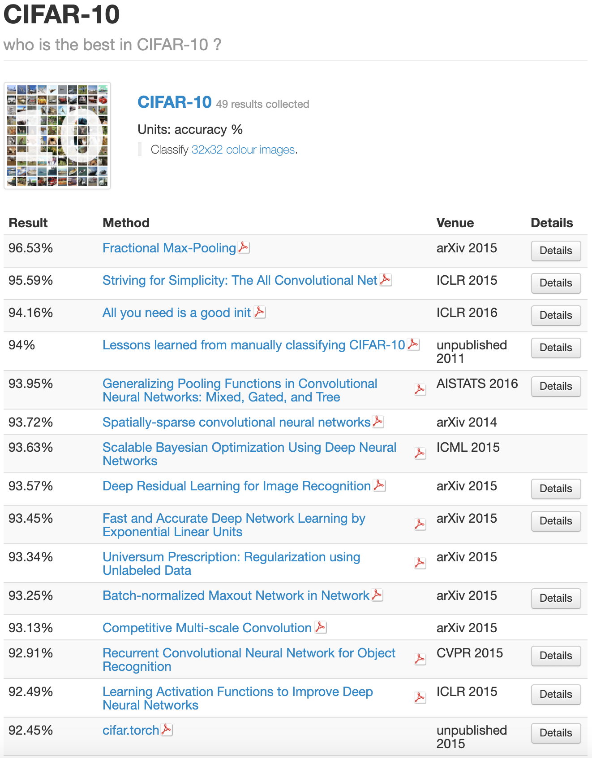
Leaderboard of CIFAR-10
Baseline: accuracy over 70%
Note that you should only train and evaluate your model on the provided dataset HERE
DO NOT download the data from other resources.

Slide 6
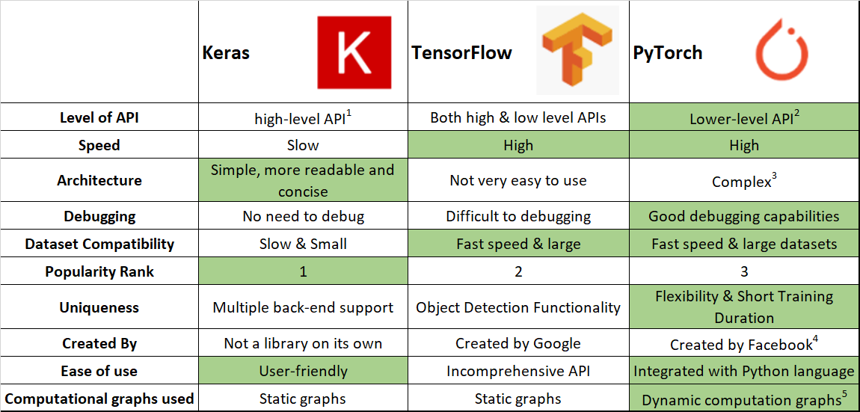
Deep learning framework
If you are a newbie in a deep learning framework, we recommend you learn Keras or Pytorch.
Keras: Only Few lines of code to build a CNN model
TensorFlow: Easy for depolyment
Pytorch: Flexible for research

Slide 7
Keyword for boosting your performance
Beat the baseline
CNN structure (number of filters, number of CNN layers,...)
Data augmentation
Regularization
Score over 90%!
Read some papers from leaderboard of Cifar-10

Slide 8
Accelerate your training by GPU
You may need GPU to accelerate the training of deep neural network. We provide several free GPU resources for you, some of resources need registration and limited by usage.
Google Colab: Free GPU usage for continuous 24 hours
Microsoft Azure: Registration for free GPU trials

Slide 9
Reference
Convolutional Neural Networks Tutorial in PyTorch
Building a Convolutional Neural Network (CNN) in Keras

Slide 10

Late Policy
No late policy on homework 5!

Slide 11
Notice
Submit your homework on E3-system !
Check your email regularly, we will mail you if there are any updates or problems of the homework
If you have any questions or comments for the homework, please mail TAs and cc Prof. Lin
Prof. Lin, lin@cs.nctu.edu.tw
TA Jimmy, d08922002@csie.ntu.edu.tw
TA 晨軒, derekt.cs06@nctu.edu.tw
TA 政儒, ace52751208@gmail.com

Slide 12

Have fun!

