Slide 1
Pattern Recognition
Homework 1 announcement
TA: 楊証琨 Jimmy
Ph.D. student at National Taiwan Universitiy
d08922002@csie.ntu.edu.tw
Notes:
‹#›

Slide 2


Homework 1
Deadline: March. 23, Wed at 23:59
Code assigment (60%): Implementing linear regression using only numpy
Short answer questions (40%): Write your answer on pdf
Submit the code (.py/.ipynb) and answers (.pdf) on E3
Include your answers of code/question in the pdf
HW1 questions
Sample Code
Naming rules: <STUDENT ID>_HW1
E3
Compress
submit
Notes:
The deadline of HW1 is march twenty three. There will be two parts of this hw1, Make sure you will done two thing before deadline.

Slide 3
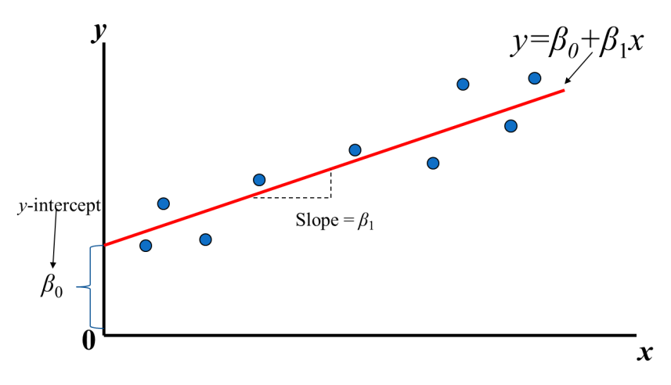
Linear Regression
Find the value of β₀ and β₁
Notes:
This HW request you to implement linear regression, A simple regression model contains two weights, our targets is trying to find a weights than get minimize the error of all data points

Slide 4
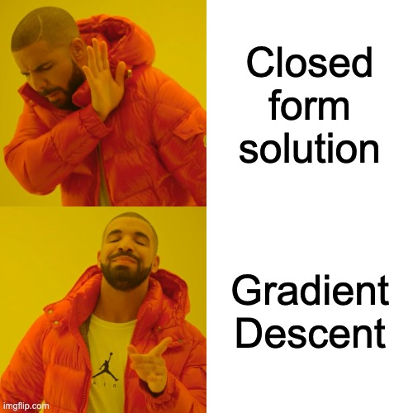
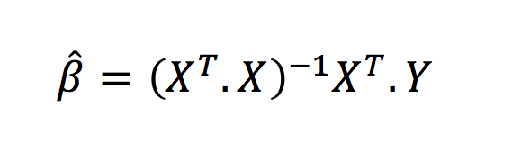
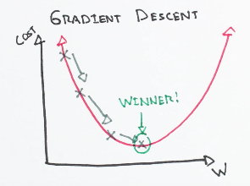
How to find β0 and β1?
TRY
and
Error
β0 = -2, -1, 0, 1, 2,...
β1 = 1, 2, 3, 4, 5,...
Notes:
So the questions here is how to find the best value of weights, suppose we randomly generate lots pairs of beta0 and beta 1, then we calculate the loss and find the weighs with lowest error, the problem is that we can’t granruantee the weights we found is the best weights since those weights are randomly generated . The other solution is closed form solution, we can use this formula to directly calculate the weights, the problem is that when you have a high demensional data, this matrixs consume lots of memory, also, it will took lots of time cacluating the inverse matrix.

Slide 5
Gradient Descent
x-axis and y-axis represent the value of weights
z-axis represents the loss of the corresponding weights
Targets: Find the weights that minimize the loss
β0
β1
Notes:
We can create a loss curve plot depend on the combination

Slide 6
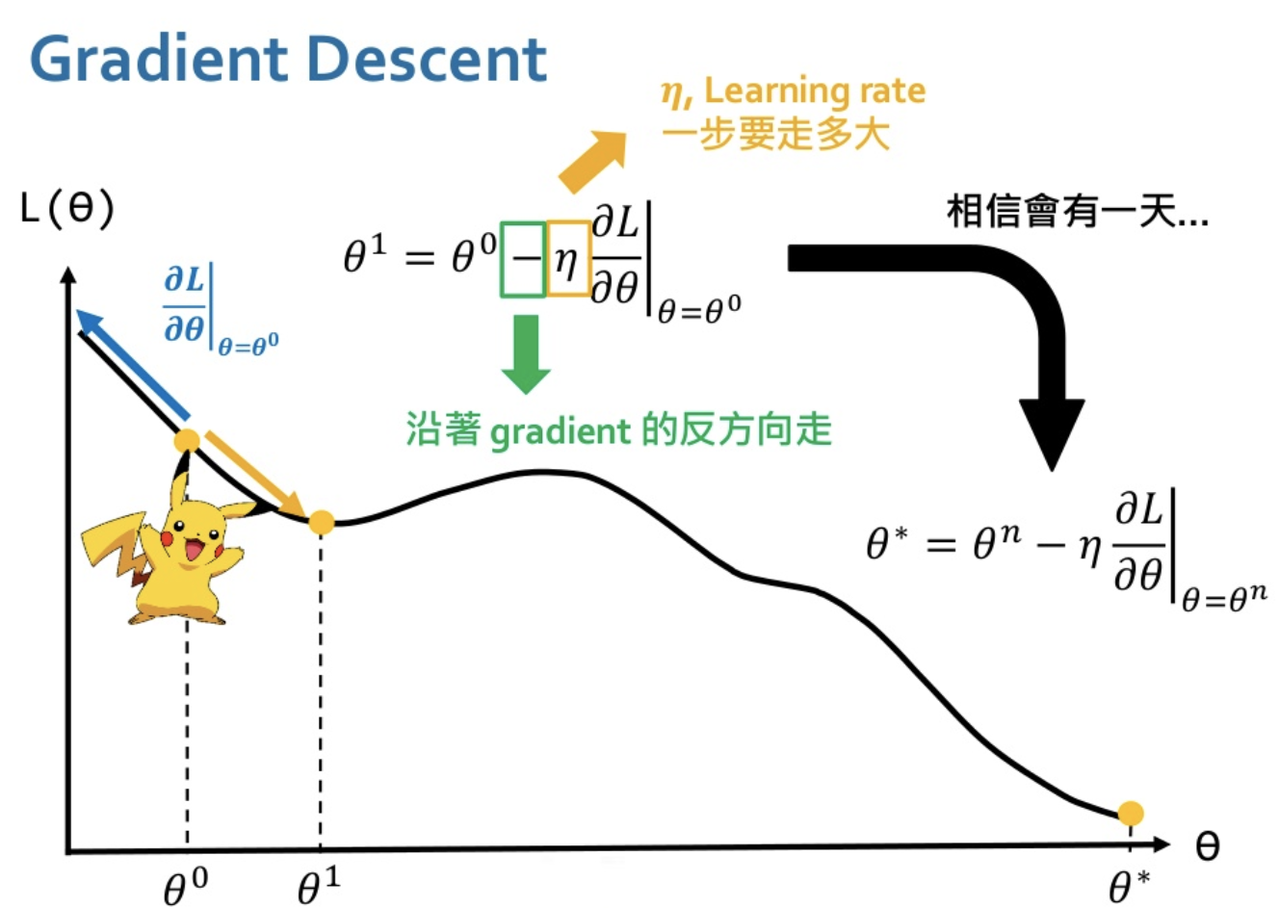
Gradient Descent
Gradient tells the direction
reverse the direction

Slide 7
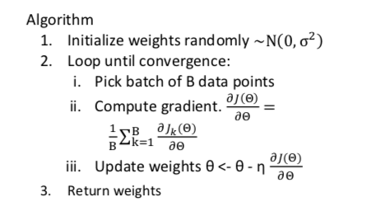
Gradient Descent pseudo code
Supplementary materials: Andrew NG: Gradient Descent

Slide 8
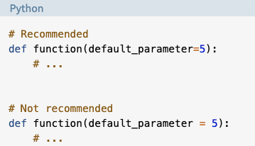
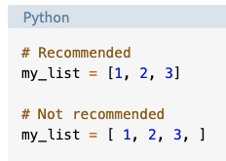
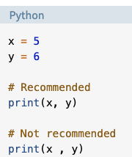
Code readability
Write beautiful Python code with PEP8 guidelines for readability
Base requirement: use whitespace correctly!
Notes:
your Python code should follow PEP8 guidelines for readability, for this HW, the base and only requirements is use whitespace correctly, for example, when you are writigin funcitno, there shoule be no whitespace between default value of argument. Check the guidelines to correctly use whitespace

Slide 9
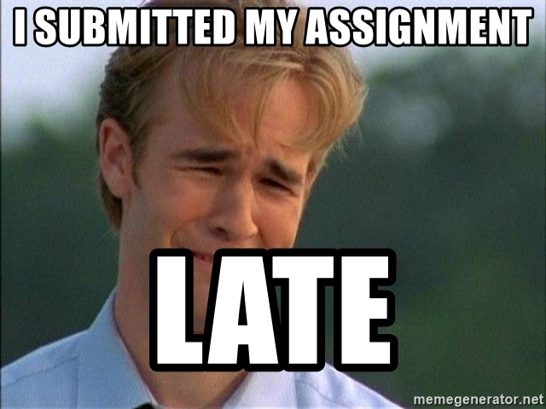
Late policy
We will deduct a late penalty of 20 points per additional late day
For example, If you get 90 points of HW but delay for two days, your will get only 90- (20 x 2) = 50 points!

Slide 10
FAQ
Why my loss is high and the training can not converge
Make sure you calculate the gradients correctly
Use smaller learning rate
Can I use deep learning frameworks such as TensorFlow, Pytorch?
No! In HW1, you are request using only Numpy to implement linear regression and gradien descent. You can use matplotlib to plot the results.
DO NOT copy homework from others! Otherwise, both of you will get 0 points for the homework
Notes:
Here I list some questions you may want to ask.

Slide 11
Notice
Submit your homework on E3-system !
Check your email regularly, we will mail you if there are any updates or problems of the homework
If you have any questions or comments for the homework, please mail me and cc Prof. Lin
Prof. Lin, lin@cs.nctu.edu.tw
TA Jimmy, d08922002@csie.ntu.edu.tw
TA 晨軒, derekt.cs06@nctu.edu.tw
TA 政儒, ace52751208@gmail.com

Slide 12
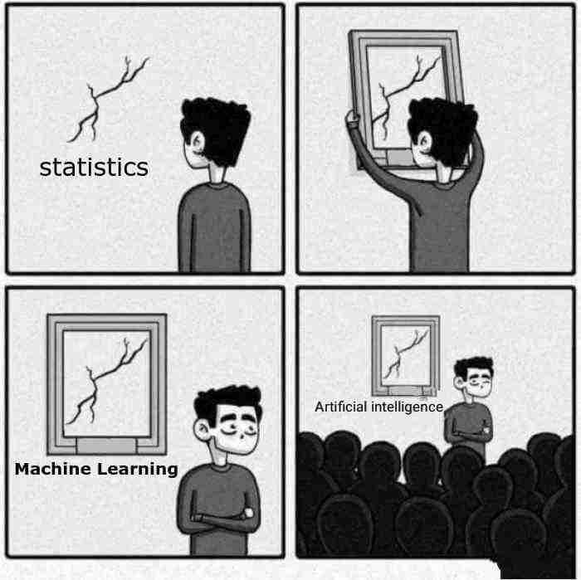
Have fun!
Linear Regression

