Slide 1
Pattern Recognition
Homework 2 announcement
TA: 楊証琨 Jimmy
Ph.D. student at National Taiwan Universitiy
d08922002@csie.ntu.edu.tw
Notes:
‹#›

Slide 2


Homework 2
Deadline: April. 06, Wed at 23:59.
Code assigment (60%): Implement Fisher’s linear discriminant using numpy only
Short answer questions (40%)
Submit your code (.py/.ipynb) and reports (.pdf) on E3
Sample Code
HW2 questions
Please follow the file naming rules <STUDENT ID>_HW2.pdf, otherwise, you will get penalty of your scores
E3
Compress
submit
Notes:
The deadline of HW1 is October seventeen. There will be two parts of this hw1, Make sure you will done two thing before deadline. First, finish…, I will introduce Kaggle later, wh do i mean finish is that you will inference the testing data by your trained model and submit your predictions. Only if you see your student ID and score on leaderboard mean you finish this competition. Mail

Slide 3
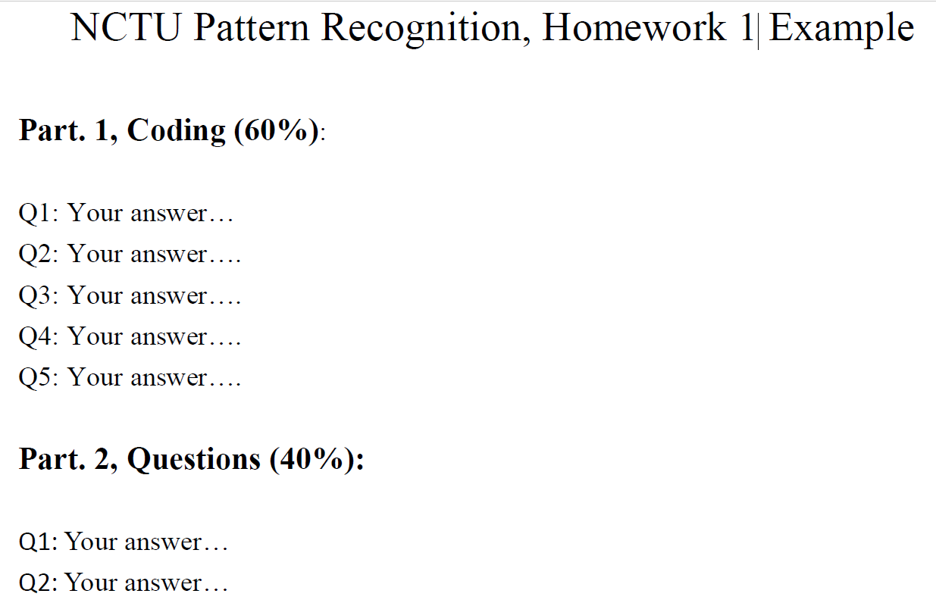
Reports
Submit in PDF format
Please include the answers of coding part

Slide 4
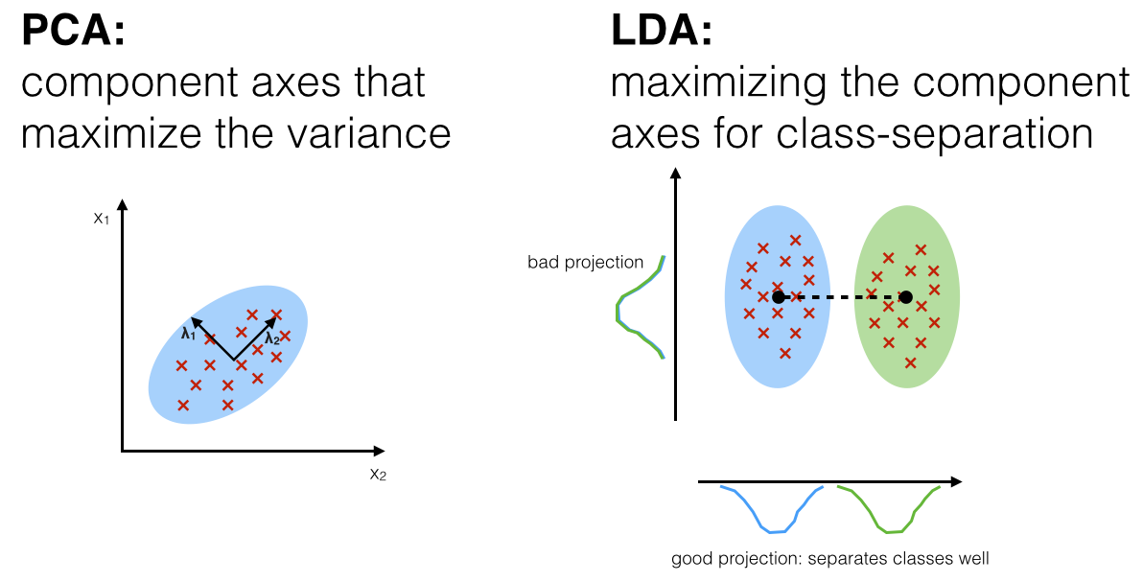
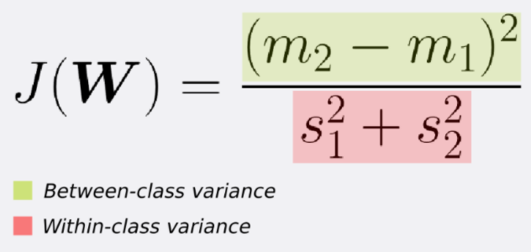
Fisher’s linear discriminant
FLD seeks the projection w that gives a large distance between the projected data means while giving a small variance within each class

Slide 5
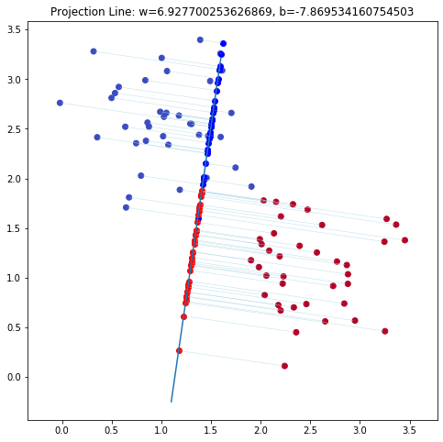
Question 6
Projection line
Colorize the data points
Project the data points into projection line

Slide 6
Supplementary materials
An illustrative introduction to Fisher's Linear Discriminant

Slide 7
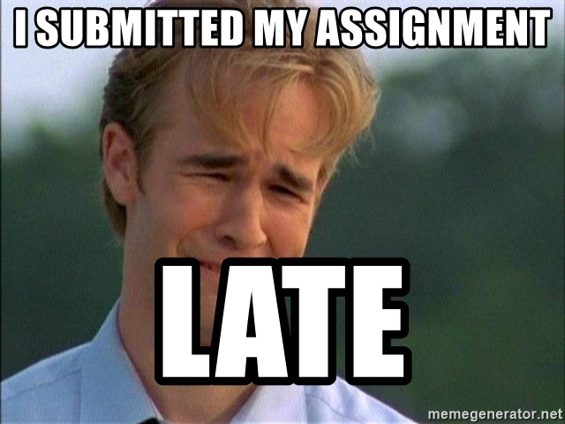
Late Policy
We will deduct a late penalty of 20 points per additional late day
For example, If you get 90 points of HW2 but delay for two days, your will get only 90- (20 x 2) = 50 points!

Slide 8
Notice
Submit your homework on E3-system !
Check your email regularly, we will mail you if there are any updates or problems of the homework
If you have any questions or comments for the homework, please mail me and cc Prof. Lin
Prof. Lin, lin@cs.nctu.edu.tw
TA Jimmy, d08922002@csie.ntu.edu.tw
TA 晨軒, derekt.cs06@nctu.edu.tw
TA 政儒, ace52751208@gmail.com

Slide 9

Have fun!
Lady tasting tea

