Slide 1
Pattern Recognition
Homework 3 announcement
TA: 楊証琨 Jimmy
Ph.D. student at National Taiwan Universitiy
d08922002@csie.ntu.edu.tw
Notes:
‹#›

Slide 2


Homework 3
Deadline: May. 4, 23:59
Code assignment (80%): Implementing decision tree, adaboost and random forest by only NumPy
Short answer questions (20%)
Submit your code (.py/.ipynb) and reports (.pdf) on E3
Sample Code
HW3 questions
Please follow the file naming rules <STUDENT ID>_HW3.pdf, otherwise, you will get penalty of your scores
E3
Compress
submit
Notes:
The deadline of HW1 is October seventeen. There will be two parts of this hw1, Make sure you will done two thing before deadline. First, finish…, I will introduce Kaggle later, wh do i mean finish is that you will inference the testing data by your trained model and submit your predictions. Only if you see your student ID and score on leaderboard mean you finish this competition. Mail

Slide 3
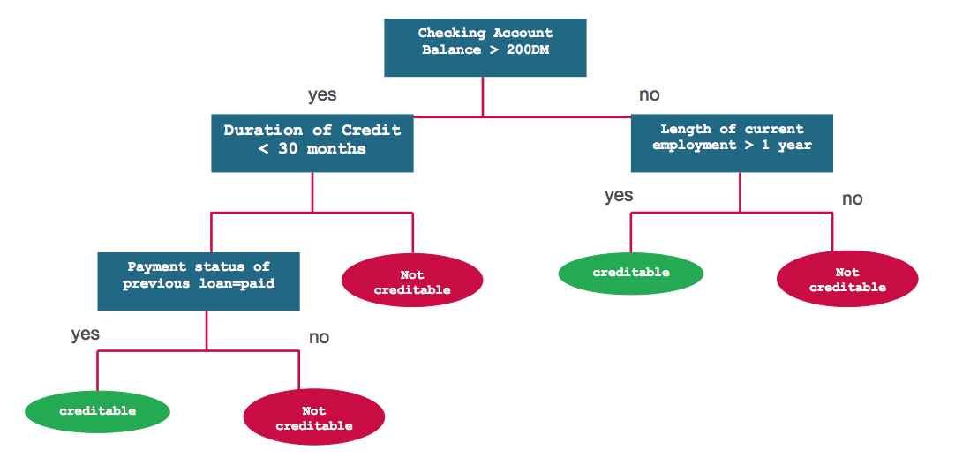
Decision tree algorithm
Whether to approve the loan for a customer?
node
leaf

Slide 4
Decision tree algorithm
How to find the feature to make the decisions?
Find the feature to split data that the class at the resulting nodes are as pure as possible
depth

Slide 5


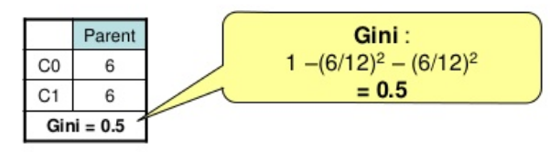

How to measure “pure”?
Entropy: the smaller, the purer
Gini-index: the smaller, the purer
If all classes are the same in one node
If the classes are half-and-half

Slide 6
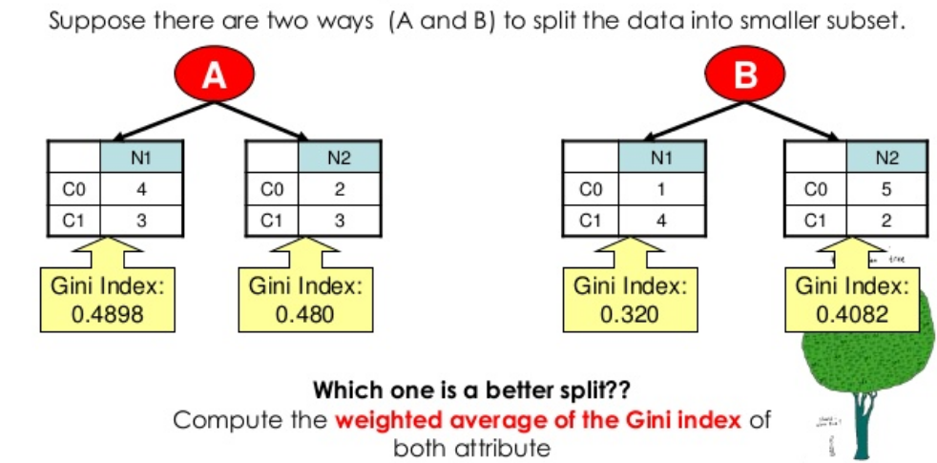
How to find best split?

Slide 7
Decision tree pseudo code
Until stopped
Select a node
loop all values of all features
partition the node and calculate the purity of data
find the value of feature can yield lowest value of gini or entropy
Split the node using the feature value found in step b.
Go to next node and repeat step a to c.
Stopping criteria
The data in each leaf-node belongs to the same class
Depth of the tree is equal to some pre-specified limit

Slide 8
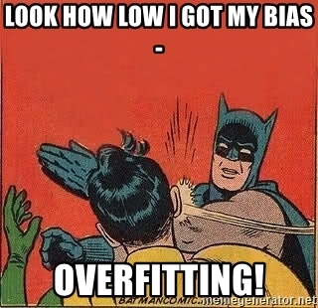
Overfitting
Decision tree can find a unique path for each data if we don’t pre-specified any limits, such as the depth of the node

Slide 9
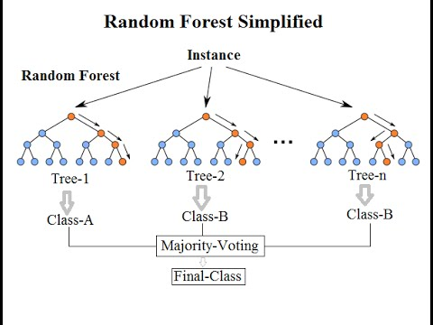
Ensemble method of decision trees: Bagging
Bagging (Bootstrap aggregating): Fit many deep trees to bootstrap-resampled versions of the training data, and classify data by majority voting

Slide 10
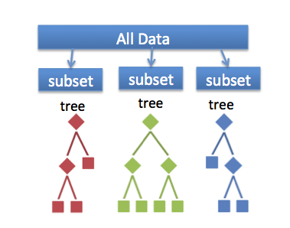
Random forest: Where is the “randomness”?
Bootstraped dataset
Each tree in the forest may grow with different data and features
Which features or data to be used are randomly sampled to grow the tree

Slide 11
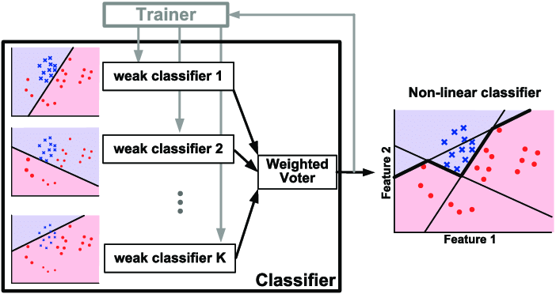
Ensemble method: Boosting
Boosting: Iteratively fit many shallow trees and get the results by weighting those classifiers

Slide 12

Coding
Make sure to comment your code!
Document each step of your model
PEP8 online checker
Notes:
your Python code should follow PEP8 guidelines for readability, for this HW, the base and only requirements is use whitespace correctly, for example, when you are writigin funcitno, there shoule be no whitespace between default value of argument. Check the guidelines to correctly use whitespace

Slide 13

Late policy
We will deduct a late penalty of 20 points per additional late day
For example, If you get 90 points of HW but delay for two days, your will get only 90- (20 x 2) = 50 points!

Slide 14
Notice
All of your model should get the accuracy over 0.7 (Deicision tree may suffer from overfitting and need to tune the hyperparameter)
Submit your homework on E3-system
Check your email regularly, we will mail you if there are any updates or problems of the homework
If you have any questions or comments for the homework, please mail me and cc Prof. Lin
Prof. Lin, lin@cs.nctu.edu.tw
TA Jimmy, d08922002@csie.ntu.edu.tw
TA 晨軒, derekt.cs06@nctu.edu.tw
TA 政儒, ace52751208@gmail.com

Slide 15

Have fun!

