Slide 1
Pattern Recognition
Homework 4 announcement
TA: 楊証琨, Jimmy
Ph.D. student at National Taiwan Universitiy
d08922002@csie.ntu.edu.tw
Notes:
‹#›

Slide 2


Homework 4
Deadline: May. 25, Wed at 23:59.
Code assignment (50%): Implement cross-validation and hyperparameter searching for SVM model training
Short answer questions (50%)
Submit your 1) code (.py/.ipynb) and 2) reports (.pdf) on E3
Sample Code
HW4 questions
Please follow the file naming rules <STUDENT ID>_HW4.pdf, otherwise, you will get penalty of your scores
E3
Compress
submit
Notes:
The deadline of HW1 is October seventeen. There will be two parts of this hw1, Make sure you will done two thing before deadline. First, finish…, I will introduce Kaggle later, wh do i mean finish is that you will inference the testing data by your trained model and submit your predictions. Only if you see your student ID and score on leaderboard mean you finish this competition. Mail

Slide 3
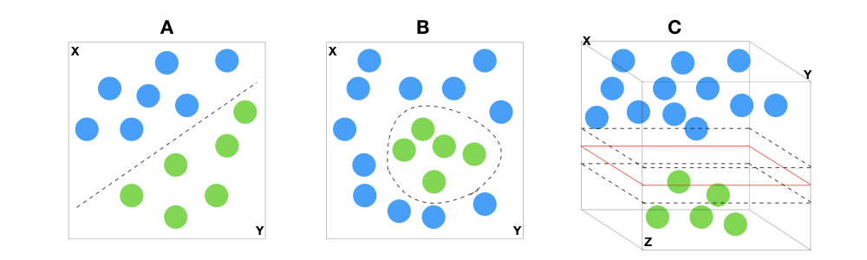
Support vector machines
Support Vectors Classifier tries to find the best hyperplane to separate the different classes by maximizing the distance between sample points and the hyperplane

Slide 4

No need to implment SVM!
Since SVM requires lots of difficult mathematical operations, we will not ask you to implement SVM in homework 4 :)

Slide 5
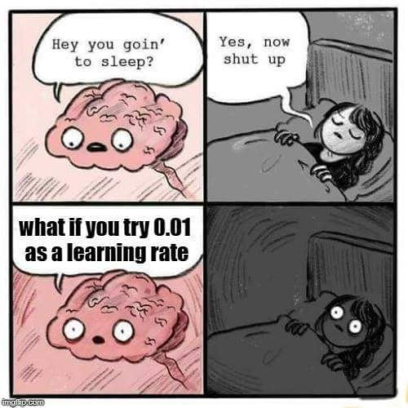
Grid search and cross-validation
There are lots of hyperparameters in SVM. In this homework, you will need to implement grid search and cross-validation to find the best hyperparameters of the SVM on the provided dataset

Slide 6
Hyperparameter searching
Suppose we want to find the best values of two hyperparameters for an RBF kernel SVM, namely C and gamma
Interactive demo
Explanation of C and gamma
There are many combinations to be considered!
Notes:
Gamma is inverse proportion to sigma

Slide 7
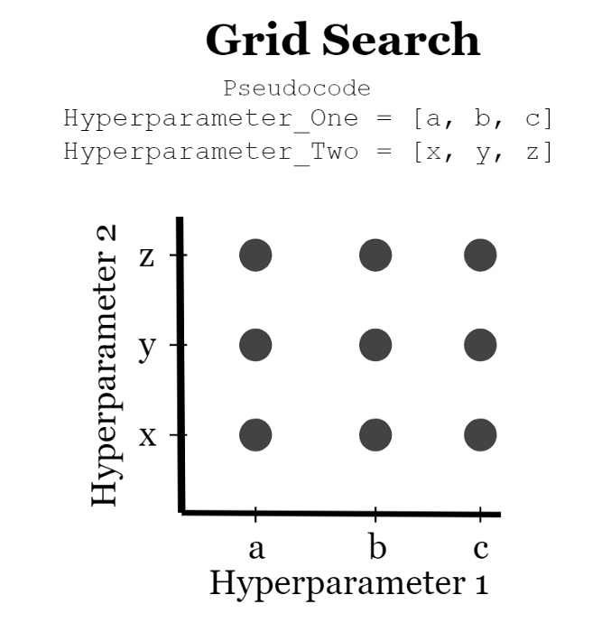
Hyperparameter searching: Grid search
Grid search exhaustively considers all hyperparameter combinations and picks the best one based on the model that gives the best performance
C = [0.1, 1, 10] #3 values
gamma = [0.01, 0.1, 1, 10] #4 values
# There are totally 12 combinations for tuning
C\gamma | 0.01 | 0.1 | 1 | 10
0.1 | [0.1, 0.01] | [0.1, 0.1] | [0.1, 1] | [0.1, 10]
1 | [1, 0.01] | [1, 0.1] | [1, 1] | [1, 10]
10 | [10, 0.01] | [10, 0.1] | [10, 1] | [10, 10]

Slide 8
K-fold Cross-validation
The main idea behind cross-validation is that each data point in the dataset has the opportunity of being tested
Illustration of K-fold cross-validation when n=12 observations and K=3. After data is shuffled, a total of 3 models will be trained and tested.

Slide 9
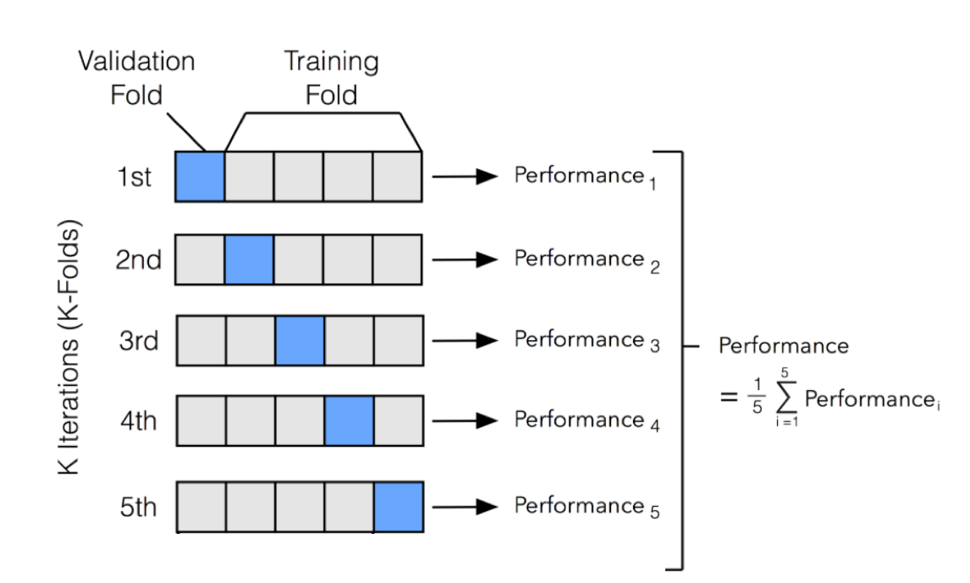
K-fold Cross-validation
We split the dataset into K parts: one part is used for validation, and the remaining K-1 parts are merged into a training subset. This process repeats K times, with each part used exactly once as the validation data
Training set

Slide 10
K-fold Cross-validation for hyperparameter searching
We can experiment with 12 combinations of hyperparameters defined in page 7. For each combination, we apply the K-fold cross-validation and get the average performance
Find the best combination which yield best performance
Combination 1: [0.1, 0.01] avgerage score=0.8
Combination 2: [0.1, 0.1] avgerage score=0.91
Combination 12:[10, 10] avgerage score=0.75
Training set
Training set
Training set
...

Slide 11
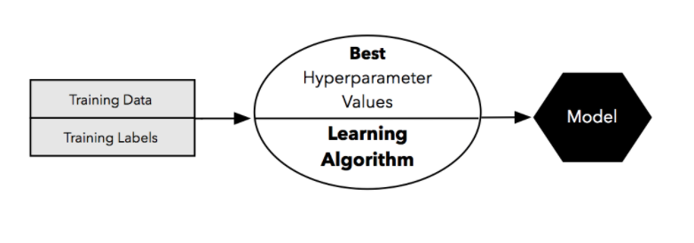
K-fold Cross-validation for hyperparameter searching
Finally, train your model on the whole training set with the best hyperparameters and evaluate on the test set
C=0.1, Gamma = 0.1 from combination 2
evaluate
Test set

Slide 12
Reference
K-fold Cross-Validation & Grid Search
SVM hyperparameter tuning

Slide 13
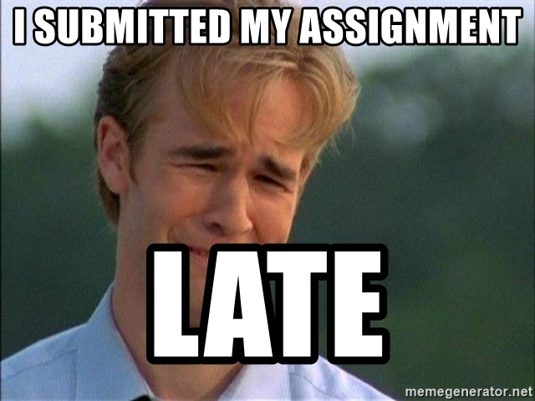
Late Policy
We will deduct a late penalty of 20 points per additional late day
For example, If you get 90 points of this HW but delay for two days, your will get only 90- (20 x 2) = 50 points!

Slide 14
Notice
Submit your homework on E3-system !
Check your email regularly, we will mail you if there are any updates or problems of the homework
If you have any questions or comments for the homework, please mail TAs and cc Prof. Lin
Prof. Lin, lin@cs.nctu.edu.tw
TA Jimmy, d08922002@csie.ntu.edu.tw
TA 晨軒, derekt.cs06@nctu.edu.tw
TA 政儒, ace52751208@gmail.com

Slide 15
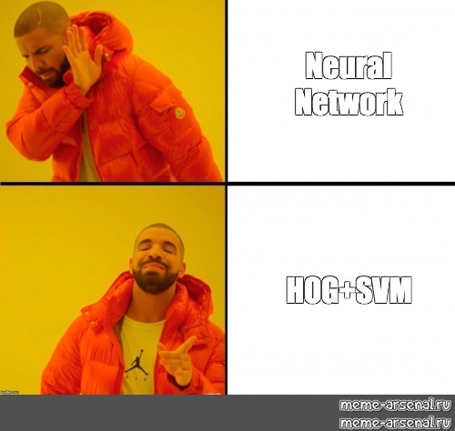
Have fun!

