Slide 1

Health Smart Home

Slide 2
Slide 2 title

Slide 3
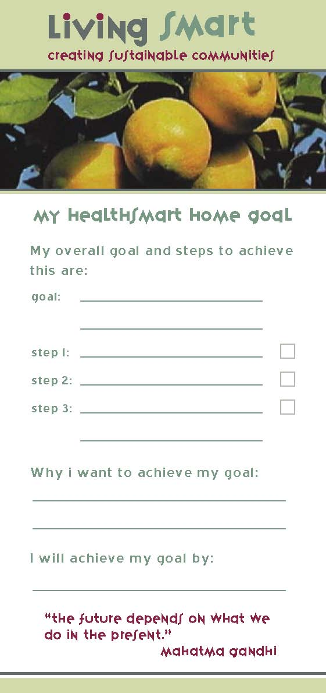
The Seven Steps to Goal Achievement
1) Write your goal down
2) Make it specific
3) Make it positive
4) Make it challenging
5) Make it measurable
6) Give it a deadline
7) Make it flexible

