Slide 1
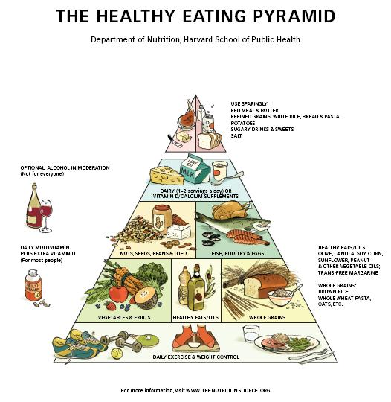

Slide 2
Tonight’s outline
Where your food comes from
Exercise & Time out
Wellbeing – pointers for a healthy diet
Healthy Break
Healthy Homes with Alison

Slide 3
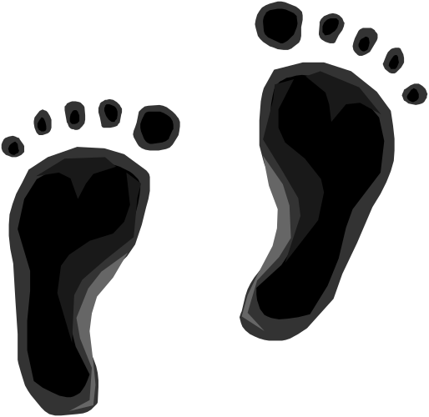
Reflecting on Actions Taken or Planned – share in groups

Slide 4
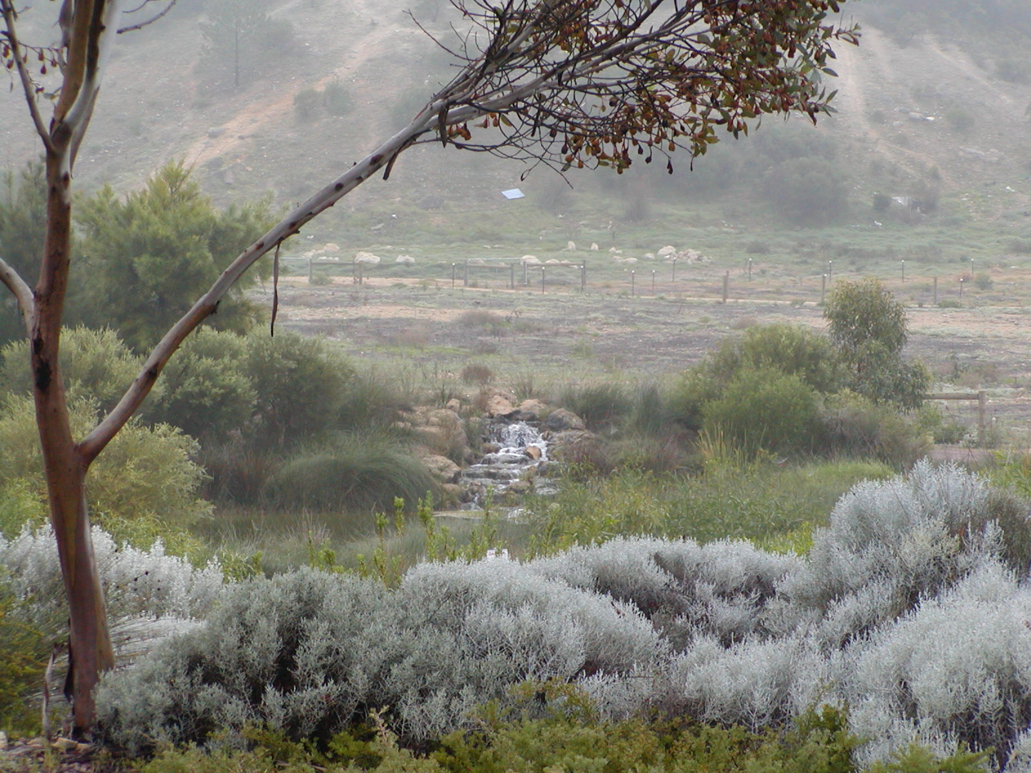
4 key elements for well-being
Nutritious Food
Exercise
Health for the soul, and
Healthy environment
Be proactive in your health, seek out the health solutions that work for you …and the planet.

Slide 5

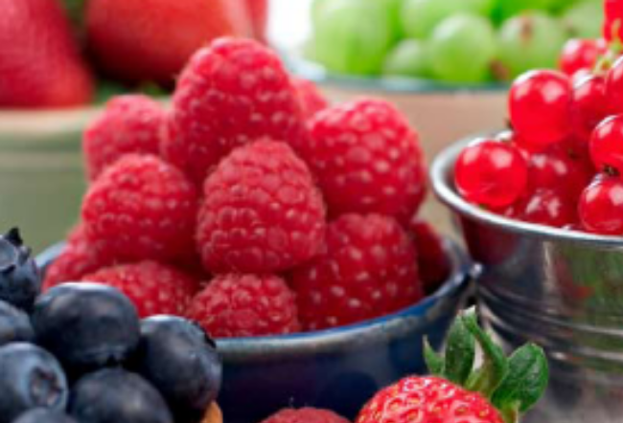
The 4 Ps to reduce
Reduce the 4 Ps
  Pasta
  Pastries
  Potatoes
  Panne – bread
Choose wholegrains
Instead
  Choose Diversity
  Choose Colour

Slide 6
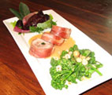
Slow eating
Make time to eat…
  first breathe and smell
  then chew and digest, while relaxing.

Slide 7
Healthy Exercise & Time out
Aerobic exercise
  Gardening, stairs, swimming, fast walking, dancing, aerobic classes
Resistance and Weight bearing activity to stimulate Ca deposition and build muscle type 2.
  Star jumps, sprints, push-ups, weights
Time to quieten and relax the mind
  Breathing exercises, meditation, yoga, gentle walk, midday nap, singing

Slide 8
Maintaining Well-being
Aerobic exercise
  at least 150 minutes of each week
Resistance and Weight bearing activity to strengthen bones and build muscle type 2.
  10 minutes a day 3-4 times a week
Time to quieten and relax the mind
  Every day or every second day

Slide 9
Your choice and source of food makes a difference to the planet
How was it grown/produced?
What was the artificial fertilizer volume used?
How much processing was involved?
Where did it come from?
Was it refrigerated for a long period?
Was it genetically-modified

Slide 10
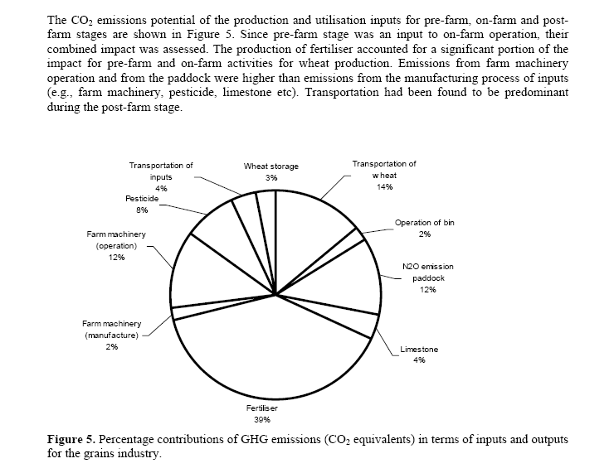
Lifecycle Global Warming Potential of Wheat Production in Western Australia (Biswas, Barton & Carter, 2007)

Slide 11

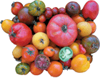
Choosing Certified Organic –Why?
Healthier?
  A ten-year study comparing organic tomatoes with standard produce found almost double the level of flavonoids - a type of antioxidant (University of California, July 2007)
Animal welfare – room for wildlife etc
Gentler on the soil
Reduced N fertiliser use
  less greenhouse emissions and river pollutants
Tastier? Try for yourself

Slide 12
Choosing GM-free
Future of Food DVD
see websites:
http://www.futureoffood.com/
http://www.onestopgreenshop.com.au

Slide 13
Discussion points
What did you have for dinner last night?
  Main ingredients
  How were they created/grown, processed, stored
  Where did they come from
How could you reduce the embodied energy of your meals and make them healthier for you?

Slide 14
Time for Tea Break…

