Slide 1
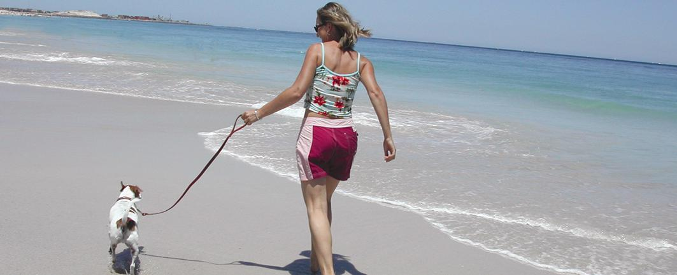
Health Smart You
Shani Graham
Some time for reflections
Slide <number>

Slide 2
Some Reflections
What have you had to eat or drink in the last 24 hours? Write down everything!
What exercise have you done in the last week?
What “being”, “mindfulness” or soul health time have you had this week?
Slide <number>

Slide 3

Slide <number>

Slide 4
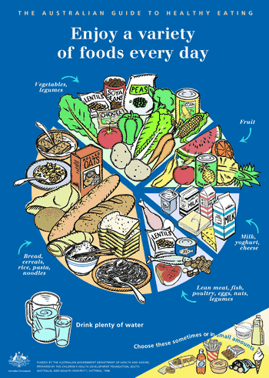
Slide <number>

Slide 5
What should we be eating and how did we do today?
No. of serves | Bread, cereals, rice, pasta, noodles | Veggies, Legumes | Fruit | Milk, Yoghurt, Cheese | Meat, Fish, Poultry, Eggs, Nuts Legumes | Extra Foods
Women | 4 - 6 | 5 | 2 | 2 | 1 - 1.5 | 0 - 2.5
Men | 5 - 7 | 5 | 2 | 2 | 1 - 1.5 | 0 - 3

Slide 6


Slide <number>

Slide 7
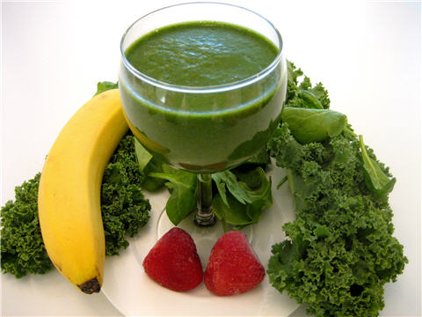
Raw foods
Slide <number>

Slide 8

Easy on the meat
Slide <number>

Slide 9
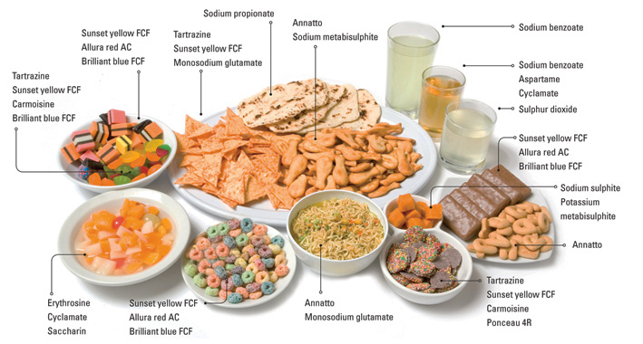
Slide <number>

Slide 10

Exercise and Activity
Slide <number>

Slide 11
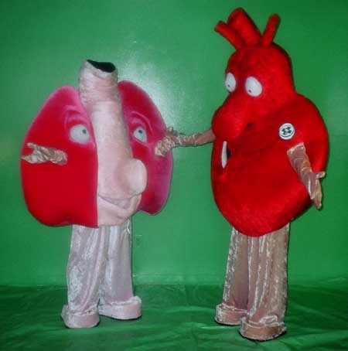

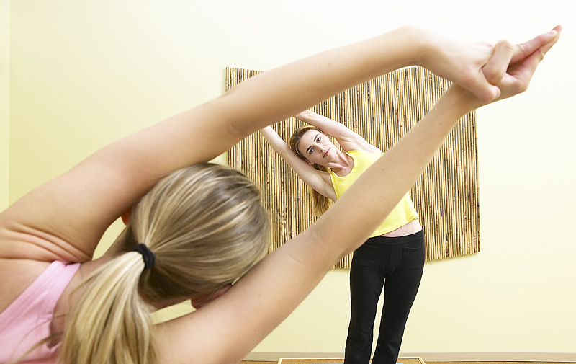

Types of Exercise
Strength
Heart and Lung
Flexibility
Rest
Slide <number>

Slide 12
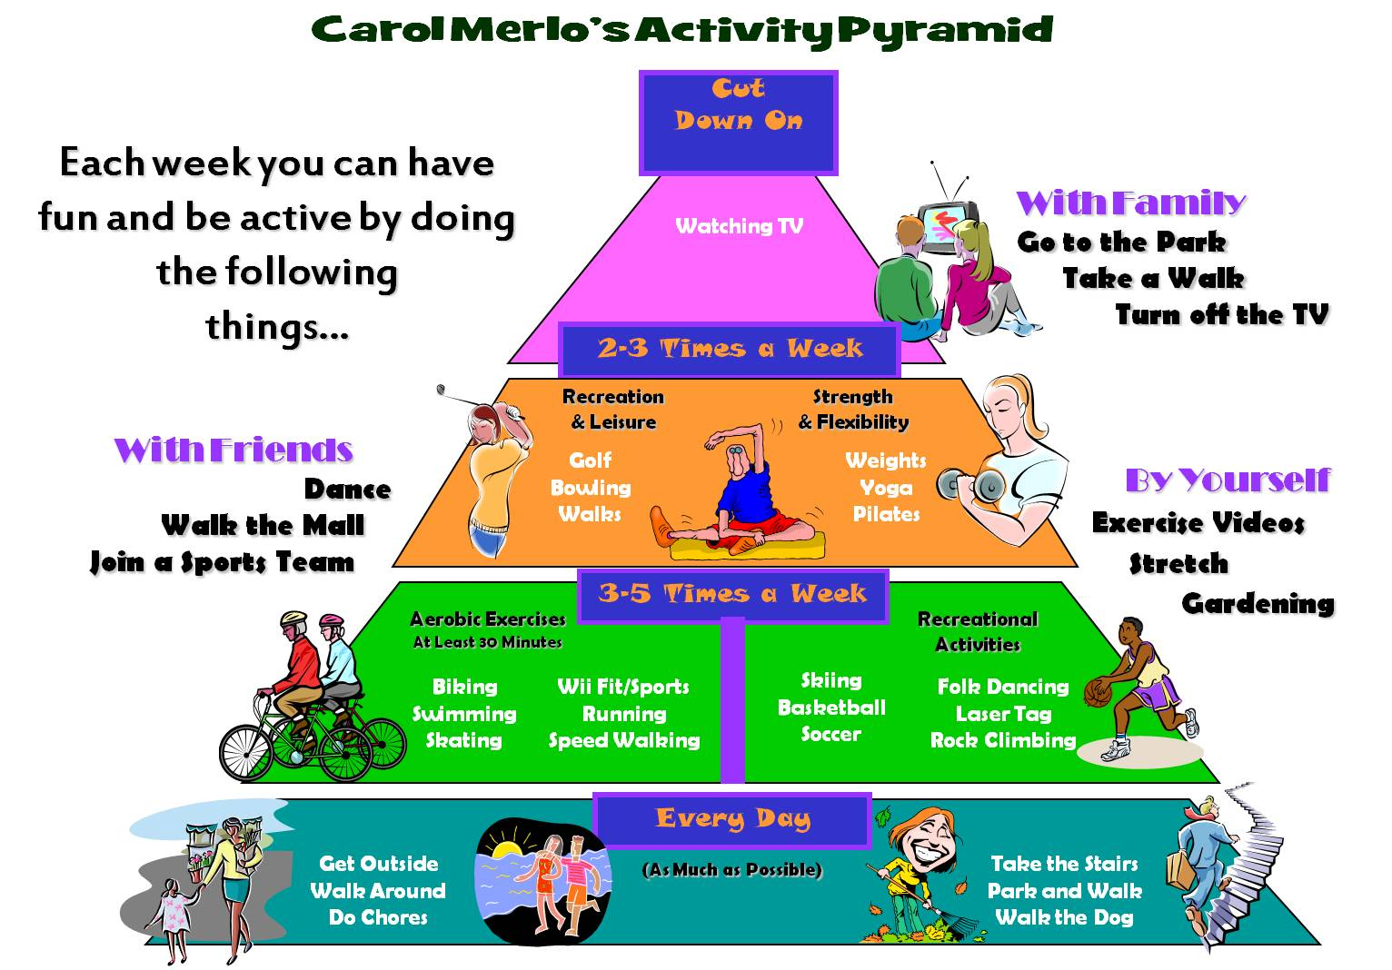
Slide <number>

Slide 13
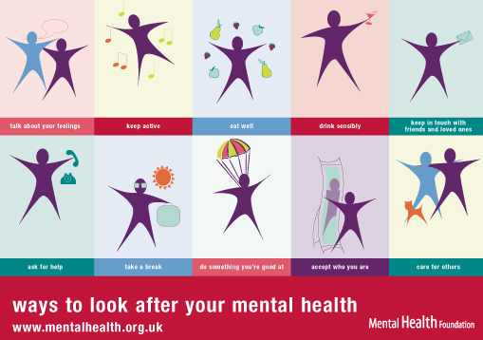
Mental Health
Slide <number>

Slide 14
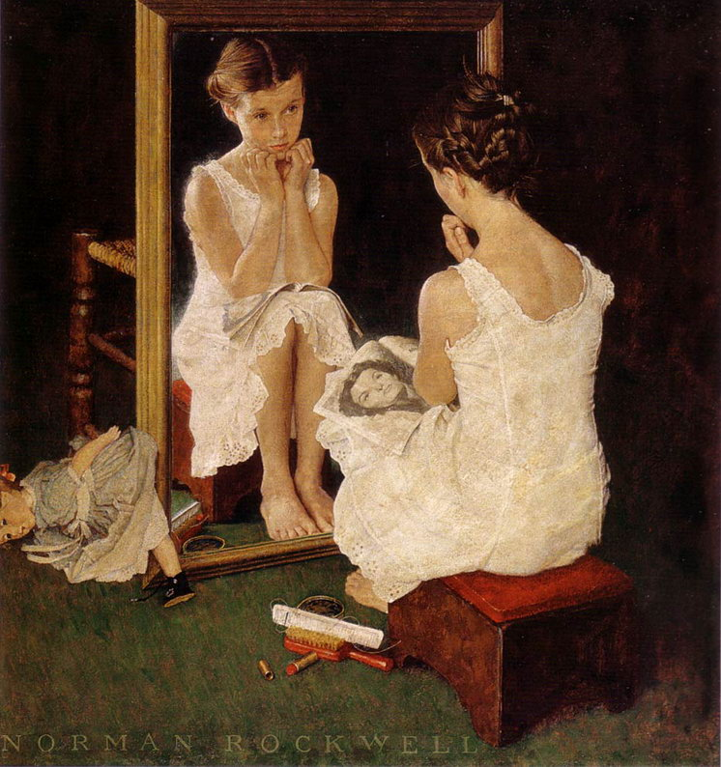
Slide <number>

Slide 15
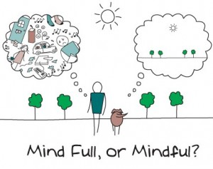
Mindfullness
Slide <number>

Slide 16

Slide <number>

Slide 17

Share a success and a goal!
Slide <number>

