Slide 1
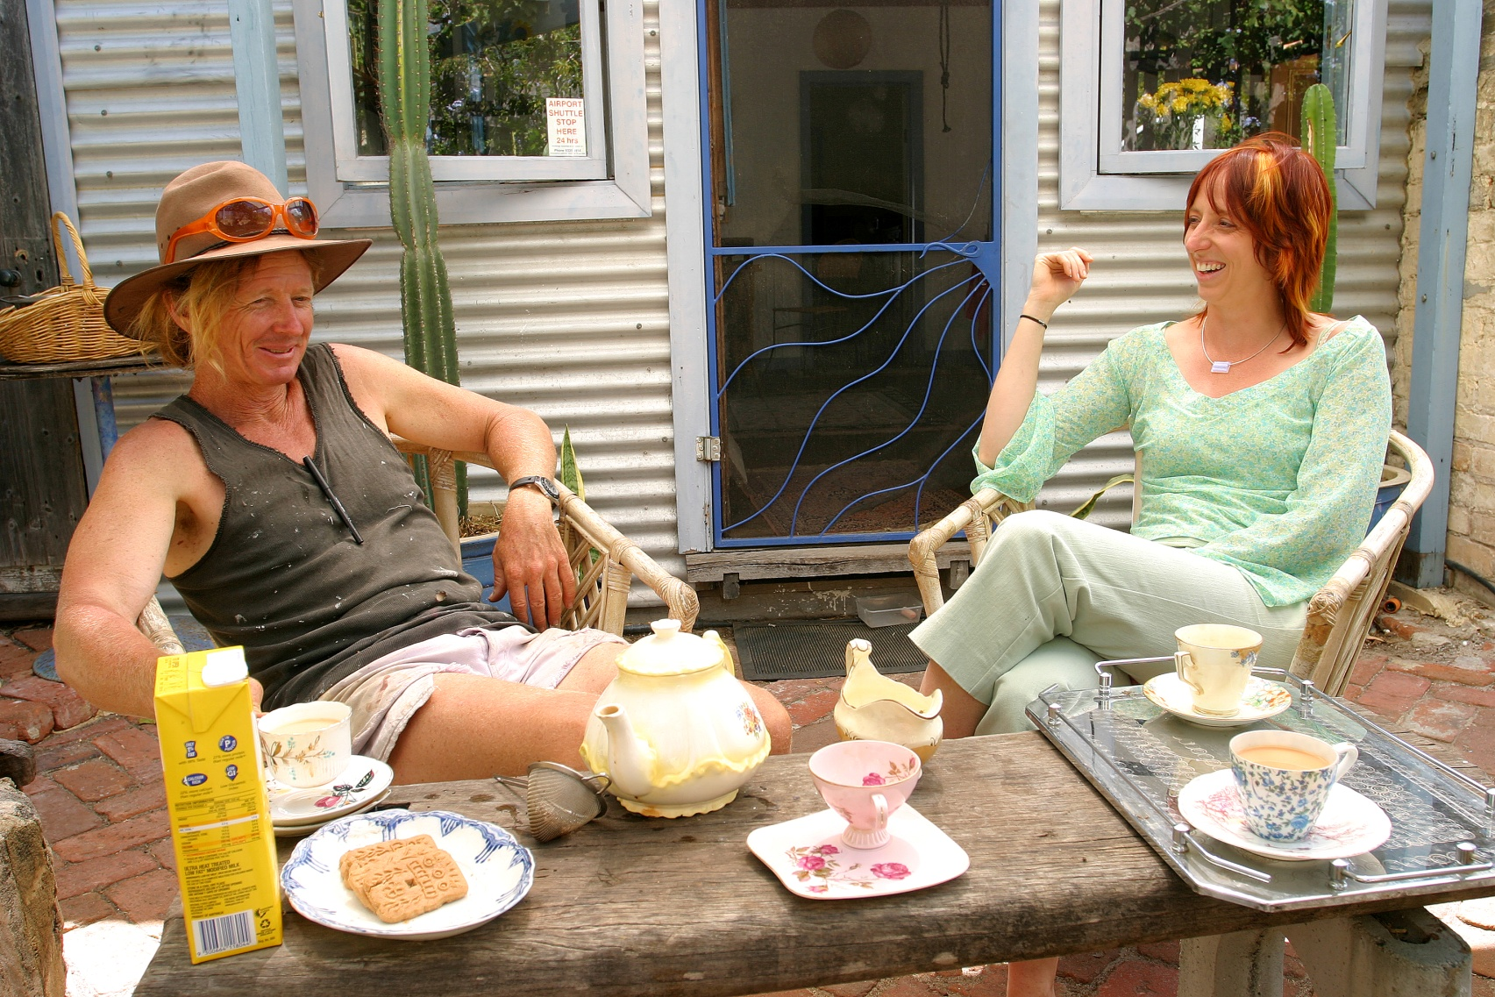

Tim Darby and Shani Graham

Slide 2
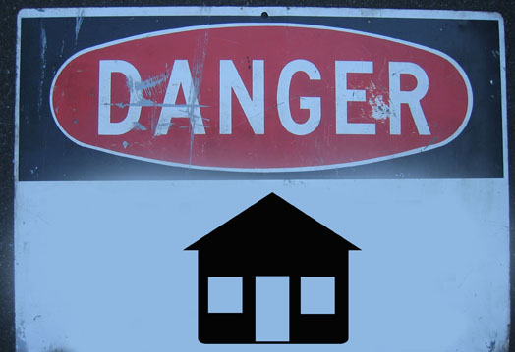
Slide 2 title
Notes:
Is your house killing you? Might be slightly hysterical overstatement but when you have met someone who has been affected by issues in their home it can affect a great many aspects of their lives.

Slide 3
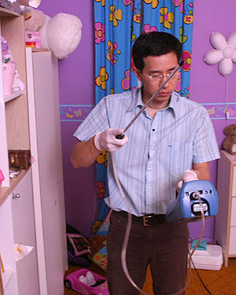
Notes:
Air quality
The average Australian spends 80 to 90% of their time indoors – which can be very unhealthy if the air quality indoors is poor.
Indoor air is far dirtier than outdoor air – up to 10 times dirtier, this is a concern to many of us. Most contaminants from outside come inside and stay there due to our modern homes being more snug and airtight. Many homes don’t get “aired out” regularly. Many indoor items will also be releasing toxins into the air eg carpets.
Indoor contaminants include volatile organic compounds, dust and mould.
VOC’s - A class of carbon based chemicals, which evaporate easily at room temperatures, giving off vapours, which can be inhaled.

Slide 4

VOC

Slide 5
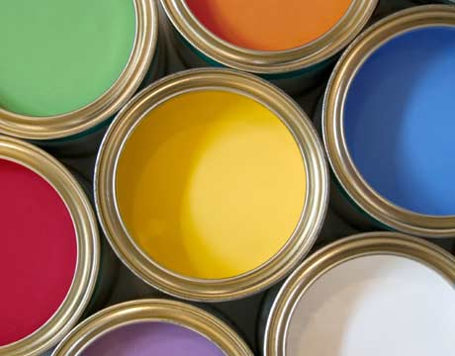

Slide 6
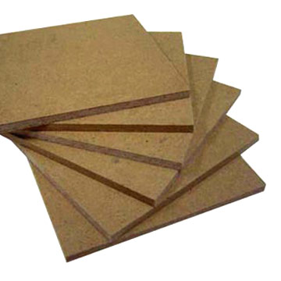
MDF

Slide 7
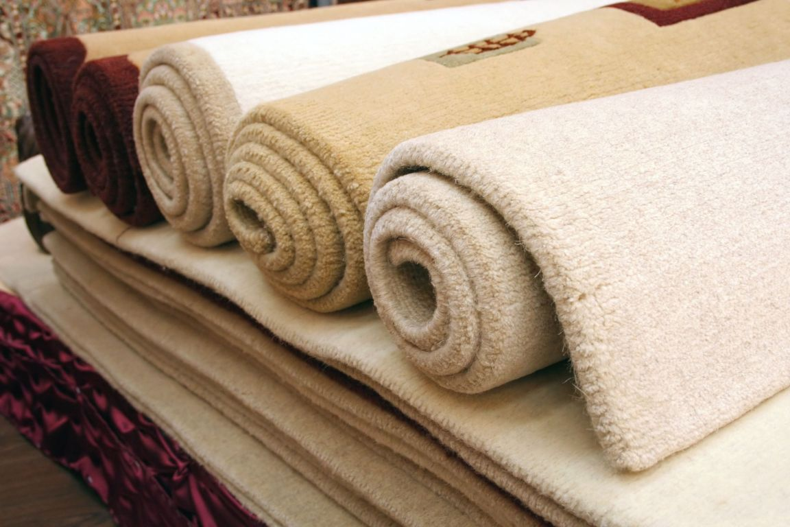
Carpets

Slide 8
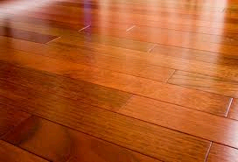

Slide 9
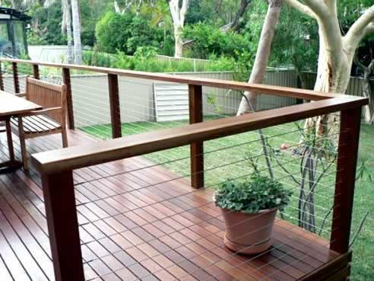
Notes:
Cca treated pine

Slide 10
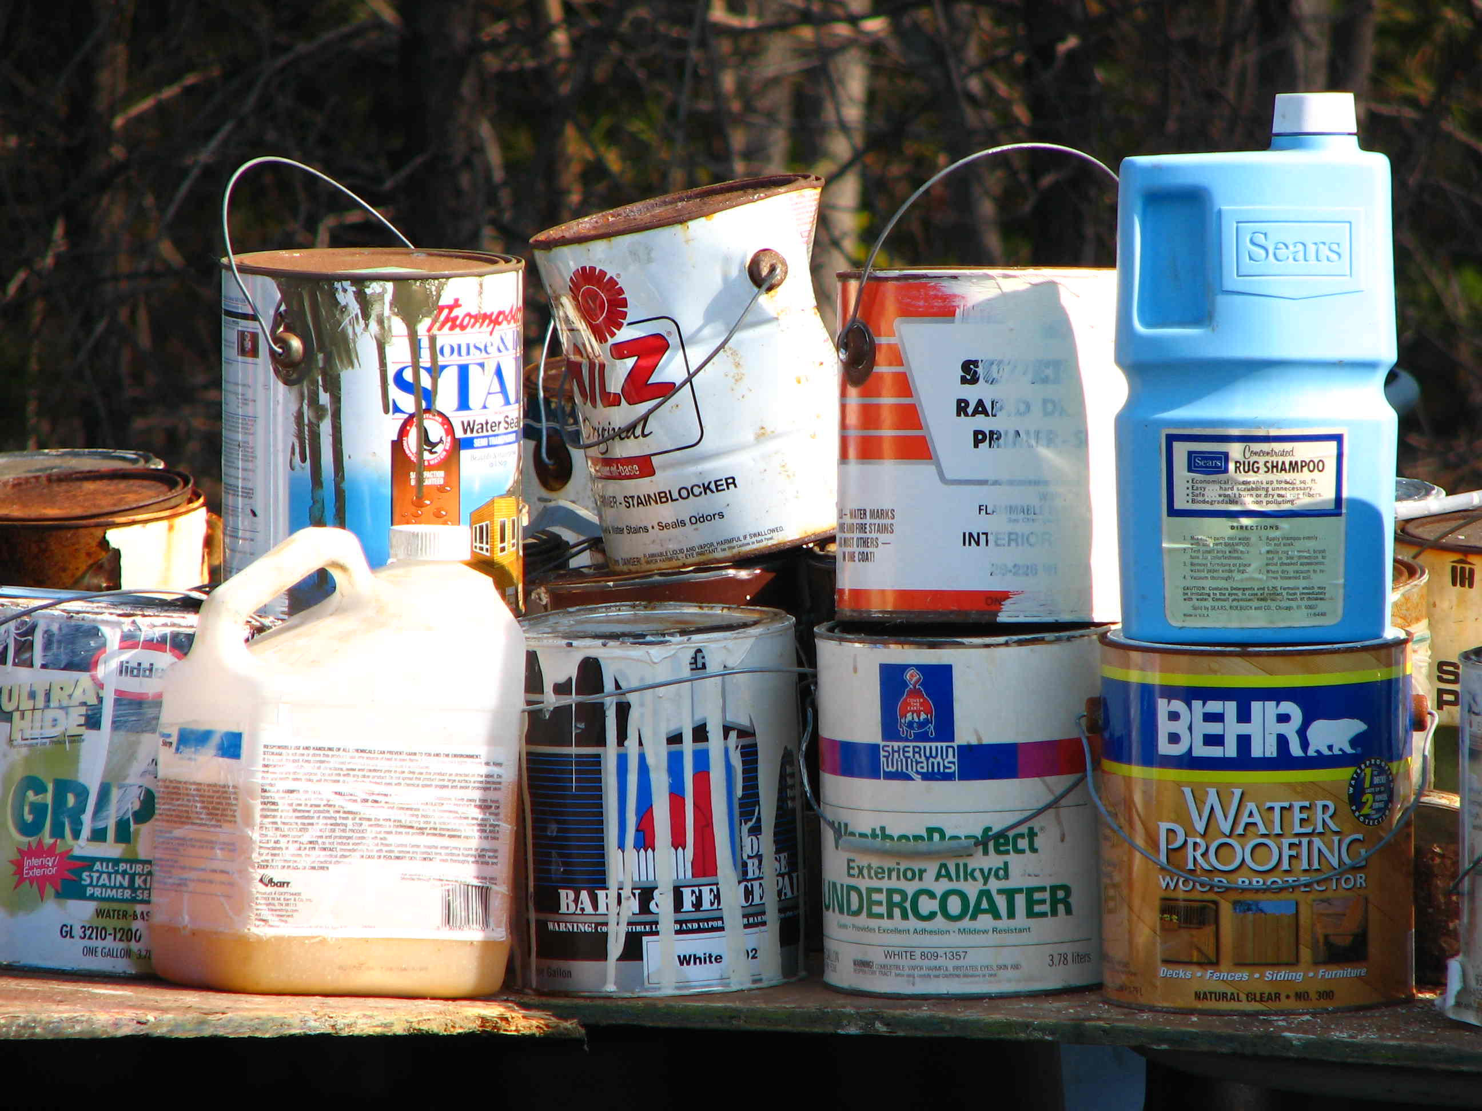
Notes:
It’s a good idea to do a chemical audit of your home for the presentation – it may surprise you how many chemicals you have, how many of these overlap in function and how many you don’t need! You may want to take a photo of your chemical shelf to get an idea of what’s there. This list may take up several slides.

Slide 11
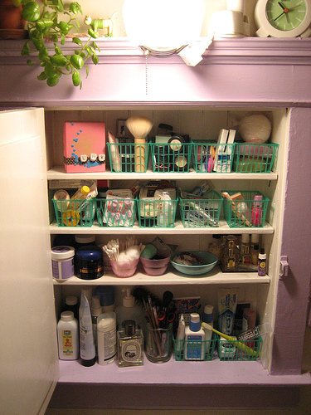
Notes:
There are potentially a lot of chemicals in the products we put on our body all in the name of beauty!
It is possible to look good, reduce your exposure to chemicals and be friendly to the environment.
Unfortunately there is no black and white answer to choosing “green” cosmetics.
But you can ask yourself the following questions:
What is in the product?
Where did it come from and how was it made?
Is it tested on animals?
How is it packaged?

Slide 12
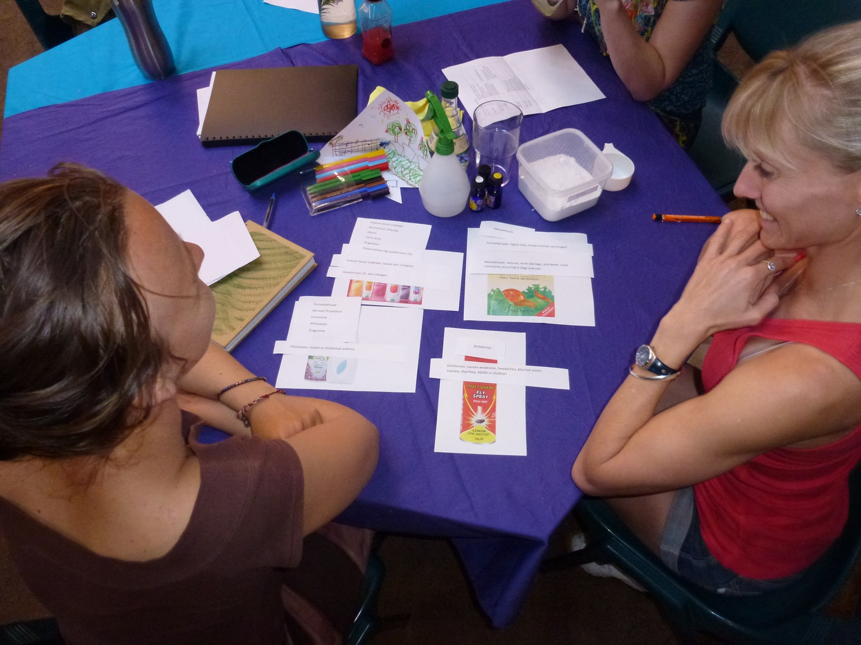

Slide 13

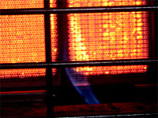
Notes:
Unflued gas heaters

Slide 14
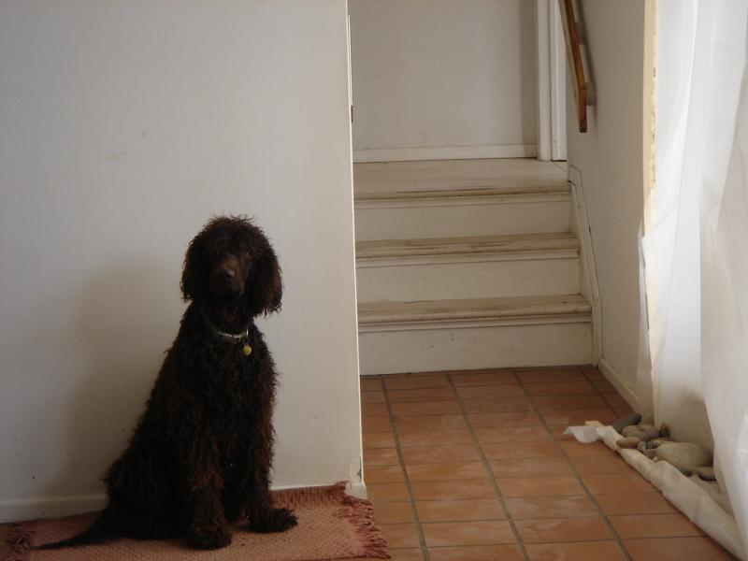
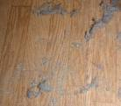
Notes:
DUST
On a normal day we breathe in one teaspoon of microscopic dust particles
Dust contributes to respiratory infection and disease – many of the microscopic particles can be absorbed into our lungs.
Causes headaches, nausea and asthma
What Constitutes Dust?
Skin cells (animal and human)
House dust mites
Mould and fungal spores
Dead and living bacteria
Insect parts
Fibrous material
Left over food particles
Inorganic particles
Chemicals
Pesticides from gardens
Heavy metals from exhausts
Pet faeces
etc

Slide 15
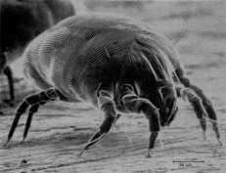
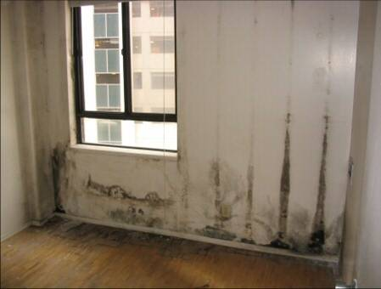
Notes:
MOULD Dust mites are microscopic organisms that feed on dried human skin
Both love moist areas- and dust mites need mould to survive.
Exposure to mould spores is serious especially for children. Mould can cause serious health consequences – any mould in a house is too much!
Both can cause asthma, chronic bronchitis, rhinitis, nasal congestion, coughs, wheezing and sore throats
Dust mites are common trigger for asthma

Slide 16
So what can we do to make our homes healthier?
Notes:
Use objects and photos
Microfibre cloths
Vinegar
Salt and lemon
Bicarb soda
Ecaluptus oil
Borax
Soap flakes
HEPA filter vacuum (high efficiency particulate airs)
In the 1940's HEPA (High Efficiency Particulate Air) filters were invented to filter out radioactive dust particulate contaminants in bomb shelters during the atomic bomb tests. These filters were designed to capture particles down to 0.3 microns in size at efficiency ratings of 99.97%. This standard is still used to this day for HEPA vacuum cleaners and HEPA air cleaners for asbestos and lead abatement. However HEPA vacuum cleaners are now used everyday in homes and businesses to clean and remove household dust and allergens to improve the indoor air quality you breathe
Picture of open windows
Picture of the sun
Face mask
Protective clothing
Shoes at the front door

Slide 17


Slide 18
