Slide 1
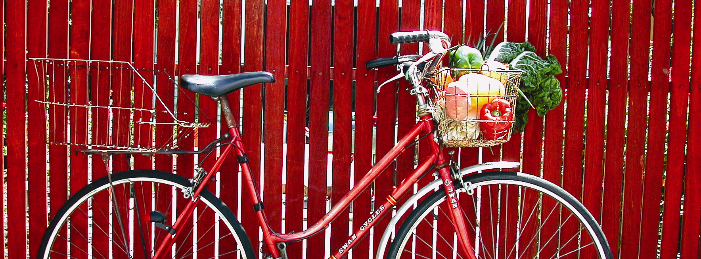
Move Smart
Hilton Living Smarties
PCYC, 13 November 2011
Slide <number>

Slide 2
Transport
Allows movement of people and goods from one place to another.
Transport affects sustainability in many ways:
environmental;
social;
economic.
Slide <number>

Slide 3
Environmental
Around 20% of all energy consumed in WA (mostly oil).
Approx. 15% of WA’s greenhouse gas emissions (mostly road).
Air quality issues.
Land clearing, habitat loss and fragmentation, spread of ferals.
Slide <number>

Slide 4
Social & economic
Declining physical activity.
Traffic accidents, loss of lives.
Quality of life, time taken away from family.
15-25% of annual family budget.
Slide <number>

Slide 5
The cars that ate Perth…
One of the most car dependent cities in the world.
784 vehicles per 1000 people (2006).
One-third of all car trips are for less than 3km. 50% are for less than 5km.
Land use planning promotes car dependence.
Slide <number>

Slide 6
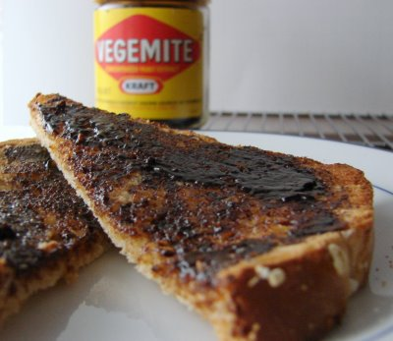
Vegemite sandwich analogy
Slide <number>

Slide 7
The alternatives
For a daily 40km return car trip, car pooling with just one passenger can save between $600 and $900 a year.
A safe and fairly comprehensive public transport system. Visit the Journey Planner on Transperth website.
Good bike maps for the whole of Perth metro area.
Slide <number>

Slide 8
Sustainable transport
Limits emissions and waste, uses renewable energy, affordable, equitable.
A sliding scale of sustainable options:
green cars (use about 1/3 fuel);
bus or train (1/6 to 1/20 of carbon emissions per journey);
cycling and walking.
Slide <number>

Slide 9
Benefits of cycling
Cost of buying and maintaining a bike is about 1% of cost of buying and maintaining a car.
Increase levels of physical activity.
Recommended min. of 30mins moderate exercise a day. Add 5-8years to your life, decreases illness and injury, increases quality of life, combats obesity, heart disease, T2 diabetes.
Slide <number>

Slide 10
Reduced greenhouse gas emissions and air pollution.
More community interaction and social cohesion.
More goods and services purchased locally.
And lastly, TIME!
For trips less than 5km (especially in CBD areas), a bike is quicker.
Building exercise into daily behaviours saves time and $$ on the gym.
Slide <number>

Slide 11
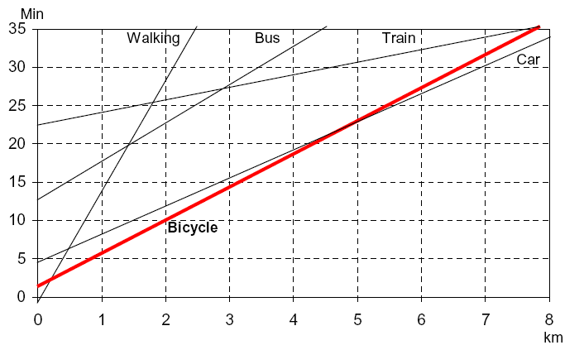
Journey time against distance by mode
Slide <number>

Slide 12
My story
Cycled 5-6km (15-20mins) to work each day in Fremantle for about 3 years. Had a 15-year old bike.
I occasionally caught the bus and got a lift with Chrissie but never drove the car.
In March 2010, I started acting in a position in East Perth.
Slide <number>

Slide 13
For my first couple of weeks, I caught the bus. Journey time of about 60mins.
Productive and relaxing time – read a book, wrote a letter, planned my day.
Decided to upgrade and invest in a new bike. Worried about maintenance.
Cost approx. $900 plus extras.
Needed to find a route to work.
Slide <number>

Slide 14
Lost in the city. About 75min journey.
After my first day, I was exhausted and very hungry.
Journey was a little quicker the next day.
Decent facilities, including secure shed, lockers, showers.
Got into a pattern of riding 3-4 times a week. Journey 22km = approx. 60mins.
Transport costs to work = $5-10/week.
Slide <number>

Slide 15
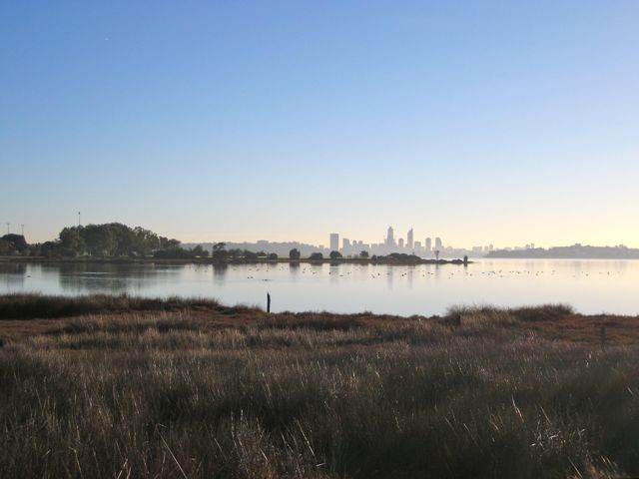
Slide <number>

Slide 16
Ensured I got 2 hours exercise each day.
Always felt more alert and productive.
When I returned to my job in Fremantle, I missed my commute to the city!
About 12 months ago, our branch relocated to Kensington (near Vic. Park).
Now ride average 4 times a week. Journey 17-19km = 45-55mins.
Dolphins, pelicans, ospreys, Carnaby’s cockatoos and bee-eaters.
Great feeling leaving the car at home!
Slide <number>

Slide 17
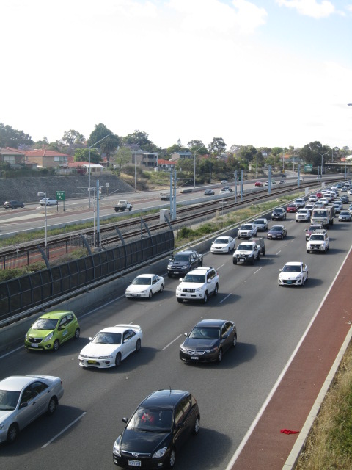
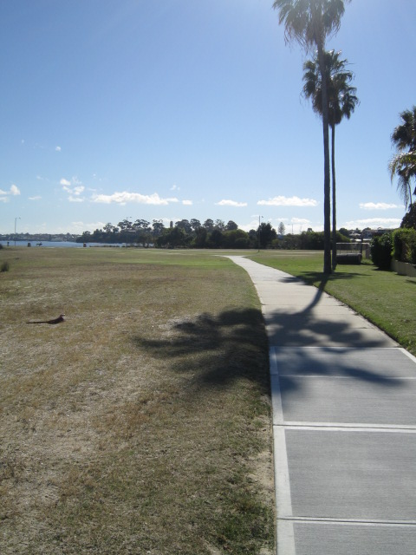
Slide <number>

Slide 18
It’s not all a ride in the park...
Summer days can be scorching.
Easterlies in the morning; sea-breeze in the afternoon.
Winter mornings are very chilly!
And storms and fronts aren’t much fun!
Punctures can make you late to work.
And by the end of the week your legs may ache a lot!
Slide <number>

Slide 19
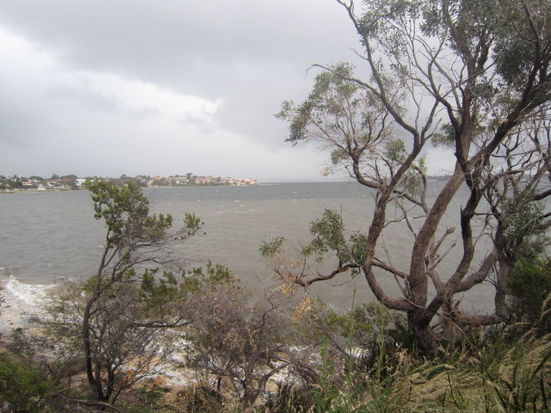
Monday’s storm approaching!
Slide <number>

Slide 20
So why don’t more of us cycle?
More people are cycling to work but numbers still tiny compared with those who drive. Very few kids cycle to school.
Not enough time. Too far.
Too hot, too cold, too wet.
Too much to carry.
Helmet hair.
Worried about getting a puncture.
Concerned about safety.
Slide <number>

Slide 21
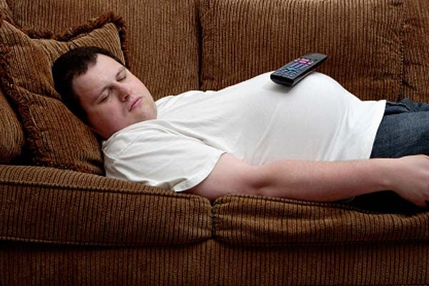
Cycle Specific Motivational Disorder
Slide <number>

Slide 22
Activity
Identify 1 or 2 journeys where you currently use your car.
Think of 1 or 2 barriers that stop you from using more sustainable modes of transport (e.g. public transport, cycling, walking).
Share with a partner.
Put your heads together and discuss how these could be overcome.
Slide <number>

Slide 23
Top tips for moving smart!
Replace some of your car trips with more sustainable transport options.
Replace short car trips with cycling or walking when you can.
Plan your route and have a test run.
Just give it a go.
When cycling, ease yourself into it.
Slide <number>

Slide 24
Resources
Transperth
(http://www.transperth.wa.gov.au/)
WA Department of Transport
(http://www.transport.wa.gov.au/cycling)
Bicycle Transportation Alliance
(http://btawa.org.au/)
Slide <number>

