Slide 1
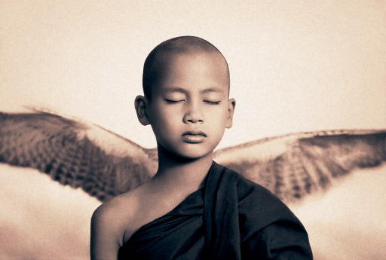
The Principle of Emptiness

Slide 2
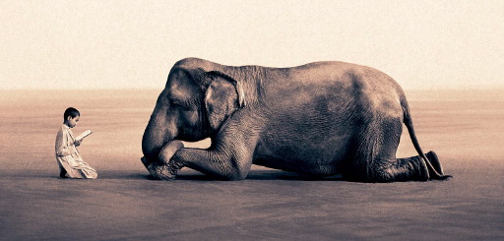
Do you have the habit of hoarding useless objects, thinking that one day, who knows when, you may need them?

Slide 3
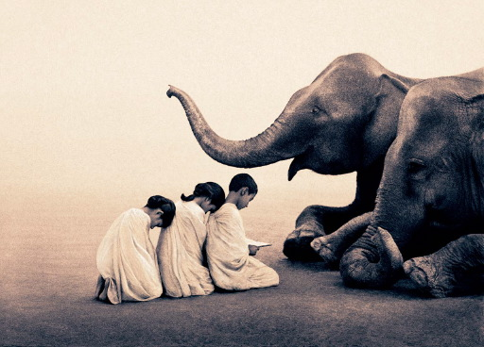
Do you have the habit of accumulating money, and not spending it because you think that in the future you may be in want of it?

Slide 4
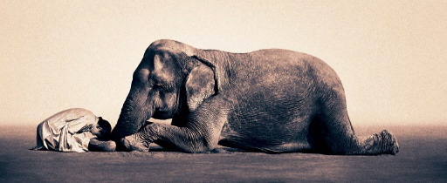
Do you have the habit of storing clothes, shoes, furniture, utensils and other home supplies, that you haven’t used for some time?

Slide 5
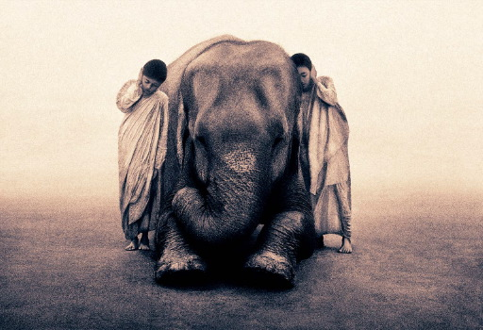
And inside yourself? Do you have the habit of keeping reproaches, resentment, sadness, fears and more?

Slide 6
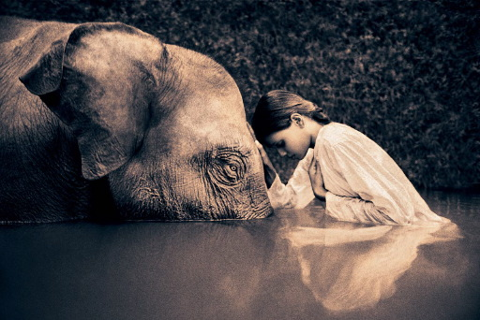
Don’t do it! You are working against the rule of prosperity!

Slide 7
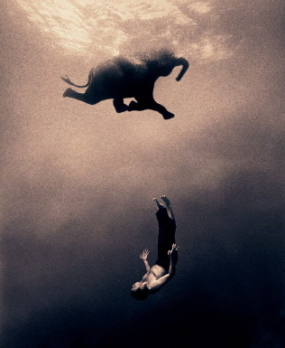
It is necessary to make room, to leave an empty space, in order to allow new things to arrive into your life.

Slide 8
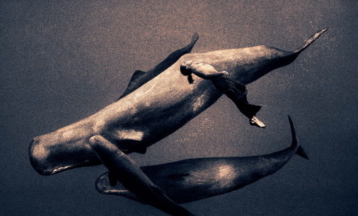
It is necessary that you rid yourself of all the useless things that are in you and in your life, in order for prosperity to arrive.

Slide 9
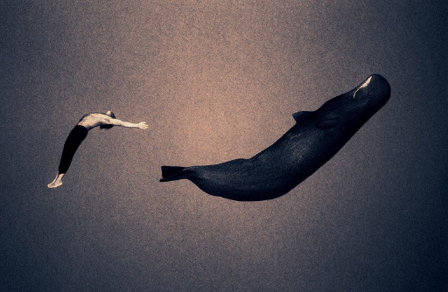
The energy of this emptiness is one that will attract all that you desire.

Slide 10
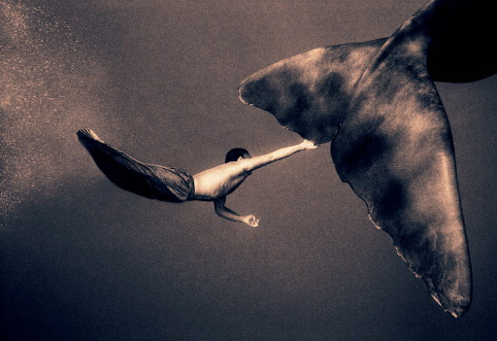
As long as you are holding on to useless feelings, either materially or emotionally, you will not have the space for new opportunities.

Slide 11
All things should circulate....
Clean the drawers, the wardrobes, the workshop, the garage...

Slide 12
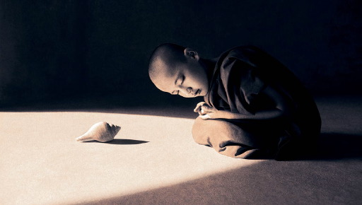
Give away what you no longer use or need...

Slide 13
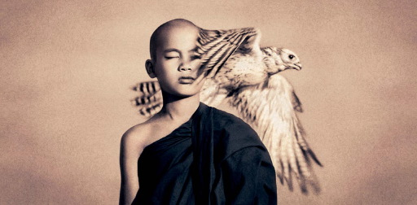
The attitude of hoarding and keeping unwanted things will severely limit the possibilities in your life.

Slide 14
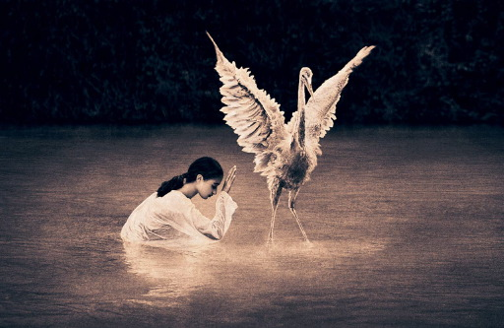
Although it is not so much the unneeded objects
that stagnate your life...

Slide 15
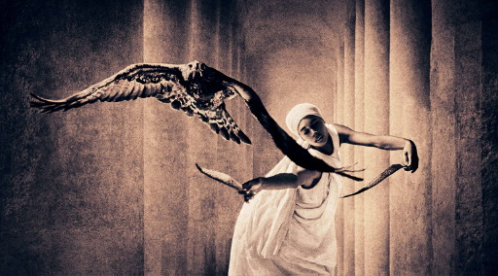
but rather the attitude of keeping...

Slide 16
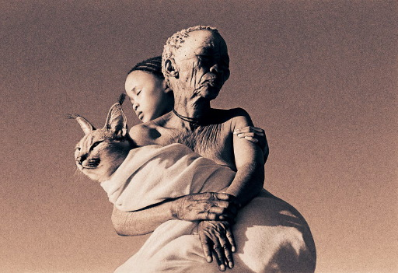
When we keep things we no longer need, we are buying into the negative belief of want and penury..

Slide 17
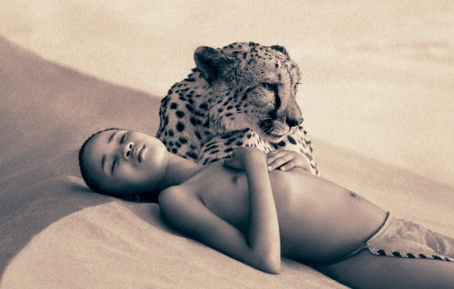
..and that tomorrow may bring a lack of necessities and we will have nothing.

Slide 18
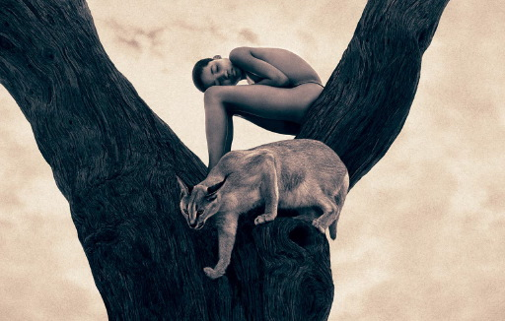
With that belief, we are sending ourselves
two messages:

Slide 19
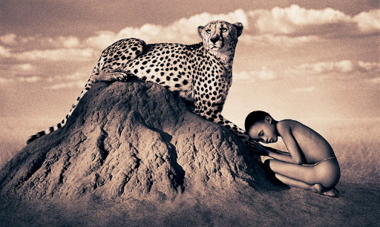
That we don’t trust what tomorrow will bring...

Slide 20

and we think that we are not worthy of good things in our life.

Slide 21
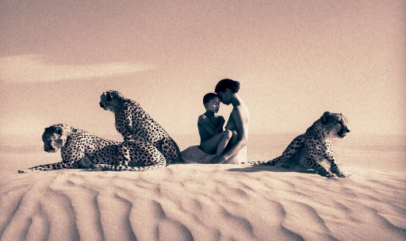
Discard what has lost it’s colour and brightness.

Slide 22
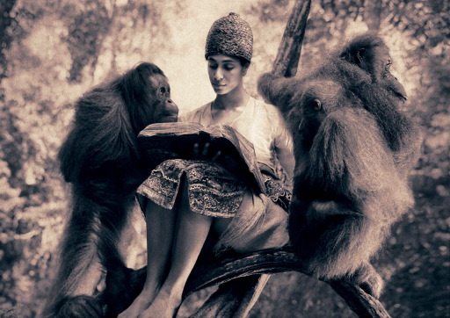
Let the new enter your home...

Slide 23
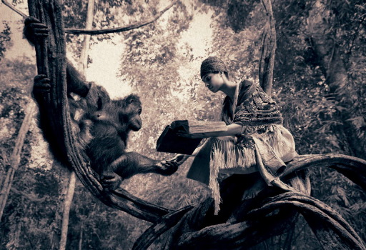
and your Self.

Slide 24
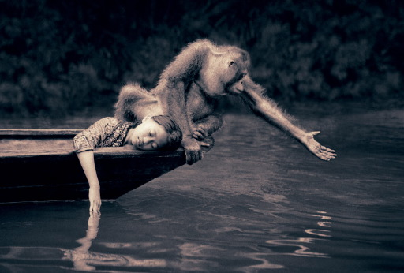
After reading this...

Slide 25
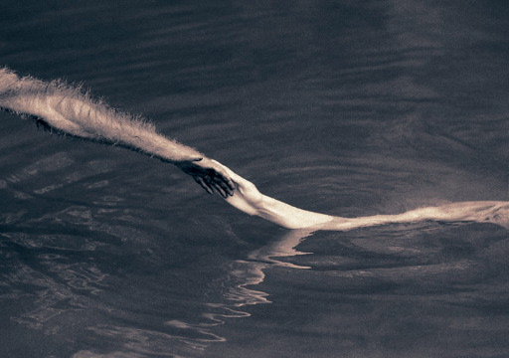
you may decide to share it...

Slide 26
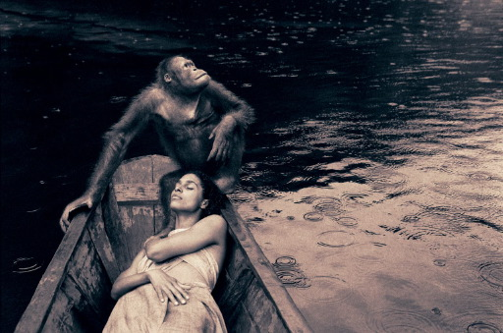
..with those who would appreciate receiving it.

Slide 27
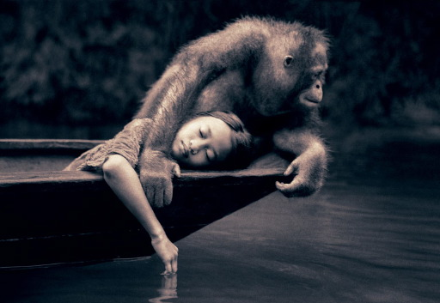
May prosperity and peace be yours

Slide 28
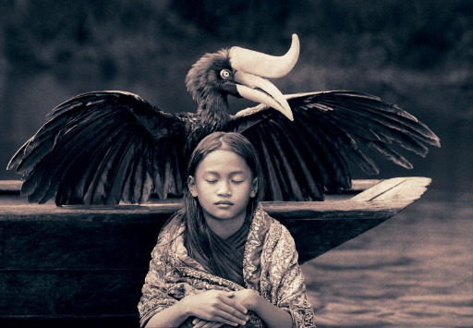
Amén

Slide 29
Photography
Gregory Colbert
Text
A variation on ”The Principle of Emptiness”
by JOSEPH NEWTON
Music
Coeurs D’Or
Clayderman

