Slide 1


Healthy YOU!

Slide 2
Health is a state of complete
physical, mental & social wellbeing.
- World Health Organisation.

Slide 3
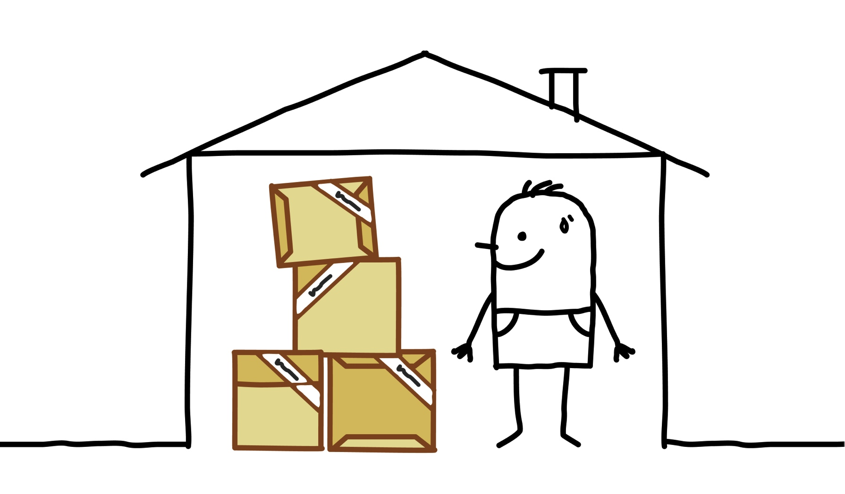


So, what is the way to
wellbeing?

Slide 4

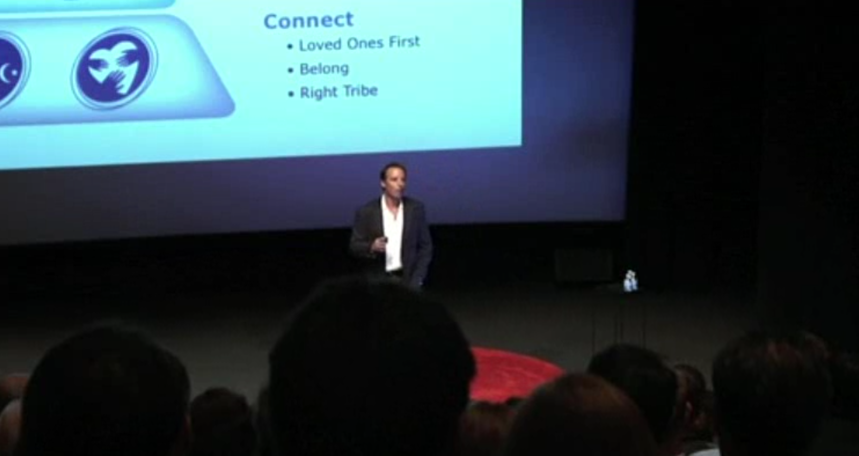
How to live to be 100.
Source – Ted Talks Ted Buettner

Slide 5





Source: www.neweconomics.org

Slide 6


Slide 7
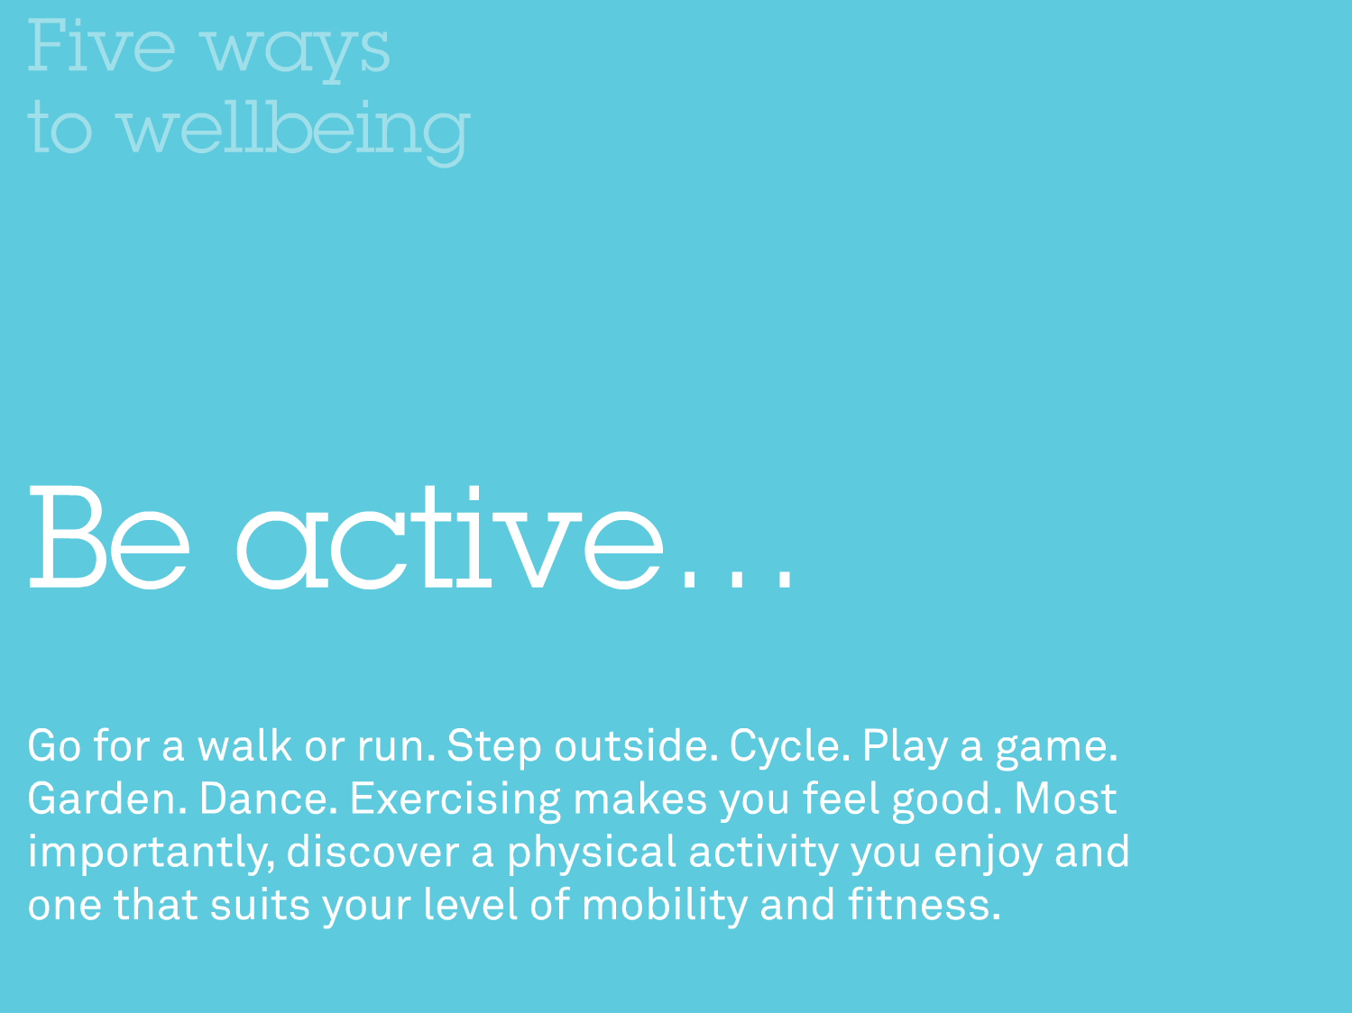

Slide 8
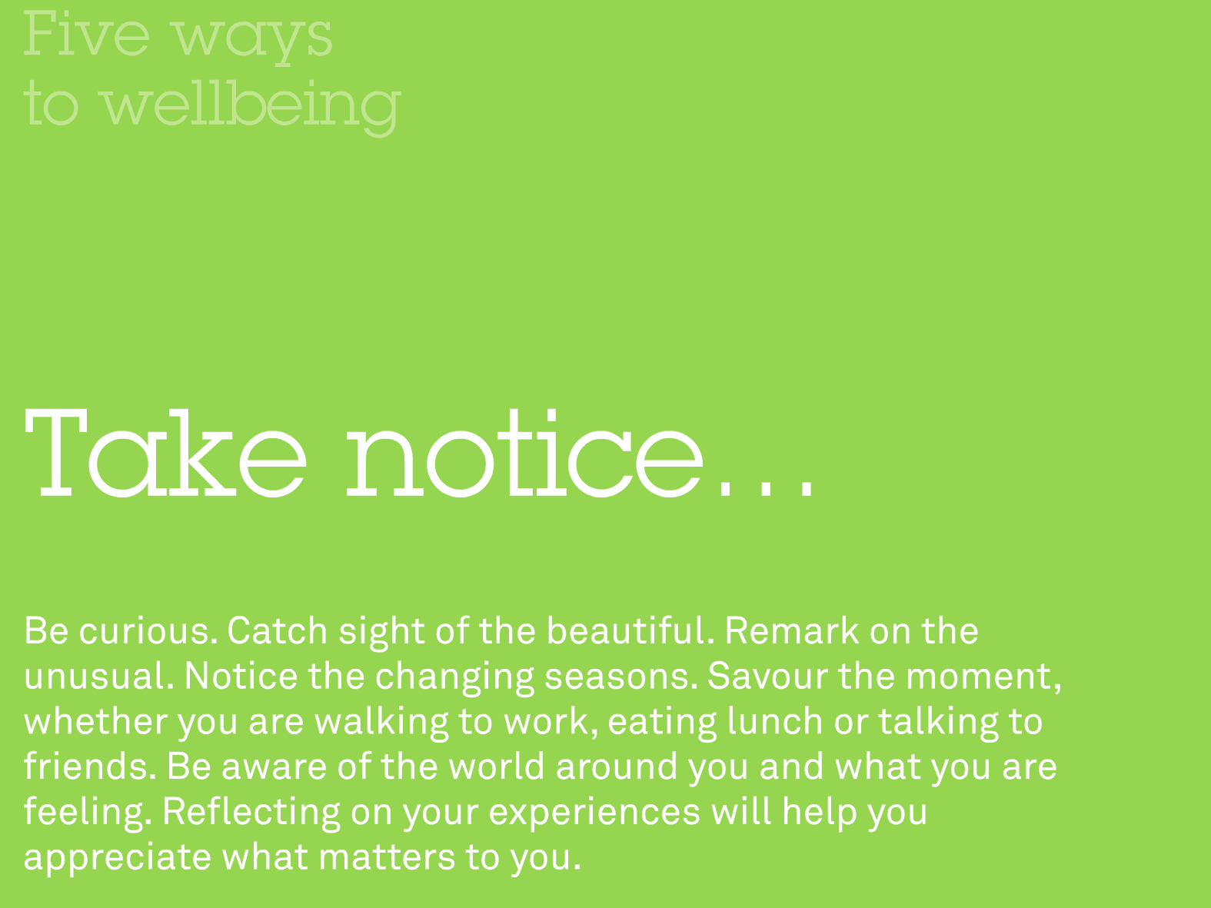

Slide 9


Slide 10
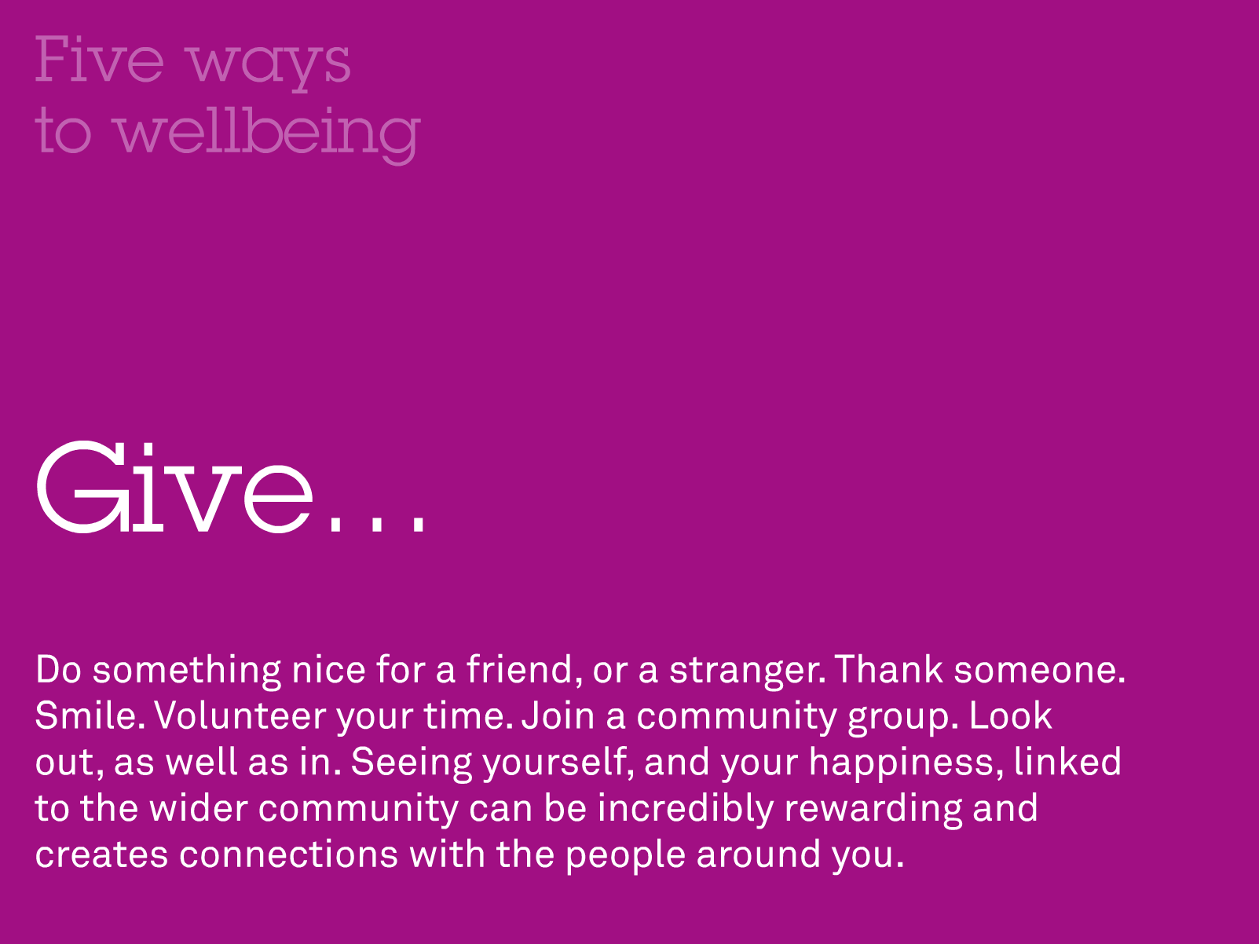

Slide 11

You’ve heard of the 12 Days of Christmas, but how about the Living Smarties…
25 Days of
Wellbeing?

Slide 12
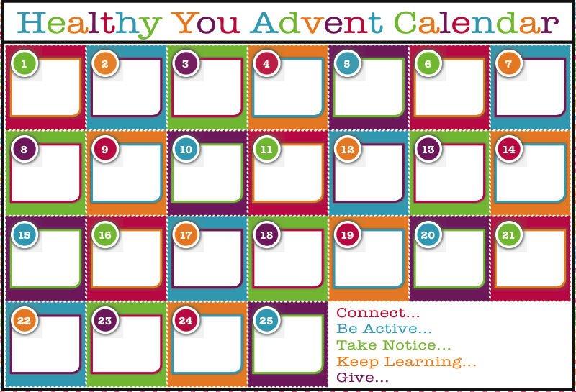
Beaconsfield Living Smarties

Slide 13
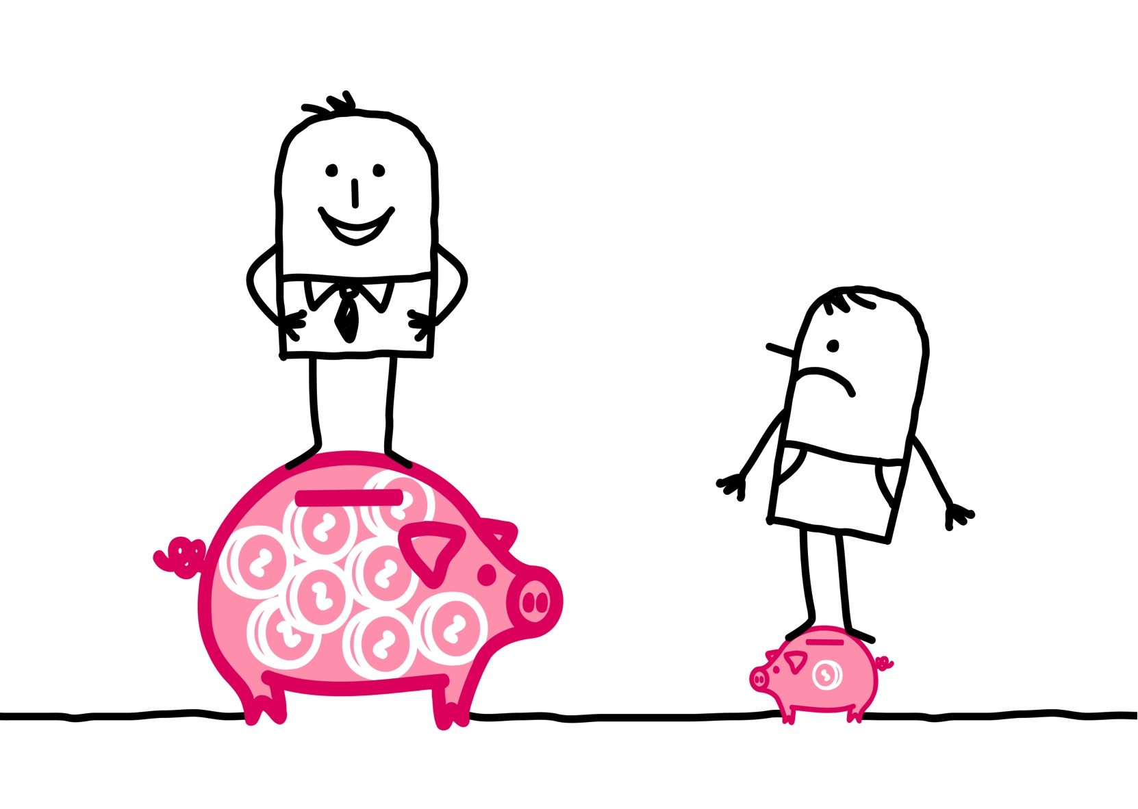

What are some of the barriers?

Slide 14
S. Simple
A. Affordable
A. Achievable
M. Meaningful

Slide 15
Source: www.neweconomics.org

Slide 16
Beaconsfield Living Smarties

Slide 17

Enjoy the Ride…

