Slide 1
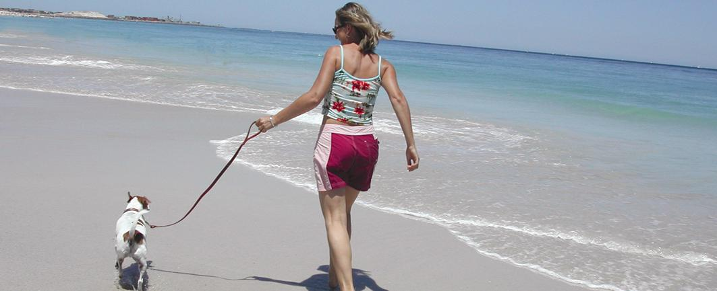
Health Smart You
Shani Graham
A Personal Story
Slide <number>

Slide 2
Think to when you were the fittest and healthiest you have been.
(it could be now)
Write down five words to
describe that experience. Be prepared to share at your table!
Slide <number>

Slide 3
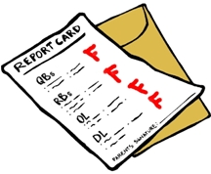
Shani’s Healthy You Report Card
2007
Slide <number>

Slide 4

Slide <number>

Slide 5
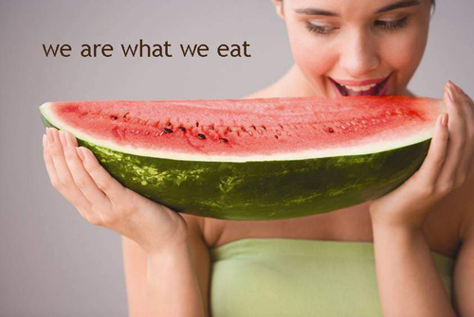
Slide <number>

Slide 6
What should we be eating and how did we do today?
No. of serves | Bread, cereals, rice, pasta, noodles | Veg, Legumes | Fruit | Milk, Yoghurt, Cheese | Meat, Fish, Poultry, Eggs, Nuts Legumes | Extra Foods
Women | 4 - 6 | 4 - 7 | 2 - 3 | 2 - 3 | 1 - 1.5 | 0 - 2.5
Men | 5 - 7 | 6 - 8 | 3 - 4 | 2 - 4 | 1 - 1.5 | 0 - 3

Slide 7
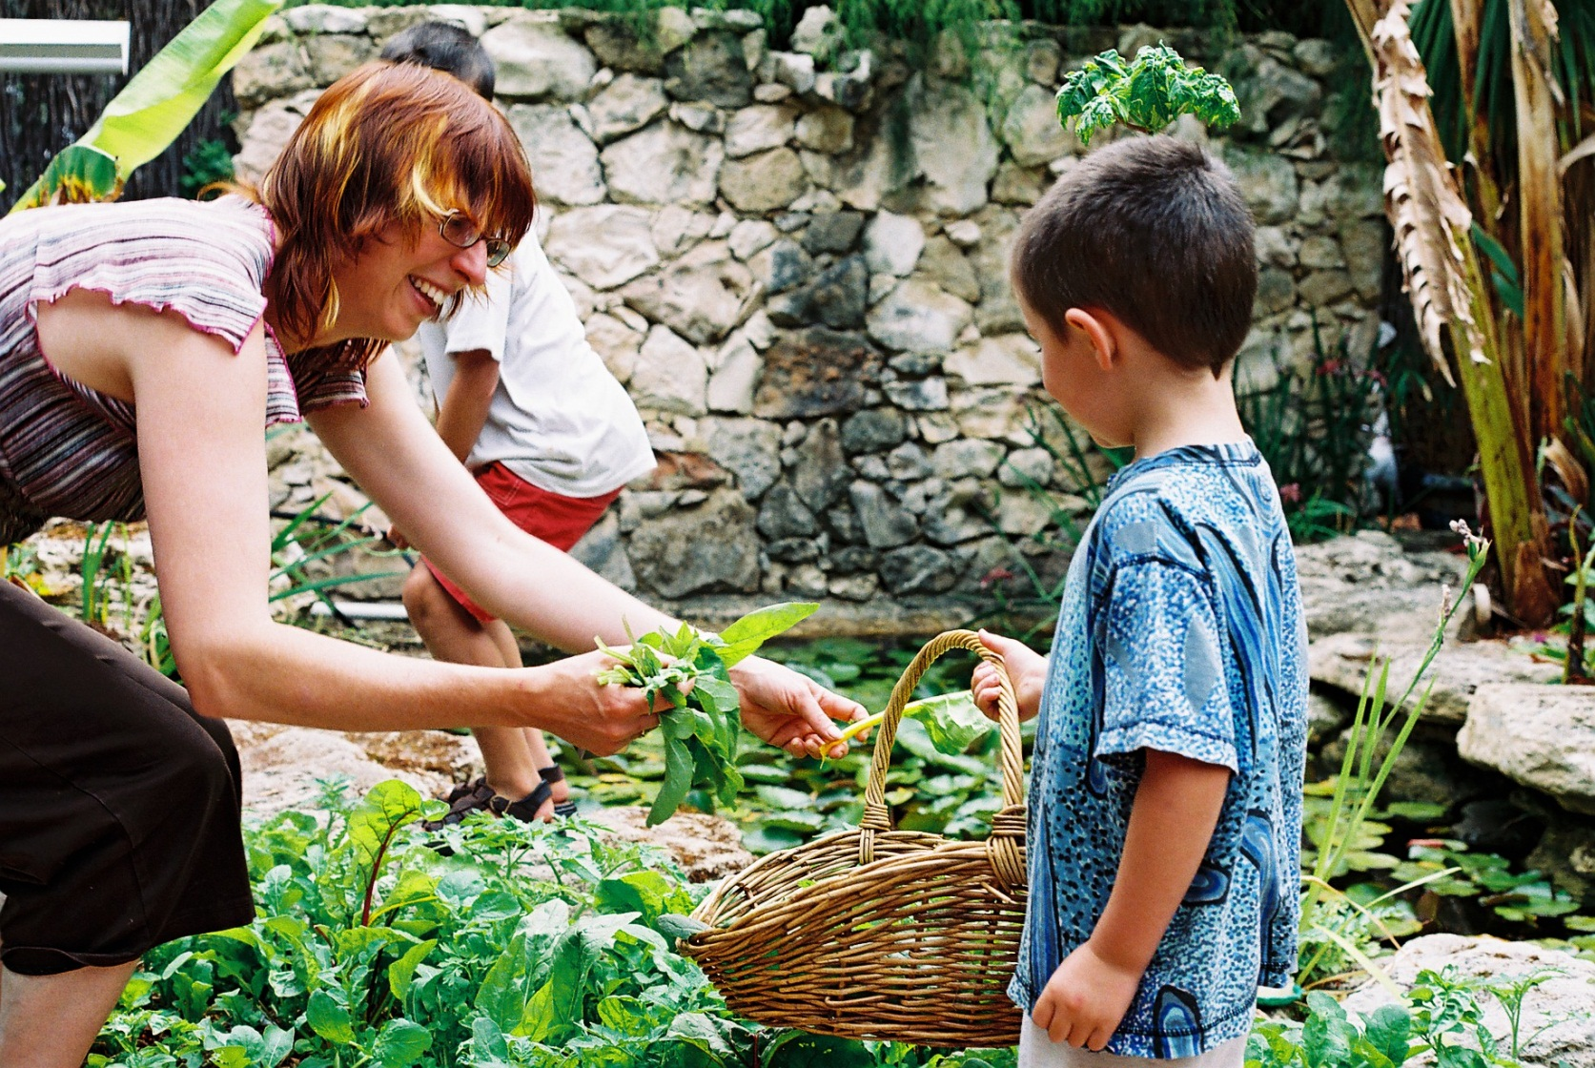
Slide <number>

Slide 8
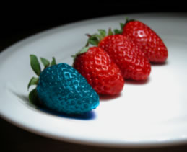
Genetically modified foods?
Slide <number>

Slide 9
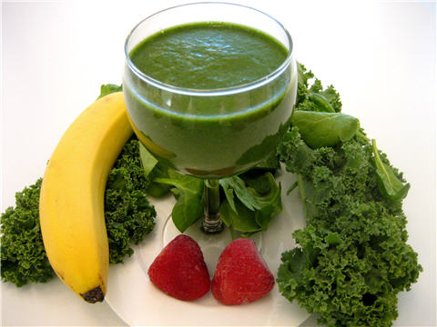
Raw foods
Slide <number>

Slide 10

Easy on the meat
Slide <number>

Slide 11
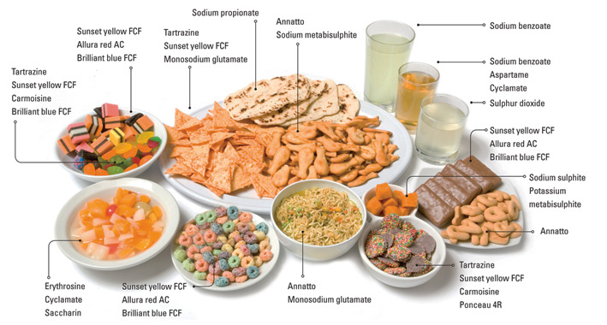
Slide <number>

Slide 12
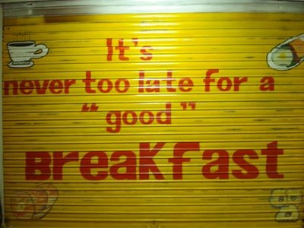
Slide <number>

Slide 13
Progress – A Achievement - C
Shani has shown a great deal of progress in this area over the last few years. She is growing and preserving most of her own vegetables, and can cook healthy wholesome meals. She needs to work on avoiding those cakes at the café!
Her idea of planning the days meals over breakfast each morning sounds like a good one. Good luck with the smoothie challenge too!
Slide <number>

Slide 14

Exercise and Activity
Slide <number>

Slide 15
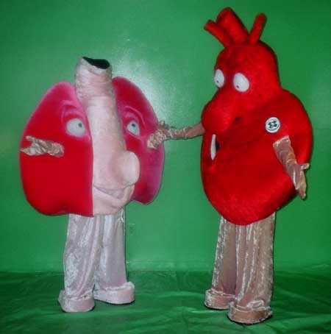

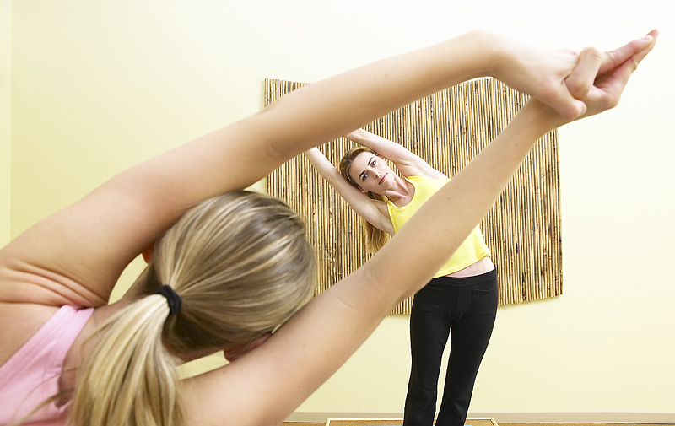

Types of Exercise
Strength
Heart and Lung
Flexibility
Rest
Slide <number>

Slide 16
Progress B Achievement C
Shani’s current achievement and progress in this area has been good, but she has really let things slide over winter and into spring. Not having a car means she gets good blasts of riding throughout the day. Well done on your weekly yoga class!
Her goal should be to get back into the routine, even though it takes time, she needs regular exercise
Slide <number>

Slide 17

Mental Health
Slide <number>

Slide 18

Slide <number>

Slide 19
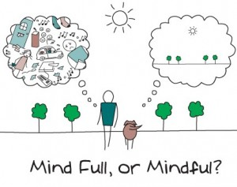
Mindfullness
Slide <number>

Slide 20

Slide <number>

Slide 21
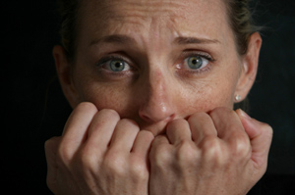
Slide <number>

Slide 22
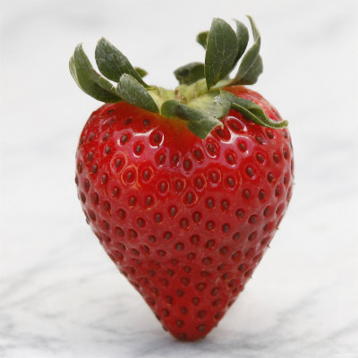
Slide <number>

Slide 23

Slide <number>

Slide 24
Progress A Achievement B
Shani is showing solid progress and achievement. She has gained some good skills for managing her emotions and stress levels. I am pleased that she engages so willingly in her weekly “chat” with Tim. Now that there is no house renovating going on, don’t forget to take the time to enjoy your friends and family – this is your year “off!”.
Slide <number>

Slide 25

Share your report card!
Slide <number>

