Slide 1
Some Bike Lessons
From Shani

Slide 2
You CAN get over childhood bike trauma.

Slide 3
It is better to go twice as far than go up a big hill.

Slide 4
What a bike looks like has NOTHING to do with how good it is.

Slide 5
Just because you can ride, it doesn’t necessarily mean you are comfortable doing it!

Slide 6
Celebrate what you have done, don’t obsess about what you should have.

Slide 7
Don’t be surprised if hard things suddenly become easier just because something shifts in your head.

Slide 8
You can go anywhere you want.

Slide 9
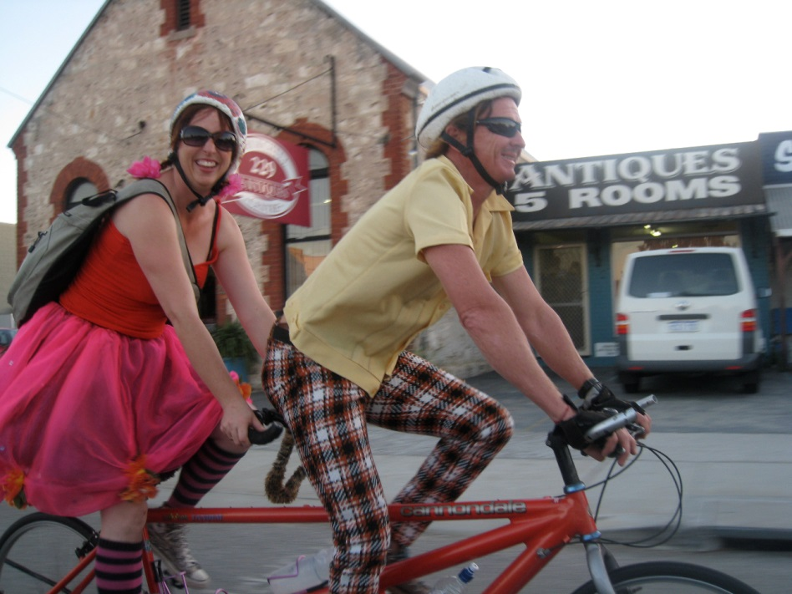
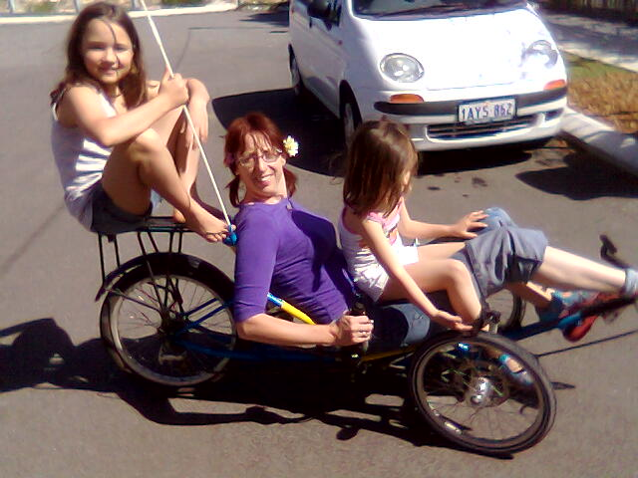
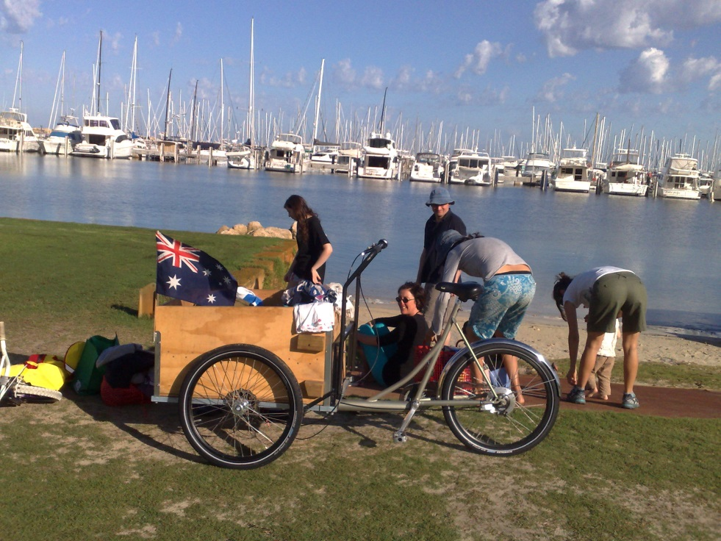
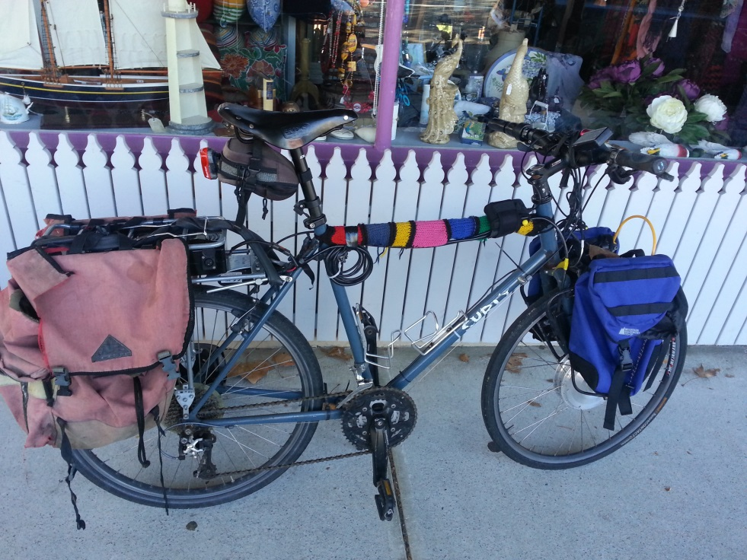

Slide 10
Take one trip at a time Keep exploring until you are comfortable

