Slide 1
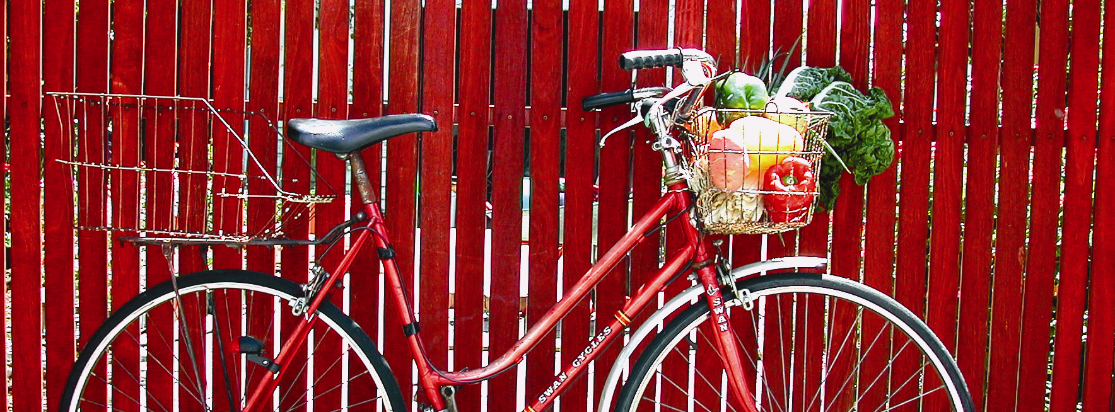


TravelSmart
Environmentally Friendly Travel
Sue Waite
TravelSmart Officer
Town of Cambridge

Slide 2
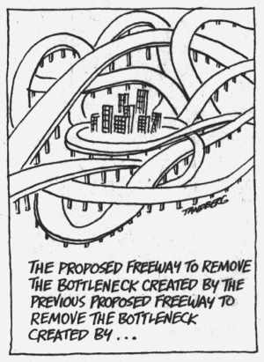

Slide 3
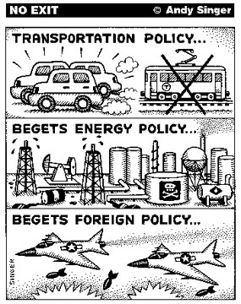

Slide 4
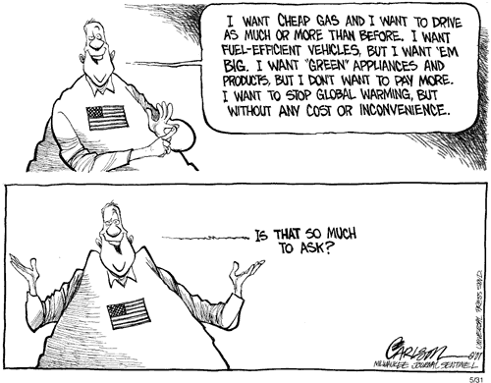

Slide 5
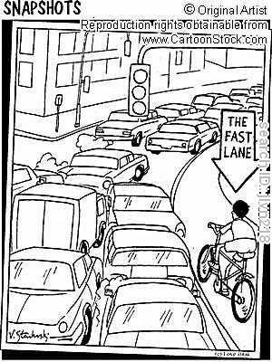

Slide 6
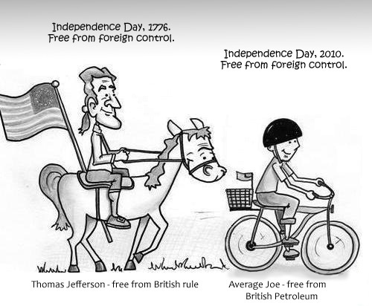

Slide 7
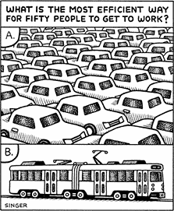

Slide 8
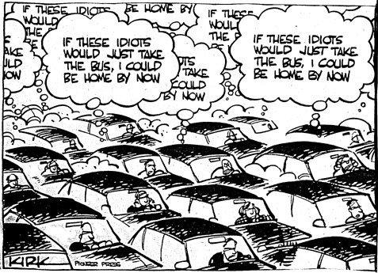

Slide 9
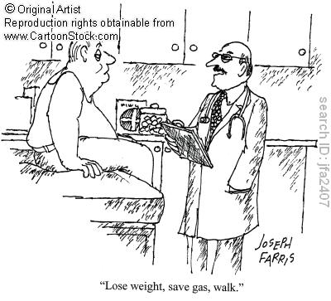

Slide 10
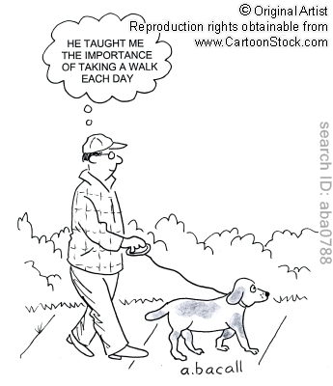

Slide 11
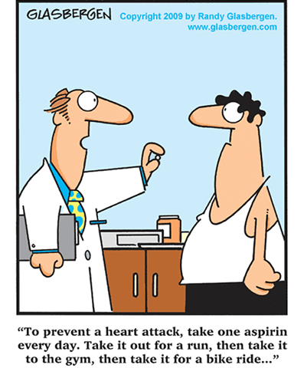

Slide 12
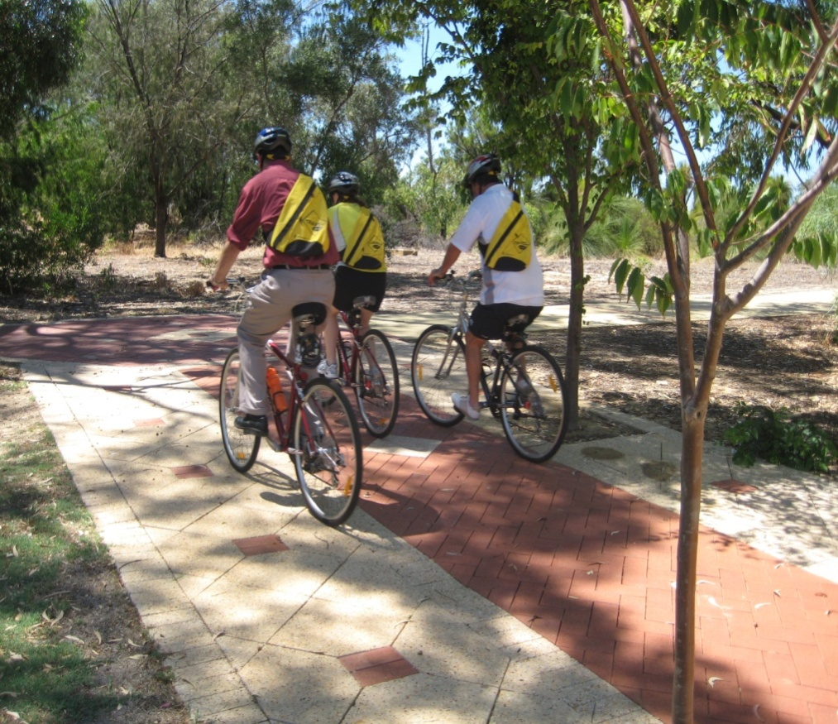

Town of Cambridge
TravelSmart
TravelSmart is a range of programs that aim to change travel behaviours towards walking, cycling, using public transport and car pooling.
TravelSmart delivers or is a component of the following programs:
  TravelSmart to School
  TravelSmart Workplace
  TravelSmart Household
  Other settings including
  Universities and Hospitals
  Living Smart

Slide 13


Town of Cambridge
TravelSmart in Perth
The high and growing level of car use in Perth is a concern because:
Cars are expensive! Running a car is a major cost and accounts for 15% of WA household expenditure. Source of financial stress that will increase if fuel prices rise.
Maintaining and extending the urban road network is a significant public cost.
Traffic congestion is becoming a significant issue in Perth. Adding road capacity will not solve the problem.
Car dependency fosters inactivity. As more trips are made by car, fewer are made (in part or entirely) by walking or cycling - 45% of WA adults do not engage in sufficient physical activity for good health. Physical inactivity is a major risk factor for cardiovascular disease and other preventable conditions that impact on the public health budget.

Slide 14
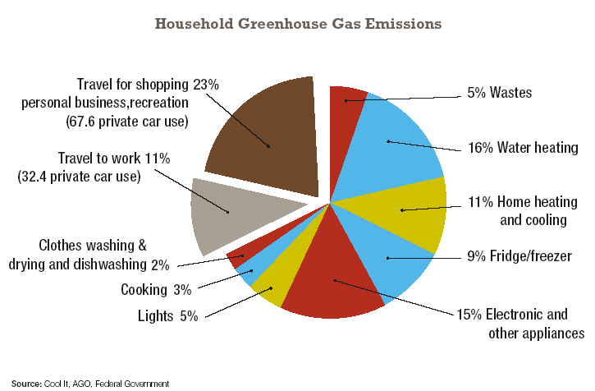
Town of Cambridge
What Impact Does It Have
On our Environment?
Transport is responsible for 34% of household greenhouse gas emissions, compared to lighting which accounts for 5% (Australian Greenhouse Office 2006).

Slide 15
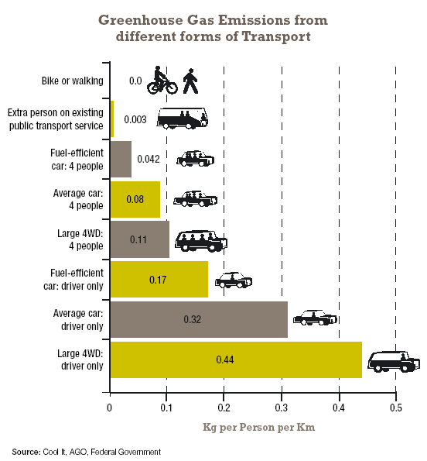
Town of Cambridge
What Impact Does It Have
On our Environment?

Slide 16
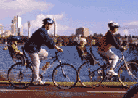
Alternatives to the Car
Perth is one of the most car dependent cities in the world, with 81% of all trips undertaken by car (55% as driver and 26% as passenger).
Walking
  1km = 12 minutes
Cycling
  5km = 20 minutes
Public Transport
  – Buses, Trains and Ferry
Car Pooling - when two or more people share a ride to a common or nearby destination
www.sharemycar.com.au www.mycarpools.com.au
Notes:
Walking and Cycling – discuss how the ‘Take a closer look at your neighbourhood works’
Car Pooling - There are several carpooling websites which help match up people who are interested in carpooling, and many of these services are free.

Slide 17
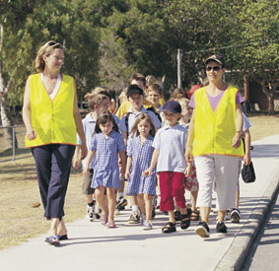
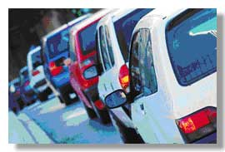
Benefits of TravelSmart
Environmentally friendly
Save money - petrol prices are increasing
Health benefits
Decrease congestion
Increase community safety and ‘eyes on the street’
Enjoy family time walking and cycling

Slide 18


How Do You Travel?
Activity
How and where you travelled in the last 2 days.
Use the activity sheet to mark down each trip, the reason for your trip, the length and duration and if an alternative form of transport could be used.

Slide 19
How Do You Travel?
Activity
Trip No. | Start of trip location | Destination | Mode of transport | Time (minutes) | Distance (km) | Could you use alternative transport? (Y/N)
1 | Home | Work | car | 10 | 4 | n
2 | Work | Subiaco | Car pool |  |  | y
3 | Subiaco | Work | bus |  |  | n/a
4 | Work

Slide 20
Town of Cambridge
Does it really make a difference?
TravelSmart has been implemented all over Perth and annually 418, 500 residents from Clarkson to Rockingham are (for all projects 2000 to 2007):
Cutting over 30 million car trips
290 million fewer car kilometers
88,000 tonnes less greenhouse gas (equivalent to 19,000 fewer cars)
An extra 4.4 million public transport boardings
7 million hours more physical activity from 9 million more walking trips and 4 million more cycling trips
Reducing fuel use by 20 million litre, saving households a total of $25 million.

Slide 21
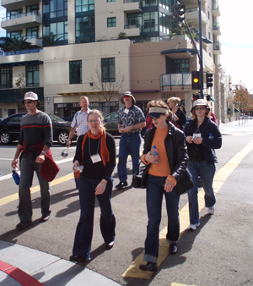
Town of Cambridge
Tips for Travelling Smart
Over the following week, two weeks and even one or two months, use these tips to change the way you move.
Target the trips that are easy to change
Test what is best
Be prepared
Plan your day
Plan your trip
Be car smart
Challenge yourself
Get to know your neighbourhood

Slide 22



Transperth
People over-estimate the time they think it will take to reach a destination by public transport. Many public transport trips – especially trips to the city – can be as quick as driving and are less stressful then driving.
Transperth’s Journey Planner provides you with the best travel options in just a few seconds.
It is as simple as entering in where you want to leave from and where you want to go to. The Journey Planner tool will tell you what buses, trains or ferry to catch, what time it leaves and what time it will arrive at the destination. It couldn’t be easier!
Transperth's Infoline - 13 62 13.
www.transperth.wa.gov.au

Slide 23


Slide 24

Questions?

