Slide 1

Frog Bogs
A quick presentation by Tim
Slide <number>

Slide 2
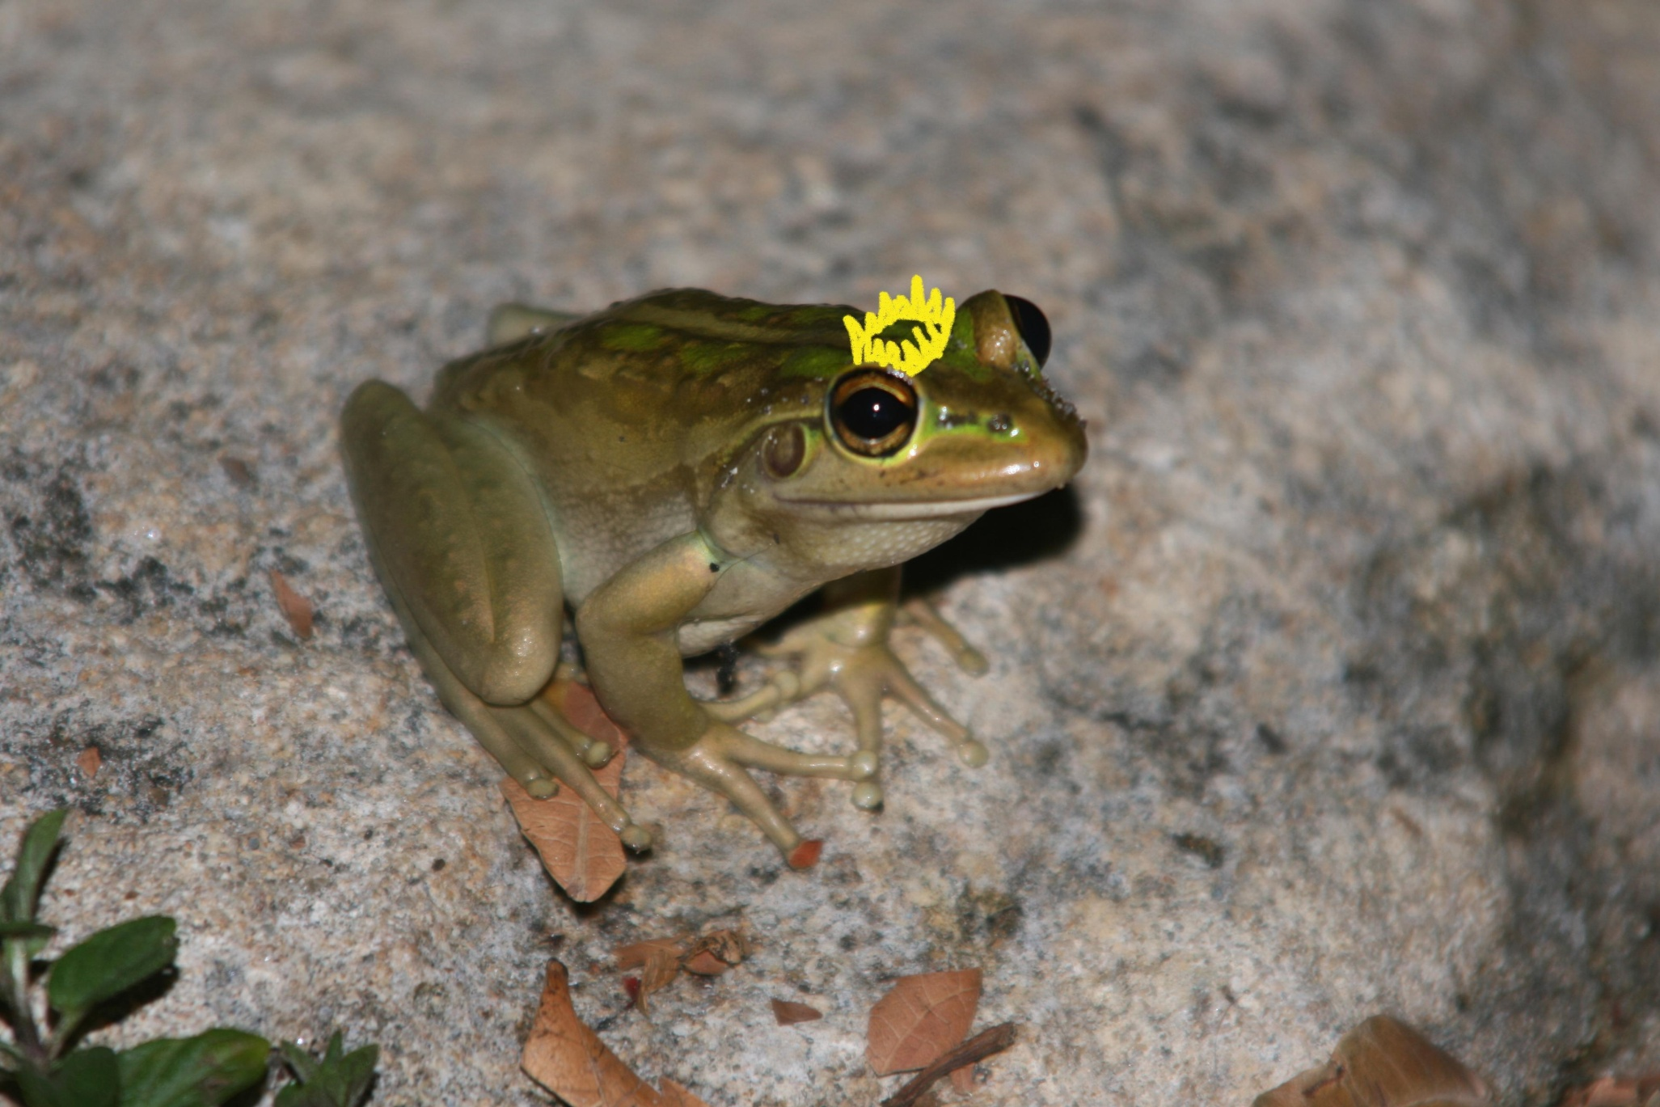
Slide 2 title
Slide <number>

Slide 3
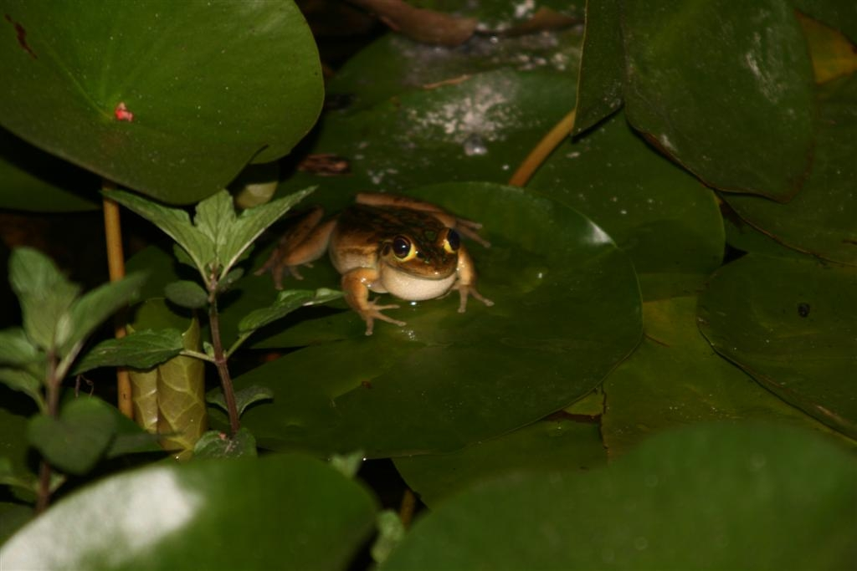
Slide <number>

Slide 4
I wish to create a frog bog, which I assume is a pond filled with dirt. I can’t help thinking this will result in a smelly, putrid, swampy mess. Thoughts?”
from Frogboy Gardening in Aust online forum
Slide <number>

Slide 5
Frogs “Critters of SJ”
Moaning Frog
Turtle Frog
Western Banjo Frog
Motorbike Frog
Glauerts’s Froglet
Squelching Froglet
Red-thighed Froglet
Sand Frog.
Slide <number>

Slide 6
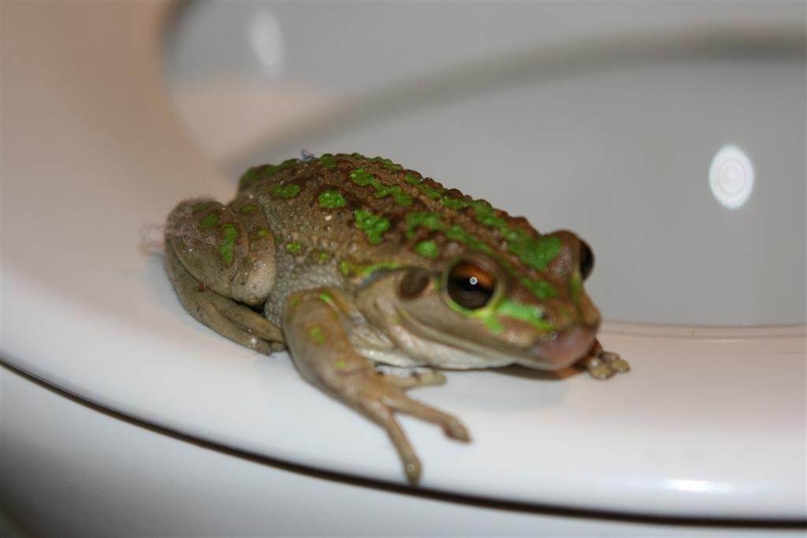
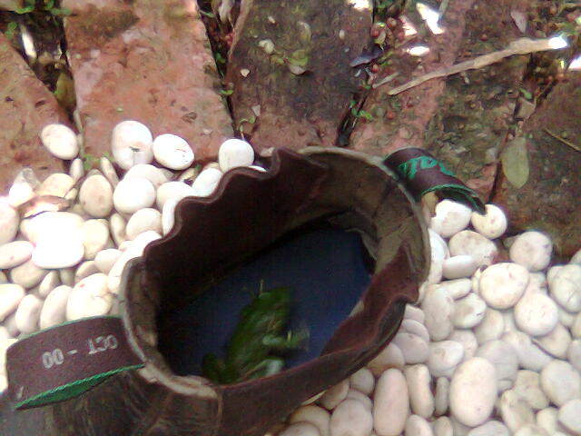
Slide <number>

Slide 7
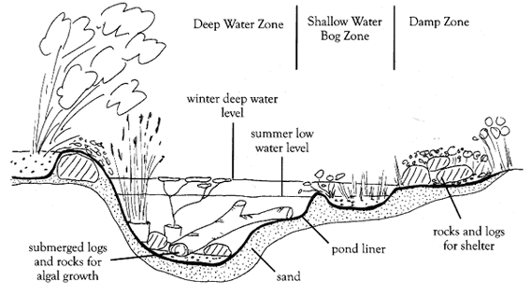
Slide <number>

Slide 8
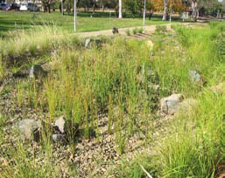
Slide <number>

Slide 9
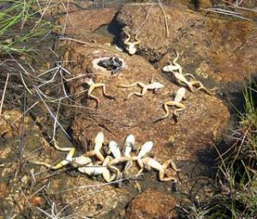
Frog in dangerous situation
Slide <number>

Slide 10
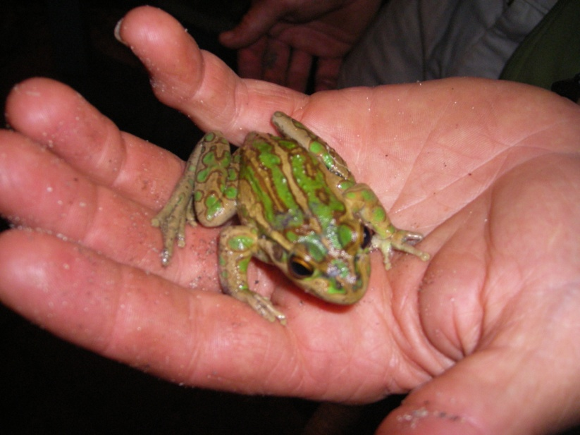
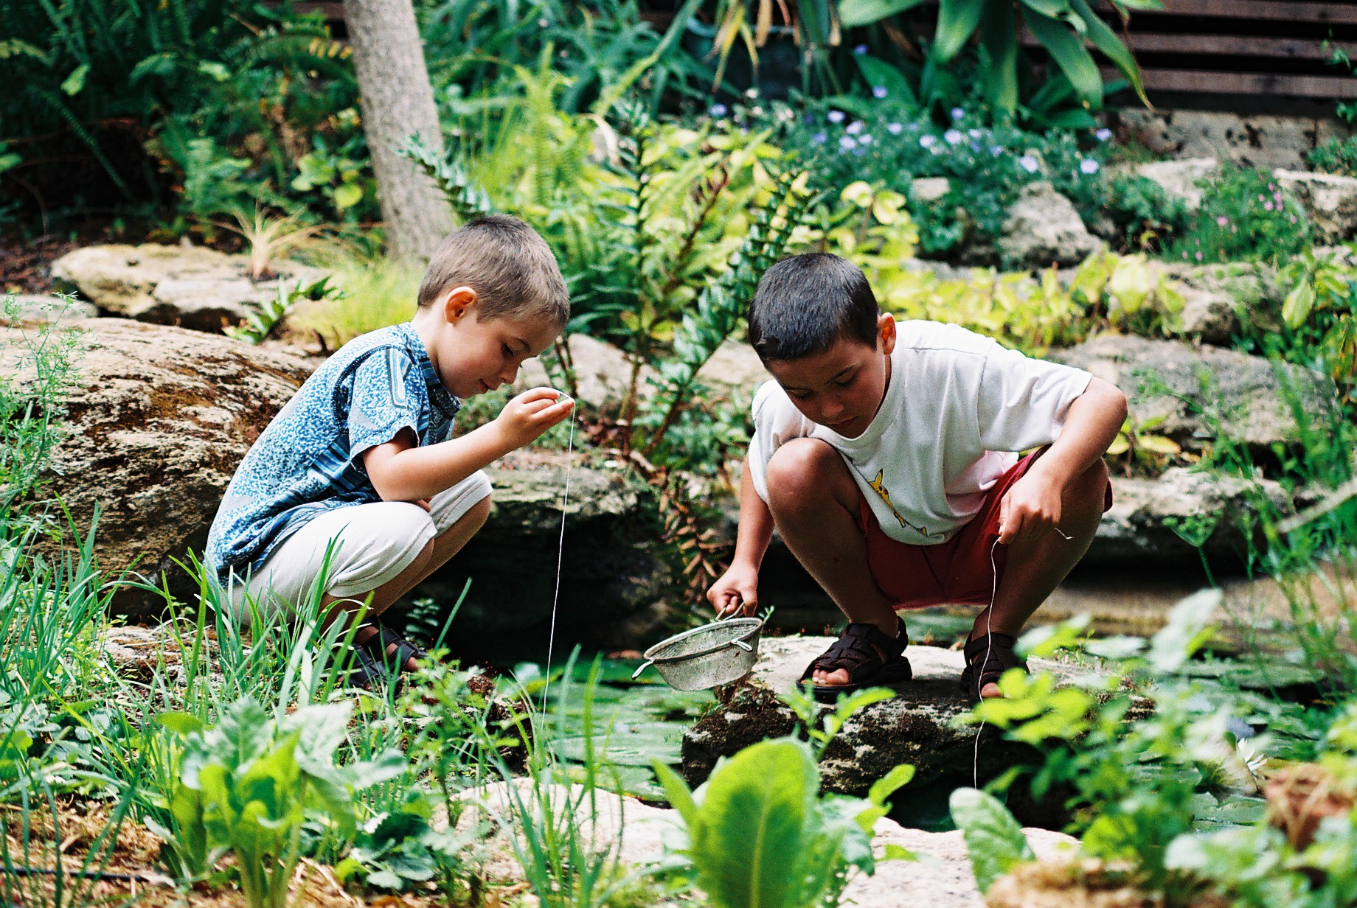
Slide <number>

Slide 11

Do you have room for a frog bog?
Slide <number>

