Slide 1
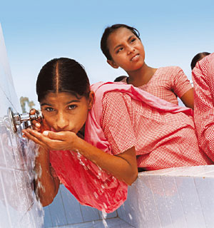
An Introduction to Water
Slide <number>
Notes:
Use four sheets to get into groups of four
Read information each person has been given and then present to the rest of the group.
Show slide show that Tim and Shani put together.

Slide 2
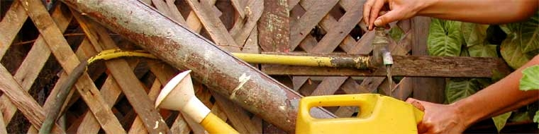
Water Smart
Some information about
Greywater Recyling
Shani Graham
and Tim Darby
The Painted Fish

Slide 3

What is Grey Water?
Notes:
Water generated from bathroom – showers and hand basins, laundry
NOT kitchen and toilet
Kitchen water is about 5- 11% of total. Contains food particles, oils, fats, can result in soil blockages. High sodium from detergents.

Slide 4
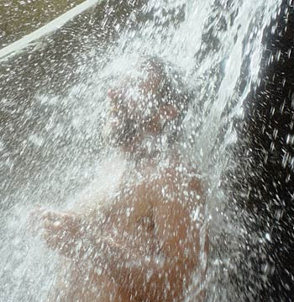
What’s in Grey Water?
Notes:
Faecal chloroforms – indicators of likelihood of infection through contact
Sodium (salt)
Used as bulking agents particularly in powdered detergents and are detrimental to plants. Some salts occur natrually (eg sweat!)
Higher PH – ph outside range of 6-7 will affect the solubility of soils hence plants ability to absorb nutrients
High ph greater than 7 – add sulphur
Low ph less than 6 – add calcium carbonate

Slide 5
How much do we produce?
Number of bedrooms | Domestic Greywater Volumes (litres per day) |  |  | Total greywater flow
 | kitchen | laundry | bathroom
2 or less | 72 | 126 | 153 | 351
3 | 96 | 168 | 204 | 468
4 | 120 | 210 | 255 | 585
5 or more | 144 | 252 | 306 | 702
From Code of Practice for the Reuse of Greywater in WA Jan 2005 pg 32
Notes:
Does vary
Eg Shani and I 160 litres per day including kitchen and small garden
The Painted Fish – 1000 – 1200 litres – big garden and three houses
Average for a three bedroom house is 372 litres per day

Slide 6
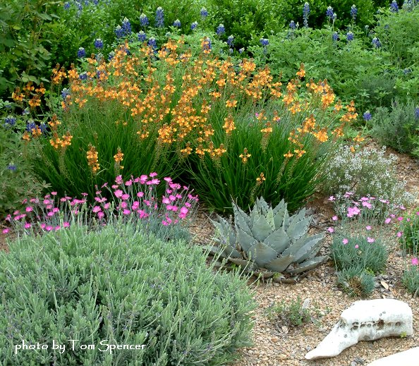
Why recycle greywater?
Notes:
Reduces dependence on scheme water
Reduces power use both in treating and transportation of water to your home
Reduces the power and cost of removing waste from your property
Closes the circle for plants

Slide 7
Things to consider
Grey water volume
(litres per week)
Divided by DIR (mm/week)
Equals area needed in m2
Copyright Ecoburbia 2011
Slide <number>

Slide 8
But is it safe?
It should be noted that the comparison of grey water and raw sewerage highlights that grey water is still a relatively contaminated wastewater stream and should therefore be managed carefully.
(Code of Practice for the Reuse of Greywater in WA)
Generally speaking pathogens and bacteria content is low in most greywater sources.
(Greywater System Buyers Guide, ReNew Issue 102)

Slide 9
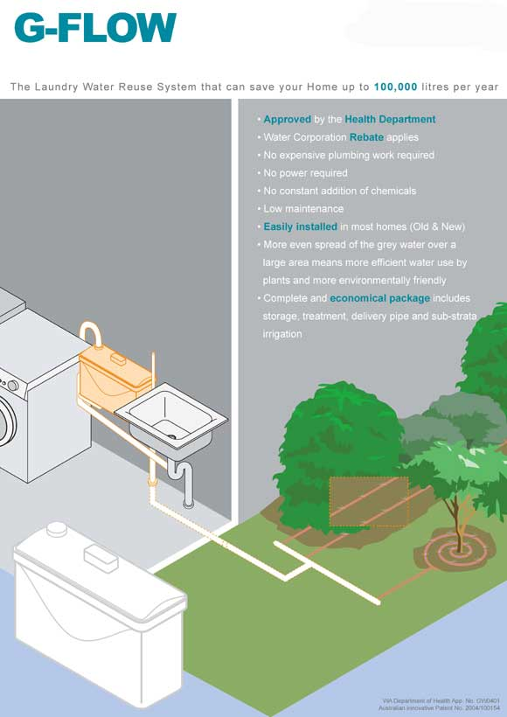
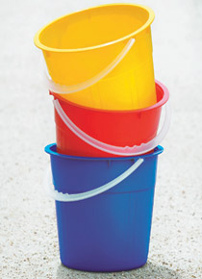

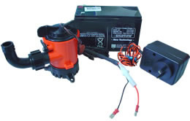
Types of Greywater
Systems
Notes:
1) Bucket it out by hand
2) Collection and gravity feed
Eg g flow costs about $600 and you get about half back as a rebate
Collects from laundry, sponge filter and gravity feeds and subsurface reticulation
3) Collection and pump – to be pumped out every twenty four hours
Can use bathroom, laundry and basins
Costs start at about $1000. Filters need regular cleaning. Water is still considered untreated and must be dispersed via sub-surface irrigation to fruit trees or ornamentals.
Diversion or collection $5000
4) Treatment systems
Usual cost is $10,000 plus

Slide 10
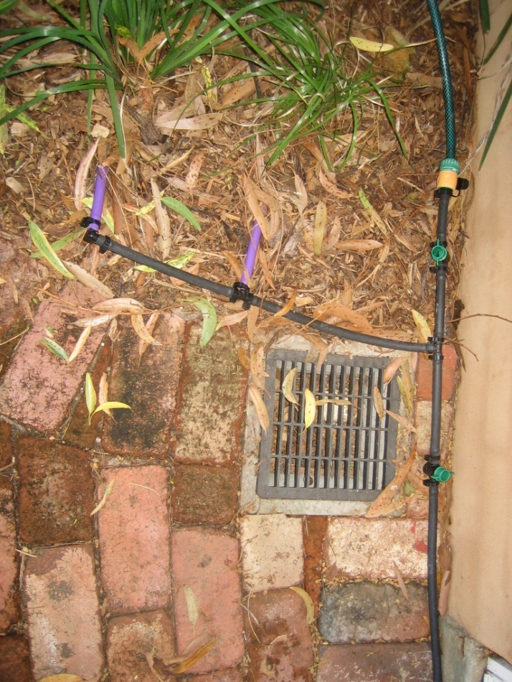
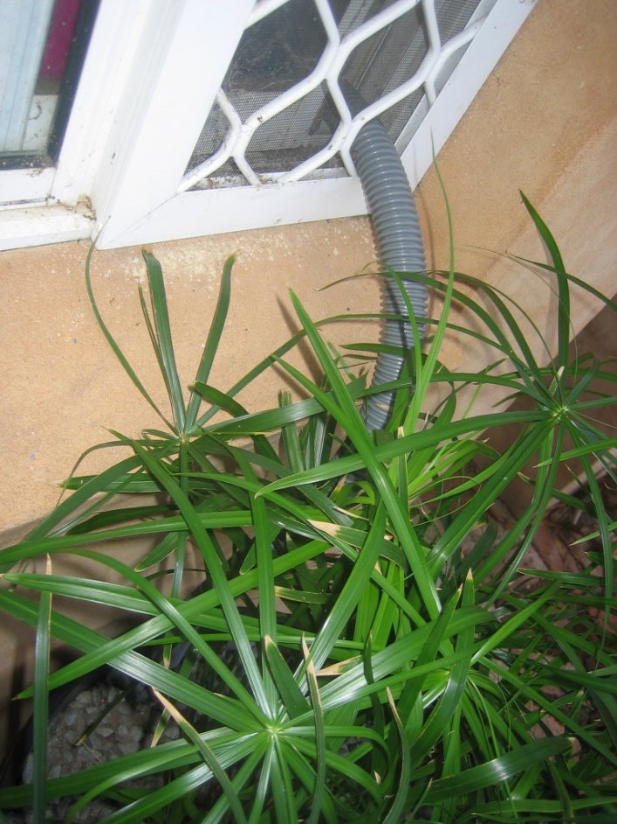
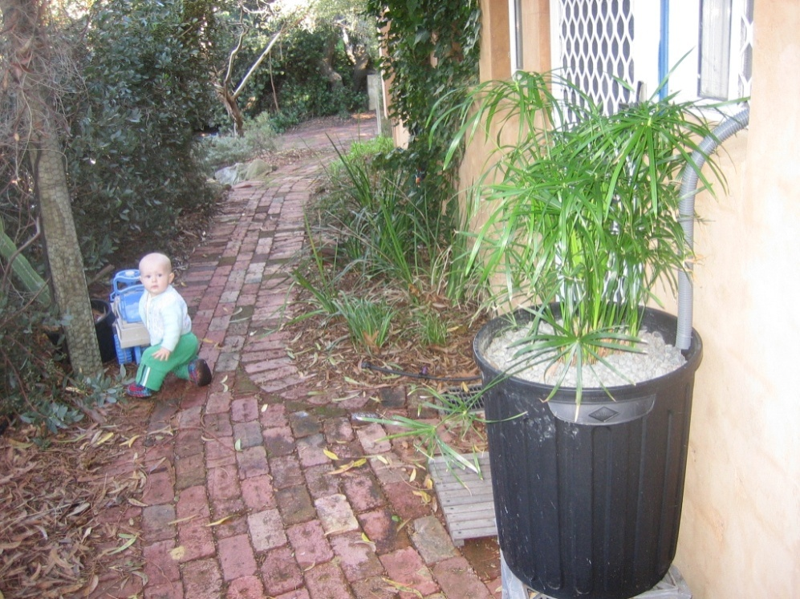
One “homemade” greywater system

Slide 11
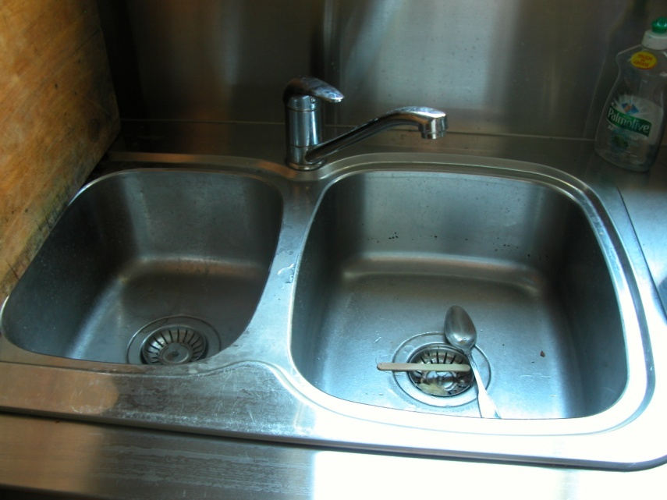
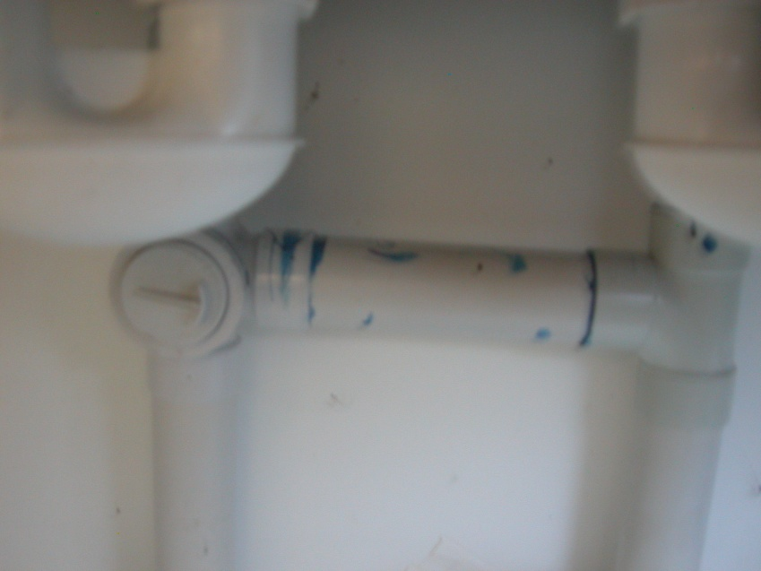
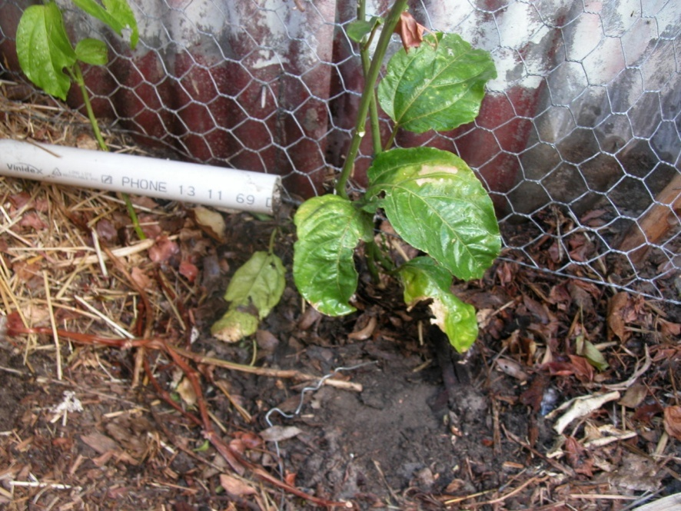
And an even simpler one!

Slide 12

What do you want to know more about?

