Slide 1

Project 2019 – AM-database
Greta Lindwall, Niclas Stenberg and Sareh Götelid
Stockholm, 2019-09-27

Slide 2
Outline
Aim of proposed project
Configurational Data Curation System (CDCS)
Project work packages and time plan

Slide 3
2019 Technical Group Project
Aim: Capture and store AM-related materials data produced within PhD/postdoc projects at Swedish universities in an open searchable and reusable structure.
Motivation
Materials science is becoming more data intensive
Data-driven techniques (e.g., machine learning) are becoming more common
Awareness and education
Notes:
For some time: strong recommendations for an infrastructure supporting ICME that would enable access to precompetitive materials data for both scientific and engineering applications.
Data-driven techniques have already demonstrated the ability for a rapid and efficient means to augment materials discovery, design, and deployment.

Slide 4
2019 Technical Group Project
Aim: Capture and store AM-related materials data produced within PhD/postdoc projects at Swedish universities in an open searchable and reusable structure.
Approach
Make use of available materials data infrastructures (suggestion: to use CDCS)
Setup a common repository/database
Train students in using CDCS to fill the repository
Engage students in collaborative activities

Slide 5
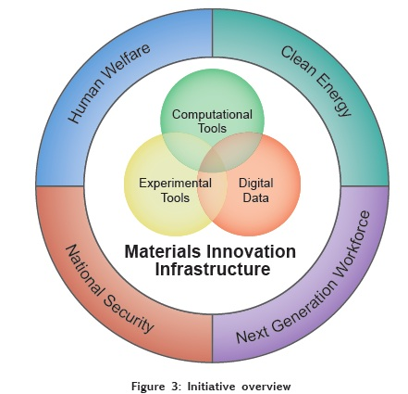
Materials Genome Initiative (MGI)
A U.S. multi-agency initiative to create policies, resources and infrastructure to support
Discovery
Manufacturing
Deployment
of advanced materials twice as fast and at a fraction of the cost.
Holdren, MGI for global competitiveness (2011)
Notes:
The Materials Genome Initiative is a multi-agency initiative designed to create a new era of policy, resources, and infrastructure that support U.S. institutions in the effort to discover, manufacture, and deploy advanced materials twice as fast, at a fraction of the cost.
Advanced materials are essential to economic security and human well being, with applications in industries aimed at addressing challenges in clean energy, national security, and human welfare, yet it can take 20 or more years to move a material after initial discovery to the market. Accelerating the pace of discovery and deployment of advanced material systems will therefore be crucial to achieving global competitiveness in the 21st century.
Since the launch of MGI in 2011, the Federal government has invested over $250 million in new R&D and innovation infrastructure to anchor the use of advanced materials in existing and emerging industrial sectors in the United States.

Slide 6
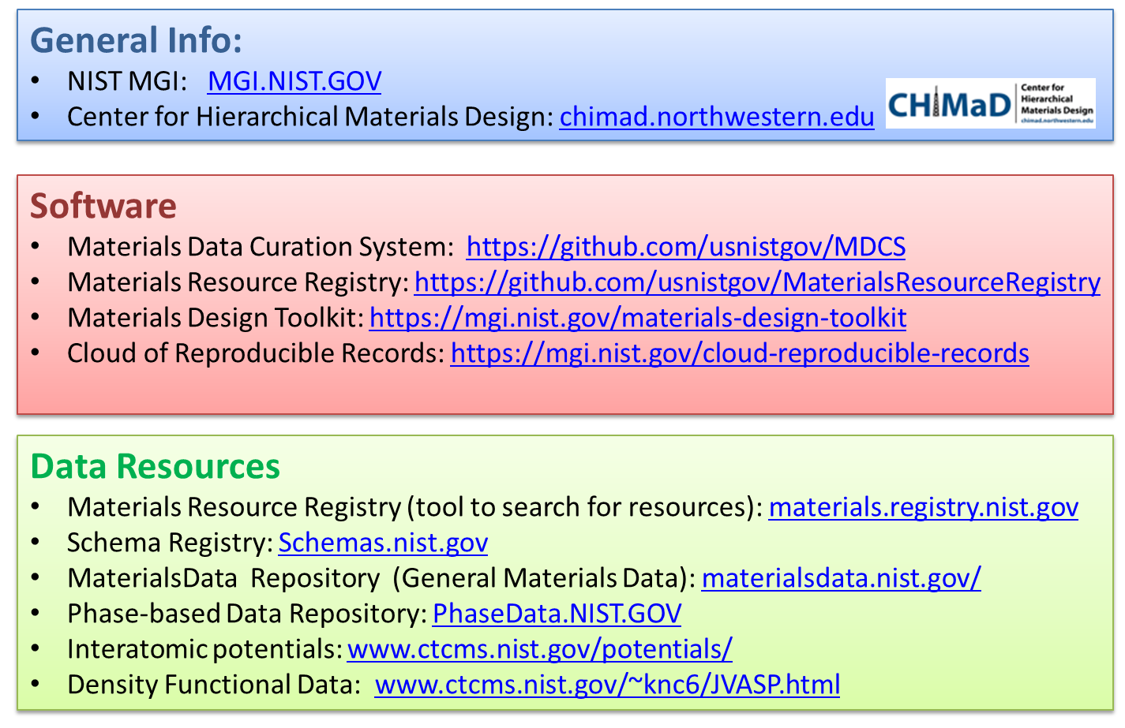

MGI activities at NIST
Notes:
NIST promotes U.S. innovation and industrial competitiveness by advancing measurement science, standards, and technology in ways that enhance economic security and improve our quality of life.
Expertise in the
Integration
Curation
Critical evaluation of data and models
Hence a leading role within MGI

Slide 7
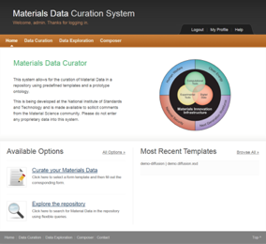
Configurable Data Curation System (CDCS)
Need
Scientific data exists in many formats
Difficult to
Combine data from multiple sources
Understand and reuse existing data
Find associated metadata
Transform data into new formats
Objectives
Facilitate collection, use, and reuse of materials data
Provide needed informatics infrastructure to enable High Throughput Experimentation (HTE)
https://github.com/usnistgov/MDCS
Achievements and Impact
Made available to community via GitHub
Several early adopters of CDCS
Warren & Ward, JOM 2018:70
Notes:
There are a large number of early adopters of the MDCS, including
the NextFlex manufacturing institute,
the NanoMine project
the LightMatenergy materials network, and
the Shanghai Materials Genome Institute.

Slide 8




Overall Design - CDCS
Digital Data
& Metadata
(any format)
Web
Framework
Data Analysis Infrastructure
GUI
Exporter
REST API
Data Provider
Harvester
Simulation
User Scripts
Data Management
& Search Engine
Data
Metadata
Images
Large Files
BLOBs
Measurement
Database
Large Dataset
Repository
Data Provider
Harvester
Notes:
Web-based
Store data in XML-based templates
Contains interfaces for us to interact with it:
Graphical interface which one can use to enter and curate data
In-built interface - rest-API (Representational State Transfer Application programming interface) that can/and should be used to automize the data capture
And then when you have the data stored in XML format you can transfer the data and the meta-data to any format. And then use it.

Slide 9
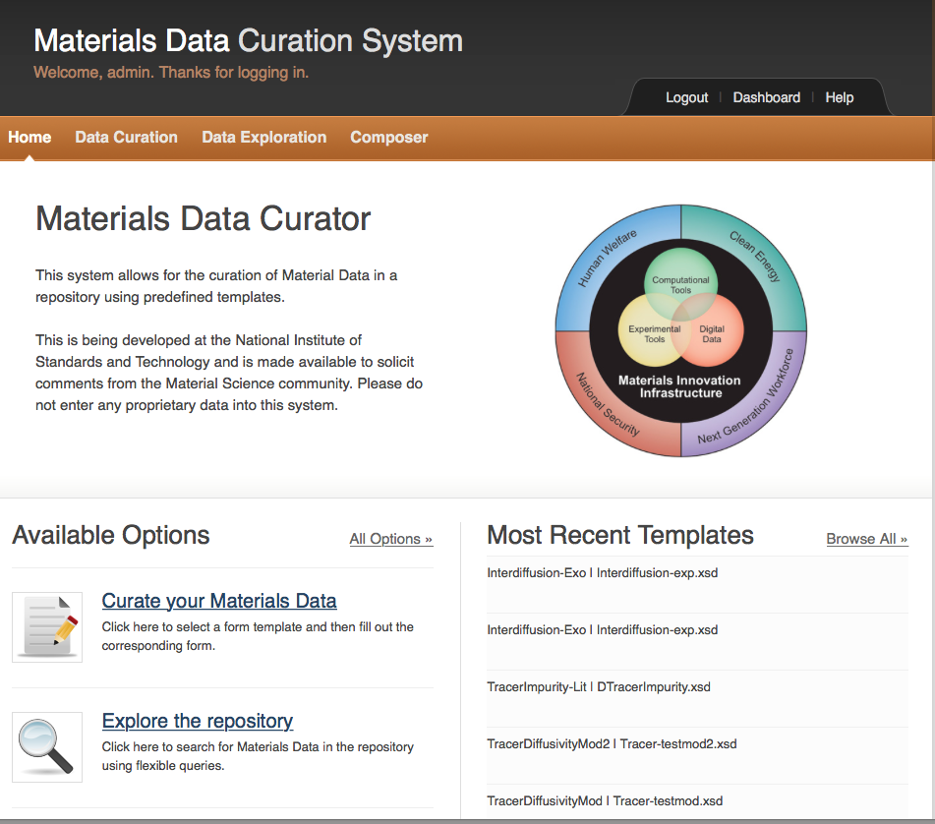
https://github.com/usnistgov/MDCS
MDCS Functions
Data Curation
Data Exploration/Exporter
Composer

Slide 10
Why use CDCS?
Open-source software built on widely used open-source software packages (MongoDB, Django, Redis, Celery)
XML format (text based) – readable by machines and humans
It already has built-in APIs (very important!)
It’s available and it’s developed for these purposes acknowledgeing
It’s been developed for years and is still being developed (XML schemas for AM)
Notes:
The reasons for recommending CDCS are multifold; e.g., it is an open-source software, it is built around widely used open-source software packages, it uses a XML format (text based) which is readable by machines and humans, it has been developed for some years and is still developed (last commit 8 days ago), it is used in real environments throughout the world and it already has built-in APIs which is the key to easy deployment.
MongoDB (noSQL-db)
Django (python framework)
Redis(in-between data handling)
Celery(task scheduler)

Slide 11
Example: AM Bench Schema
Additive Manufacturing Benchmark test series
Its intent is to develop a continuing series of controlled benchmark tests + conference series
Main goals:
Allow modelers to test their simulation results against rigorous and controlled experimental data
Encourage AM practitioners to develop novel mitigation strategies of challenging build scenarios
www.nist.gov/ambench
Notes:
Long-term impact
Since the measurement data will be permanently archived and available, the measurements can be used for comparison to AM simulation for many years. Further, continuing series of new benchmark tests are planned which will enable supply of benchmark data up-to-date with the status of the modeling field.
Short-term impact
The submissions of the modeling results will be blind submission; i.e., the modelers submit their predictions for the benchmark challenges without knowing the experimental results, and will therefore provide a snapshot of how accurate the simulation capabilities are today. In addition, they will provide information on what kinds of benchmark tests the AM researchers are the most interested in.

Slide 12
Example: AM Bench Schema
AM-Bench 2018 measurements
www.nist.gov/ambench
Notes:
Additive Manufacturing Benchmark test series (AM-Bench) is organized by the National Institute of Standards and Technology (NIST), Army Research Laboratory (ARL) and Naval Research Laboratory (NRL) in the US. It gathers a large number of research organizations and industries (see Section 4) with the intent to develop a continuing series of controlled benchmark tests in conjunction with a conference series. The two main goals are (1) to allow modelers to test their simulation results against rigorous and controlled experimental data, and (2) to encourage AM practitioners to develop novel mitigation strategies for challenging build scenarios.

Slide 13
2019 Technical Group Project
Aim: Capture and store AM-related materials data produced within PhD/postdoc projects at Swedish universities in an open searchable and reusable structure.
Approach
Make use of available materials data infrastructures (suggestion: to use CDCS)
Setup a common repository/database
Train students in using CDCS to fill the repository
Engage students in collaborative activities

Slide 14
2019 Technical Group Project
Four workpackes
WP1 – Setup
WP2 – Organization
WP3 – Training
WP4 – Data capture
WP1 – Setup Setting it all up at the host-university and write manual (API documentation). Explore required conditions for a sustainable solution.
Suggested tasks
Decide on host, set the design and name
Set up the main server and administer
Set long-term development
Set long-term funding
Notes:
WP1-Initiation: The first WP will be devoted to setting it all up and write manual (API documentation). One of the universities should be hosting the site and the repository as well as administrate the accounts. Universities have the capacity to set-up secure services like this one. For a sustainable solution, some thoughts need to be dedicated to this; e.g., 1. How to fund the continuation of the platform - faculty means, a foundation, via AM-arena? 2. Who will be the main maintainer? 3. How to contribute to the CDCS and related projects?

Slide 15
2019 Technical Group Project
Four workpackes
WP1 – Setup
WP2 – Organization
WP3 – Training
WP4 – Data capture
WP2 – Organization Coordinate the work. Nominate CDCS ”ambassadors” (PhD student/postdoc) at each university to lead the in-house CDCS activities and communicate the sub-group.
Suggested tasks
Nominate ambassadors
Project management
Follow and communicate the progress of the work
Notes:
WP2-Training: The second WP will be devoted to the organization of the work. Since several AM groups with rather different research focuses will be participating, each university will nominate a CDCS ambassador (PhD students/Postdocs) that will coordinate and lead the in-house CDCS activities. The ambassadors will also be responsible for the communication with the other universities and the project leaders.

Slide 16
2019 Technical Group Project
Four workpackes
WP1 – Setup
WP2 – Organization
WP3 – Training
WP4 – Data capture
WP3 – Training Training of students in how to use CDCS, how to develop XML Schemas and use rest-API.
Suggested tasks
Hands-on workshops at the universities
Document rest-API function
Notes:
WP3-Training: The third WP will be devoted to training of the students in how to use CDCS and how to compose XML Schemas so that they can tailor them to their specific data and metadata. This will include a workshop where the CDCS is introduced and some practical exercises in data curation.

Slide 17
2019 Technical Group Project
Four workpackes
WP1 – Setup
WP2 – Organization
WP3 – Training
WP4 – Data capture
WP4 – Data capture Data capturing and creation. Engagement activites to accelerate the work, motivate the students and help reach consensus on common schemas temlates for similiar types of data sets.
Suggested tasks
Data capture and curation at each university
XML schema ”hackatons”
Notes:
WP4-Data collection: The fourth WP will be dedicated to the data collection. To accelerate this and to inspire the students to create a collaborative network, schema “hackatons” will be arranged where the students meet during 1-2 days to work together on the schema development. This will enable them to learn from each other as well as to help them reach consensus on common schema templates for similar data sets.

Slide 18
Time plan
Continuation/training
Initial training

Slide 19
https://amdata.proj.kth.se/

