Slide 1
BlackChat
Incognito Messaging System
Alpaca Security Solutions

Slide 2
System Level
External USB device for wireless text messages
  AES-128 encryption
  Portable Linux interface
Discrete RF transceiver
  433MHz ISM band
  OOK modulation scheme
  <100mW broadcast power

Slide 3
Hardware – Top Level

Slide 4
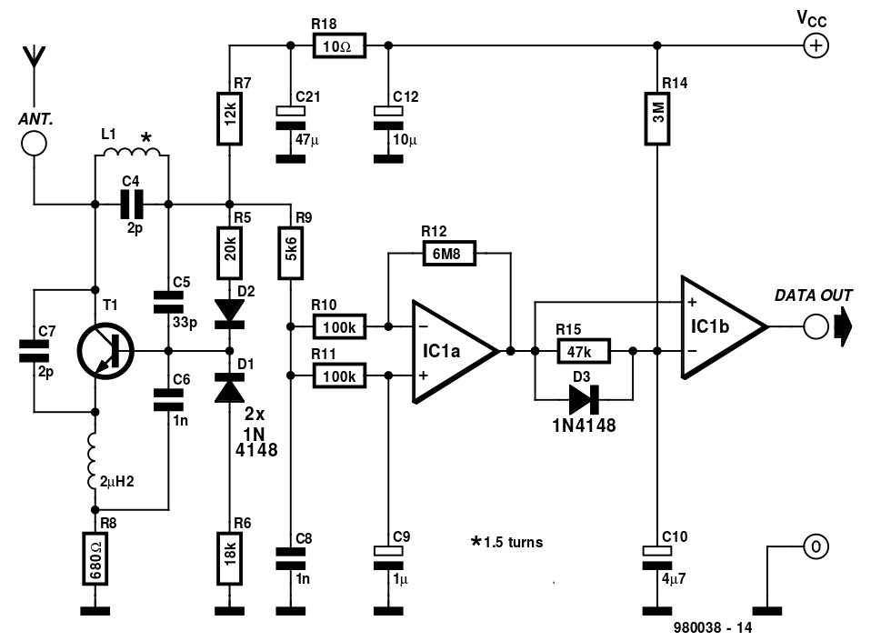
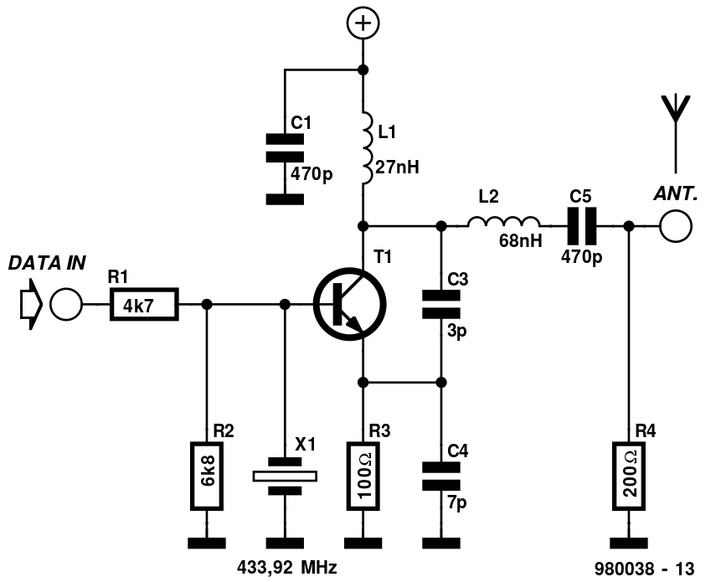

Hardware - RF
Modulator
Elektor Electronics
Demodulator

Slide 5
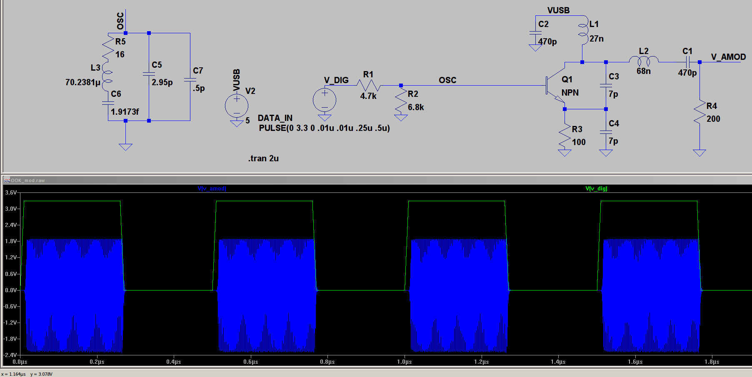
Simulations – Modulator

Slide 6
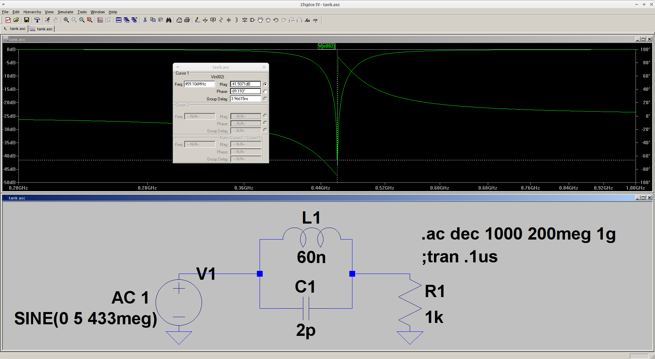
Simulations – LC Tank

Slide 7
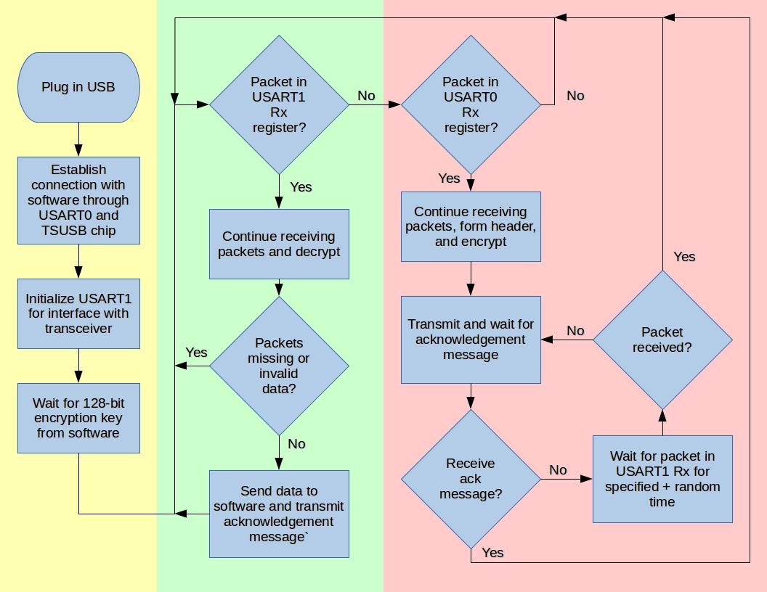
Software

Slide 8
Division of Labor
 | Patrick | Russell
Encryption | *
Packet Handler |  | *
MSP-TRX Interface | *
MSP-USB Interface |  | *
RF Modulator Build / Test |  | *
RF Demod. Build / Test | *
Misc. Analog | *
Misc. Digital |  | *

Slide 9
Timeline

Slide 10
Stretch Goals
>2 module communication
Miniaturization
OS ambivalence (Windows compatibility)

