Slide 1

BlackChat Incognito Messaging System
Patrick Lloyd
Russell Crowe

Slide 2
System Level
External USB device for wireless text messaging
MSP430F2xxx processor
AES-128 encryption
Portable Linux interface
Discrete RF transceiver
433MHz ISM band
OOK modulation scheme
Super-regenerative receiver
<10mW broadcast power

Slide 3
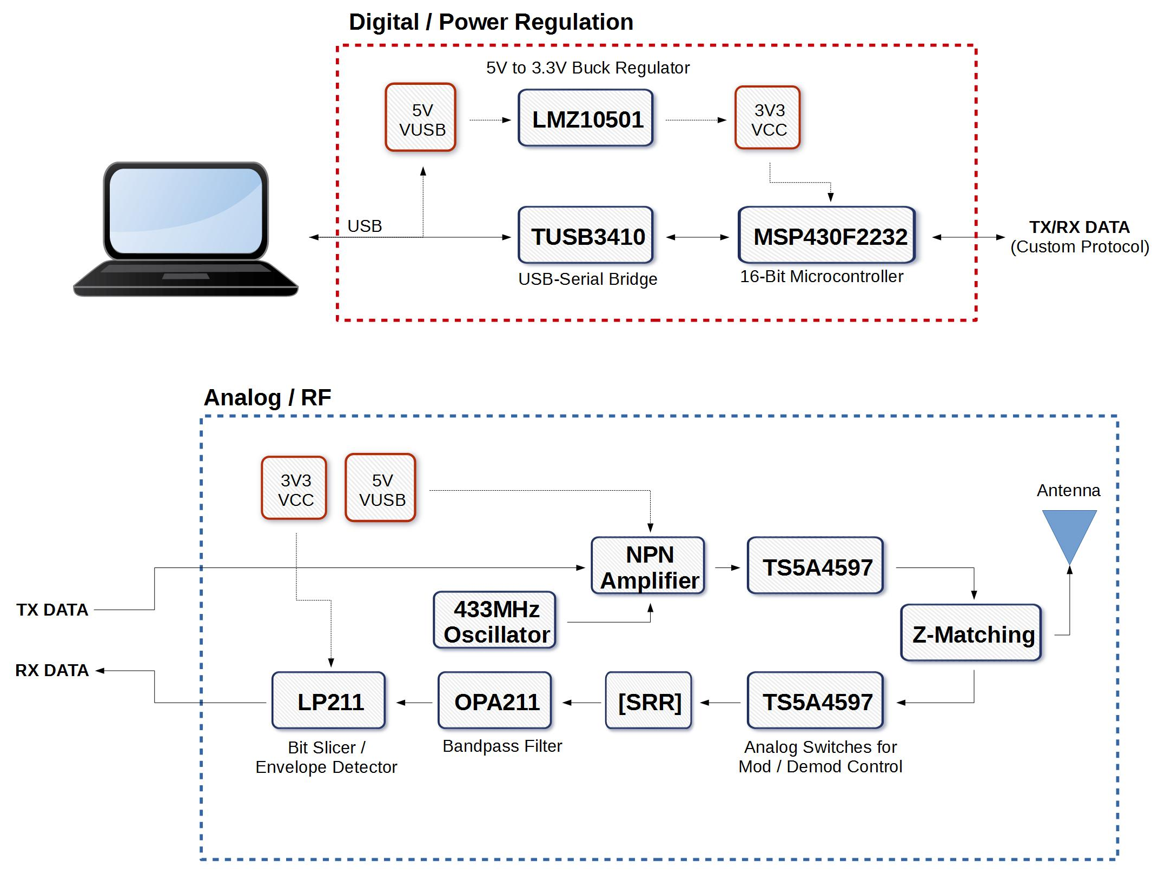
Hardware – Top Level

Slide 4
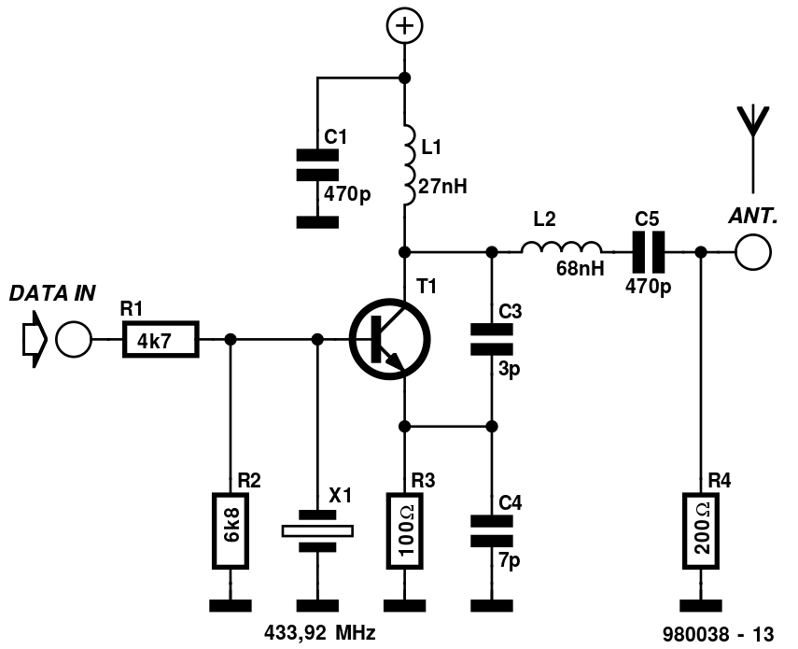
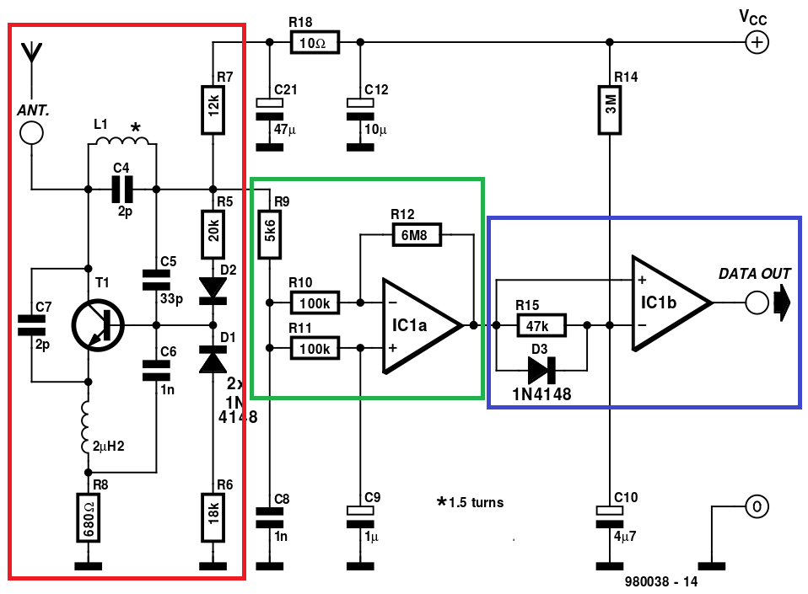
Hardware - RF
Modulator
Demodulator

Slide 5
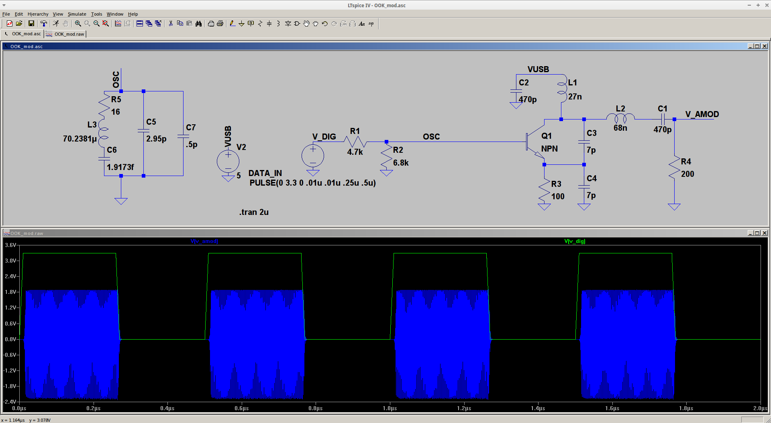
Simulations – Modulator

Slide 6
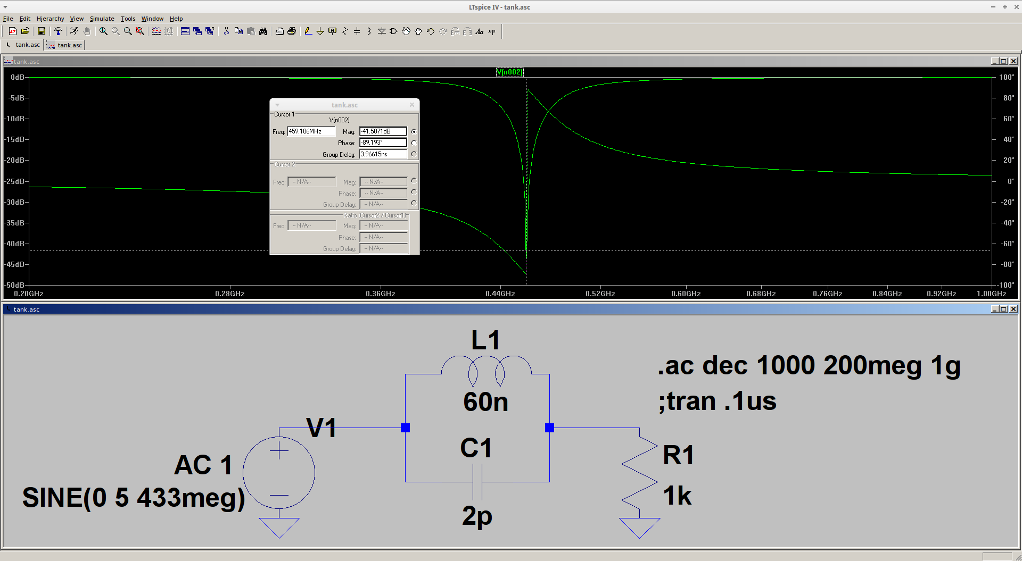
Simulations – LC Tank

Slide 7
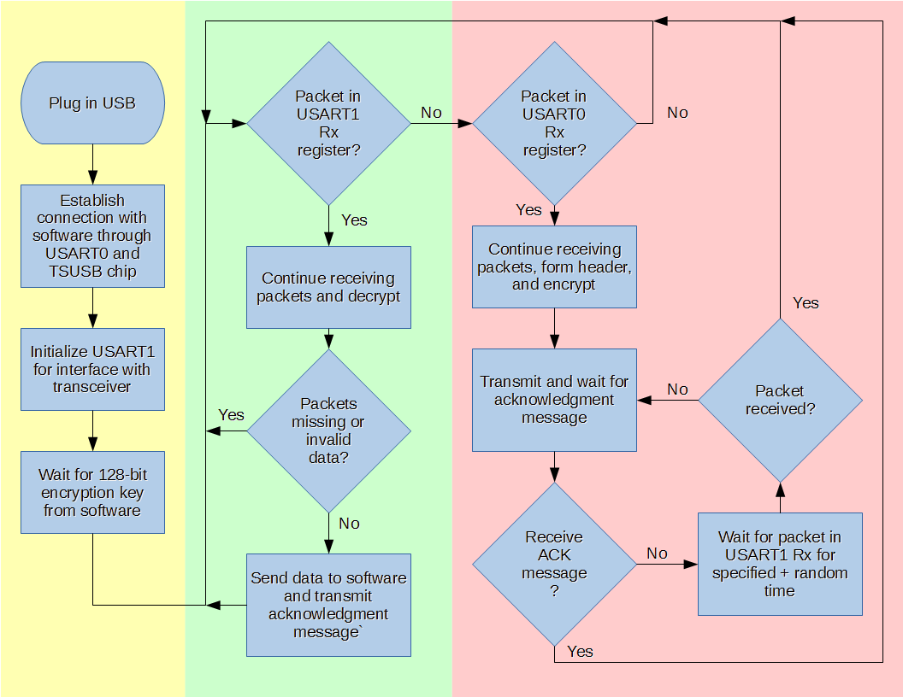
Firmware

Slide 8
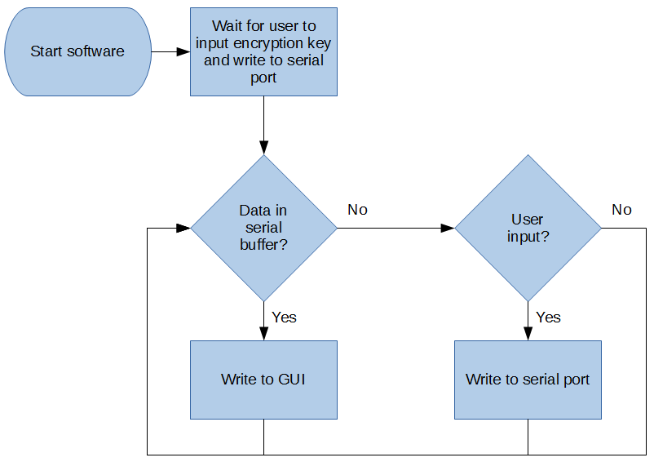
Software

Slide 9
Division of Labor
 | Russell | Patrick
PDR | ($) | ($)
Transmitter | (#)
Antenna |  | (^)
Receiver |  | (*)
Firmware | (@)
uC-TRX Interface |  | (-)
Laptop Software | (&)
uC-Laptop Interface | (!)
Final Board Design | (%) | (%)
Testing & Validation | (\) | (\)
Stretch Goals | (+) | (+)

Slide 10
GANTT CHART
Week | 1 | 2 | 3 | 4 | 5 | 6 | 7 | 8 | 9 | 10 | 11 | 12 | 13 | 14 | 15 | 16
Date | 1-Sep | 8-Sep | 15-Sep | 22-Sep | 29-Sep | 6-Oct | 13-Oct | 20-Oct | 27-Oct | 3-Nov | 10-Nov | 17-Nov | 24-Nov | 1-Dec | 8-Dec | 15-Dec
PDR
Transmitter
Antenna
Receiver
Firmware
uC TRX Interface
Laptop Software
uC Laptop Interface
Final Board Design
Testing & Validation
Stretch Goals

Slide 11
Stretch Goals
Near
3+ module communication
More discrete form factor
Cross platform (Windows compatibility)
Far
2.4Ghz transceiver with more robust modulation scheme
Forward error correction
Plausibly deniable filesystem

Slide 12
Questions?

