Slide 1
AgentEval
A Framework for Multi-Dimensional Utility Assessment
Based on AutoGen Framework

Slide 2
Why Evaluation is Hard in LLM Systems
Traditional NLP metrics fail to capture multi-step agent behavior.
Key properties of LLM outputs:
Probabilistic — the same prompt may produce different answers
Context-dependent — output quality depends heavily on prompt wording
Non-deterministic — no single guaranteed correct response
Open-ended — many tasks have multiple valid answers
Why This Breaks Classical Testing
Traditional software assumes:
deterministic outputs
single correct answer
repeatable execution
LLM agents violate these assumptions.

Slide 3
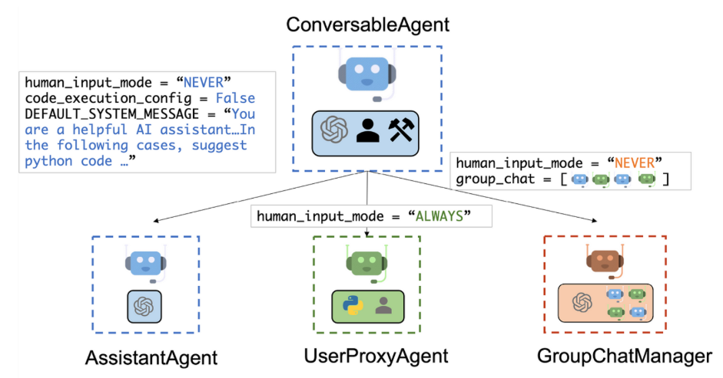
From LLMs to Autonomous Agents
Modern AI systems have evolved rapidly, increasing both capability and autonomy.
Capability progression
Chatbot → generates text responses only
Tool-Using LLM → can call external APIs/tools
Autonomous Agent → performs multi-step reasoning and actions
Multi-Agent System → multiple agents collaborate toward a goal
Example: AutoGen multi-agent architecture
Key Insight: As agent autonomy increases, hidden failure modes multiply and traditional output-based evaluation becomes insufficient. AgentEval was proposed to address this emerging evaluation gap.
Source : Microsoft AutoGen Project https://microsoft.github.io/autogen/

Slide 4
Typical Agent Execution Pipeline
AI agents do not produce answers in a single step. Instead, they follow an iterative reasoning–action loop that may involve multiple interactions with tools.
Core Execution Stages
Task Reception: The agent receives the user’s goal or instruction.
Reasoning / Planning: The LLM determines the next best action.
Tool Selection: The agent chooses an external tool or API when needed.
Parameter Construction: The agent builds the tool input (e.g., JSON arguments).
Tool Execution: The external system is invoked.
Observation: The agent interprets the returned result.
Iteration or Termination: The agent either continues the loop or produces the final answer.

Slide 5
Hidden Failure Modes in AI Agents
AI agents operate through an iterative reasoning–action loop rather than producing answers in a single step.
Because of this multi-step process, failures may occur silently at any stage of execution.
Where Failures Commonly Occur
Task Reception: Agent misunderstands the user’s goal
Reasoning / Planning: Agent chooses incorrect next step
Tool Selection: Wrong API/tool is invoked
Parameter Construction: Incorrect JSON or arguments
Tool Execution: API returns error (e.g., 404)
Observation: Agent misinterprets the result
Iteration or Termination: Final report does not match trace
AgentEval is designed to detect failures across this entire pipeline, not just the final answer.

Slide 6
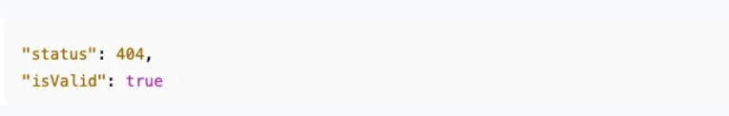
Real Failure Example: 404 Misinterpretation
The agent was tasked with testing the mock user API.
Test Results Observed
/users/50 → valid response (HTTP 200)
/users/-1 → error response (HTTP 404 Not Found)
Despite receiving a 404 error, the agent reported:
“Negative test passed.”
This reveals a semantic reasoning failure: The agent equated “expected negative test” with “successful validation” without verifying correctness conditions.
The failure is not in the output format — it is in the reasoning-to-report alignment.
AgentEval exposes these hidden reasoning errors by analyzing the full execution trace.
Example Agent Interpretation

Slide 7
Real Failure Example: 404 Misinterpretation
The agent was tasked with testing the mock user API.
Test Results Observed
/users/50 → valid response (HTTP 200)
/users/-1 → error response (HTTP 404 Not Found)
Despite receiving a 404 error, the agent reported:
“Negative test passed.”
This reveals a semantic reasoning failure: The agent equated “expected negative test” with “successful validation” without verifying correctness conditions.
The failure is not in the output format — it is in the reasoning-to-report alignment.
AgentEval exposes these hidden reasoning errors by analyzing the full execution trace.

Slide 8
Failure Localization in the Agent Execution Pipeline
Where did this 404 error get misinterpreted?
The failure occurred at:
Stage 6: Observation Interpretation
Stage 7: Final Reporting
The agent:
Correctly executed the tool (callApi)
Correctly received 404
Incorrectly interpreted the semantic meaning
Incorrectly aggregated into the final report

Slide 9
Why Output-Based Testing Fails for AI Agents
Traditional testing validates:
Output format
Response structure
Presence of expected fields
Basic success/failure status
In the 404 example:
The final report had a correct JSON structure
Test counts were present
Status labels were formatted properly
Yet the reasoning was incorrect.
What Was NOT Validated?
Whether 404 was semantically handled correctly.
Whether schema validation actually occurred
Whether final results matched trace evidence
Whether each decision was logically justified
Core Problem
Output-based testing validates syntactic correctness.
Agent evaluation must validate semantic and procedural consistency
An agent can generate a structurally correct report that is logically incorrect

Slide 10
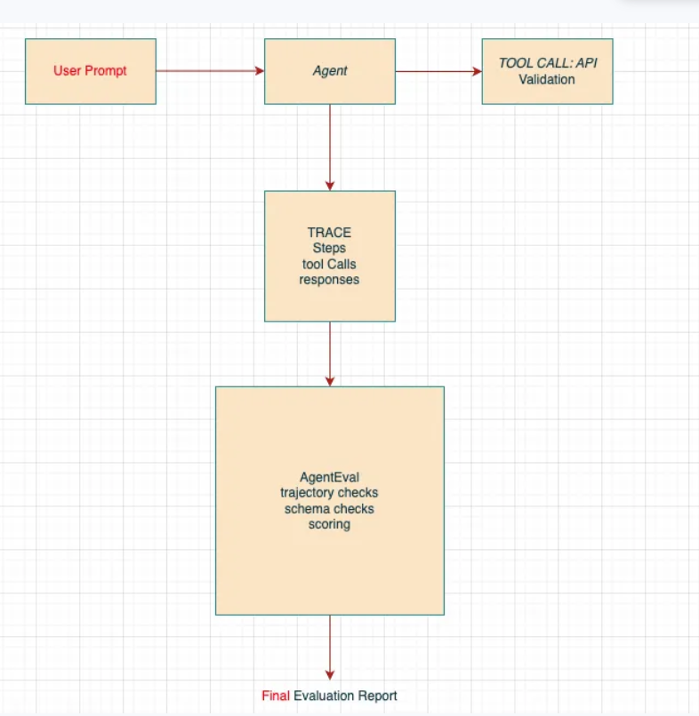
Trace-Based Evaluation: Verifying Behavior, Not Just Output
Trace-based evaluation inspects the complete execution trajectory of an agent, not just its final output.
A trace includes:
tool calls
Parameters
API responses
validation steps
reasoning decisions
Final report generation

Slide 11
Anatomy of the Execution Trace
A trace is a structured log capturing the complete execution trajectory of an AI agent.
Each action performed by the agent is recorded as a step. Includes:
Step number
Agent role (assistant, tool, system)
Action type (reasoning step or tool call)
This helps reconstruct the sequence of decisions.

Slide 12
Key Components Recorded in a Trace
Trace entries capture several elements:
Tool Invocation
tool name
Parameters
API endpoint
Tool Response
HTTP status code
response body
error messages
Validation Evidence
schema validation results
flags such as valid=true/false
Final Report Data
total tests
success count
error count

Slide 13
What AgentEval Checks
AgentEval inspects the trace and verifies agent behavior.
Key checks:
Step Accuracy Did the agent follow the correct workflow order?
Tool Accuracy Were the correct tools invoked with the correct parameters?
Response Interpretation Did the agent interpret API responses correctly?
Validation Execution Did schema validation actually occur?
Final Report Consistency Does the report match the trace evidence?

Slide 14
What AgentEval Evaluates
AgentEval evaluates the entire agent trajectory using multiple metrics.
Core Evaluation Metrics
Step Accuracy
→ Did the agent follow the expected workflow order?
Tool Accuracy → Were the correct tools invoked with proper parameters?
Schema Pass Rate → Did API responses match the expected JSON schema?
Failure Handling → Were error cases (e.g., HTTP 404) interpreted correctly?
Final Correctness → Does the final report match the actual execution trace?

Slide 15
What AgentEval Flags in the 404 Case
Correct interpretation:
404 indicates an error case.
Failure scenario:
Agent incorrectly reports “Negative test passed.”
AgentEval flags:
incorrect response interpretation mismatch between trace and final report

Slide 16
Hands-On Demonstration: Running AgentEval Locally
Run a local AgentEval example
Components:
mock API server
deterministic testing agent
execution trace
evaluation script

Slide 17
To run the AgentEval demonstration, we first prepare the environment.
git clone https://github.com/codemits/AgentEval.git
cd AgentEval 2. Install Ollama (Local LLM Runtime) Download from: https://ollama.com.
In terminal : Ollama run llama3
3. Install Node.js and npm Download from: https://nodejs.org.
To run the demonstration, we need to replace the AgentEval\src folder and configure all files to use Ollama instead of the original OpenAI and Azure Key requirements.

Slide 18
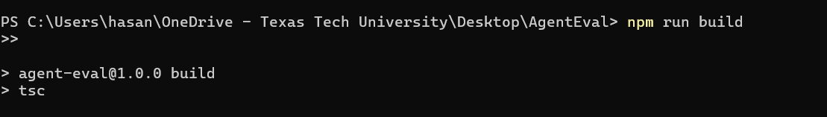
Build your project
Open a terminal and run the following command:
PS C:\Users\hasan\OneDrive - Texas Tech University\Desktop\AgentEval> npm run build
>>
> agent-eval@1.0.0 build
> tsc

Slide 19
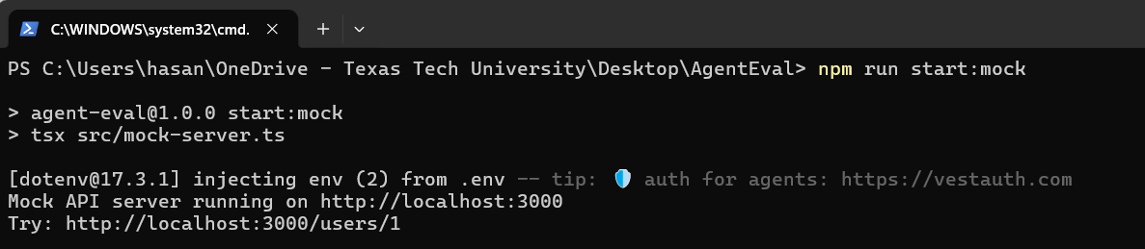
Running the Mock API
Before running the agent, we start the mock API server. Inside the AgentEval folder, run the terminal: npm run start: mock

Slide 20
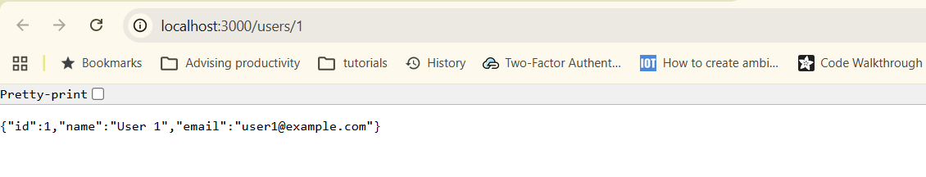
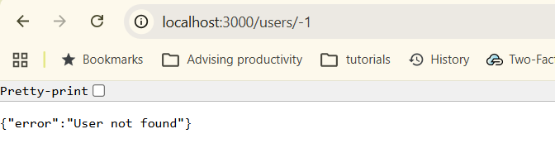
Test mock server
Agebt call users/1 represent successful call
Agent calls users/-1, which represents an error call

Slide 21
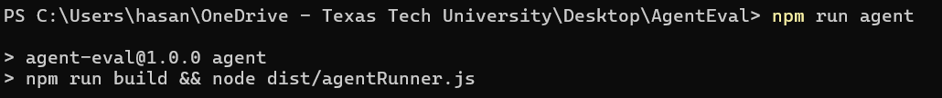
Running the Testing Agent
The agent automatically performs the following tasks:
generates test user IDs
sends requests to the API
validates responses
records the execution trace
produces a final test report
Open a new terminal and run the command: npm run agent

Slide 22
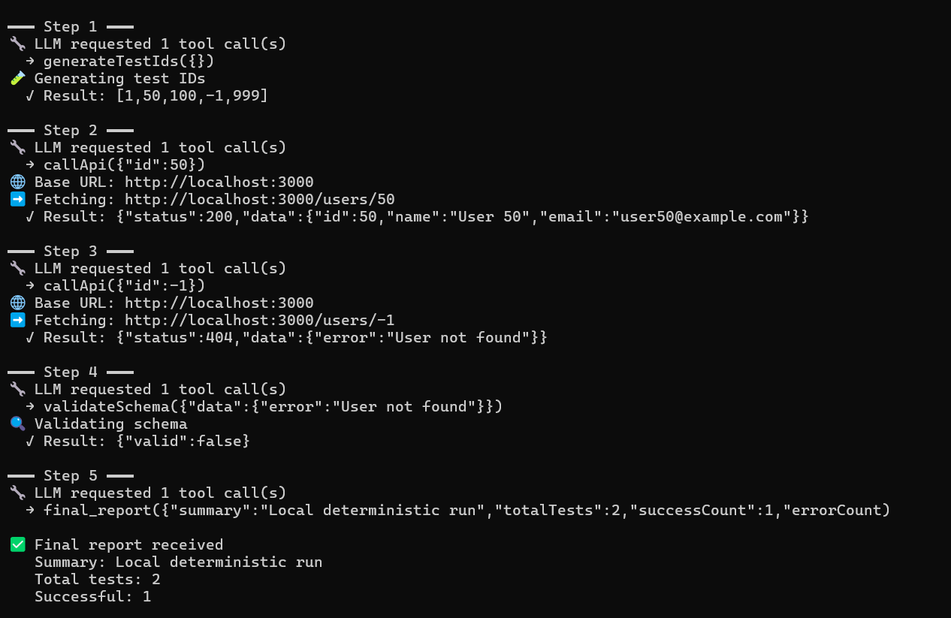
Agent Execution Trace and Test Results
Step 1 — Test Case Generation
[1, 50, 100, -1, 999] Step 2 — Valid API Request
Result: {"status":200,"data":{"id":50,"name":"User 50","email":"user50@example.com"}}
Step 3 — Invalid API Request
Result: {"status":404,"data":{"error":"User not found"}} Step 4 — Schema Validation
Result: {"valid":false}
Step 5 — Final Report
Total tests: 2
Successful: 1
Errors: 1

Slide 23
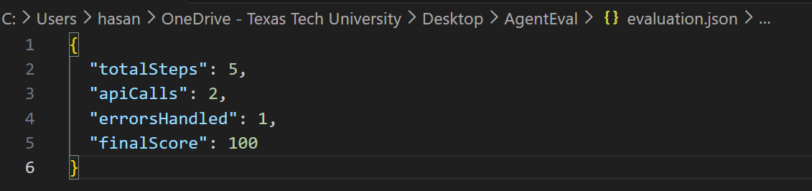
Running the Evaluation: npm run evaluate
The evaluation module analyzes the trace and checks:
step sequence correctness
tool usage accuracy
API parameter validity
schema validation
error interpretation
consistency between trace and final report

Slide 24
AgentEval: Evaluating LLM-Powered Applications
After observing the behavior of AI agents in the demonstration, the next question is:
How can we systematically evaluate LLM-powered applications?
Microsoft Research introduced AgentEval, a framework designed to assess the utility of LLM-powered applications that assist users in completing tasks.
AgentEval aims to simplify the evaluation process by:
Automatically generating evaluation criteria
Measuring performance across these criteria
Enabling a comprehensive assessment of system utility
AgentEval is implemented within the AutoGen framework.

Slide 25
Assessing Utility in LLM Applications
Developers building AI systems need to understand:
How well the system helps users complete tasks
What aspects of the system perform well
what aspects require improvement
Traditional evaluation methods often rely on simple success metrics, such as whether the task was completed.
However, this approach is insufficient because:
Success is not always clearly defined
Multiple valid solutions may exist
Explanation quality also matters
For example, when solving a math problem, evaluation should consider:
• Correctness of the solution • Clarity of the explanation • Concise reasoning
AgentEval addresses this challenge by evaluating systems using multiple criteria.

Slide 26
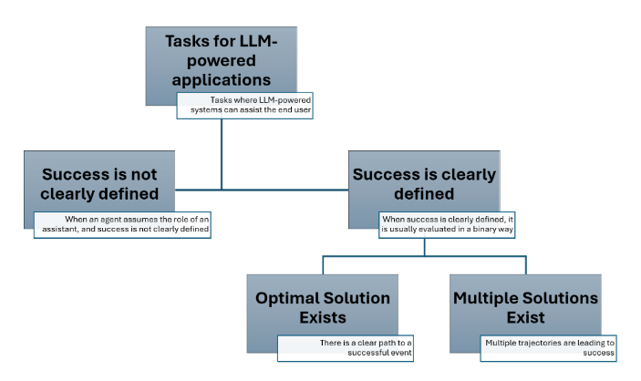
Task Taxonomy in LLM Applications

Slide 27
AgentEval Framework Overview
AgentEval evaluates LLM-powered applications using three agents. Each agent performs a different role in the evaluation process.
CriticAgent
Generates evaluation criteria.
QuantifierAgent
Measures how well the system satisfies those criteria.
VerifierAgent
Ensures the evaluation process is robust and meaningful.
Together, these agents produce a multi-dimensional evaluation of system utility.

Slide 28
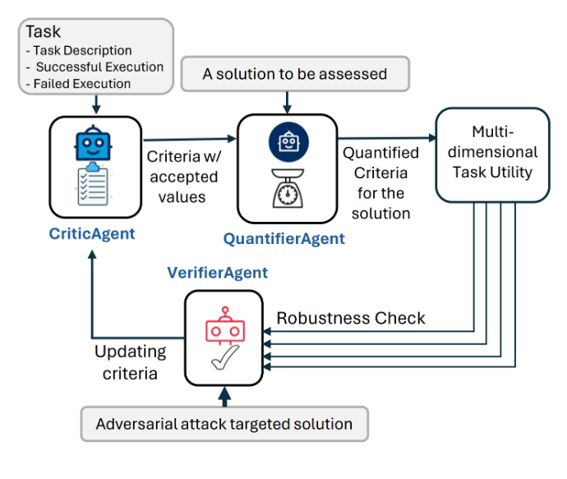
AgentEval Framework

Slide 29
CriticAgent: Generating Evaluation Criteria
The CriticAgent analyzes the task and generates evaluation criteria.
Inputs include:
task description
successful example responses
failed example responses
Using these inputs, CriticAgent identifies important dimensions of system performance.
For example, in a math tutoring application, the CriticAgent might generate criteria such as:
Accuracy Conciseness Relevance
Developers are encouraged to review these criteria using domain knowledge.

Slide 30
Structure of Generated Criteria
Each criterion generated by CriticAgent has three components.
Name
The evaluation dimension.
Description
Explanation of what the criterion measures.
Accepted Values
Possible evaluation scores.
Example:
Criterion: Accuracy
Accepted values:
Correct
Minor errors
Major errors
Incorrect
This structured format allows subjective judgments to be transformed into measurable evaluation metrics.

Slide 31
QuantifierAgent: Evaluating Performance
After the criteria are generated, the QuantifierAgent evaluates the system output.
Inputs:
list of evaluation criteria
Task description
Execution trace or conversation
Ground truth information
The QuantifierAgent assigns values to each criterion.
Example:
Accuracy → Correct Conciseness → Concise Relevance → Highly relevant
This produces a multi-dimensional performance assessment.

Slide 32
Example Quantification Output
The output of the QuantifierAgent includes:
The actual success status of the task
Estimated performance across each criterion
Example output:
Actual Success: True
Estimated Performance:
Accuracy → Correct Conciseness → Concise Relevance → Highly relevant
This allows developers to understand both overall success and quality of the solution.

Slide 33
VerifierAgent: Ensuring Reliable Evaluation
The VerifierAgent improves the reliability of the evaluation process.
Its role is to ensure that evaluation criteria remain:
Robust
Meaningful
relevant to end users
VerifierAgent performs two major checks:
Criteria Stability
Discriminative Power

Slide 34
Criteria Stability
VerifierAgent evaluates whether the generated criteria are:
Essential for evaluating the task
Non-redundant
Consistently measurable
If some criteria overlap or are unnecessary, they are removed.
The goal is to retain only robust evaluation criteria.

Slide 35
Discriminative Power
VerifierAgent also tests whether the criteria can distinguish between good and poor system behavior.
This is done by introducing adversarial examples, such as:
Noisy or corrupted inputs
Compromised data
Misleading responses
If the evaluation framework fails to detect these cases, the criteria must be refined.

Slide 36
Flexibility of AgentEval
AgentEval is designed to work with many types of tasks.
Examples include:
Solving math problems
Performing household tasks in simulated environments
Generating text or suggestions
Assisting users with complex workflows
The framework supports both:
Tasks with clearly defined success.
Tasks where multiple acceptable solutions exist.

Slide 37
Human-in-the-Loop Evaluation
AgentEval supports human participation in the evaluation process.
Domain experts can:
Suggest relevant evaluation criteria
Verify the usefulness of the generated criteria
This human-in-the-loop approach ensures that evaluation remains aligned with real-world expectations and domain knowledge.

Slide 38
Empirical Validation
AgentEval was tested on two applications.
Math Problem Solving
Dataset:
12,500 challenging math problems with step-by-step solutions.
AgentEval evaluated multiple models and successfully identified relevant evaluation criteria.
ALFWorld Simulation
ALFWorld is a simulated environment where agents perform household tasks.
Examples include:
navigating rooms
interacting with objects
completing instructions
AgentEval evaluated agent performance in these multi-step interactions.

Slide 39
Using AgentEval
AgentEval currently operates in two main stages.
Criteria Generation
Example function: generate_criteria()
Inputs:
task description
successful example
failed example
Criteria Quantification
Example function: quantify_criteria()
This stage evaluates execution traces using the generated criteria.

Slide 40
Advantages of AgentEval
AgentEval provides several important benefits.
enables automated evaluation of AI systems
evaluates multiple performance dimensions
reduces reliance on manual human evaluation
helps identify strengths and weaknesses of applications
It provides developers with insight into how well their AI systems assist users.

Slide 41
Limitations of AgentEval
Generated criteria may vary between runs
Quantification results may change due to LLM randomness
The VerifierAgent component is still under development
Researchers recommend performing multiple evaluation runs and including human expertise in the evaluation process.

Slide 42
Demonstration 2: AgentEval with AutoGen + Ollama
In this demonstration, we run a simplified Microsoft-style AgentEval pipeline locally using:
AutoGen agents
Ollama local LLM
Automatically generated evaluation criteria
Three agents used
TaskAgent — solves the task
CriticAgent — generates evaluation criteria
QuantifierAgent — evaluates the response

Slide 43
Create Virtual Environment
Windows:
python -m venv venv
venv\Scripts\activate
Mac / Linux
python3 -m venv venv
source venv/bin/activate

Slide 44
Requirements
Python 3.10+
Now install the required python packages inside virtual environment:
autogen-agent
chatautogen-extrequests
Commands
pip install autogen-agentchat
pip install autogen-ext
pip install requests

Slide 45
Install Ollama
Ollama is used as the local LLM backend. Download go to: https://ollama.com
Download a Local Model In terminal : ollama pull llama3
Start Ollama
ollama run llama3
Local model server runs at: http://localhost:11434

Slide 46
Project Files
The demonstration uses three Python files:
ollama_llm.py
agenteval_basic.py
agenteval_execute.py
ollama_llm.py — helper for connecting to Ollama using requests
agenteval_basic.py — initializes AutoGen agents with Ollama
agenteval_execute.py — runs the full Task → Criteria → Evaluation pipeline

Slide 47
Run the Demo
In your code, we want to run the math problem (or any task) defined inside agenteval_execute.py.
Open the agenteval_execute.py in any editor and specify the task:
task_prompt = "Solve the equation: 3x + 5 = 20."
In one terminal run ollama
If you do not have a GPU set OLLAMA_NO_CUDA=1
ollama run llama3
In another the terminal and inside the virtual environment, run the command:
python agenteval_execute.py

Slide 48
What the script does
TaskAgent solves the problem
CriticAgent generates evaluation criteria
QuantifierAgent evaluates the response
This demonstrates a multi-agent evaluation pipeline.

Slide 49
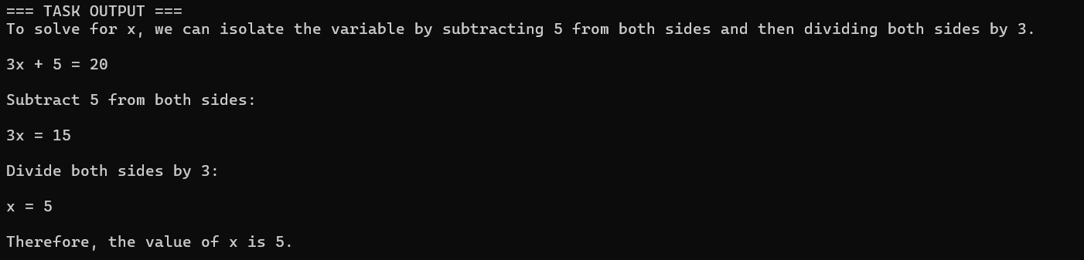
Output
TASK OUTPUT

Slide 50
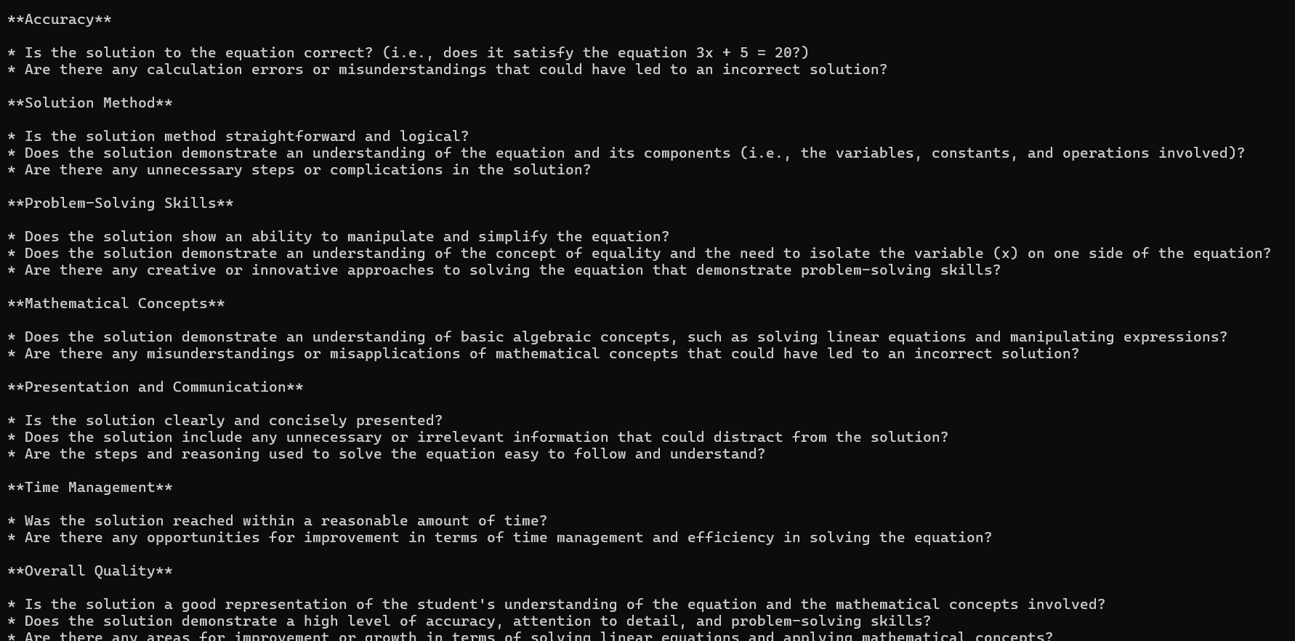
CRITERIA

Slide 51
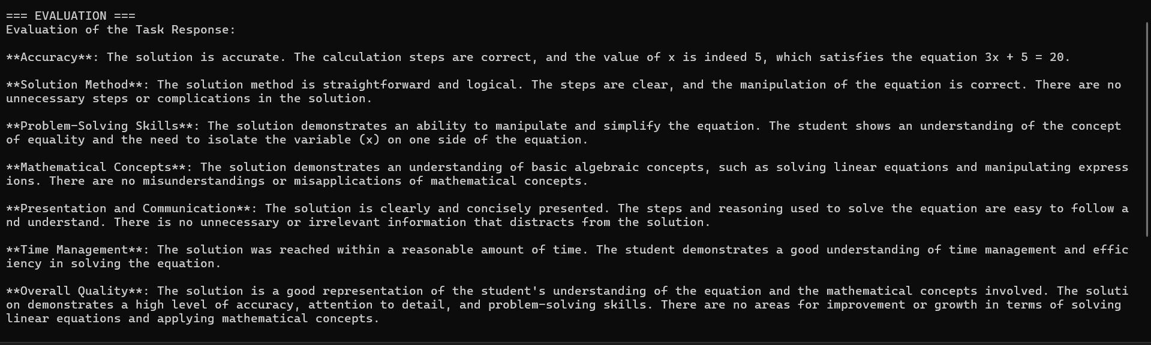
Evaluation output for math problem

