Slide 1
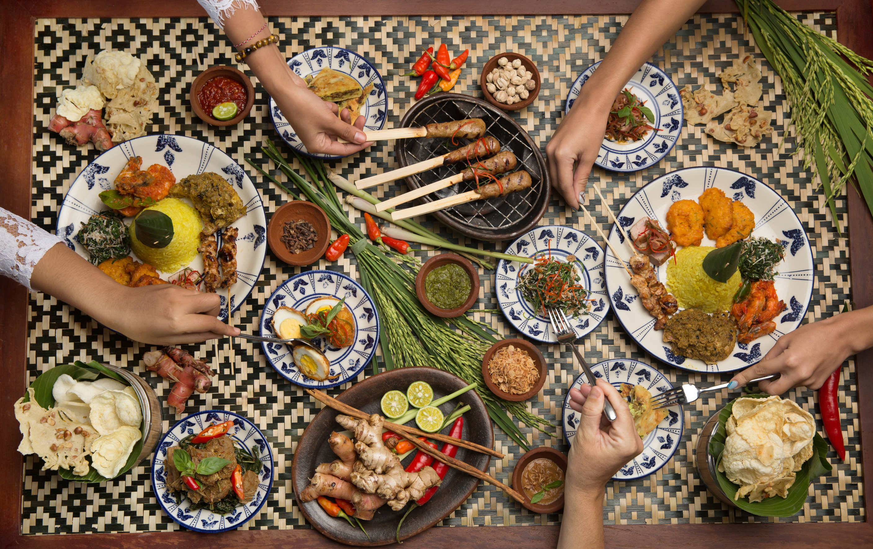


PBL-IF240
A web-based application that recommends traditional culinary delights and restaurants typical of Yogyakarta.

Slide 2
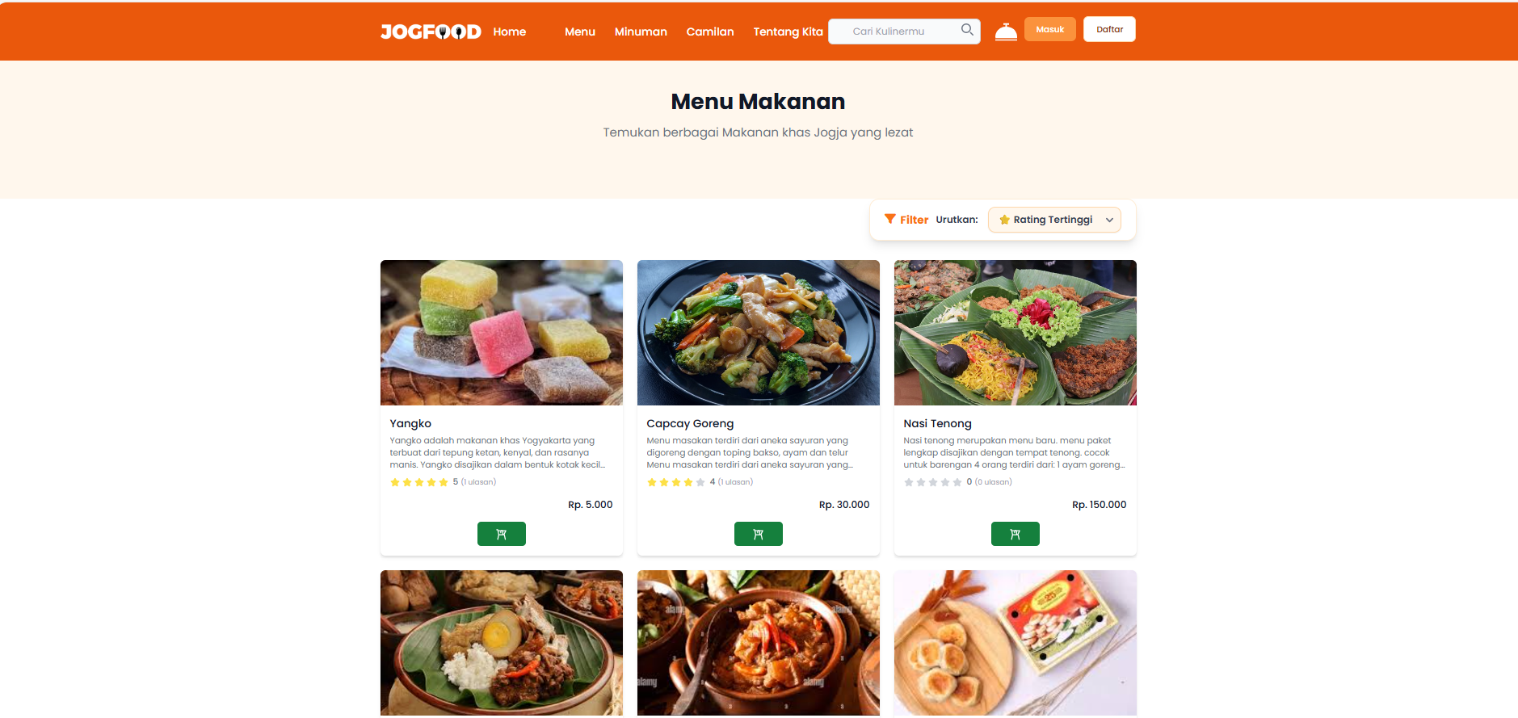
TABLE OF CONTENTS
01 Meet Our Team
02 Why JOGFOOD?
03 Problem Comparison Table
04 System Requiretments JOGFOOD
05 Implementation
06 Testing
07 Conclusion

Slide 3
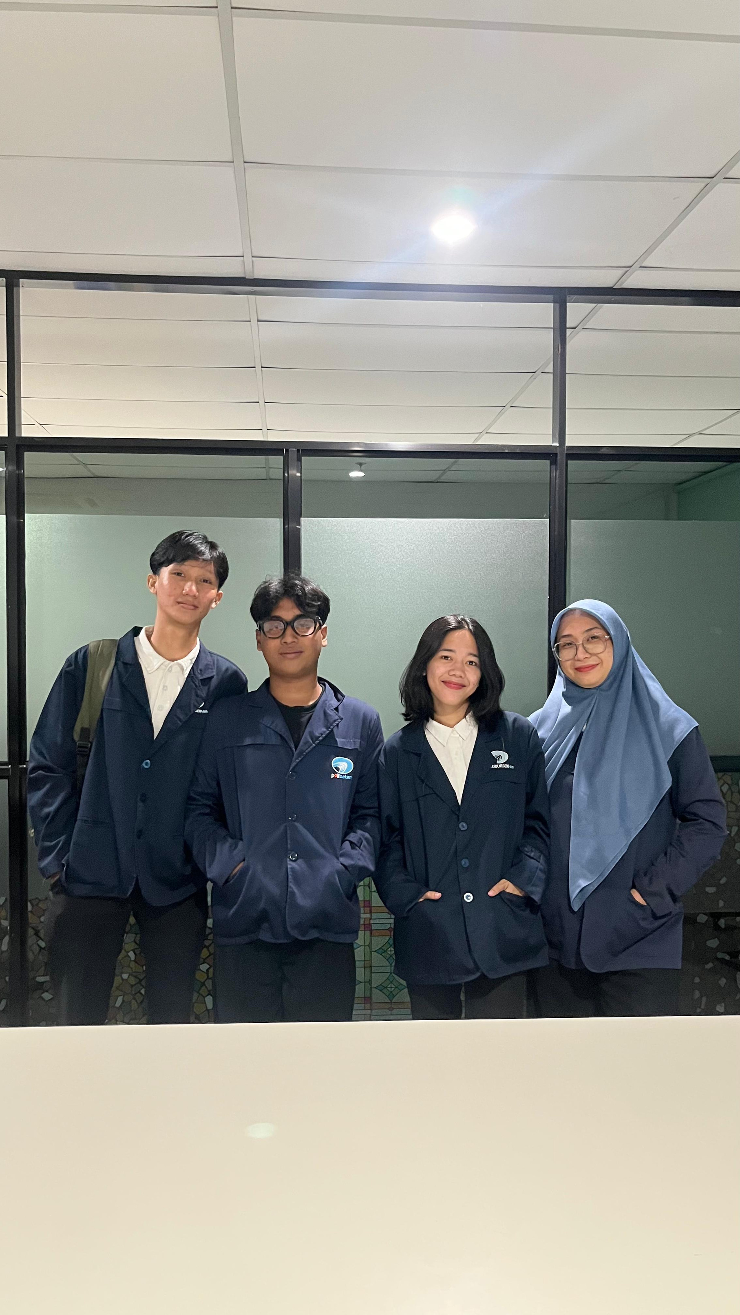
01
Meet Our Team
Manpro : Yeni Rokhayati, S.SI., M.SC.
Leader : Ridho Putrawan
Member : Ruth Y. Manurung
Member : Josepine S. Hia
Member : M. Rizky Raapi R

Slide 4
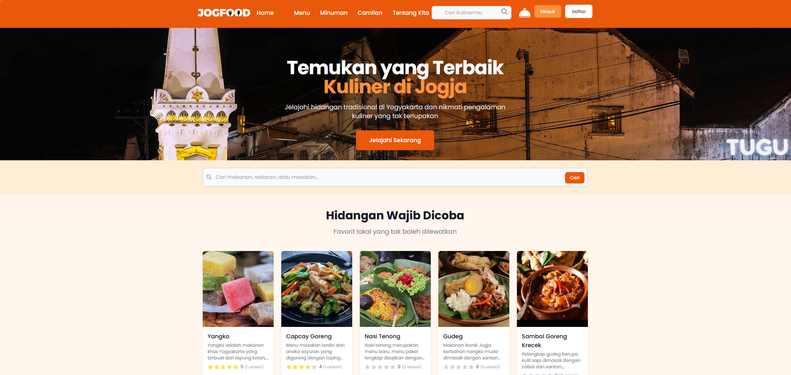
02
Why JOGFOOD?
Why Do We Need JOGFOOD ?
🔸 Most restaurant websites don’t show food recommendations
🔸 No online ordering or delivery services
🔸 Users need a fast and seamless way to discover and enjoy local cuisine
What Makes JOGFOOD Different?
✔ Personalized food recommendations — tailored to user ratings & reviews
✔ Online ordering with our own delivery service
✔ Ideal for tourists & locals to explore trusted local flavors instantly

Slide 5

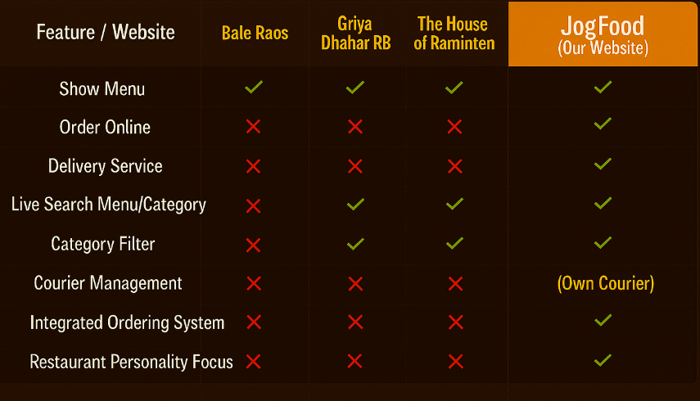
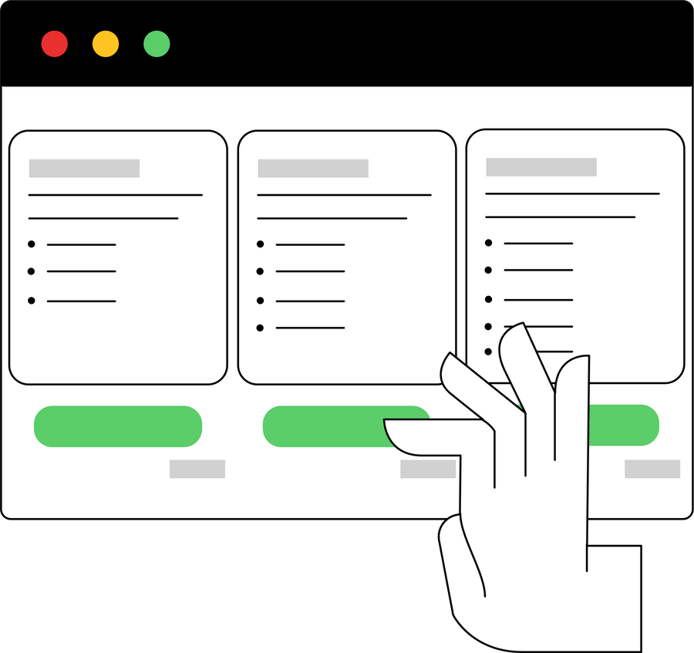
Problem Comparison Table
03

Slide 6
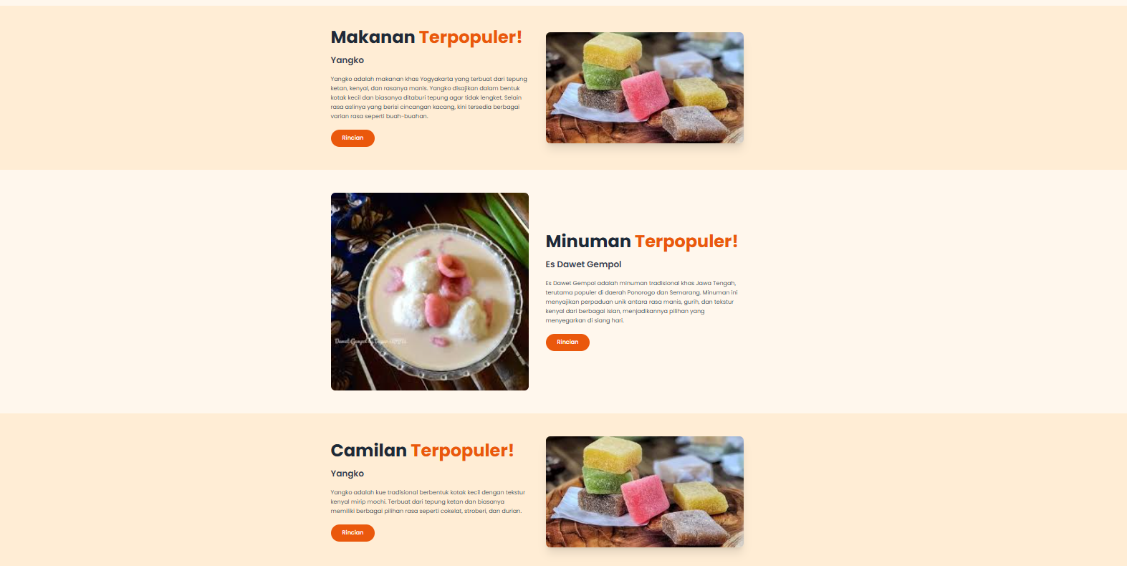
04
System Requirements Jogfood
Functional Requirements
🍽️ Admin-controlled menu management
🔍 Search and discover culinary menus easily
💳 Order & Payment Process
🛵 Courier Delivery System
Non-Functional Requirements
🔐 Security
📱🖥️ Responsive UI
💳 Payment Integration

Slide 7
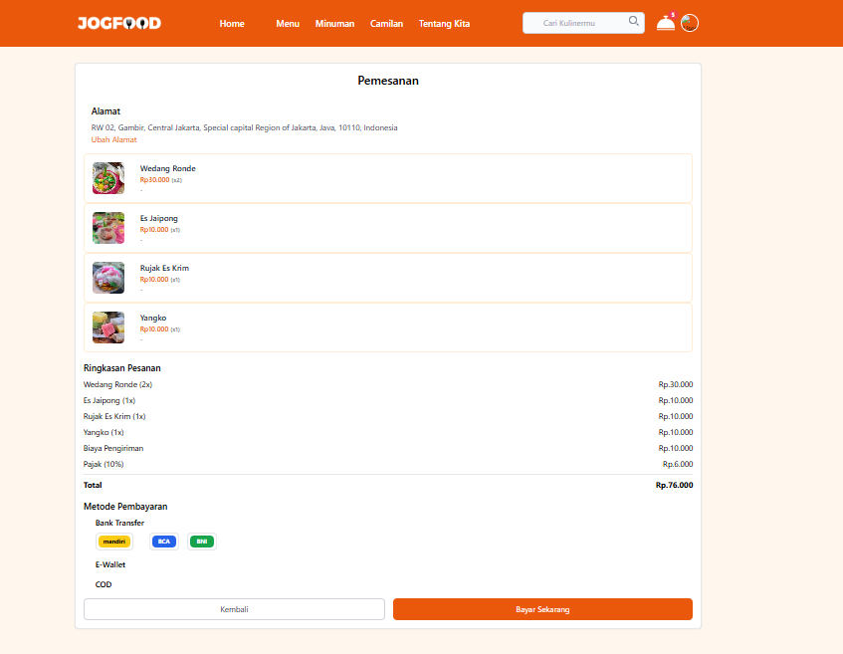
05
IMPLEMENTATION
Technology Stack :
Backend: Laravel 12
Frontend: Laravel Blade + Tailwind CSS
Database: MySQL
Payment Gateway: Midtrans
Key UI Features :
🍽️ Dynamic food recommendations
🛵Real-time order tracking
⭐ User ratings and review
🧑‍💻 Admin dashboard for managing users, menus, and analytics

Slide 8



06
TESTING
Testing Methodology
Blackbox testing
Manual Testing
Environment
Chrome
Edge
Results
50+ test cases executed
100% of major use cases passed
Examples
Add menu (TC001) – Passed
Checkout (TC027) – Passed
Payment failure (TC044) – Handled
Submit rating (TC049) – Passed
🧪 System is stable, functional, and ready for deployment.

Slide 9
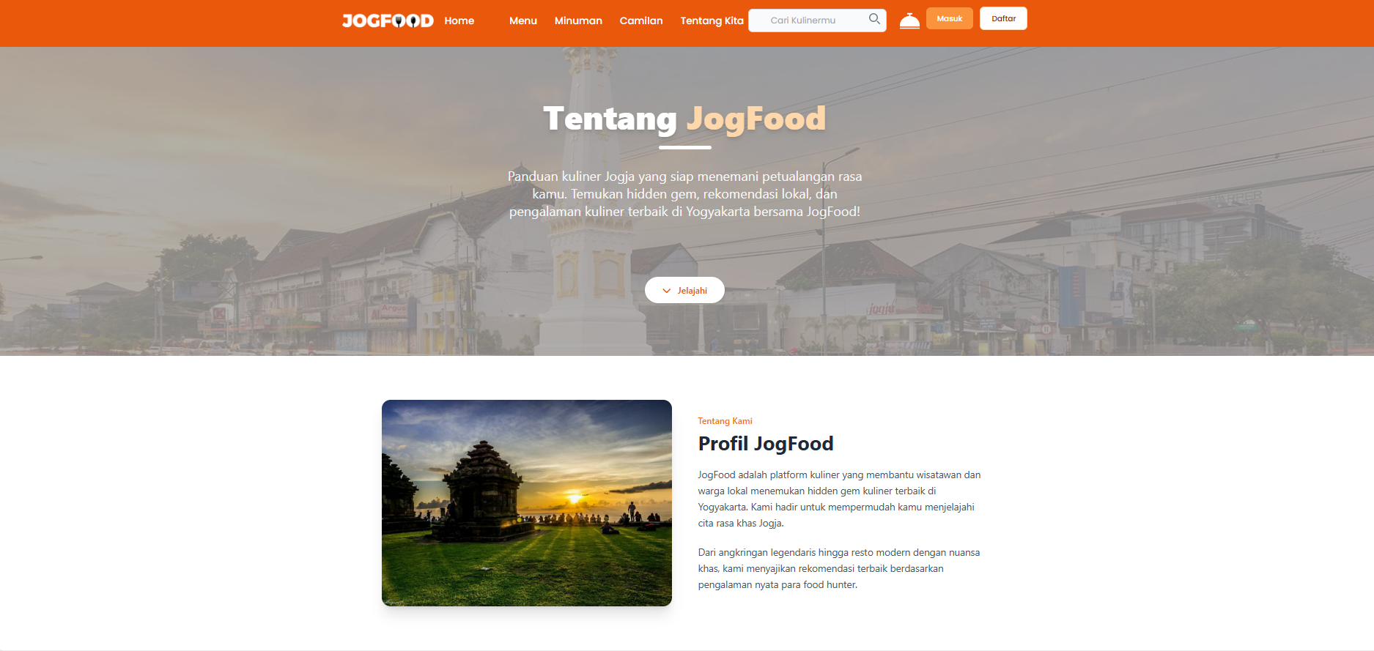

07
Conclusion
🔸 Easy access to authentic Jogja food
🔸 Stronger digital visibility for local restaurants
🔸 All-in-one platform for browsing, reviews, and delivery
🛠️Future Suggestions:
Add AI-based food recommendations
Support multi-language interface
Enable real-time courier tracking

Slide 10
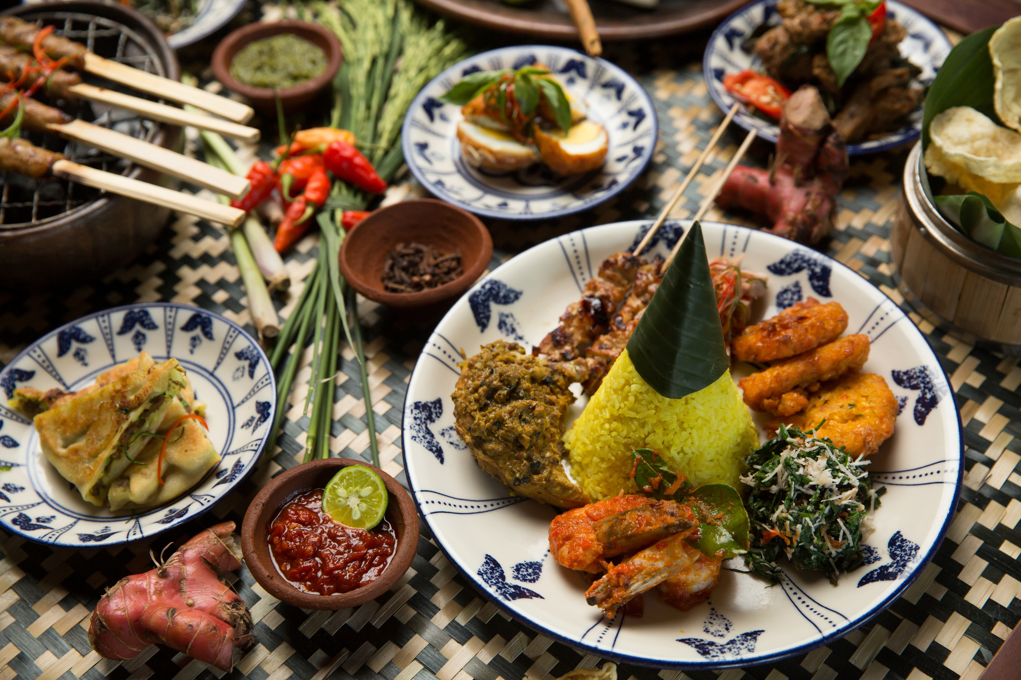

Thank you for exploring JOGFOOD with us!
PBL-IF240

Slide 11
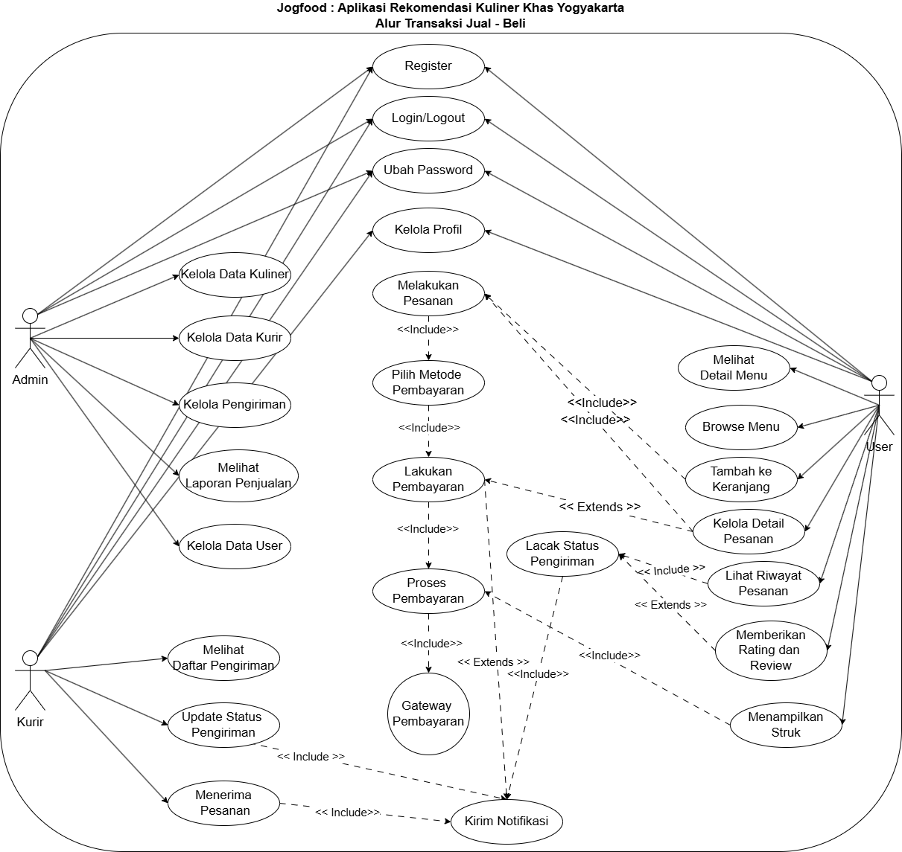

DIAGRAM USE CASE
Usecase Overview
Shows how Admin, User, and Courier interact with the system:
✅ Admin manages data & orders
✅ Users register, order, and pay
✅ Couriers deliver & update status
🔄Covers key flows : payment, tracking, and notification

Slide 12
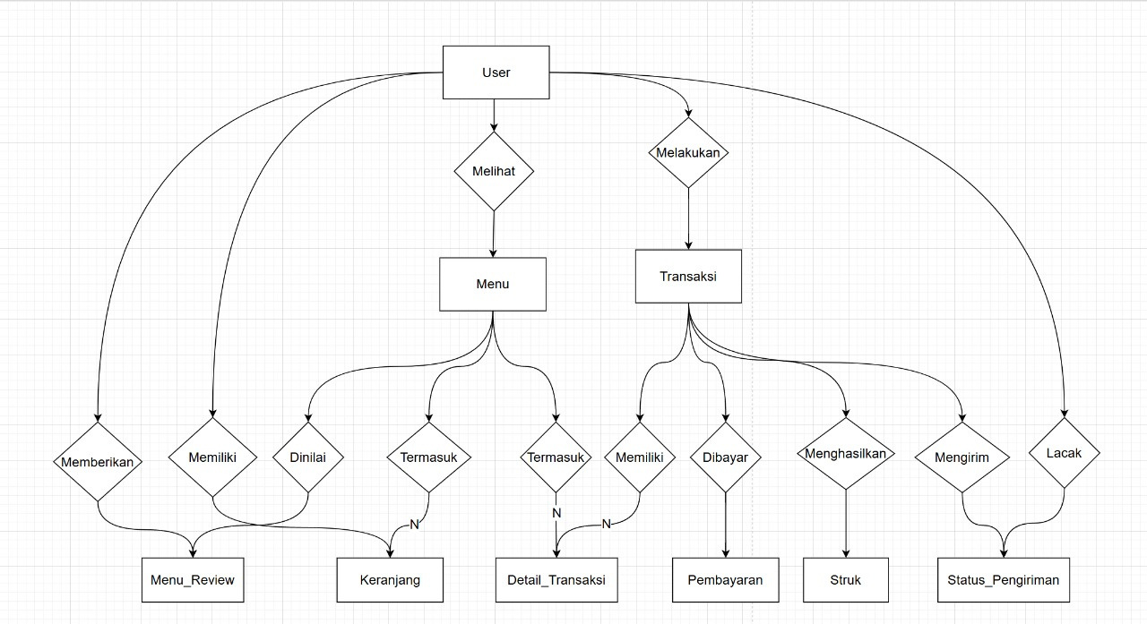

ER DIAGRAM
Shows how users interact with menus, make transactions, and track orders.
Each menu can be reviewed, ordered, and paid.
Designed for smooth ordering, payment, and delivery flow.

