Slide 1
Automatic Detection of White Plague using New Modified VGG16 Network with Chest X-Rays
EE 552/CSE 583: PATTERN RECOGNITION & MACHINE LEARNING (PROF. YANXI LIU)
TERM PROJECT
Sweekar sudhakara
Sks6492@psu.edu

Slide 2
Problem Description and Motivation
Around the globe, 75 mn people are infected by the white plague (tuberculosis) and chest x-ray is the most common type of radiology examination.
There are few existing works on TB detection using chest x-ray and the automated networks (convolutional neural network (CNN)) used in these works need further improvement, to be deployed in real-world testing.
To compensate for the inefficient performance we introduce a new supervised learning-based CNN architecture inspired from the VGG16 in order to identify the TB manifested images effectively.
In addition, we introduce Ladder network, a semi-supervised technique known to perform well on fewer labelled data for the classification task. This network has not been evaluated on bio-medical applications so far, particularly on less labelled data or augmented data.

Slide 3
Existing Work
Related work on the dataset area:
Meraj et al. used CNN models appended with pre-trained models in order to identify TB manifested chest x-rays. They find that VGG-16 model generalizes well on the data. (State-of-the-art: 87% for Shenzhen Data & 77% for Montgomery Data)
Pasa et al. built a CNN optimized for the problem with architecture like AlexNet along with GAP and He-weight initializer trained & tested on augmented chest x-ray images.
Related work on the Pattern Recognition Approach:
VGG16 CNN network was introduced by Simonyan et al. to win ILSVR (ImageNet) competition in 2014.
Ladder network was first employed by Rasmus et al. They combined supervised with unsupervised learning in DNNs and trained to simultaneously minimize the total cost by backpropagation. It was evaluated on MNIST data of hand-written digits.
Baseline
Model
These works haven't explicitly mentioned the post augmented data size along with the hyper-parameters used and ladder networks haven't been tested on bio-medical images.

Slide 4
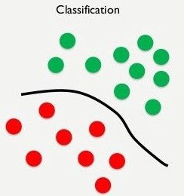
A Clear view of the Project
We have implemented three different models in this project:
Baseline Model by Meraj et al. (Supervised Learning) considering VGG16 and ResNet50 pre-trained weights.
Ladder Networks by Rasmus et al. (Semi-Supervised Learning).
New Modified VGG16 Network (Supervised Learning).
What are we trying to solve in this work; Classification Problem with two classes:
Normal X-ray
Tuberculosis Infested X-ray

Slide 5
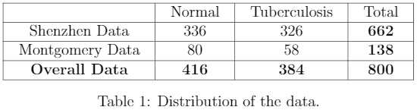
Data Description
The experiments are based on the combination of the two publicly available datasets, Shenzhen & Montgomery that contain human chest frontal x-ray images with two different classes, i.e. TB infested and normal, respectively.
Why the data size is sufficient for my machine learning task?
The datasets have been already employed by other researchers for the same classification task. The data is balanced with approximately 400 samples in each class.
Data augmentation techniques will be employed to increase the number of data samples if deeper or wider networks will be applied.
Shenzhen Data -
Image Size: 3000 x 3000
Montgomery Data -
Image Size: 4892 x 4020

Slide 6
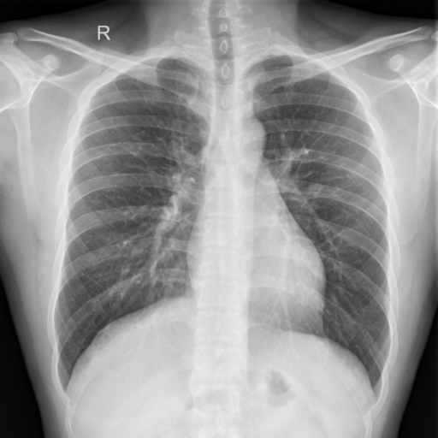
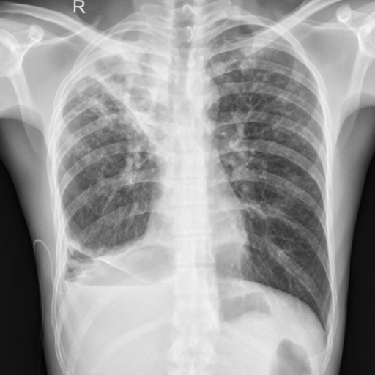
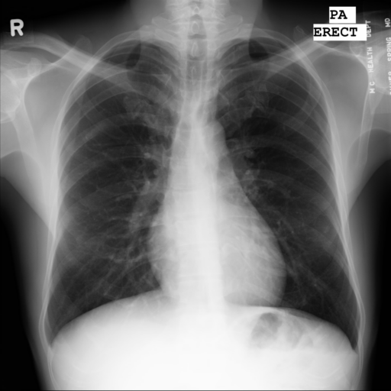
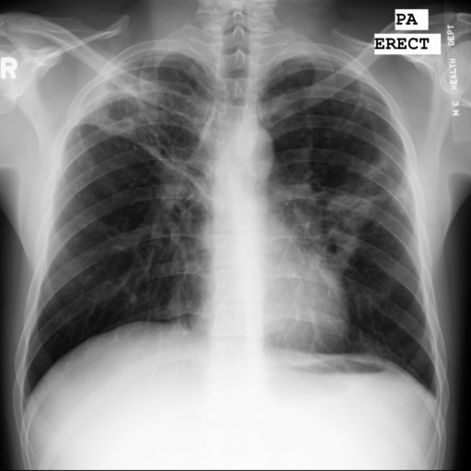
Normal
TB infested
Normal
TB infested
Shenzen Data
Montgomery Data

Slide 7
Methods
Pre-processing of the input images: 1) cropping the black borders, 2) resizing the image into (224 x 224 x 3) and, 3) whitening & centering for each image.
Data augmentation to increase the data size by flipping, rotating and shifting the images.
Implementation of transfer Learning using pre-trained weights instilled in Meraj et al. proposed architecture (baseline) with global average pooling, fully connected layers and dropout. However, the hyper-parameters and the post-augmented data size is not known.
Implementation of New Modified VGG16 convolutional neural network trained and tested on the TB data.
Implementation of proposed fine-tuned ladder network trained and tested on the TB data.

Slide 8
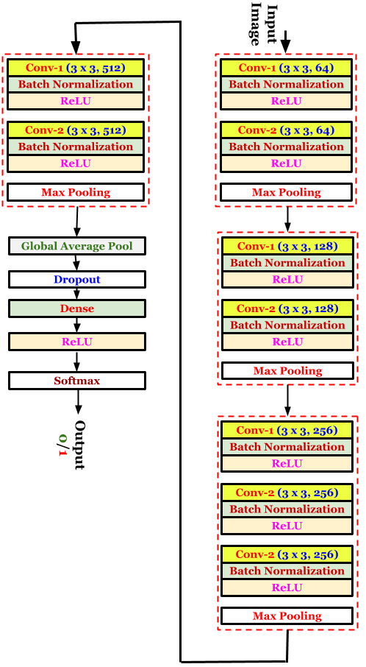
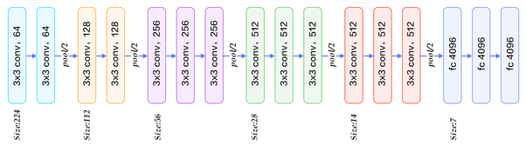
New Modified VGG16 Network
New Modified Network
Original Network
The new network is inspired from the existing VGG16 network.
The modifications to the existing network are:
Change In number of conv layers.
Inclusion of Batch Normalization.
Inclusion of GAP layer.
Change in number of neurons in dense layer.
Loss Function: Categorical Cross Entropy
Optimizer: Adam
Classification Layer: Softmax
Input Size: 224 x 224 x 3

Slide 9
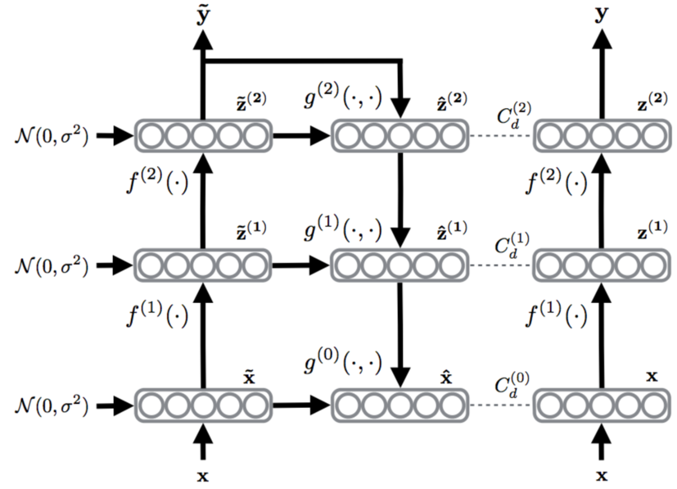

Ladder Networks
The ladder network is an application of supervised and unsupervised learning together.
The unsupervised learning task is associated with the denoising of the layer representations at each level.
The structure of the network is similar to the auto-encoder with skip connections from the encoder to the decoder.
The aim is to minimize the overall loss function of i.e. the combination of the classification loss and the reconstruction cost of all the layers.
Loss Function: categorical cross entropy & RMS error.
Optimizer: Adam
Classification Layer: Softmax

Slide 10
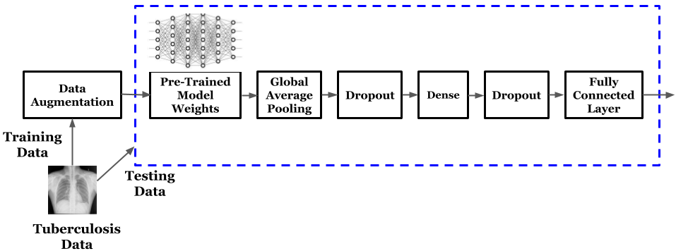
Transfer Learning using Pre-trained Network (Baseline)
The data is firstly split into training & testing and the training data is further augmented.
The pre-trained model weights (VGG16 & ResNet50) trained previously on ImageNet data is loaded.
To confine the weights from the pre-trained model the GAP layer is used.
In the end, a softmax layer activation is used to predict the label of the chest x-ray.
Loss Function: Binary Cross Entropy
Optimizer: Adam
Classification Layer: Sigmoid
Input Size: 224 x 224 x 3

Slide 11
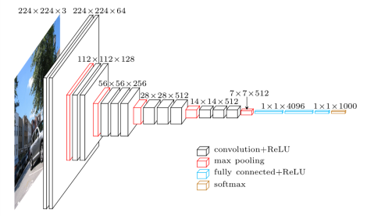
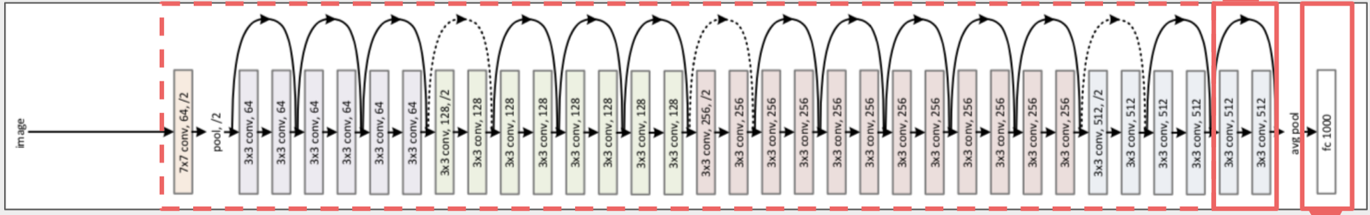
Pre-trained Model Weights
The two pre-trained model weights evaluated in the baseline model is VGG16 and ResNet50
VGG16
Network
ResNet50
Network

Slide 12
Transfer Learning using Pre-trained Network (Baseline)
What changes we have incorporated in the baseline’s implementation?
We have done basic pre-processing on the data.
Considered 5 types of data augmentation instead of just flipping.
Post augmented data size and hyper-parameters along were not mentioned and has been iteratively found.
Experiments on the two dataset's have been individually done with accuracy (86% & 77%). However, we achieve 88% (approx) for the two data combined.

Slide 13
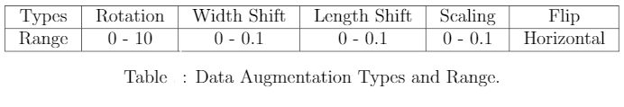
Pre-processing and Data Augmentation
Pre-processing:
Black border removal from images, resizing of images to (224 x 224 x 3) and centering & whitening over pixels of each image in the data.
Data Augmentation:
The complete data of 800 samples was split for training & testing in the ratio 70 : 30 i.e. Training data: 560 samples (294 - Normal, 266 - TB) & Testing data: 240 samples (122 - Normal, 118 - TB).
Only the 560 training samples were further augmented with 5 types combined 13 times to generate 7776 training samples (3812 - Normal, 3964 - TB).

Slide 14
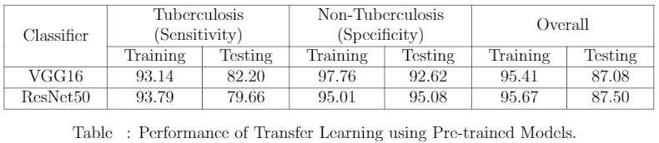
Results - (1)
Tuberculosis Detection using Transfer Learning with Pre-trained Weights (Baseline)
Learning Rate:
1 x 10⁻⁴
Epochs: 10
Batch Size: 8
Training Duration:
1 hr
Sensitivity which measures the proportion of actual positives that are correctly identified and specificity measures actual negatives that are correctly identified.
VGG16 has more sensitivity towards TB than ResNet50 which is preferable in the bio-medical field.
The overall performance of both the pre-trained model weights are similar with ±4% accuracy change.

Slide 15
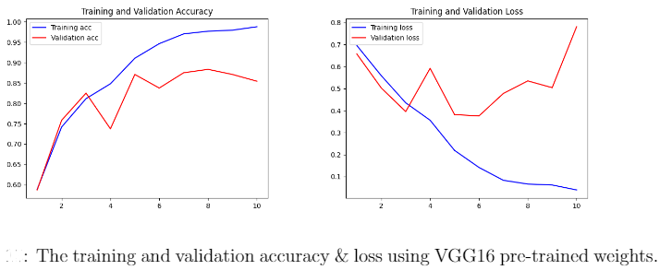
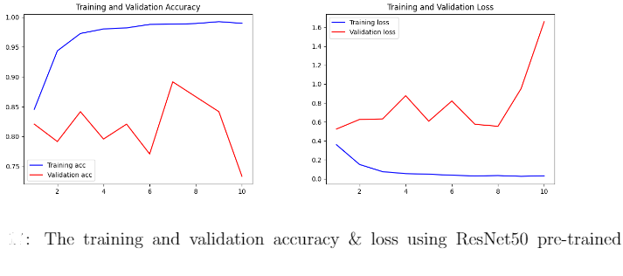
Results - (1)
Tuberculosis Detection using Transfer Learning with Pre-trained Weights:
Training and Testing Performance in terms of Accuracy & Loss
VGG16 Performance
ResNet50 Performance

Slide 16
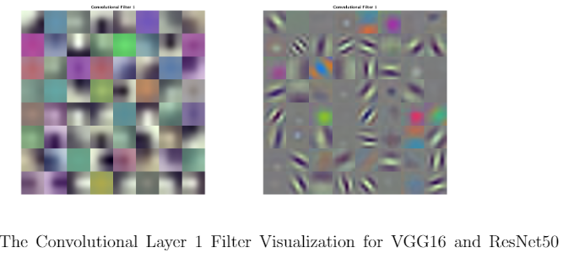
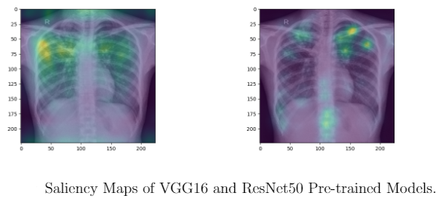
Results - (1)
Filter Visualization and Saliency Map/Heat Map
Saliency map is a visualization technique to understand the network and is an approximate visual diagnosis for presentation to radiologists.
Saliency maps generate a heatmap that shows which region of the image weights more for the classification.
Convolution Layer 1 filter shows the fundamental features of the image such as edges.

Slide 17
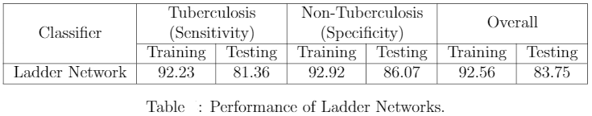
Results - (2)
Tuberculosis Detection using Ladder Networks
Learning Rate:
2 x 10⁻³
Epochs: 50
Batch Size: 4
Training Duration: 1 hr
The ladder network contains 7 fully connected layers with each layer containing 128x128,1000, 500, 250, 250, 250 & 2 neurons with the input image of size (128×128).
For each layer in the encoder-decoder part a Gaussian noise with variance of 0.3 and a batch normalization term is added.
The ladder network has similar performance in terms of sensitivity and specificity with ±2% accuracy change.
However, the ladder network's overall performance is comparatively lower than the baseline model.

Slide 18
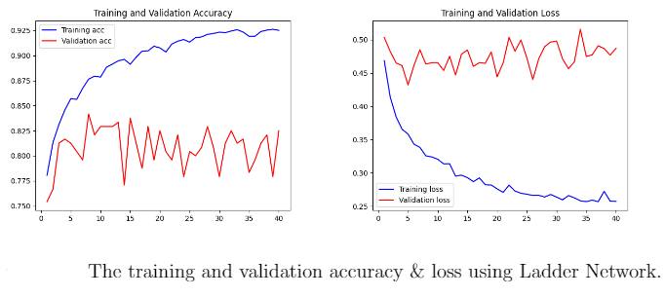
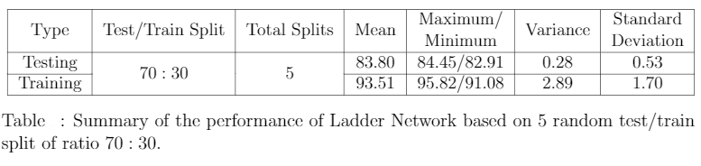
Results - (2)
Tuberculosis Detection using Ladder Networks:
Training and Testing Performance in terms of Accuracy & Loss

Slide 19
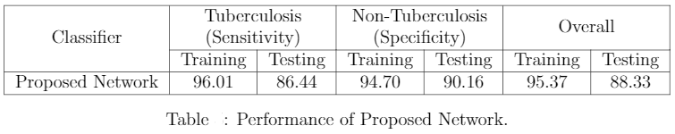
Results - (3)
Tuberculosis Detection using Modified VGG16 Network
Learning Rate:
1x 10⁻⁵
Epochs: 200
Batch Size: 4
Training Duration: 5 hr
The new modified VGG16 network contains 9 convolutional layers with GAP layer and a dropout value of 0.3.
The new proposed network has similar performance in terms of sensitivity and specificity.
The modified network has a slightly better performance in comparison to the baseline model in terms of overall performance and sensitivity.

Slide 20
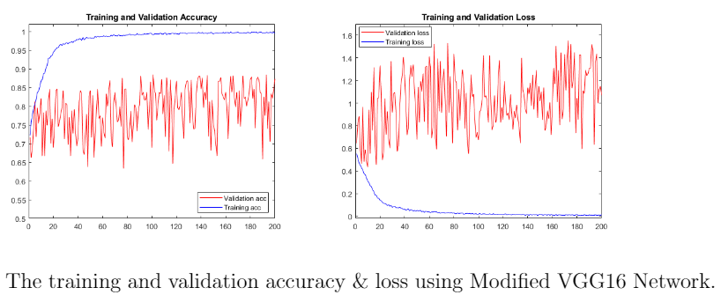
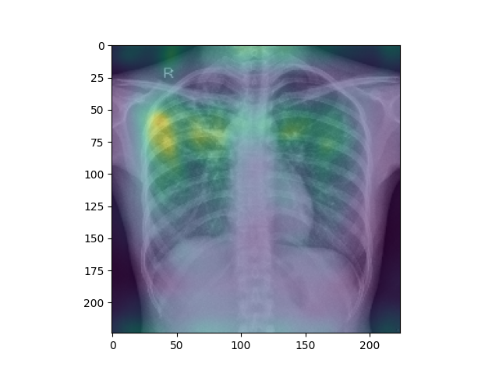
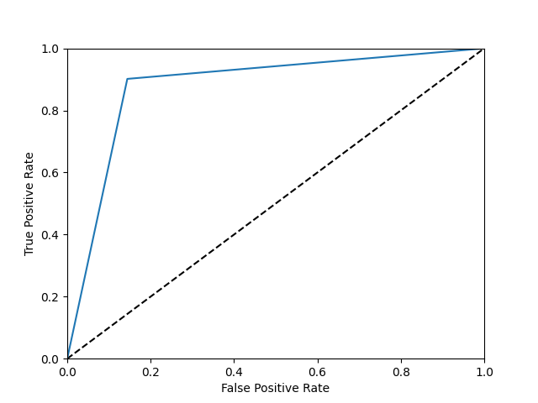
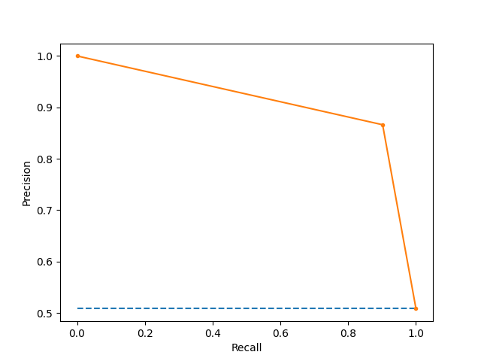
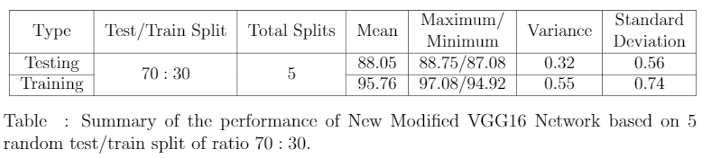
Results - (3)
Training and Testing Performance in terms of Accuracy & Loss:
Tuberculosis Detection using
Proposed Network:
Saliency Map
/Heat Map
ROC Curve and Precision-Recall Curve

Slide 21
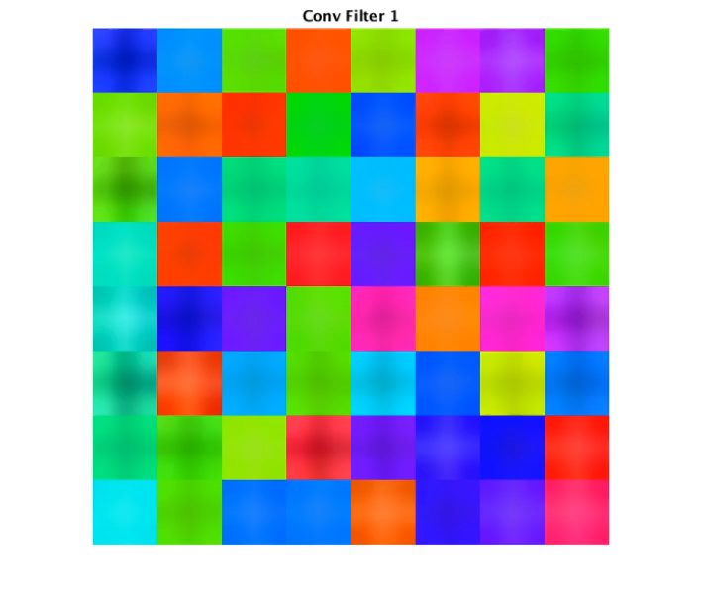
Results - (3)
Tuberculosis Detection using Modified VGG16 Network
Filter Visualization

Slide 22
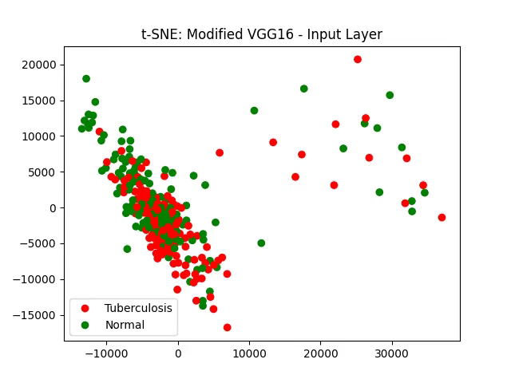
Results - (3)
Tuberculosis Detection using Modified VGG16 Network
t-SNE Visualization
for Testing Data

Slide 23
Result Analysis
It is observed that the New Modified VGG16 Convolutional Neural Network has an overall better performance than the rest of the models implemented in this project.
The convolutional layers captures the dense foggy nature depicting the TB in the lungs accurately, however, sensitivity of the proposed network is still lower than expected.
The architecture known for its known performance with further fine-tuning perfomed well as expected on the TB data.
The ladder network which was designed to perform classification task on minimal labelled failed to perform on the tuberculosis data. The reasons could be:
Ladder networks were previously trained and tested on MNIST data which contains low resolution images and is comparatively an easier classification task unlike the TB data which has too much information.
Ladder networks contain only dense layers in the feedforward path which fail to capture the relevant information from a complex chest x-ray image and do not aid much in the learning process of the unsupervised autoencoder.
The baseline pre-trained network proved to be tough competitor. The reasons could be:
The VGG16 pre-trained weights have been trained on an enormously large data, ImageNet with 1000 classes and 1.3M images. The fine-tuned weights trained further on x-ray data extracts very good features with lower computation time.

Slide 24
Surprises & What have we learnt from this Project?
Surprises
Ladder Networks was expected to perform well on the binary classification task, but it resulted in poor performance. However, the current results are promising to improve on.
Data augmentation improves the ability of the network to generalize better.
Transfer learning is an effective tool that converges quickly and mostly gives accurate results.
Visualization of convolutional neural network functioning with tSNE and filter visualization.
Networks as simple as a few convolutional layers can capture good amount of information, it is all about whether the right features are being picked from the filter or not.
It's easy to build a network but difficult to prune it (hyper-parameters).
What have we learnt from this Project?

Slide 25
What can be done in the future?
Fine-tune the ladder networks further to achieve better results such that it can be deployed into real world testing.
Replace fully-connected layers in the ladder network (feed-forward path) with convolutional layers to extract relevant features from images.
Fine-tune the proposed new modified VGG16 convolutional network further to improve its overall performancce, particularly its sensitivity.
Data Augmentation with noise injection other than the usual flipping, rotation, translation, etc.
Implement bio-medical image pre-processing techniques to further enhance performance.

Slide 26
References
[1] W. H. Organization,Global Tuberculosis Control: Epidemiology, Strategy, Financing: WHO Report 2009. World Health Organization, 2009.
[2] S. S. Meraj, R. Yaakob, A. Azman, S. N. M. Rum, A. Shahrel, A. Nazri, and N. F. Zakaria, “Detection of Pulmonary Tuberculosis Manifestation in Chest X-rays Using Different Convolutional Neural network (CNN) Models.”
[3] S. Jaeger, S. Candemir, S. Antani, Y.-X. J. W ́ang, P.-X. Lu, and G. Thoma, “Two public chest x-ray datasets for computer-aided screening of pulmonary diseases,” Quantitative Imaging in Medicine and Surgery, vol. 4, no. 6, pp. 475–477, 2014.
[4] F. Pasa, V. Golkov, F. Pfeiffer, D. Cremers, and D. Pfeiffer, “Efficient deep network ar-chitectures for fast chest x-ray tuberculosis screening and visualization,” Scientific reports,vol. 9, no. 1, pp. 1–9, 2019.
[5] A. Rasmus, M. Berglund, M. Honkala, H. Valpola, and T. Raiko, “Semi-supervised learning with ladder networks,” in Advances in neural information processing systems, 2015, pp. 3546–3554.
[6] G. Ye, “Sign language translation using ladder networks,” Stanford Deep Learning Course (CS230) Project, 2019.
[7] K. Simonyan and A. Zisserman, “Very Deep Convolutional Networks for large-scale image recognition,”arXiv preprint arXiv:1409.1556, 2014.
[8] D. P. Kingma and J. Ba, “Adam: A method for stochastic optimization,” arXiv preprintarXiv:1412.6980, 2014.
Thank you! Questions?

